Slide 1

Ram Pump
Christine Curtis, Harrison Gill, Teresa Wong

Slide 2

Outline
Introduction and theory
Modular pump fabrication
Construction of hydraulic testing facility
Experimental setup
Future work

Slide 3


Ram Pumps: An Introduction

Slide 4

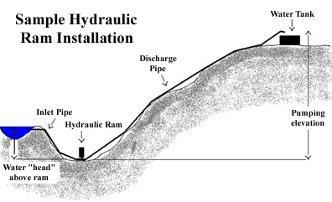
Ram Pumps: An Introduction
Notes:
http://www.clemson.edu/irrig/equip/ram3.htm

Slide 5
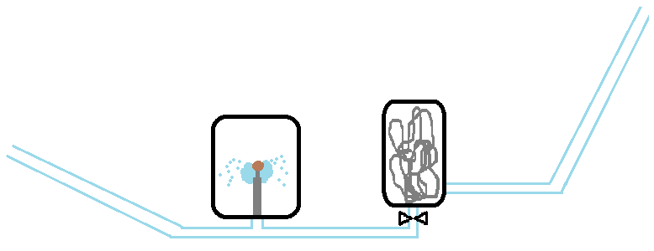
Ramp Pump: Components
Destination
Waste Valve
Air Chamber
Source
Drive Pipe
High Pressure Line
High Pressure Valve

Slide 6
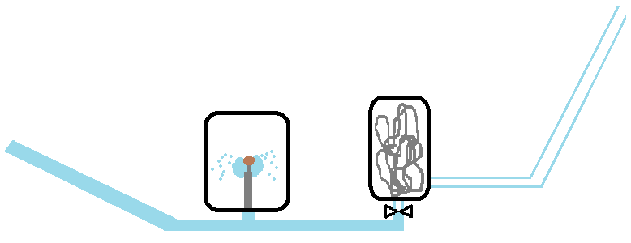
Hydraulic Transients: Acceleration
Destination
Source
Notes:
Acceleration phase

Slide 7
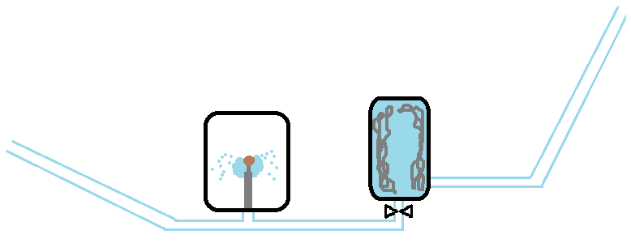
Hydraulic Transients: Deceleration
Destination
Source
Notes:
Acceleration phase

Slide 8
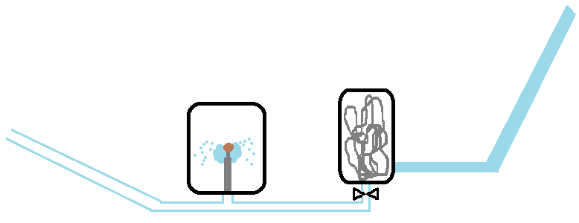
Hydraulic Transients: Pumping
Destination
Source
Notes:
Acceleration phase

Slide 9
Design Goals
Modular
Relatively easy to build
To scale

Slide 10
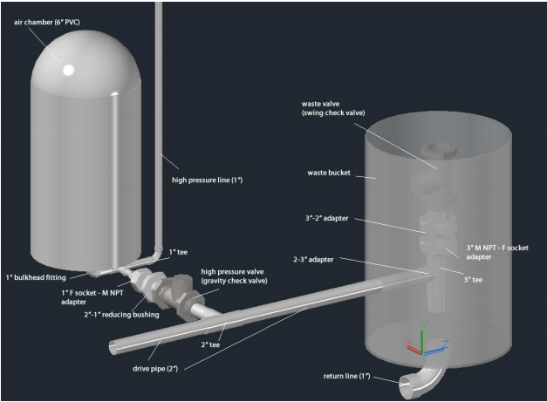
The Agua Clara Ram Pump

Slide 11
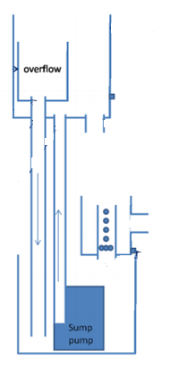
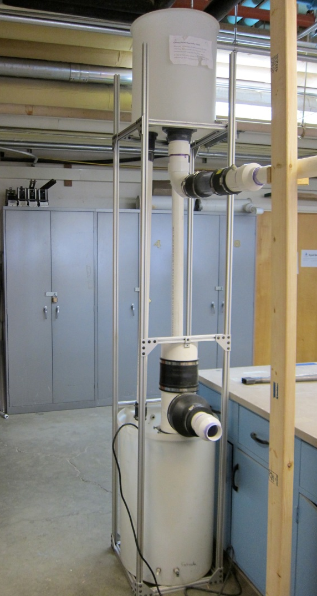
Hydraulic Test Facility
(AKA The Tower of Power)
upper reservoir
To pump
LFOM
from pump
Lower reservoir
Notes:
The tower of power.

Slide 12

Notes:
Flood of biblical proportions.

Slide 13
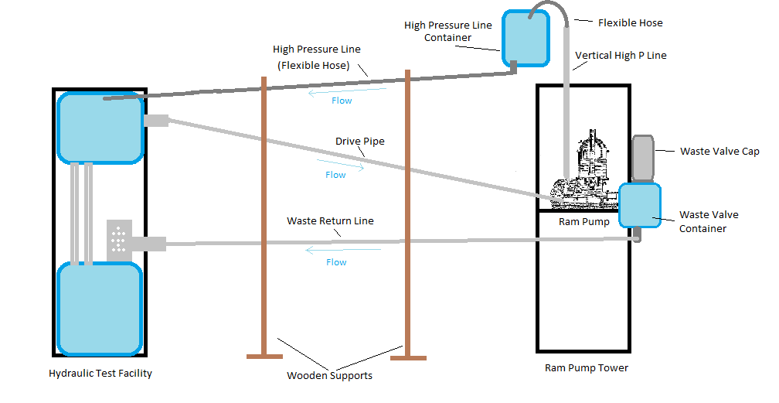
Hydraulic Testing Facility
(The Tower of Power)
Tank
LFOM
Pump

Slide 14
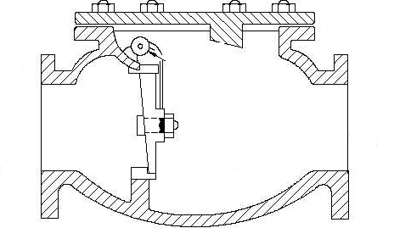
Flow out
Commercial swing check valve.
Flow in

Slide 15
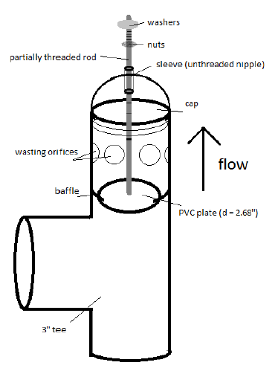
Homemade Wasting Valve
Notes:
Data Collection

Slide 16
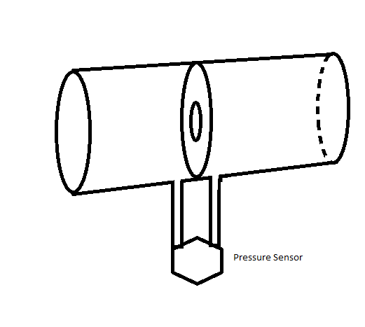
Data Collection
Orifice Meter
LFOM
Orifice Meter
Pressure sensors
Dye injection

Slide 17
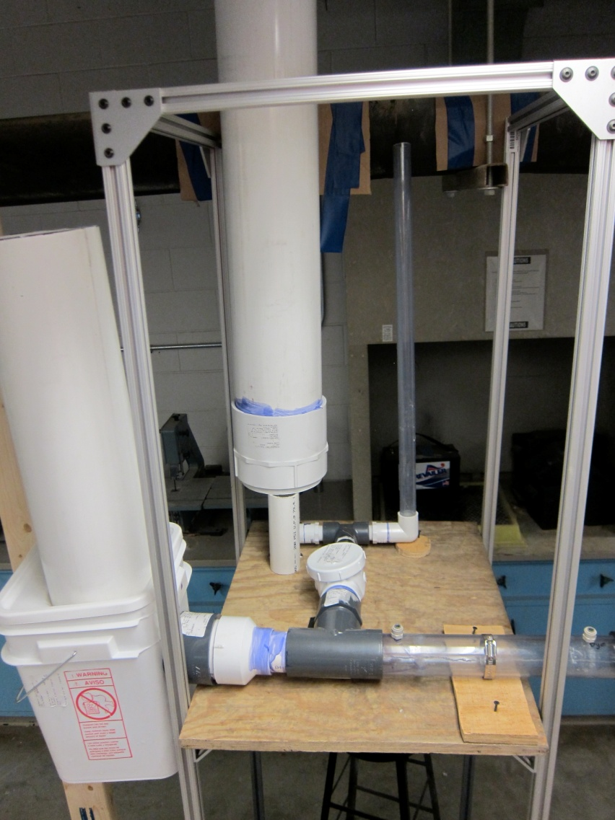
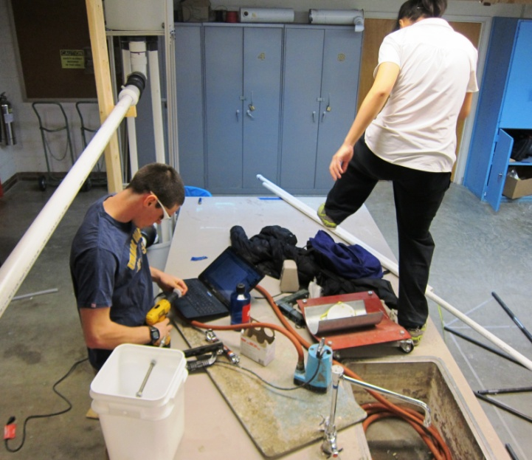
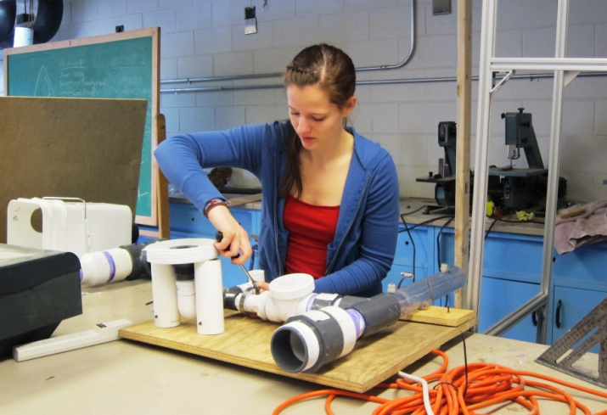
Construction

Slide 18
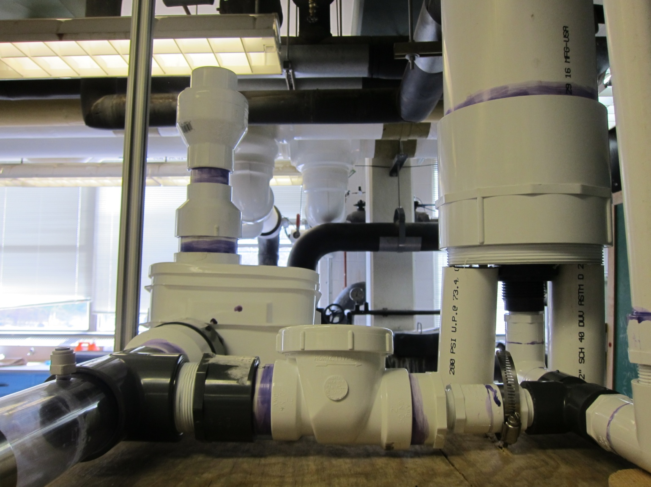

A Modular Approach

Slide 19
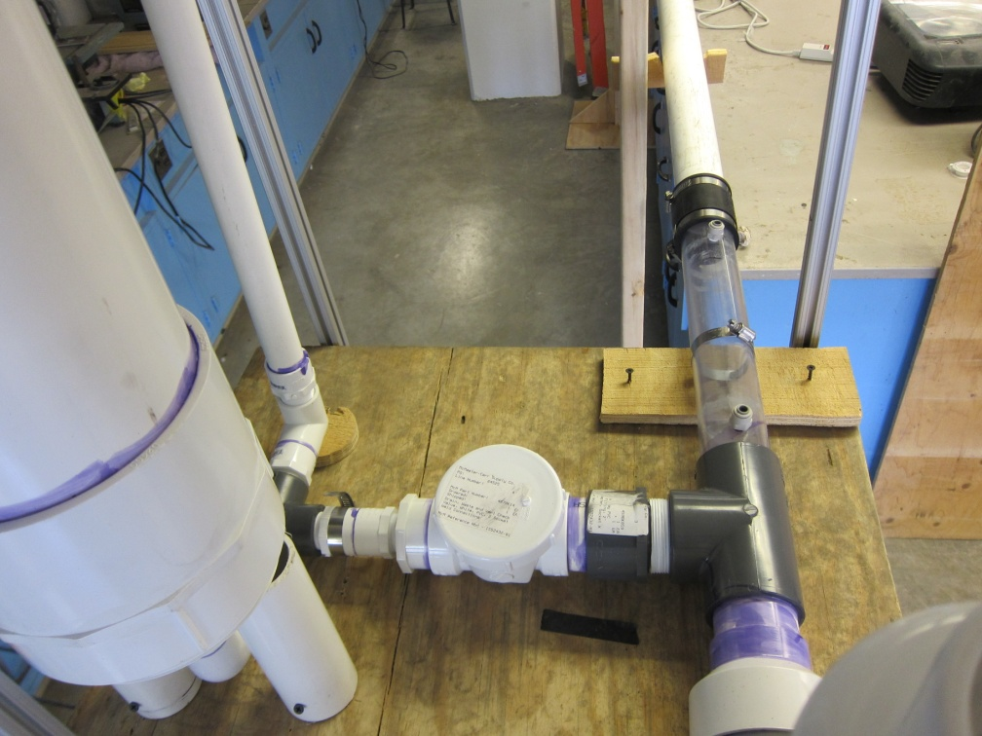
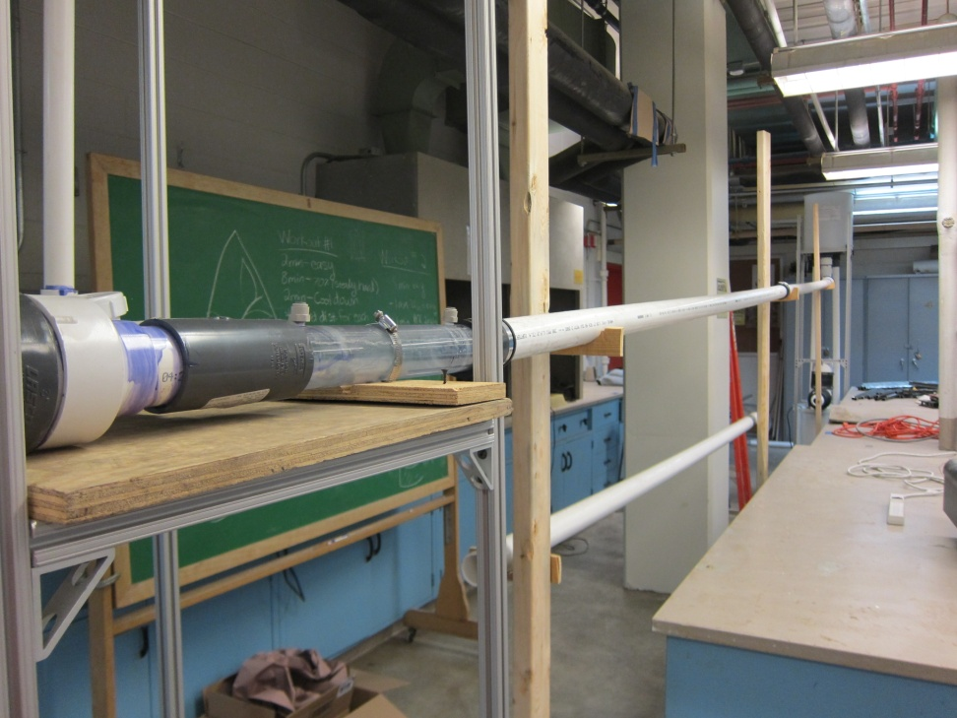
Drive Pipe

Slide 20
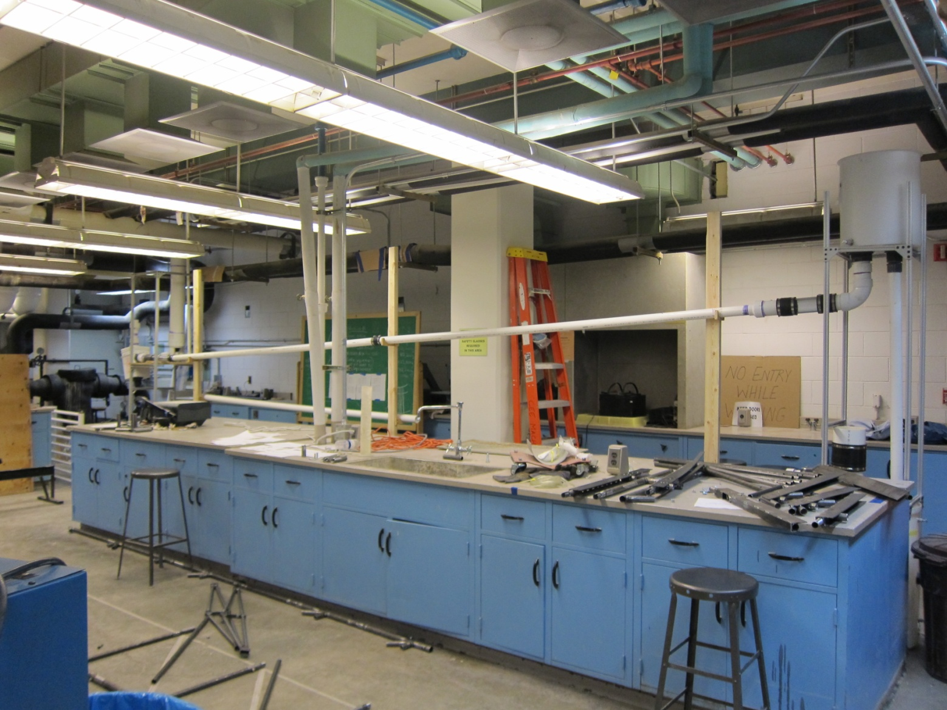
Elevation & Available Head

Slide 21
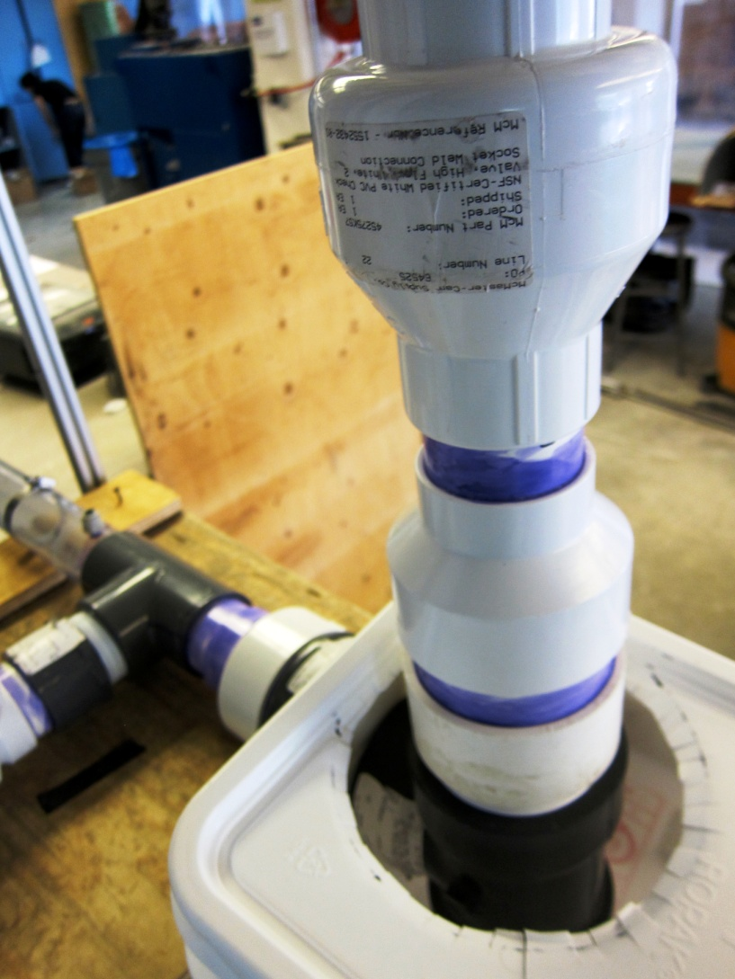
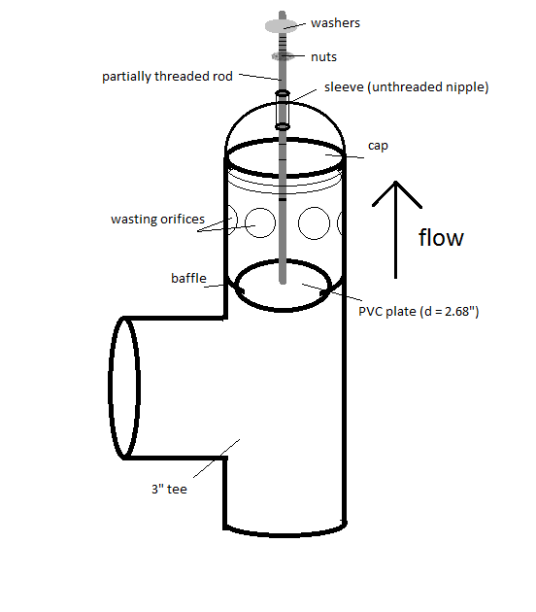
Valves

Slide 22
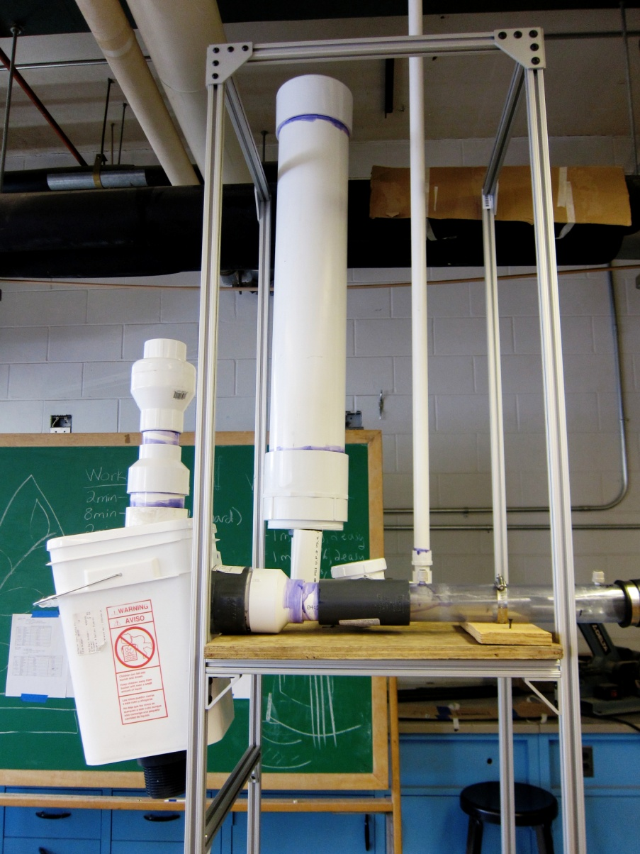
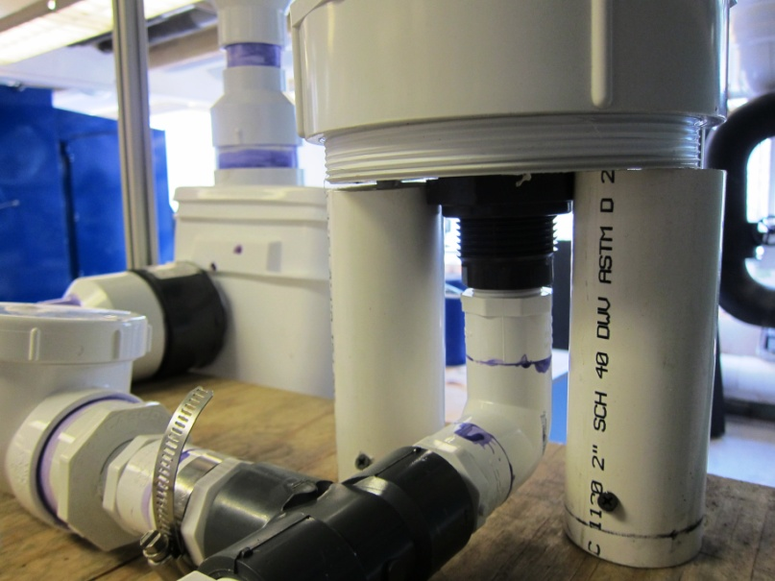
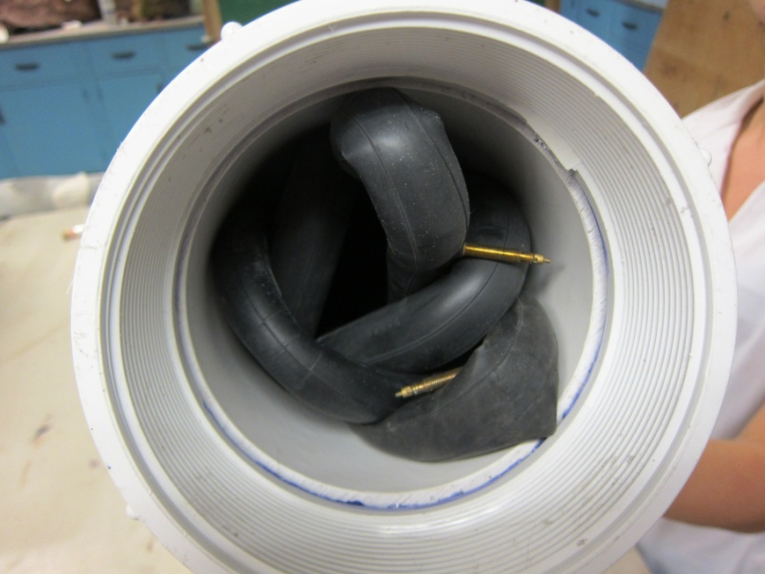
Air Pressure Chamber

Slide 23

Future Work

