Slide 1

Ram Pump
Jill Freeman
Sam Rabkin
Mahina Wang

Slide 2

Outline
Introduction
Goals
Test Apparatus
Hydraulic testing facility
Preliminary Results
Future teams

Slide 3

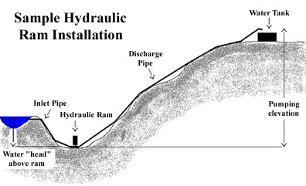
Introduction

Slide 4
Goals
Make design:
  Smaller, simpler, more efficient
Easy maintenance
Determine ways of measurement
Design a pump for a drive flow rate of 0.1 L/s to pump a minimum of 0.01 L/s
  delivery height of 7.15m to chemical stock tanks and bathroom facilities

Slide 5
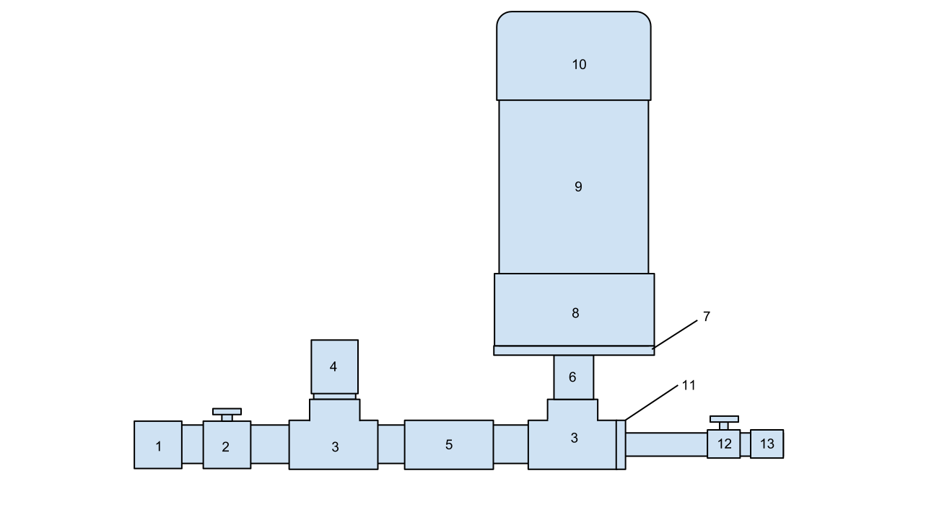
Test Apparatus
Ram Pump
  Drive pipe: ¾”, 1.4m
  Delivery pipe: ½”, 2m
  2 check valves

Slide 6
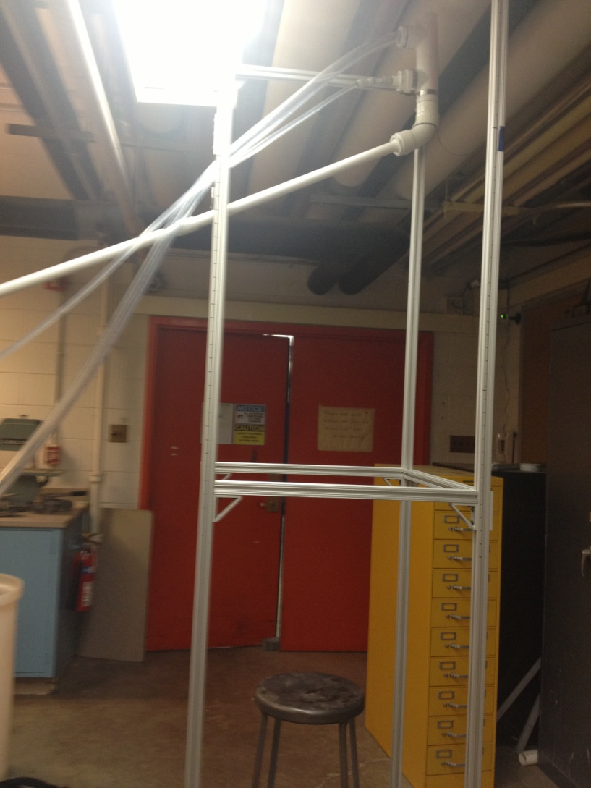
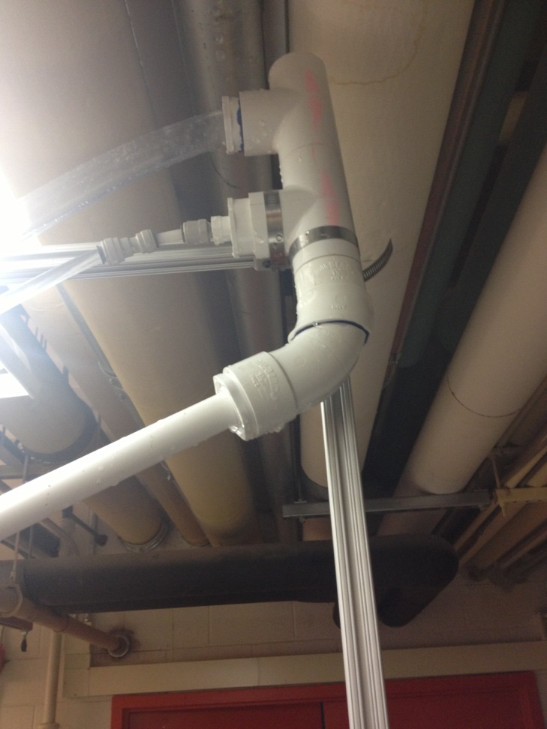
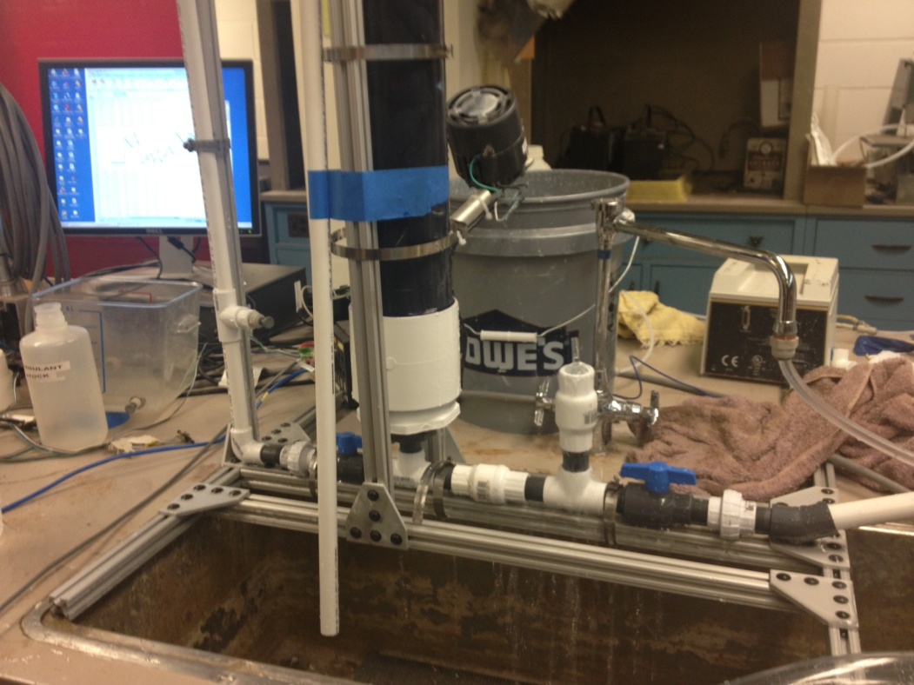
Ram Pump pictures
Body
Drive system

Slide 7

Video
Video illustrating charged ram pump operating automatically

Slide 8
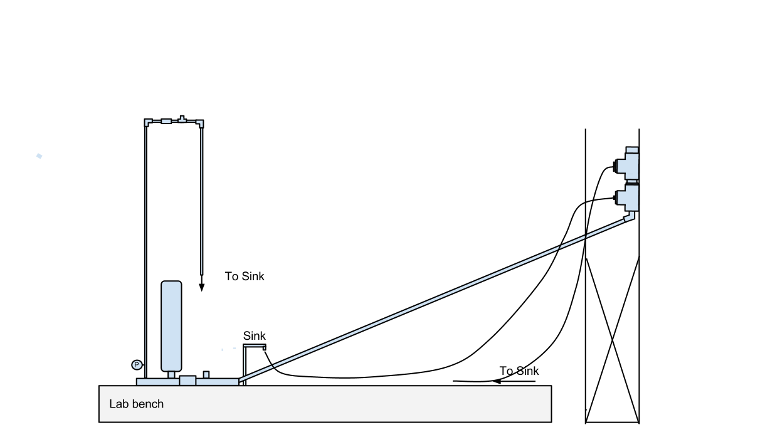
Hydraulic Testing Facility
Support system
Constriction
Overflow weir
Oversized tee
Delivery pipe
Drive pipe

Slide 9
Important Features
Pump placed directly on lab bench, with stand to reduce shaking
Pressure sensor to measure pump head
Constriction to increase pump head
Flow rates measured manually
Removable air chamber, drive pipe, and check valves

Slide 10
Challenges
Shaking in drive pipe
Leaks in pump and air chamber
Stuck check valve
Notes:
-result in lower ram pump efficiency—fixing these should increase our efficiency

Slide 11
Preliminary Results:
Delivery flow rates (mL/s)
Cycle time (s)
 | 0.5 | 1 | 1.5
80 | 15 | 1 | --
100 | 33 | 8 | --
130 | 42 | 14 | 3
Drive flow (mL/s)

Slide 12
Preliminary Results:
Pumping efficiency
Cycle time (s)
 | 0.5 | 1 | 1.5
80 | 0.27 | 0.02 | --
100 | 0.47 | 0.12 | --
130 | 0.45 | 0.15 | 0.03
Drive flow (mL/s)
Notes:
**because our goal is to optimize ram pump efficiency, we are more concerned with this data than the flow rate data.
Optimal cycle time for each drive flow rate. We believe that this optimal cycle time decreases with decreasing flow rate, as can be seen from our efficiency data..

Slide 13
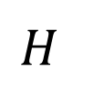


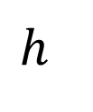
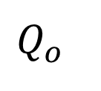
Preliminary Results:
Pump efficiency
$$Q_{o}×h=η\left(Q_{i}×H\right)$$
$$Q_{o}$$
$$h$$
$$Q_{i}$$
$$H$$
Notes:
In our trials, we used a delivery height of 2m because we are limited in our lab space and pressure sensors were not working.
We will need

Slide 14
Preliminary Results:
Estimated delivery flow
Input flow rate (mL/s) | Delivery flow rate (mL/s)
80 | 4
100 | 8.8
130 | 11
Notes:
Using the efficiencies calculated for the best-case scenario for each of the tested flow rates, the estimated delivery flow rate for a delivery height of 7.15m was estimated.
We have determined that we need a delivery flow rate of 0.01 L/s to supply an AguaClara plant with 1100 L of treated water a day, to fill the stock tanks and bathroom, plus some additional water for cleaning and other uses.

Slide 15
Future Work
Modification of check valve
Experimentation with different check valve weights
Use of pressure sensors
Improved measurement of input and output flow rates

Slide 16
Questions?

