Slide 1
Ram Pump
Larissa Sakiyama, Priya Aggarwal,
Pablo Nistal, Kadambari Suri
Notes:
Okey, this is a information slide, write here comments / questions / whatever you need
Key points:
1 minute per slide & 1 slide per minute
I won’t let you have a paper for reading! (yes, I’m so bad) (I mean, if u really need it it’s ok but try not to)
Include results where they are needed but with 1 / 2 numbers is more than enough
Our final report is our friend in this presentation, feel free to bring things from there
CHOOSE ONE SLIDE AND WRITE YOUR NAME NEXT TO IT!

Slide 2
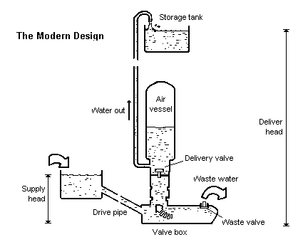
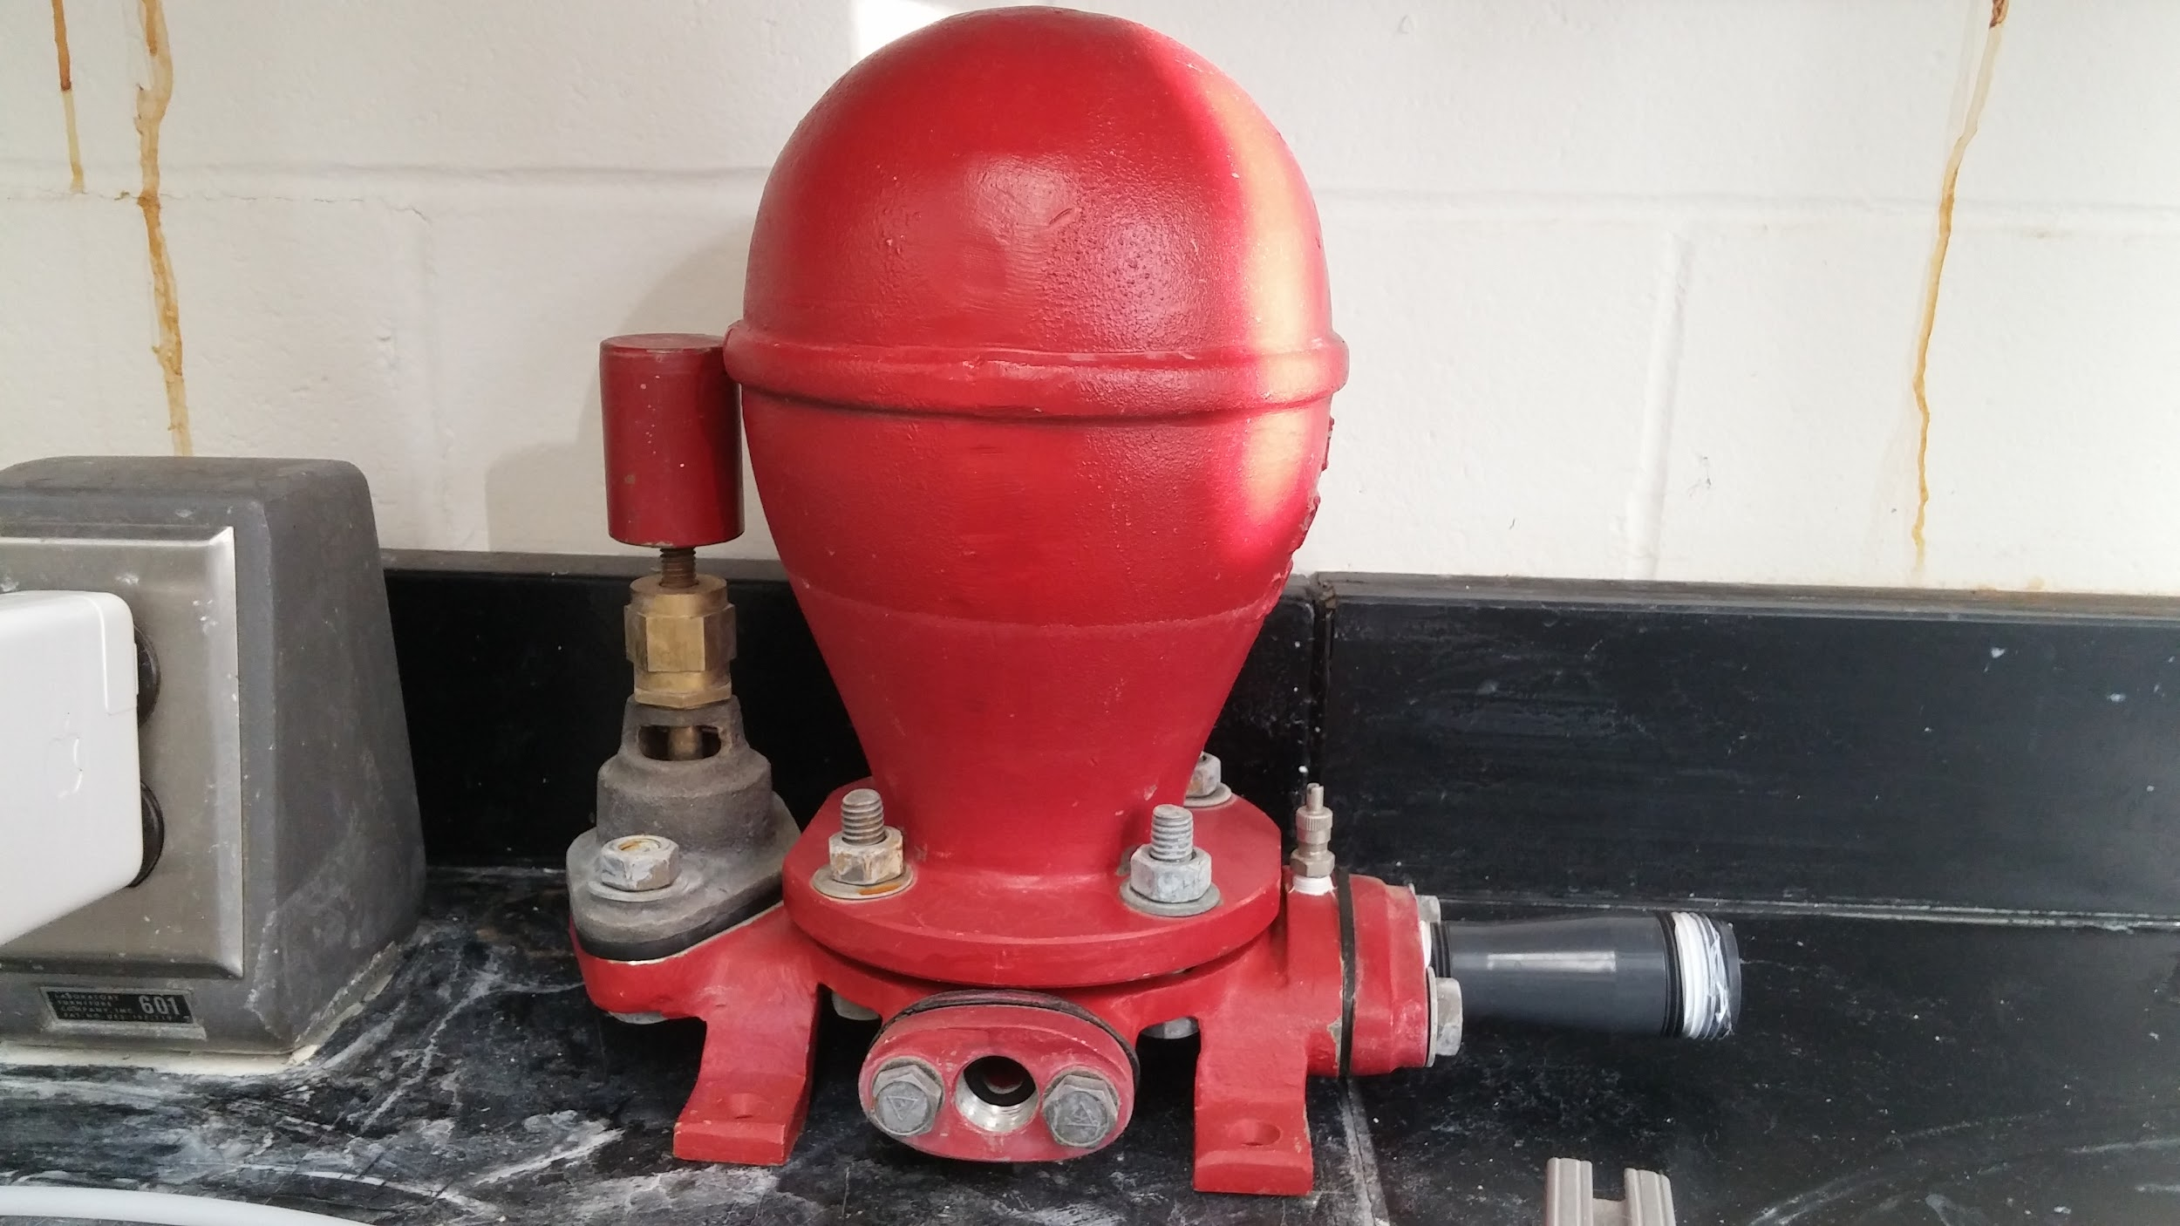
What is a Ram Pump?
A Conventional Ram Pump
Notes:
Priya-Through a series of interlocking valves controlling synchronized pressure systems, the ram pump utilizes the combination of gravitational force, hydrostatic force, and spring force in order to pump the water to a higher altitude without using electricity. Conventional ram pumps depend on the water hammer effect.

Slide 3


Why do we want to use a ram pump?
Notes:
Priya- We want to use ram pump because it is an easier way or bringing the water to to bathrooms and to mix stock concentrations of coagulant and chlorine present within the AguaClara plants.

Slide 4
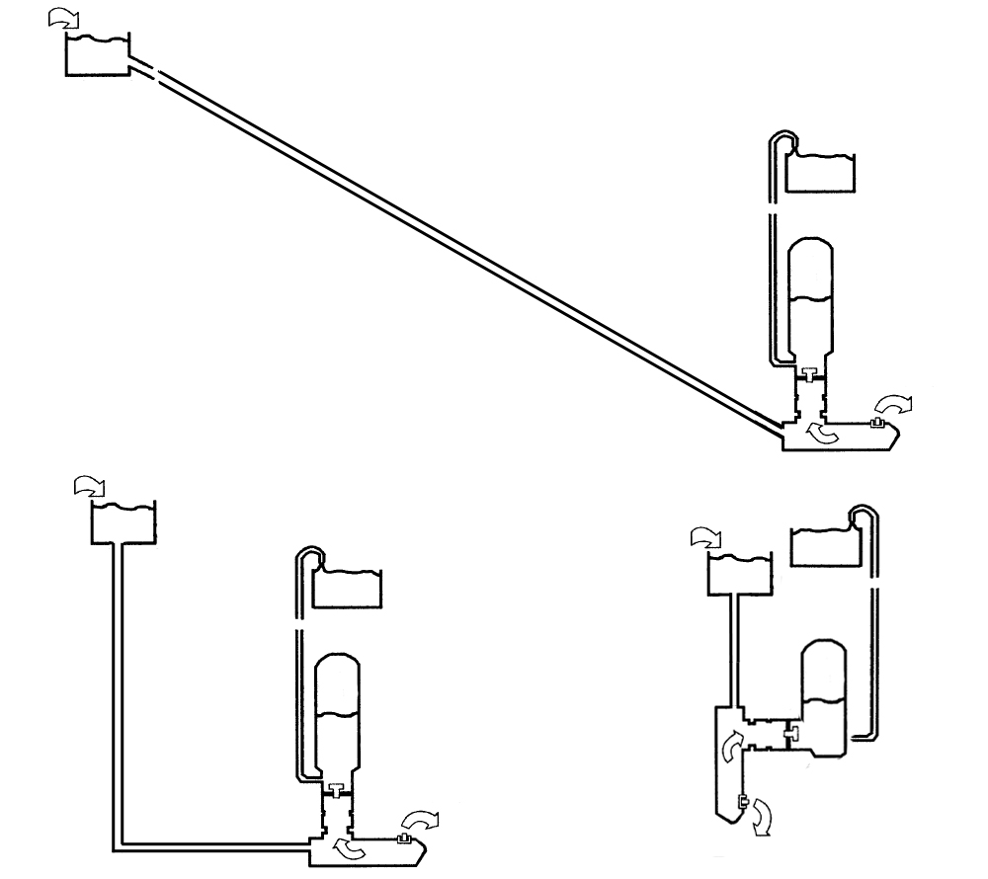
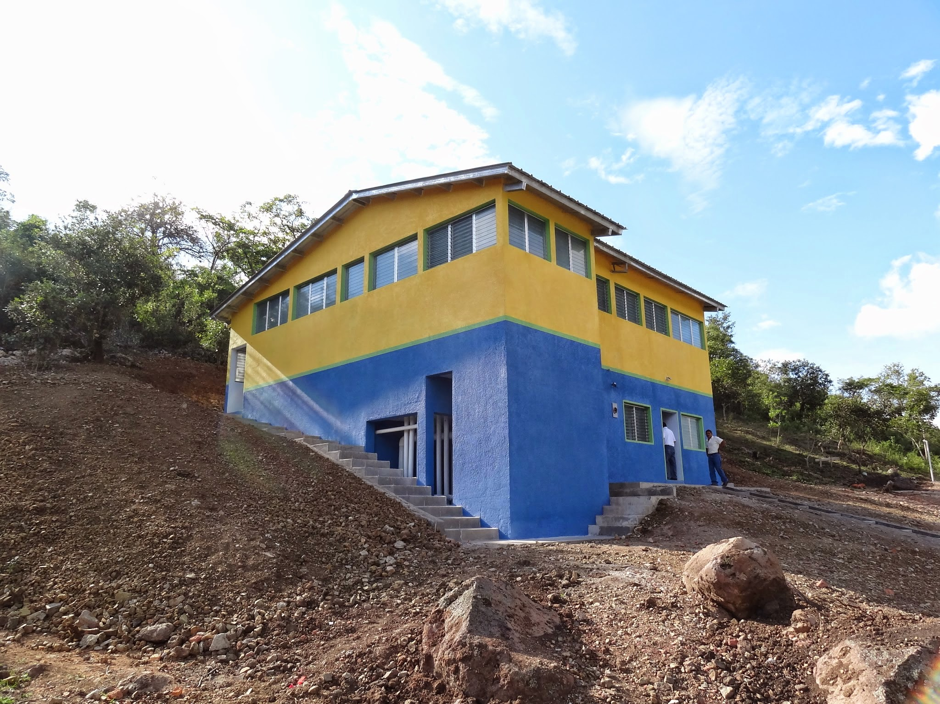
Conventional vs.
Vertical Design
1
2
3
Notes:
Conventional ram pumps have a recommended drive pipe slope for the best performance: from 3 to 7 times longer x axis than y
This was found to be a problem in the current plant designs because of the space needed for the drive pipe and the previous teams developed a similar system but changing the tilted drive pipe for a combination of 2 pipes and a 90º elbow.
This first design solved the major problems with space but made it impossible for the ram pump to reach the efficiency needed because of the drive pipe and how it is connected with the pump (loses).
During the previous semester a new design was proposed that would improve the compactness even more and also solve the problems with the drive pipe. However, because of the changes introduced the team has faced several challenges. Our goal this semester was to develop this new idea and try to make it work

Slide 5
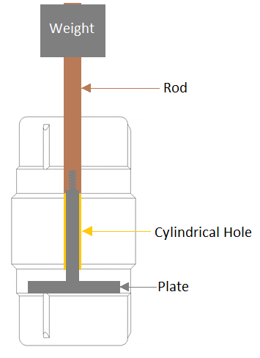
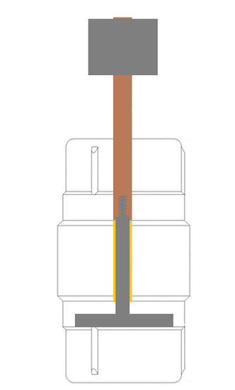
New Design
Notes:
The flow of water that used to come from the bottom is now entering the pipe from above. This removes the possibility of using the previous solution of using the weight of small steel plates. Instead, we are using a spring that forces the rod up when it is compressed, valve closed, and opens it again.
The selection of a spring instead of another mechanical system was also due to the new drive pipe design. Because now the drive pipe is completely vertical instead of a long tilted pipe, water acceleration is greater and therefore the period at which the pump works is much faster and that can cause problems when added to the vibrations (as we learned last semester--because the steel plates were jumping as crazy the rod started to rub?)

Slide 6
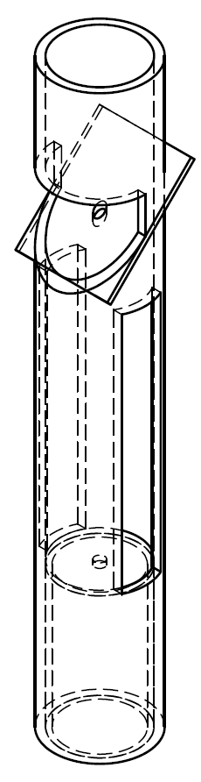
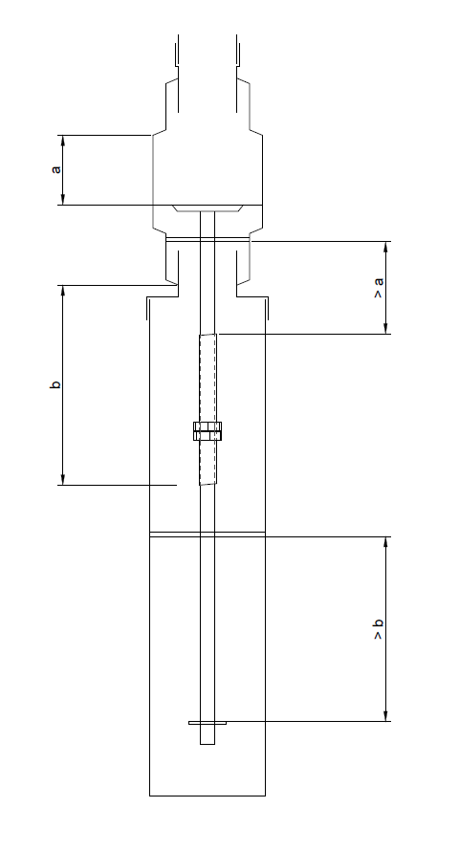
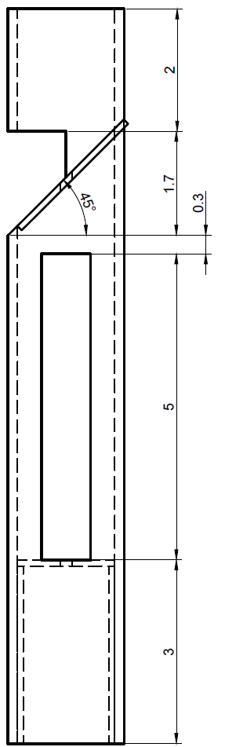
Spring Manipulation
Notes:
Two main challenges when dealing with the new design:
First of all, our research will be mainly focused on how does the selection of the spring affect the behavior of the pump. It is important then to have a method of having the spring accessible, what was the goal of this new component in the beginning.
A small pipe attached at the bottom of the pump which will hold the spring and the rod connected to the waste valve plate, making it easy to change springs or select the length during testing. It also solves the problems with the vibration of the rod with two different plates that hold the rod in place.
For the plants the team has proposed a closed design with lower accessibility but allows the water to be collected directly from the pipe to the next point (in the lab water is dumped to the kiddie pool)

Slide 7
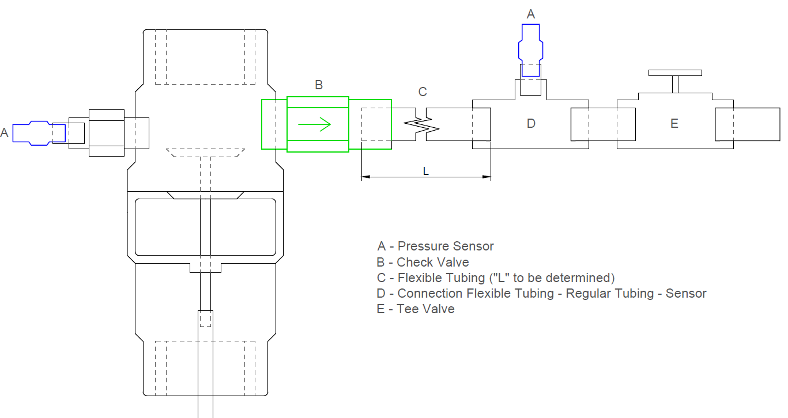
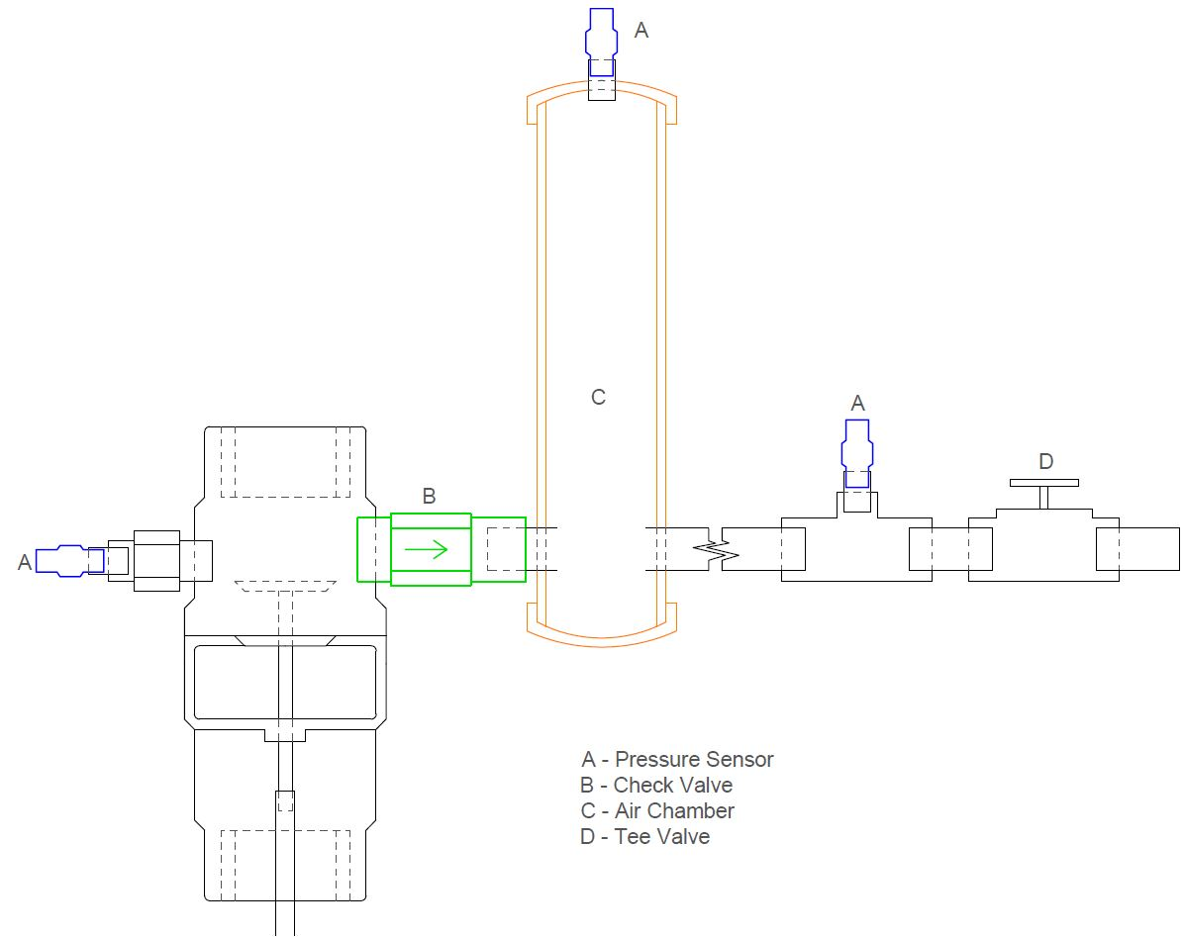
2. Valves
Notes:
The second challenge was the location of the different components of the ram pump in this new model.
Because of the early results obtained at the end of the previous semester we found out that the closeness between components was critical for good performance, especially at high rates (just what we have with the vertical pipe).
The design reduced the distance between the check valve and the waste valve from 1 ft to less than 1 inch.
We have tested a ⅜” check valve with a 1” waste valve located as close as it was possible to manufacture.
Firstly we used flexible tubing but after that we decided to include an air chamber (bari explains why).
Pressure sensors are included for analyzing the pressure before the check valve, in the air chamber and in the delivery for controlling the head loss

Slide 8
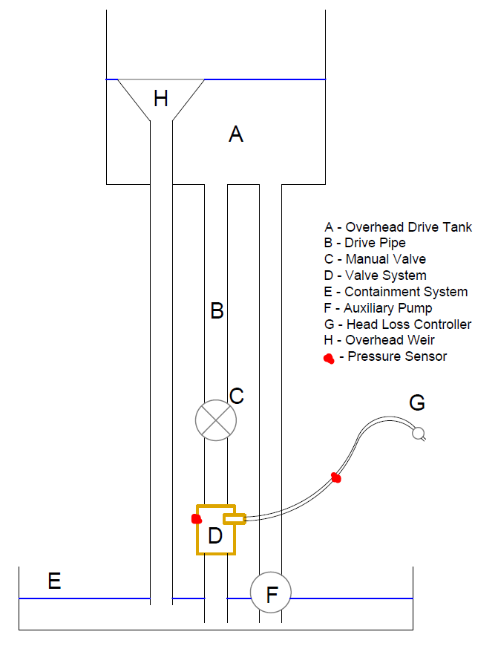
Laboratory Set up
Notes:
The water is pumped up by a commercial ram pump into the water tank we have shown by A. The water then follows down through the drive pipe B, depending on whether the manual valve C is open or closed, and the water will go through the ram pump (D) and be delivered at a certain head loss and flow rate controlled by the pressure sensor at (G) or it will go back into the stream and repeat the cycle.

Slide 9
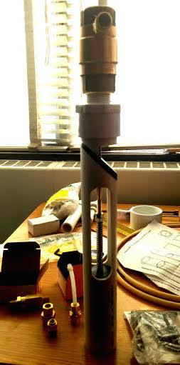
Experimentation
{Purpose & Method}
Tested different springs-- with varying spring constants-- at different lengths to test the effect of forces and lengths.
Notes:
Bari

Slide 10
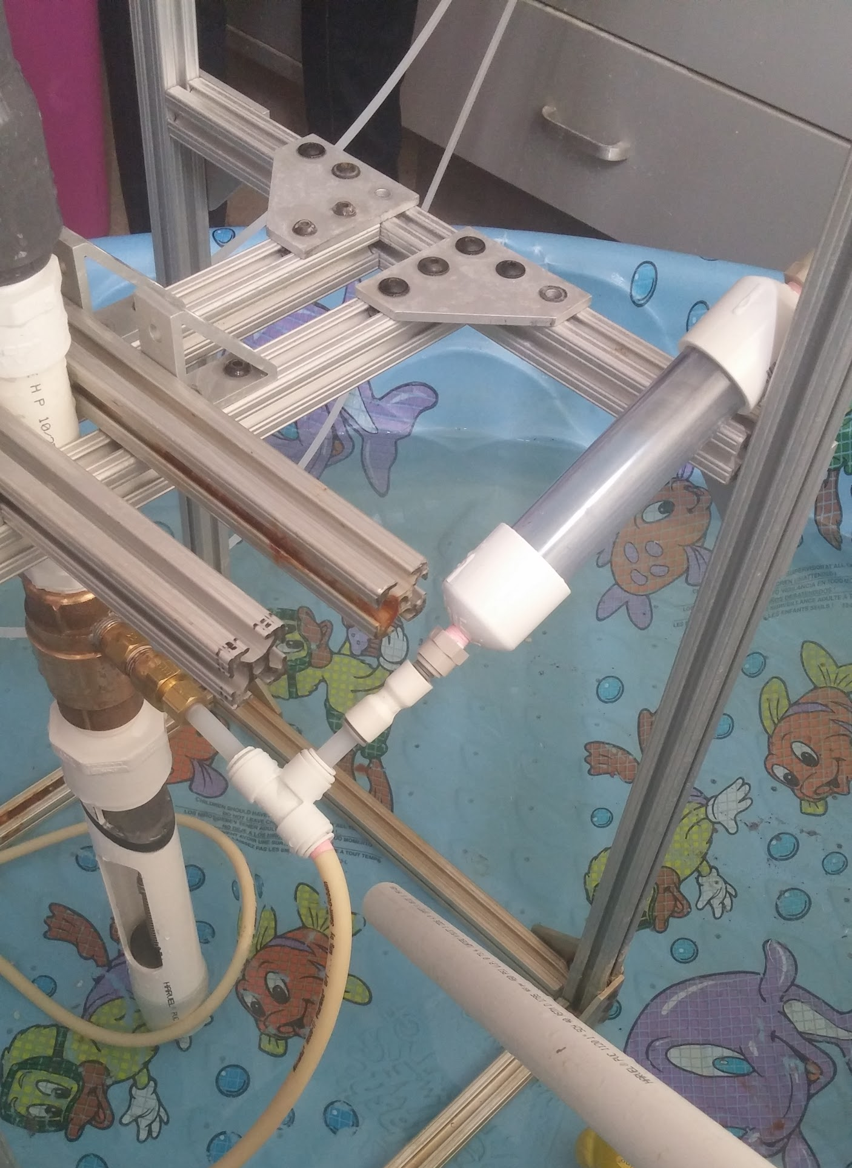
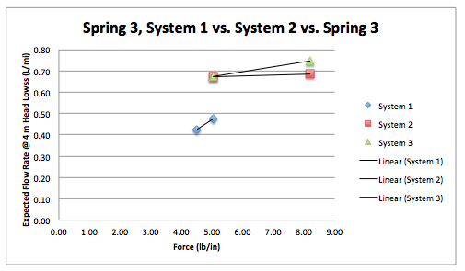
Experimentation
{Change in Set-Up}
Tubing does not act like an air chamber → add in a scaled down version of an air chamber.
DOUBLE THE FLOW RATE!
Notes:
Bari

Slide 11
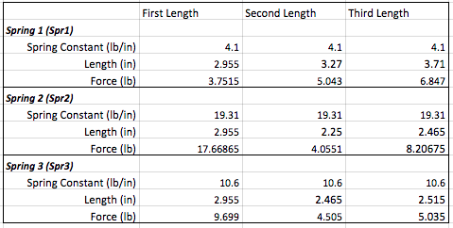
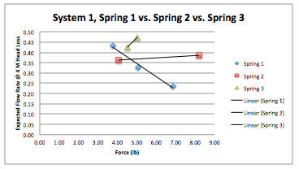
Experimentation {Decoding the Data}
Longer springs means longer periods → but how much does that matter.
Notes:
Bari

Slide 12
Experimentation {Problems}
Leakages
Stabilization
Machining
SO MUCH IS UNKNOWN
Notes:
Bari

Slide 13
Insights into the Ram Pump
Proximity of Components
Air Chamber= Smooths Pressure Profile
Spring Manipulation System= inconclusive data suggests that forces besides those in static conditions exist
Confinement System= Diminish Vibrations
Notes:
Larissa
Our results show that all of the springs worked in very similar ways and there is not a clear best choice among them. An air chamber is needed for best performance and its size also produces small variations (So far, it looks like slightly bigger air chambers work better); and the overall efficiency of the pump is directly proportional to the closeness of the components.
After constructing the spring manipulation system while understanding how to perform with the vertical design proposed by the previous team, we have learned that this ram pump design can obtain almost the same results although it is the first of its kind developed by AguaClara.
Although the results are lower than desired and still far from the design goal, this current model has the capacity of improving previous results with a compact vertical design.
For future teams we would recommend to continue with the same system and try to test different springs with the same lengths and varying force or the opposite, same force but varying lengths, in order to have a better idea on how this affects the cycle time.
The overall goal is to enhance the vertical ram pump such that we generate a working system that has an effluent flow rate that meets with what is expected at the plant.

