Slide 1
Pyothorax
Jenefer Stillion, DVM
Resident Board Review
Nov 8, 2011

Slide 2
Pyothorax
Pleural anatomy
Canine pyothorax
Feline pyothorax

Slide 3
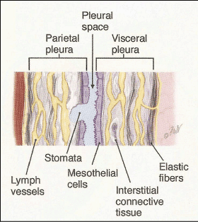
Pleural Anatomy
Serous membranes that line the entire thoracic cavity, lungs and mediastinum
Surface layer of mesothelial cells
Deeper layer of elastic fibers and smooth muscle cells

Slide 4
Pleural Anatomy
Connective tissue layer contains lymphatics, arteries, veins and capillaries
Subdivided into:
Parietal pleura - lines the internal surface of the ribs, diaphragm and mediastinum
Visceral pleura - covers the serosal surface of the lungs

Slide 5
Pleural Space
Only a potential cavity in normal animals
Contains 2-3 ml of transudative fluid
  Lubricates the pleural surfaces
Mediastinal pleura is fenestrated
  Allows air and most effusions to pass freely between right and left pleural cavities

Slide 6
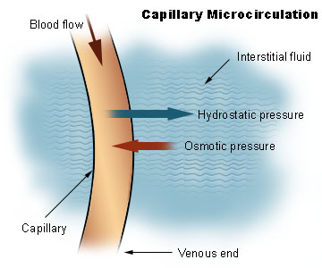
Pleural Fluid Dynamics
Follow Modified Starling’s Law
Net filtration = k[(Pc_{parietal} – Pc_{visceral}) – P_{if}] – (π_{c} – π_{if})
k = filtration coefficient
Pc: capillary hydrostatic pressure of the visceral and parietal pleura
Pif: intrapleural hydrostatic pressure
π_{c}: plasma oncotic pressure
π _{if} : intrapleural oncotic pressure
Notes:
The filtration coefficient is the constant of proportionality. A high value indicates a highly water permeable capillary. A low value indicates a low capillary permeability.
Parietal pleural capillaries (arise from systemic circulation) have a higher hydrostatic pressure than visceral pleural capillaries (arise from pulmonary circulation)
Gradient that moves fluid across pleural space
Visceral pleura has a greater role in fluid absorption
Lower hydrostatic pressure
Greater vascularity
Visceral and parietal capillary oncotic pressures are equal and are > those of the intrapleural cavity
Favors fluid absorption from the pleural cavity
COP of pleural space is 3.2 cm H2O
By convention, outward force is defined as positive, and inward force is defined as negative. The solution to the equation is known as the net filtration or net fluid movement. If positive, fluid will tend to leave the capillary (filtration). If negative, fluid will tend to enter the capillary (absorption).

Slide 7
Pleural Lymphatics
75% of pleural fluid is drained via the parietal pleural lymphatics
Lymphatic flow is enhanced by:
Smooth muscle contractions of lymphatic walls (intrinsic)
Respiratory movements (extrinsic)

Slide 8
Pressure Gradients
Average pleural pressure is – 5 mmHg
Represents the difference between the lung recoil and the thoracic cavity expanding forces at rest

Slide 9
Pressure Gradients
Air, fluid or soft tissue within the pleural space:
  Cause the lungs to collapse and the chest wall to spring out by increasing subatmospheric pressure within the thorax
Leads to:
↓ Tidal volume
↓ Total vital capacity
↓ Functional residual capacity
Notes:
Atelectasis leads to both hypoxemia and hypoventilation

Slide 10
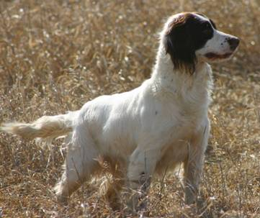
Pyothorax
Accumulation of septic purulent exudate within the pleural space

Slide 11
Pathophysiology of Pleural Infection
Abnormal accumulation of fluid within the pleural space occurs with:
Increases in hydrostatic pressure
Decreases in colloid oncotic pressure of pleural capillaries
Increases in colloid oncotic pressure of pleural cavity
*Increased capillary permeability
*Lymphatic outflow impairment
Notes:
The last two are most important in development of pyothorax

Slide 12
Pathophysiology
1. Increased capillary permeability
Endothelial damage:
  Kinins, histamines
  Increased body temperature
  Inflammation
Influx of fluids, proteins, cells and macromolecules into pleural space
Net filtration = k[(Pc_{parietal} – Pc_{visceral}) – P_{if}] – (π_{c} – π_{if})

Slide 13
Pathophysiology
2. Increased capillary hydrostatic pressure
Increases in local blood flow secondary to inflammation
Net filtration = k[(Pc_{parietal} – Pc_{visceral}) – P_{if}] – (π_{c} – π_{if})

Slide 14
Pathophysiology
3. Lymphatic outflow obstruction
Impeded drainage:
Inflammation
Edema
Fibrin deposition
Thickening of parietal pleura

Slide 15
Pathophysiology
4. Increased pleural space oncotic pressure
Decreased resorption of protein secondary to lymphatic obstruction
Net filtration = k[(Pc_{parietal} – Pc_{visceral}) – P_{if}] – (π_{c} – π_{if})

Slide 16

Pyothorax in Dogs
Signalment:
Mean of 3 to 4 years-old
Medium to large breed
Hunting/working breeds
  Labrador Retriever
  Golden Retriever
  Brittany Spaniels
  Airedale Terriers
Most occur during fall and winter co-insiding with hunting and training seasons

Slide 17

Etiology
Migrating inhaled foreign bodies
Penetrating wounds to the chest, neck or mediastinum
Esophageal or tracheal perforation
Lung parasites
Extension from bacterial pneumonia
Hematogenous or lymphatic spread from septic foci
Spread from cervical or lumbar infections
Neoplasia and abscessation
Iatrogenic (thoracocentesis)

Slide 18
History
Exercise intolerance
Poor field performance
Tachypnea
Dyspnea
Cough
Restlessness
Anorexia
Lethargy
Diarrhea
Polyuria
Polydipsia

Slide 19

Physical Examination
Fever
Dyspnea
Weight loss
Depression
Cyanosis
Tachypnea
Orthopnea
Muffled heart sounds
Decreased lung sounds
Acute Respiratory Distress:
Dehydration
Shock
Pale mucous membranes
Hypothermia
Notes:
Restrictive breathing pattern: rapid shallow breathing

Slide 20

Diagnostics
Thoracocentesis
  Cytology
  Culture and sensitivity
Radiographs/CT scan
Hematology

Slide 21
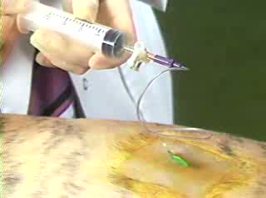
Thoracocentesis
Diagnostic and therapeutic
Fluid accumulation within the pleural space displaces functional lung tissue
Atelectasis → hypoxia and hypoventilation
If dyspnea persists after tap:
  Pulmonary parenchymal disease
  Fibrosing pleuritis
  Pneumothorax

Slide 22
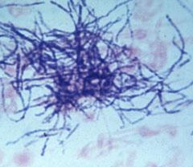
Fluid Analysis and Cytology
Exudate (> 3 g/dl protein, > 7,000 cells/µl)
Septic suppurative effusion
  Neutrophils predominate
  Intracellular bacteria
  Gram-positive filamentous rods: Actinomyces, Nocardia
Absence of septic changes on cytology does not rule out pyothorax
  Prior antibiotic administration
  Mycoplasma
Notes:
LDH activity increased, glucose decreased compared to blood

Slide 23
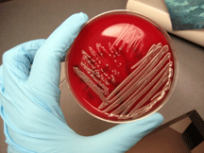
Bacterial Culture
Submit for aerobic, anaerobic and Mycoplasma cultures
High prevalence of polymicrobial infections
Anaerobic bacteria most common

Slide 24
Bacteria Associated with Canine Pyothorax
Study | Year | Gram + Aerobes | Gram - Aerobes | Anaerobes
Boothe HW et al. | 2010 JAVMA | Corynebacterium Staphylococcus Streptococcus Bacillus Nocardia | E. coli Klebsiella Acinobacter Pasteurella | Clostridium Peptostreptococcus Actinomyces
Rooney MB et al. | 2002 JAVMA | Staphylococcus Streptococcus | E. coli Pasteurella Bacteroides Acinobacter | Actinomyces Fusobacterium Peptostreptococcus Prevotella
Walker AL et al. | 2000 JAVMA | Staphylococcus Streptococcus Nocardia | Pasteurella E. coli Klebsiella Enterobacter cloacae | Actinomyces
Notes:
E.coli is the most common isolate in dogs

Slide 25
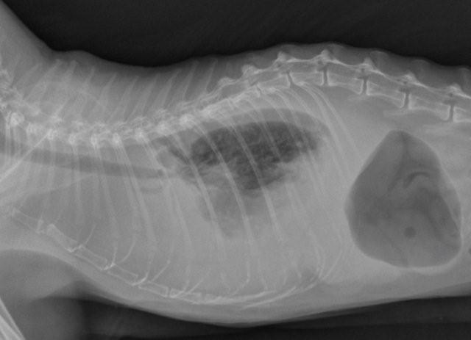
Radiographs
Usually impossible to determine cause of pleural effusion from radiographs
Presence of residual pleural fluid may obscure thoracic structures

Slide 26
Computed Tomography (CT)
Correctly identified the presence and volume of pleural fluid in all cases
Did not predict the presence of pleural thickening reliably in all cases
Correctly identified the location of single focal lesion in all cases
  Left caudal lung lobe most common
Did not eliminate the need for a thorough surgical exploratory of entire thorax
Swinbourne F et al. J Sm Anim Pract 2011
Notes:
Pleural fluid distribution on CT did not predict lesion localization at surgery

Slide 27

Hematology
Arterial blood gas
Complete blood count
Serum chemistry

Slide 28
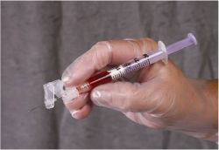
ABG
Hypoxemia
Elevated A-a gradient
FiO₂:PaO₂

Slide 29
CBC
Normocytic normochromic anemia
Neutrophilic leukocytosis
  +/- left shift
  Does not correlate with severity of infection
Rooney MB, et al. JAVMA 2002

Slide 30
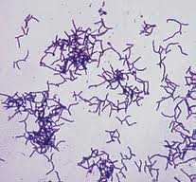
Serum Chemistry
Hypoalbuminemia
Prerenal azotemia
Hyperglobulinemia and hypoglycemia
  Associated with Actinomyces spp.

Slide 31
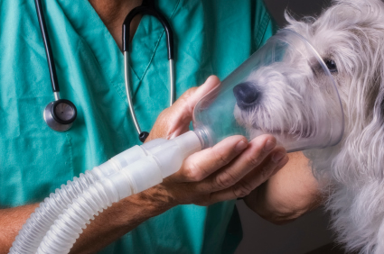
Treatment
Supportive care:
  IV fluids
  Oxygen therapy
Medical vs. Surgical
Drainage
Lavage
Antibiotics

Slide 32
Evaluation of outcomes in dogs treated for pyothorax: 46 cases (1983–2001)
Surgical treatment associated with a better short-term, but NOT long-term outcome
Pleural lavage and intrapleural heparin treatment increased the likelihood of short and long-term survival
Recurrence rate was 20% and was associated with high mortality
Empirical antibiotic therapy was associated with a 35% risk of inefficacy
Boothe HW et al. JAVMA 2010
Notes:
Retrospective, Texas A and M
Compared three treatment groups:intermittent thoracocentesis, thoracostomy tube and thoracotomy with thoracostomy tube placement
Recurrence was not different between medical and surgery groups

Slide 33
Medical and surgical treatment of pyothorax in dogs: 26 cases (1991-2001)
Surgical treatment associated with a better outcome
  78% disease free after 1 year versus 25% with medical treament
Treatment was 5.4 times more likely to fail in dogs treated medically
Surgical treatment warranted if Actinomyces spp. isolated
Total WBC count and band count not associated with outcome
Rooney MB, et al. JAVMA 2002
Notes:
Retrospective
26 dogs: 19 underwent surgery, 12 of these after perceived failure medical therapy
Medical therapy consisted of systemic antibiotics, thoracic drainage via thoracostomy tube (unilateral or bilateral), continuous or intermittent aspiration of tubes and thoracic lavage.

Slide 34
Successful medical treatment of 15 dogs with pyothorax
16 dogs with a diagnosis of pyothorax
All had thoracic ultrasound performed
  One had pulmonary abscess and referred for surgery
15 managed medically with single thoracocentesis and antibiotic therapy
  Antibiotics for 6-16 weeks
  Complete recovery with no relapse within 5 month mean follow-up
Johnson MS et al. J Small Anim Pract 2007
Notes:
Retrospective observational study
No control group

Slide 35
Medical vs. Surgical?
No prospective studies
Thoracotomy indicated:
No improvement in 48 to 72 hours with medical therapy
Underlying disease (abscess, FB, LLT)
Actinomyces spp in pleural effusion

Slide 36
Drainage
Needle aspiration generally ineffective for complete drainage of pleural cavity
  Fluid typically thick and flocculated and tends to re-accumulate quickly
Intermittent thoracocentesis may be associated with increased mortality
Greene CE, Reinero CN. Bacterial respiratory infections. In: ed. Greene CE Infectious diseases of the dog and cat, 3rd ed. St. Louis, Saunders, 2006

Slide 37
Thoracostomy Tubes
Placement requires heavy sedation to general anesthesia
Unilateral or bilateral
Size of tube has no effect on outcome but bigger tubes are more painful
Rahman NM et al. Chest 2010

Slide 38
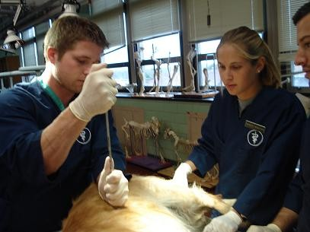
Thoracostomy Tubes
Pleural drainage may be intermittent or continuous
  Continuous has not been shown to be advantageous over intermittent
Barrs VR et al J Feline Med Surg 2005
Scott JA et al. Compendium 2003

Slide 39
Thoracostomy Tubes
Often necessary for 3 to 7 days
Removal based on daily fluid cytology and the quantity of fluid produced
  < 2.2 ml/kg/tube q 24 hours
Complications:
Kinking/clogging of tube
Inadvertent removal
Risk of ascending nosocomial infection

Slide 40
Pleural Lavage
Facilitates exudate drainage
Prevents thoracostomy tube obstruction by thick exudates
Hydraulic debridement of the pleura including breakdown of adhesions
Dilution of bacteria and inflammatory mediators

Slide 41
Pleural Lavage
Warmed isotonic fluid (0.9% saline, LRS)
10 to 20 ml/kg q 6-12 hours
Left in place for 5 to 10 minutes
Up to 75% of the instilled volume should be retrieved
Complications:
Fluid overload
  Close monitoring of fluid “ins and outs”

Slide 42
Pleural Lavage
Intrapleural fibrinolytic agents
Streptokinase
Urokinase
tPA
*Heparin
  1500 U/100 ml
Does not improve outcome in human patients with pleural infection
Tokuda Y et al. Chest 2006
Notes:
There is no indication for the routine use of intrapleural fibrinolytics in patients for pleural infection.

Slide 43
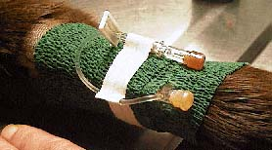
Systemic Antibiotic Therapy
Broad-spectrum pending culture and sensitivity results
Long term treatment (> 6 weeks)

Slide 44

Additional Therapies
Analgesia
  Systemic
  Intrapleural
Early enteral nutrition

Slide 45
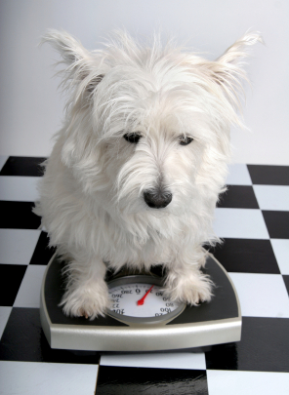
Patient Monitoring
Body weight
TPR, respiratory effort
PCV/TS
Electrolytes
Blood pressure
Oxygen saturation
“Ins and outs”
Pleural fluid cytology
Repeat radiographs

Slide 46
Prognosis and Outcome
Prognosis fair to good but highly variable
Mortality rates vary
  Euthanasia for poor prognosis, financial constraints or potential for recurrence
  Early studies 50-60% survival
  Recent studies up to 90% survival
Recurrence more of a concern with Actinomyces and Nocardia spp.

Slide 47
Feline pyothorax

Slide 48

Signalment
Young (mean age of 4-6 years)
No breed or gender predisposition

Slide 49
Etiology
Aspiration
Extension from bacterial pneumonia
Penetrating wounds to the chest, neck or mediastinum
Migrating inhaled foreign bodies
Esophageal or tracheal perforation
Lung parasites
Hematogenous or lymphatic spread from septic foci
Spread from cervical or lumbar infections
Neoplasia and abscessation
Iatrogenic (thoracocentesis)

Slide 50
Risk Factors
Multi-cat household
  3.8 times more likely to develop pyothorax
Bradycardia and hypersalivation associated with death
Outdoor access not a risk factor
Upper respiratory tract infection
Waddell LS et al. JAVMA 2002
Barrs VR et al. J Feline Med Surg 2005

Slide 51
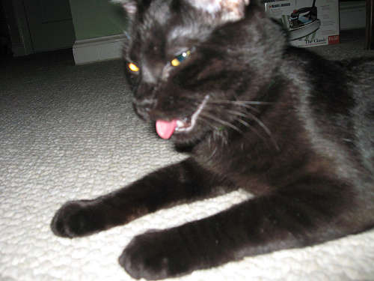
History
Dyspnea
Inappetence
Lethargy
Tachypnea
Cough
Notes:
The first 3 are reported in 80% of case
Cough reported in 14-30% of cases

Slide 52
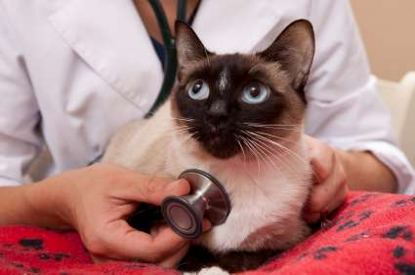
Physical Exam
Poor body condition
Dyspnea
Weight loss
Depression
Cyanosis
Tachypnea
Orthopnea
Muffled heart sounds
Decreased lung sounds
Acute Respiratory Distress:
Dehydration
Shock
Pale mucous membranes
Hypothermia
Bradycardia
Hypersalivation

Slide 53
Infectious Agents
OROPHARYNGEAL FLORA (80%)
NON OROPHARYNGEAL FLORA (20%)
*Pasteurella multocida
Bacteroides
Fusobacterium
Peptostreptococcus
Clostridium
Streptococcus
Mycoplasma
Staphylococcus
E. coli
Salmonella
Klebsiella
Pseudomonas
Toxoplasma
Fungal
Cryptococcus
Candida albicans
Blastomyces
Notes:
Pasteurella is the most common isolate in cats

Slide 54
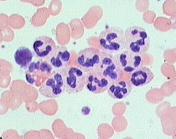
Hematology
Neutrophilia with a left shift (37-73%)
Neutropenia with a left shift
White cell count higher in survivors
Normocytic normochromic anemia
Waddell LS et al. JAVMA 2002

Slide 55
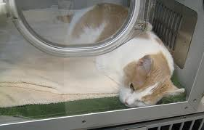
Treatment
No studies comparing different treatment protocols with outcome in cats
Respiratory distress
Minimal handling
Oxygen therapy
Initial stabilization
  Hypothermia
  Hypotension
  Dehydration

Slide 56
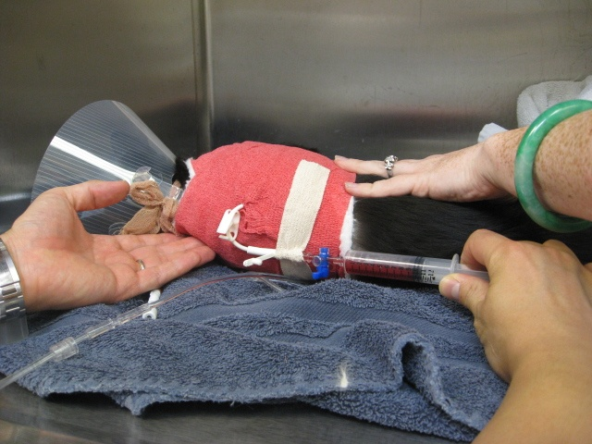
Treatment
Indwelling thoracotomy tubes recommended
  Mortality rates of 50-80% with intermittent needle thoracocentesis
Pleural lavage
Antibiotics
Patient monitoring and analgesia
Indications for surgery same as for dogs

Slide 57
Prognosis and Outcome
Most non-survivors die or are euthanized in the first 48 hours after presentation
Reported survival is 66%
Increased to 77.6% after first 24 hours of hospitalization
5.9% recurrence rate
Waddell LS JAVMA 2002

Slide 58
References
Barrs VR, Beatty JA. Feline pyothorax – new insights into an old problem: part 1. Aetiopathogenesis and diagnostic investigation. The Veterinary Journal 2008
Barrs VR, Beatty JA. Feline pyothorax – new insights into an old problem: part 2. Treatment recommendations and prophylaxis. The Veterinary Journal 2008
Boothe HW, Howe LM, Boothe DM et al. Evaluation of outcomes in dogs treated for pyothorax: 46 cases (1983-2001). J Am Vet Med Assoc 2010;236:657-663
Crawford AH, Halfacree ZJ, Lee KC et al. Clinical outcome following pneumonectomy for management of chronic pyothorax in four cats. J Feline Med Surg 2011;13:762-767
Greene CE, Reinero CN. Bacterial respiratory infections. In: ed. Greene CE Infectious diseases of the dog and cat, 3rd ed. St. Louis, Saunders, 2006
Johnson MS, Martin MWS. Successful medical treatment of 15 dogs with pyothorax. J Small Anim Pract2007;48:12-16
MacPhail CM. Medical and surgical management of pyothorax. Vet Clin Small Anim 2007;37:975-988
Rahman NM, Maskell NA, Davies CW et al. The relationship between chest tube size and clinical outcome in pleural infection. Chest 2010;137(3):536-43
Rooney MB, Monnet E. Medical and surgical treatment of pyothorax in dogs: 26 cases (1991-2001). J Am Vet Med Assoc 2002;221:86-92

Slide 59
References
Sauve V. Pleural space disease. In: Silverstein DC, Hopper K eds: Small Animal Critical Care Medicine St. Louis, 2009, Saunders
Schultz RM, Peters J, Wingenberger AZ. Radiography, computed tomography and virtual bronchoscopy in four dogs and two cats with lung lobe torsion. J Small Anim Pract 2009;50:360-363
Scott JA, Macintire DK. Canine pyothorax: pleural anatomy and pathophysiology. Compend Cont Edu Vet 2003;25(3):172-9
Scott JA, Mcintire DK. Canine pyothorax: clinical presentation, diagnosis and treatment. Compend Cont Edu Vet 2003;25(3):180-194
Swinbourne F, Baines EA, Baines SJ et al. Computed tomographic findings in canine pyothorax and correlation with findings at exploratory thoracotomy. J Small Anim Pract 2011;52:203-8
Tokuda Y, Matsushima D, Stein GH et al. Intrapleural fibrinolytic agents for empyema and complicated parapneumonic effusions: a meta-analysis. Chest 2006;129(3):783-90
Waddell LS, Brady CA, Drobatz KJ: Risk factors, prognostic indicators and outcome of pyothorax in cats: 80 cases (1986-1999). J Amer Vet Med Assoc 2002;221:819
Walker AL, Jang SS, Hirsh DC. Bacteria associated with pyothorax of dogs and cats: 98 cases (1989-1998). J Am Vet Med Assoc 2000;216:359-363

Slide 60
Questions
Which of the following does the parietal pleura not cover?
A. Internal surface of the ribs
B. Mediastinum
C. Serosal surface of the lungs
D. Diaphragm

Slide 61
Questions
Parietal pleura capillaries arise from the ________ circulation and thus have a ________ hydrostatic pressure than the visceral pleural capillaries
A. Pulmonary, lower
B. Systemic, lower
C. Systemic, higher
D. Pulmonary, higher

Slide 62
Questions
Which of the following is not a suspected route of infection in canine pyothorax?
A. Extension from bacterial pneumonia
B. Diskospondylitis
C. Abdominal surgery
D. Esophageal perforations

Slide 63
Questions
What percentage of pleural fluid is drained by lymphatics from the pleural space?
A. 65%
B. 25%
C. 98%
D. 75%

Slide 64
Questions
Pleural fluid can accumulate with all of the following except?
A. Lymphatic outflow obstruction
B. Increases in capillary permeability
C. Decreases in pleural cavity colloid osmotic pressure
D. Decreases in pleural capillary colloid osmotic pressure

Slide 65
Questions
The most common clinical signs seen on physical examination of dogs with pyothorax are:
A. Anorexia and polyuria
B. Tachypnea and hypothermia
C. Dehydration and cyanosis
D. Fever, dyspnea and weight loss

Slide 66
Questions
Which of the following anaerobic bacteria are not commonly isolated in canine pyothorax?
A. Fusobacterium
B. Clostridium
C. Bacteroides
D. Peptostreptococcus

Slide 67
Questions
The antibiotic of choice for Nocardia infections is
A. Ticarillin-clavulanate acid
B. Enrofloxacin
C. Chloramphenicol
D. Trimethoprim-sulfonamides

Slide 68
Questions
What percentage of Actinomyces infections respond with appropriate treatment?
A. 90%
B. 20%
C. 10%
D. 60%

Slide 69
Questions
What is the most common bacterial isolate in cats with pyothorax?
A. E. coli
B. Pasteurella
C. Bacteroides
D. Mycoplasma

Slide 70
Questions
In cats with pyothorax, non-survivors were more likely to present with which of the following?
A. Hypothermia and tachypnea
B. Fever and tachycardia
C. Hypersalivation and bradycardia
D. Cough and tachypnea

