Slide 1
Lung Lobe Torsion
Jenefer Stillion, DVM
Resident Board Review
Nov 8, 2011

Slide 2
Lung Lobe Torsion
Rare, life-threatening pulmonary disorder
Occurs when lung lobe rotates around the bronchovascular pedicle and is unable to return to its normal position

Slide 3
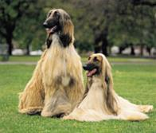
Signalment
Large, deep-chested dogs
Afghan hound overrepresented
  133 times more likely to develop LLT than other breeds
Has been documented in Pugs, Yorkshire terriers, miniature poodles, beagles and mixed-breed dogs
Also reported in cats
Neath PJ JAVMA 2000

Slide 4
Pathophysiology
Most commonly affected lung lobes are the right middle and left cranial lobes
Predisposing factors:
Pneumothorax
Pleural effusion
Previous thoracic surgery
*Thoracic trauma
Pathologic changes of the affected lobe
Bronchial cartilage dysplasia
Notes:
Most common cause in people is surgical trauma – 36 cases in recent literature review followed thoracic surgery
Pugs: left cranial lung lobe most common
Afghans: right middle

Slide 5
Pathophysiology
Affected lobe twists at the vascular pedicle
Occlusion of airway and thin walled veins
Continued arterial inflow of blood
Engorgement of the lobe
Filling of the alveoli with blood

Slide 6
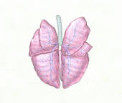
Pathophysiology
Atelectasis
Compression of lobe secondary to pleural effusion
Accumulation of fluid and inflammatory infiltrates from vascular congestion
Progressive resorption of alveolar gases (resorption atelectasis)
Atelectasis → lower tidal volume → ↑ RR

Slide 7
Pathophysiology
Hypoxemia
Ventilation/perfusion mismatch
  Dead space ventilation if zero venous return but incomplete obstruction of bronchus
Intrapulmonary shunting
  Partly occluded lobar veins allow some venous return from unventilated lung
Alveolar hypoventilation
  Decreased air movement through an airway partially occluded by a twisted bronchus
  Airway secretions may occlude air flow to a torsed lung lobe that remains perfused

Slide 8

Clinical Signs
Dyspnea
Cough
Hemoptysis
Epistaxis
Anorexia
Lethargy
Fever
Vomiting
Diarrhea
Hematemesis
Depression
PU/PD
Notes:
PU/PD reported in an affected Afghan hound

Slide 9

Physical Exam
Dyspnea
Dull heart and lung sounds ventrally
Dull lung sounds dorsally
Weakness
Signs of shock
Cyanosis

Slide 10
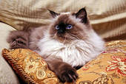
Diagnosis
Hematology
Pleural fluid cytology and culture
Imaging
  Thoracic radiographs
  Thoracic ultrasound
  Computed tomography
Bronchography/Bronchoscopy

Slide 11
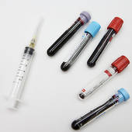
Hematology
ABG
  Hypoxemia, elevated A-a gradient
CBC
  Normocytic normochromic anemia
  Neutrophilic leukocytosis
Serum chemistry
  Hypoproteinemia
  Hyperbilirubinemia
  Elevated creatinine

Slide 12
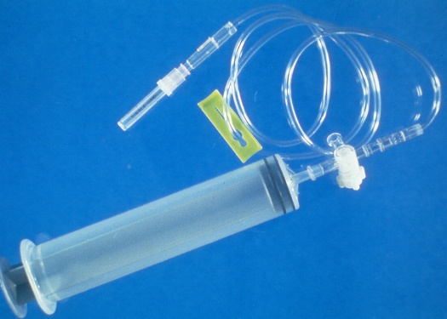
Thoracocentesis
Diagnostic and therapeutic
Fluid analysis
  Hemorrhagic, serosanguinous, chylous
Cytology
  Reflect underlying disease process
  Inflammatory : neutrophils, lymphocytes, rbc, mesothelial cells
Culture
  Pyothorax rare

Slide 13
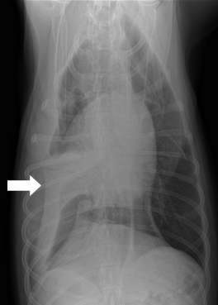
Radiographic Findings
Lung lobe consolidation
Air-bronchograms seen within affected lobe if acute
Abnormal bronchial alignment
Mediastinal shift
Pneumothorax
Pneumomediastinum
Notes:
Pleural effusion may obscure thoracic structures

Slide 14
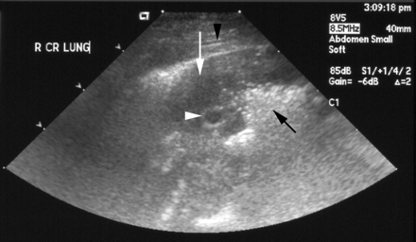
Ultrasonography
Torsed lung lobe may appear hypoechoic, rounded and surrounded by pleural effusion
Consolidated lobe and fluid-filled bronchi may resemble liver tissue → hepatization

Slide 15
CT/MRI
Recommended if radiographic findings are non-specific
Can identify:
Narrowed/collapsed/occluded bronchus
Vesicular emphysema
Pleural effusion
Underlying disease process
Schultz RM et al. J Small Anim Pract 2009
Notes:
VE: Occurs in a portion of the lung adjacent to another that cannot expand on inspiration (atelectasis, consolidation).

Slide 16
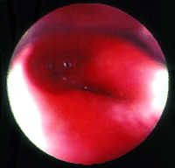
Bronchography/Bronchoscopy
Bronchoscopy
Positive-contrast bronchography
Virtual bronchoscopy
May demonstrate bronchial collapse and occlusion

Slide 17

Treatment
Medical stabilization
Oxygen therapy
IV fluid therapy
Thoracocentesis
Pain management

Slide 18
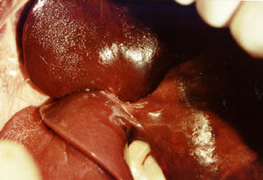
Treatment
Surgery
Derotation not recommended
  Ischemia-reperfusion injury
  Irreversible damage to pulmonary parenchyma
Resection of affected lung lobe
  Clamp bronchovascular pedicle to prevent release of cytokines into circulation if lobe is untwisted during removal

Slide 19
Treatment
Surgery
Dogs and cats can tolerate removal of 50% of their lung mass
  Complete left pneumonectomy
  NOT complete right pneumonectomy
Intraoperative placement of a thoracostomy tube

Slide 20
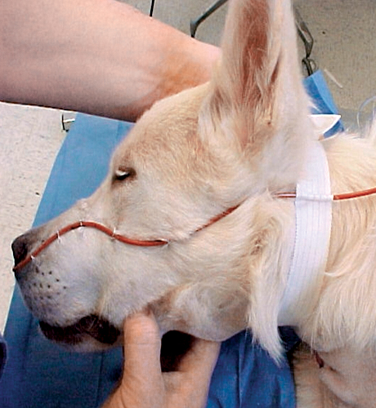
Post-operative Care
Oxygen therapy
Analgesia
IV fluid therapy
Drainage of chest tubes
Antibiotics (if indicated)

Slide 21
Outcome and Prognosis
Fair to poor depending on underlying disease and breed
Idiopathic or secondary to trauma generally fair to guarded
Associated with chylothorax generally poor
  Afghan hounds

Slide 22
References
Gicking JC, Aumann M. Lung lobe torsion. Compendium April 2011
McLane MJ, Buote NJ. Lung lobe torsion associated with chylothorax in a cat. J Fel Med Surg 2011;13:135-138
Moon M, Fossum TW. Lung lobe torsion. In: Bonagura JD, ed. Kirks current veterinary therapy. 12th edn. Philadelphia: WB Saunders, 2000:919-21
Murphy KA, Brisson BA. Evaluation of lung lobe torsion in Pugs: 7 cases (1991-2004). JAVMA 2006;228(1):86
Neath PJ, Brockman DJ, King LG: Lung lobe torsion in the dog: a retrospective study of 22 cases (1981-1999). JAVMA 2000;217(7):1041-44
Neath PJ. Lung lobe torsion. In: King LG, ed. Textbook of Respiratory Diseases in Dogs and Cats. St. Louis: Saunders, 2004:559-63
Schultz RM, Peters J, Zwingenberger A. Radiography, computed tomography and virtual bronchoscopy in four dogs and two cats with lung lobe torsion. J Small Anim Pract 2009;50:360-363

Slide 23
Questions
What breed of dog is most commonly affected by lung lobe torsion?
A. Afghan hound
B. German Shepherd
C. Pug
D. Beagle

Slide 24
Questions
Torsion is most commonly reported to affect the ___________ lung lobes?
A. Left caudal and right caudal
B. Left cranial and right cranial
C. Left cranial and right middle
D. Left caudal and right cranial

Slide 25
Questions
Which of the following is not thought to be a predisposing factor to the development of lung lobe torsion?
A. Recent thoracic surgery
B. Recent abdominal surgery
C. Pneumothorax
D. Pleural effusion

Slide 26
Questions
Dogs and cats can tolerate removal of up to _____ of their lung mass?
A. 15%
B. 25%
C. 40%
D. 50%

Slide 27
Questions
Ultrasonographically, a torsed lung lobe may appear
A. Hyperechoic, rounded, and surrounded by air
B. Hypoechoic, rounded, and surrounded by pleural effusion
C. Hypoechoic, tapered, and surrounded by pleural effusion
D. Hyperechoic, tapered, and surrounded by air

