Slide 1

Workday/CIT Technical Impact Discovery Project
Executive Summary
May 27, 2011

Slide 2
Goals and Approach
Goal:
  Integrate Workday as a new SaaS HR /Payroll system with all Cornell systems that interoperate with Cornell’s current HR/Payroll solution.
Approach:
  Phase 1 – remediate and integrate CU systems with Workday by July 1, 2012
  Phase 2 – deliver an HR/Payroll data delivery solution by a date that will be determined during Phase 1.

Slide 3
Costs and Optimizations
Cost Management:
  Reallocated staff will be used when possible.
  Contractors will be hired when CU talent shortages and resource availability due to other projects require it.
Cost reduction proposals:
  Move the Kronos Capital project forward to upgrade and expand Kronos before July 1, 2012 so that it becomes the single campus time collection system. This avoids remediation of COLTS, the custom solution, for Workday.
  Create a PeopleSoft people data hub to avoid forcing multiple systems, such as the Directory and Emergency Mass Notification, from having multiple interfaces – one with Workday and one with PeopleSoft.

Slide 4
Stakeholders
People Data Hub stakeholders:
  Student Administration, Contributor Relations, HR, Payroll, Identity Management, Data Administration
Impacted Systems’ Functional Stakeholders:
  Directory, NetID Administration, Authorization tools: CIT/Identity Management
  Emergency Mass Notification: CU Police
  Enterprise Learning Management : Sponsored programs, Facilities, HR
  IDCard : Registrar
  KFS (Budget, Labor Ledger, GL) : DFA/Accounting, Budget office, DFA/Payroll
  Kronos (time collection): DFA/Payroll
  United Way: DFA/UBSC
  Voyager : Library

Slide 5
Recommended Workday Deployment Project Structure
Exec Sponsors
Project Director
Stakeholders
Workday Project Manager
Integration and Remediation Technical Project Manager
Workday Functional adoption team
Technical team

Slide 6
Timeline with deliverables
PHASE 1
PHASE 2
July 2011
Jan 2012
July 2012
Phase 2 end: TBD
Launch
Kronos Capital Project:
Upgrade
Expand use to 24 additional units
Switch 7000 users from COLTS
Workday Phase 1:
Conversion support
ELM
Harris Connect
ID Card
ID Mgmt – Authentication
ID Mgmt – Provisioning
Integration Architecture
KFS
Kronos integration and remediation
Needs analysis for data delivery
PeopleSoft
People data hub
Student Employment
United Way
Workday Phase 2:
Data delivery solution
Decommission COLTS

Slide 7
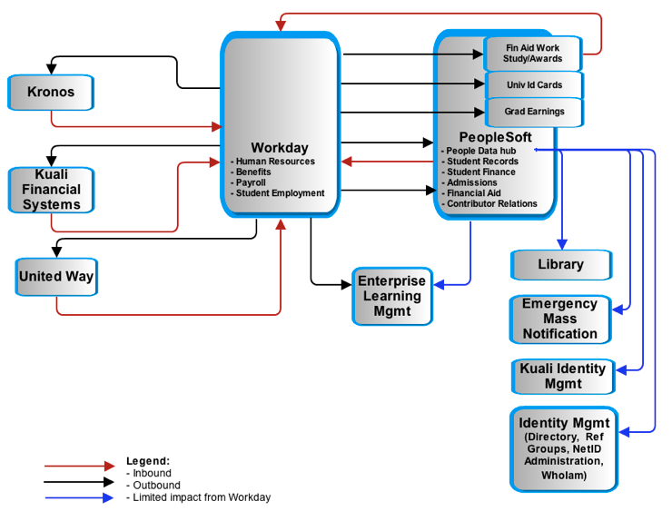
Appendix A: System Impact Diagram

Slide 8
Appendix B: Timeline with
Workday specific cost estimates
Phase 1
Phase 2
Low Estimate High Estimates
Reallocated: $440,000 - $740,000
Cash: $1,030,000 - $1,900,000
Total cost: $1,470,000 - $2,640,000
Low Estimate High Estimates
Staff Costs: $30,000 - $470,000
Cash: $300,000 - $2,400,000
Total cost: $330,000 - $2,870,000
July 2011
Jan 2012
July 2012
Phase 2 end: TBD

Slide 9
Appendix C: Total Cost Summary
 |  | Estimates
Project | Target date | Low -Staff | Low– Cash ⁽¹⁾ | High - Staff | High - Cash ⁽¹⁾
Kronos Capital Project ⁽²⁾ | June 2012 | $150,000 | $540,000 | $150,000 | $540,000
Phase 1 ⁽³⁾ | July 2012 | $440,000 | $1,030,000 | $740,000 | $1,900,000
Phase 2 ⁽⁴⁾ | TBD | $30,000 | $0 | $470,000 | $2,400,000
Total of lower estimates | $2,190,000
Total of high estimates | $6,200,000
Cash is for licenses and VMs for Kronos and consulting for most systems.
Kronos’ estimates are from Payroll.
Refer to the Timeline With Deliverables slide and Appendix A for systems included. Remediation efforts for unit systems that might be indirectly affected by Workday could not be included at this time.
Data delivery requirements will not be known until the end of phase 1 so the upper estimates are based on 2/3s of the KFS data delivery effort.

