Slide 1
Workday
Revised technical summary
May 17, 2011

Slide 2
Topics
Recap
Assumptions
Changes
Context diagram
Estimates
  Low/High ratios
  Low/High by category by option

Slide 3
Recap from 5/12
Scope: cost differentials
  separate must dos versus can waits
  Cornell specific customizations - what can go and be redone and what are the cost implications near and long term?
    KRONOS customizations?
    IDmgmt Kerberos,….?
    what else?
  PS keeping HR/Payroll data as well...feeds stay intact and we keep the downstream feeds alone; figure out the impact of the jobs data and the impact to warehouses.

Slide 4
Recap from 5/12
Schedule: cost differential
  July 2012
  Jan 2013

Slide 5
Recap from 5/12
Resources : cost differential
  1/2013
    Consultants only (5/6 for Jan 2013)
    Maximizing reallocated internal (1/6 for Jan 2013)
  7/2012
    100% consultants

Slide 6
Recap from 5/12
Check in with other schools:
  : Georgetown , Brown, CMU Georgetown , Brown, CMU
    In progress

Slide 7
Recap from 5/12
Validation of the conceptual diagrams
  From Interface inventory worked on with HR
Add a bullet about the process to validate the data/scope..
  Invited CIT reps, Workday Inc rep, and HR IT and HR project management to set of meetings
Get a cost for retaining our Consultant.
  In progress

Slide 8
Assumptions
Rates used:
  CU Rates $100 an hour
  Consultant Rates $150 an hour
Formula for January 2013:
  5/6 and 1/6 formula = Through 6/2012 is 100% consultants and July 2012 to Jan 2013 is 50% consultants and 50% CU staff Applicability of the formula:
  The 5/6-1/6 formula was applied across the board although it may only need to be applied for certain activities and not others. More analysis is needed to determine, for example, if it really applies to Identity Management's work.

Slide 9
Changes made
Time collection: The Kronos license and VM fees and upgrade project are entirely excluded. The costs still exist, and this is a prerequisite, but the costs will be counted separately in another project.
Result: No longer included.

Slide 10
Changes made
Data delivery:
  All efforts concerning the HR-Payroll data warehouse and other warehouses and systems downstream of them is now deemed optional and the low estimate is zero.
  The business impact to units and their decision making based on that data is unknown.
  HR has clearly stated a data warehouse is wanted and requirements are needed.
  More analysis is recommended to determine use of the data and to prioritize requirements.
  The high estimate is purely based on the effort (hours) spent to date and projected for the completion of the KDW.
Result: Changed to optional.

Slide 11
Changes made
Integration of People data:
  Rather than having EMN, Library and the IdManagement tools connect with Workday we would keep PeopleSoft as intact as possible to minimize changes to them.
  PeopleSoft stays as the 'People Data Hub'.
  Architecturally and for long term support it is better, but the financial implications of this change are relatively small.
  Creating services for applications to get that data rather than using the high number of direct connects should be done, and is outside the scope of Workday.
Result: Changed

Slide 12
Changes made
Reserves for impacts to 'other' systems:
  We believe there are other systems that will be impacted than those listed.
  They will either be allowed to fail or require separate funding to remediate.
Result: No longer included.

Slide 13
Changes made
Consulting for Payroll:
  If Payroll wants additional consulting for help with tools such as Windstar that CIT does not currently support it will require separate funding.
Result: No longer included.

Slide 14
Changes Made
Technical Project Management:
  It was moved up into the 'General technical and Project Management' category.
  It is an hour count now rather than a % of the project.
Result: Reduced and moved.

Slide 15
Changes discussed and not made
Replace Id. Mgmt software:
  PS Data Hub concept reduces impact.
Result: Effort reduced.

Slide 16
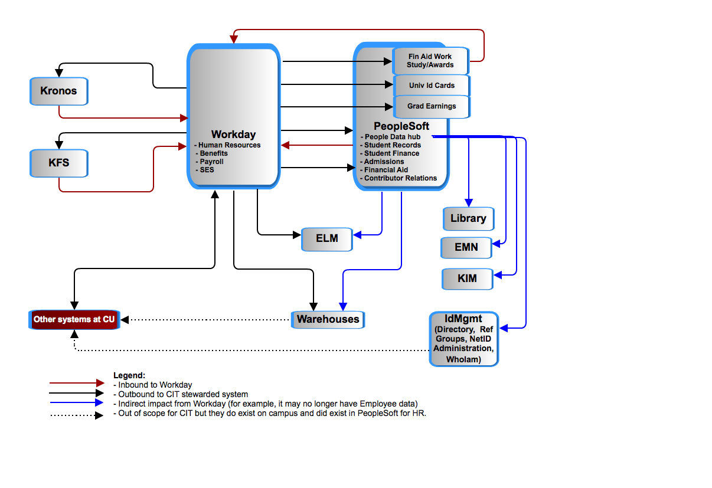
PeopleSoft as the person ‘data hub’

Slide 17
Ratios of efforts

Slide 18
Ratios of efforts

Slide 19
Costs of three options – Low Estimates

Slide 20
Costs of three options – High Estimates

