Slide 1


A Technical Point of View
@
Data collection coordination and presentation
by Vicky Mikula and Steve Lutter

Slide 2
Topics to cover
Background and status
Impact to Business processes and technologies supporting those processes that CIT stewards.
  Diagrams
  Risks
  Biggest Factors
Tasks and Estimates
Recommended next steps

Slide 3
Background and status
April 2010
  Received our first introduction to Workday and did our first assessment.
November and December 2010
  Vicky Mikula (CIT/IS/ES) joins the HR Core Workday team as overall CIT Liaison.
January through April 2011
  CIT Charters a Discovery project, reverse engineers impact from PeopleSoft, and meets to track down other technical impacts.

Slide 4
Reverse Engineering PS
Component and record data is all available for harvesting and can be linked back to a portal navigation/business process/module area.
Custom scripts built by an on-site consultant extracted the HRMS and Campus Solutions inventory of meta data. Intersection scripts located cross-module use of data/records.
The scripts reported the intersection records and associated business processes (navigation selections from the PS Portal) impacted.
PS DB
Scripts
Excel
Excel
Excel
PS Code

Slide 5
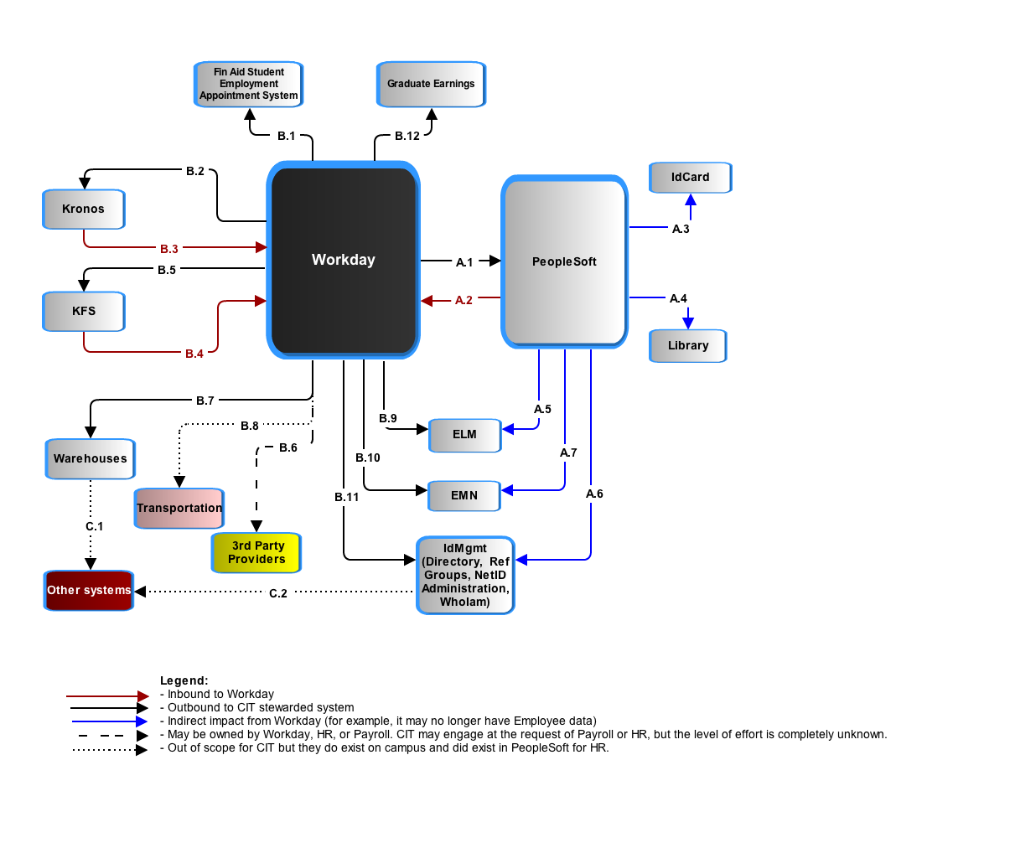
Workday – Application to Application

Slide 6
PeopleSoft and Workday have to jointly avoid duplicate people records and jointly manage the data of record for individuals who are employees and also students, prospects, or alumni. Currently, that is done in PeopleSoft as the delivered Search-Match function.

Slide 7
Cornell’s People Records in PeopleSoft
 |  | Total Population PERSON Record
 |  | 1,800,482
 | Total number of Employees |  | Total Number of Campus Solutions Persons |  | Total Number of Contributor Relations Persons
 | 116,723 |  | 1,182,270 |  | 473,080
 | Non-Student Employees |  | Students |  | Trustees and Affiliates
 | 65,449 |  | 229,417 |  | 5,062
 | Student Employees |  | Total Number of Applicants |  | Alumni and Related
 | 51,295 |  | 191,131 |  | 468,018
 |  |  | Total Number of Prospects
 |  |  | 761,722
*Person record counts are based on primary affiliation with the University. For example: A person who is an employee and a student was counted as an employee.

Slide 8

Search – Match and avoiding duplicate People records.
Conceptual

Slide 9
PeopleSoft requires changes:
# setup type of tables that are impacted: 27
# of transactional type of tables that are impacted: 30
# of batch PS Jobs to be decommissioned: 52

Slide 10
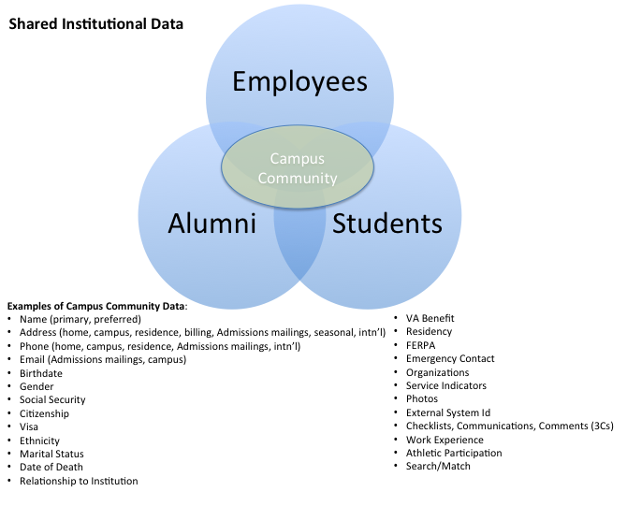

Slide 11
Assumption is that all people (employees and students) records, including bio/demo and basic status/affiliation with University will still exist in PS. The systems using this data from PS today should function post-Workday with little remediation. Those systems requiring more specific job/position data will require interaction with Workday as data of record for employee data. PS will continue to be data of record for student data.

Slide 12
Financial Aid packaging requires tracking of work study, award and gross pay earnings.

Slide 13
KFS (Kuali Finance):
Sends account data to Workday.
Gets transaction data for liabilities, gross pay, encumbrances.
Some transformation of the data between the two applications, as with all of these, should be expected.

Slide 14
Warehouse and reporting:
Most operational reporting will be done straight from Workday. All historical analysis and merging/reporting with other institutional data requires a warehouse.
Not enough requirements or assumptions are known at this time to do anything other than compare the effort to that of the KDW.
IF the effort is similar to that of the Kuali Data Warehouse then it will be between 20000 and 30000 hours, which is ~ 2/3 of the overall IT estimate for Workday.
Some systems, such as Cornell Connect, Academic Personnel Database and Activity Insight for Academic reporting, are fed from the HR/PY datamart and will be affected by changes in the structure. Impact to these systems are not accounted for at this time.

Slide 15
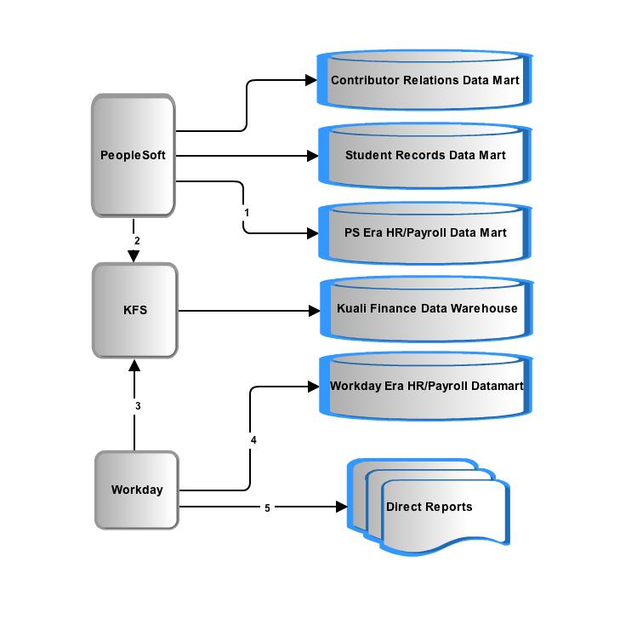
Data delivery: more questions than answers
Question 1: Do we keep our historical data as is or convert it?

Slide 16
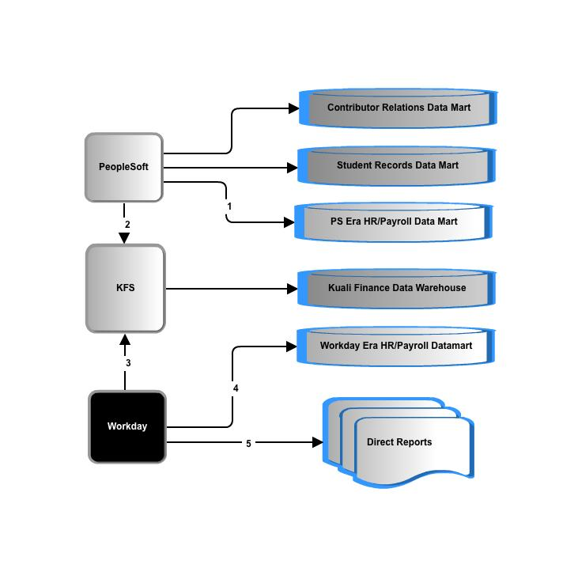
Data delivery: more questions than answers
Question 2: Workday data representation and extraction is unconventional and there is no data model or data dictionary. What is the process and effort extract, transform and load?
Question 3: What are the requirements of the new datamart?

Slide 17
Data delivery: more questions than answers
Question 4: Finance reporting provides labor detail. Is there an impact to the KDW and labor reporting from a finance point of view?
Question 6: SRDM and CRDM make use of HR data. How extensive are the changes there?
Question 5: SRDM and CRDM make use of HR data. How extensive are the impacts?

Slide 18
3rd party oversight: Payroll has requested CIT help in overseeing/developing their Workday integrations and reports. Payroll is also seeking on-going support of all integrations and reports post-Workday go-live. It is not known yet what that entails in terms of number of integrations, actual responsibilities, or level of effort.

Slide 19
Kronos (time collection) :
Options:
  Kronos takes over all campus time collection. Upgrading Kronos to replace COLTS will require licensing, more training, more technical support and a project.
  or
  COLTS (not illustrated) has to be remediated.
CU requirements have and will continue to require custom a2a interface development.

Slide 20
Workday and Cornell Time Collection
Question 1: Expand Kronos to all of campus and eliminate COLTS? Or remediate COLTS for Workday?
Answer: Anticipated plan is to migrate 100% of time collection to Kronos within next couple years. Use Workday deployment as opportunity to fast track migration of all time collection to Kronos and decommission COLTS.
?

Slide 21
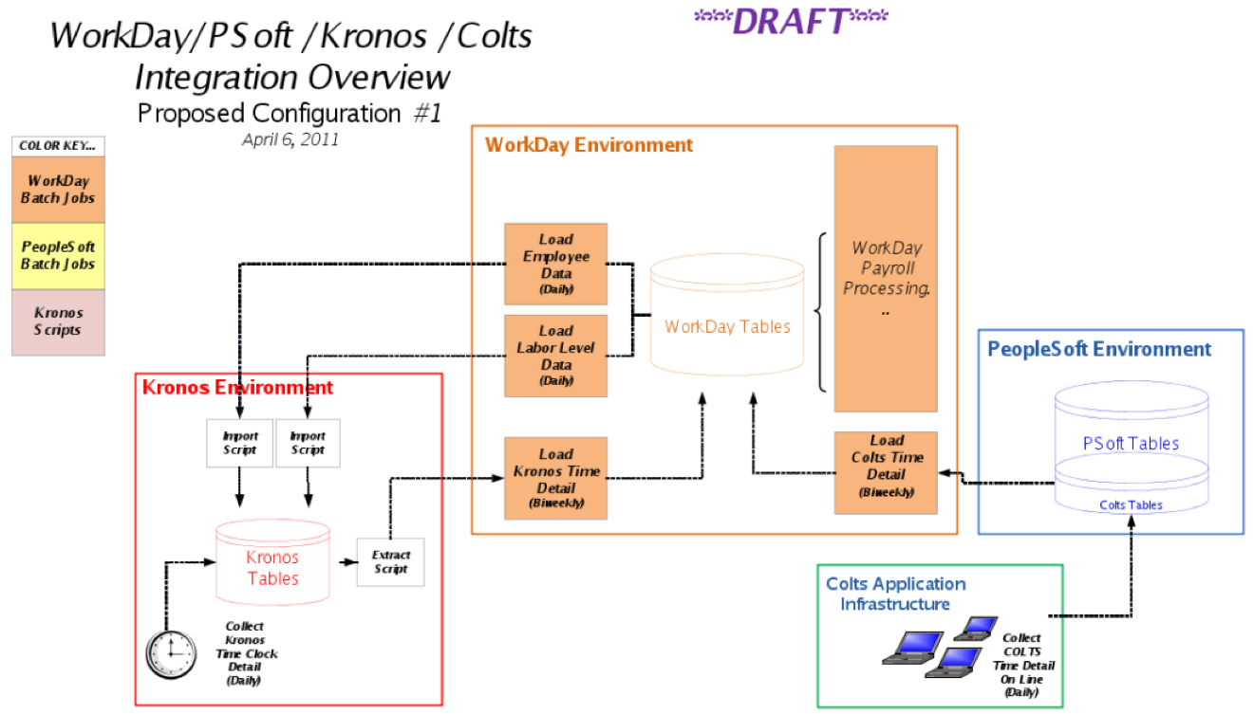
Workday and Cornell Time Collection
Question 2: If we are keeping COLTS then .. Remediate or rewrite it?
Answer: Rewrite application as the logic is tightly coupled with PS. The estimate to rewrite has been reported at $500 to $600K.

Slide 22
Workday and Cornell Time Collection
Question 3: What is the time frame needed for either the expansion of Kronos or the remediation/rewrite of COLTS?
Answer: Equally sized efforts. Estimated one year to implement either solution.
Question 4: What are the TCO differences between the options?
Answer: This hasn’t been computed.
Kronos averages .5 FTE for 4700 users.
COLTS averages .3 FTE for 9000 users.

Slide 23
Impact – Risks
  Campus Level Processes disrupted and/or redone:
    Reporting
    Identifying unique people (Search/Match)
    Core CR, Campus Community and Campus Solutions processes
      List the top 5 or so <<<<<<
    Identity Management provisioning and troubleshooting NetIDs , reference groups is dramatically affected.
    Time Collection
  Technical troubleshooting
  Timeline
I am looking for a way to summarize the largest processes at risk on this page. Maybe a table format is better. See the next slide and the notes below.
Notes:
Reporting: no strategy yet
Identifying unique people (Search/Match) requires a new design.
Core CR, Campus Community and Campus Solutions processes
List the top 5 or so <<<<<<
Identity Management provisioning and troubleshooting NetIDs , reference groups is dramatically affected.
Time Collection: challenges and decisions
Technical troubleshooting : real-time and batch a2a between multiple large apps, one of which is SaaS means new tools, skills, knowledge, practices. This is different that other SaaS CU integrations we have now – more records, more processes, more real time means more impact when there is a problem.
Timeline: 12 months for time collection and reporting alone will present significant challenges.

Slide 24
Impact – Risks
Category of Risk | Risk of Failure
Reporting and Business Intelligence | Reporting over time, reporting with other data such as financial records is inadequate.
Cornell Community | Multiple enterprise systems will be the data of record for creation of “people”. Duplicate people, reporting, knowledge of primary affiliation to university, inaccurate data, duplicity of data and so forth will be issues the University will need to address technically and through business process definition.
Provisioning | All processes related to provisioning and de-provisioning a person within the Cornell community who spans multiple enterprise systems.
Time Collection | University has 2 time collection systems. Upgrade to one or both time collection systems imposes a significant risk to calculation of paychecks.
Resources
Notes:
Reporting: no strategy yet
Identifying unique people (Search/Match) requires a new design.
Core CR, Campus Community and Campus Solutions processes
List the top 5 or so <<<<<<
Identity Management provisioning and troubleshooting NetIDs , reference groups is dramatically affected.
Time Collection: challenges and decisions
Technical troubleshooting : real-time and batch a2a between multiple large apps, one of which is SaaS means new tools, skills, knowledge, practices. This is different that other SaaS CU integrations we have now – more records, more processes, more real time means more impact when there is a problem.
Timeline: 12 months for time collection and reporting alone will present significant challenges.

Slide 25
Impact – Risks
Risk | Scope of Risk
Reporting and Business Intelligence | Reporting over time, reporting with other data such as financial records is inadequate.
Cornell Community | Multiple enterprise systems will be the data of record for creation of “people”. Duplicate people, reporting, knowledge of primary affiliation to university, inaccurate data, duplicity of data and so forth will be issues the University will need to address technically and through business process definition.
Provisioning | All processes related to provisioning and de-provisioning a person within the Cornell community who spans multiple enterprise systems.
Time Collection | A highly complex, customized time collection system (COLTS) is used for collecting hourly time for 9000 users. System is tightly coupled with PeopleSoft. A remediation effort of COLTS to support Workday deployment would be an investment of time and money into a secondary time collection system which is in contradiction to the university’s direction of moving to one common time collection system.
Notes:
Reporting: no strategy yet
Identifying unique people (Search/Match) requires a new design.
Core CR, Campus Community and Campus Solutions processes
List the top 5 or so <<<<<<
Identity Management provisioning and troubleshooting NetIDs , reference groups is dramatically affected.
Time Collection: challenges and decisions
Technical troubleshooting : real-time and batch a2a between multiple large apps, one of which is SaaS means new tools, skills, knowledge, practices. This is different that other SaaS CU integrations we have now – more records, more processes, more real time means more impact when there is a problem.
Timeline: 12 months for time collection and reporting alone will present significant challenges.

Slide 26
Impact – The Biggest Variables
  Data delivery for HR/PY: What is the end goal? What are the requirements? Just how different will the extract/transforms from Workday be? (Based purely on the KDW experience and plans, this is currently 2/3s of the entire technical cost estimate.)
  Time collection options: Kronos 100% or (remediate both COLTS and Kronos)?
  Integration options : point to point or through a SOA tool for CU <->Workday a2a traffic? (SOA is not included in the estimate at all so the default is point to point.)
  Payroll 3rd party integration advice: to what degree?
  Payroll: data modeling and report writing request

Slide 27
High Level Estimates

Slide 28
Estimate Subtotals
Category | Lower Estimate in Hours | Upper Estimate in Hours
Identify Management and IT Security | 2120 | 3180
Direct, Core Workday transactional impact to CU systems | 10670 | 18535
Data deliver, warehouses and BI | 20000 | 30000
Niche or unit apps | 610 | 900
General Technical | 190 | 285
Consult/Advise Payroll | 300 | 375
Total | 33890 | 53275
Rounded Hours | 30,000 | 50,000
TOTAL IN FTE | 19.42 | 30.53
TOTAL in $ at $100,000 per FTE | $1,942,120 | $3,053,009
TOTAL $s ROUNDED | $2,000,000 | $3,000,000

Slide 29
Recommended next near-term steps
Continue planning and research
  Determine scope of data delivery
  Prepare an implementation plan
  Prototype a few integrations technically
  Extend PS Reverse Engineering Consulting engagement, and try out 1 or 2 PS remediations
  Clarify resource contentions with previously approved projects
  Figure out if SOA Oracle Suite is in the picture or not and if not if we can upgrade webMethods in time.

