Slide 1
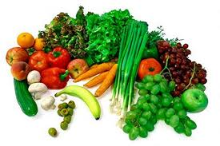
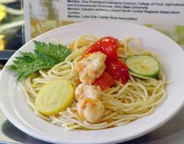
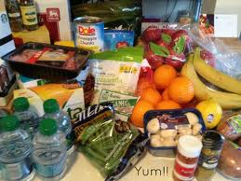
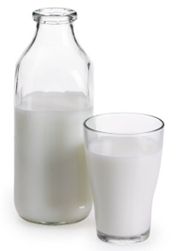
Food Safety Applications
Bernice Karlton-Senaye
North Carolina A & T State university
Food Safety Workshop
St. Pius Catholic School
Dec 12th, 2012

Slide 2

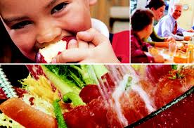
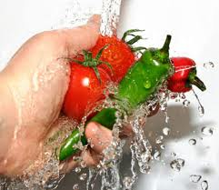
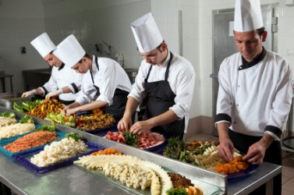
Overview
Introduction
  Factors affecting microbial growth
  How food become unsafe
  Key practices for ensuring food safety
Conclusion

Slide 3
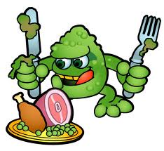
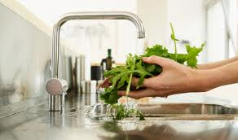
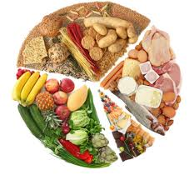

Introduction
Food safety is a scientific discipline describing handling, preparation, and storage of food in ways that prevent foodborne illness.
Several foods are recalled as a result of microbial contamination.
Food safety cannot be compromised!!!!!
Every year 5000 loss in human lives, 325,000 hospitalization and ~152 billion loss in revenue.

Slide 4
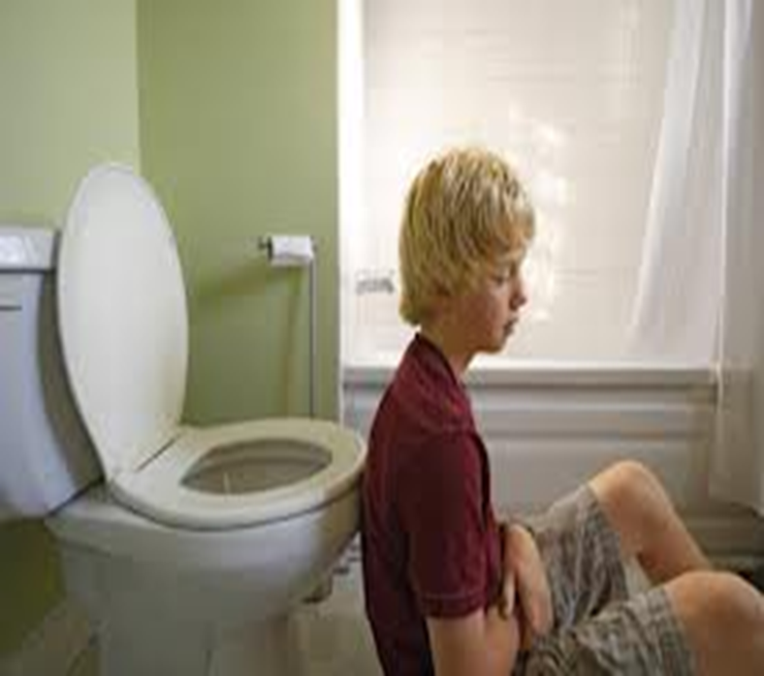

A
B

Slide 5
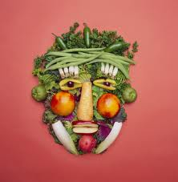
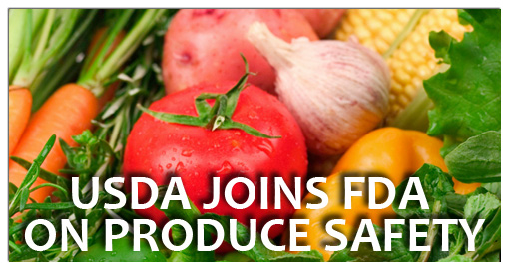

Factors affecting microbial growth
F = food
A = acidity
T= time
T = temperature
O = oxygen
M = moisture

Slide 6
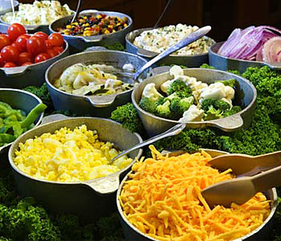
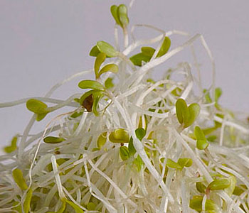
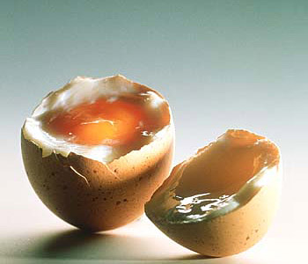
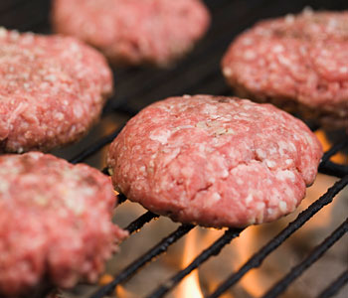
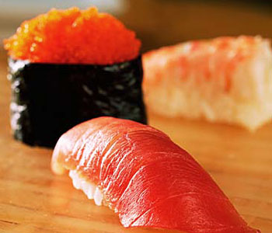
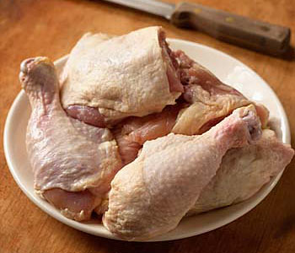

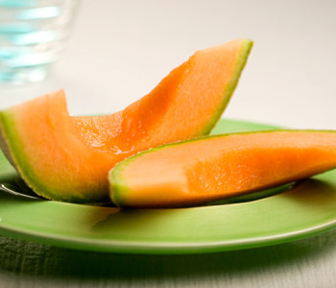
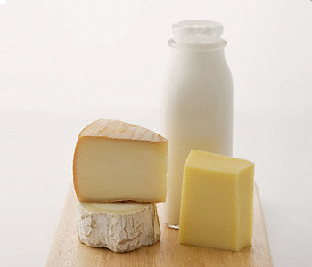
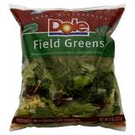
Food
Microorganisms growth best in moist protein-rich foods.
Potentially hazardous foods (PHF)-Moist protein-rich foods.
eg:(FEMM).
fish
eggs
meat,
milk,

Slide 7
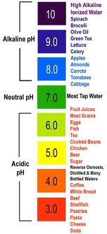
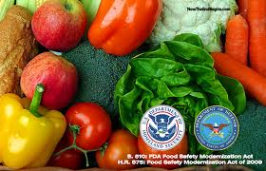
Acidity
pH is the degree of acidity
or alkalinity of a substance.
pH of 7.0 =neutral
pH<7.0 = acidic
pH >7.0=alkaline.
Safer food –pH <4.6.
6.6 and 7.5 Optimum pH for
bacteria growth.

Slide 8
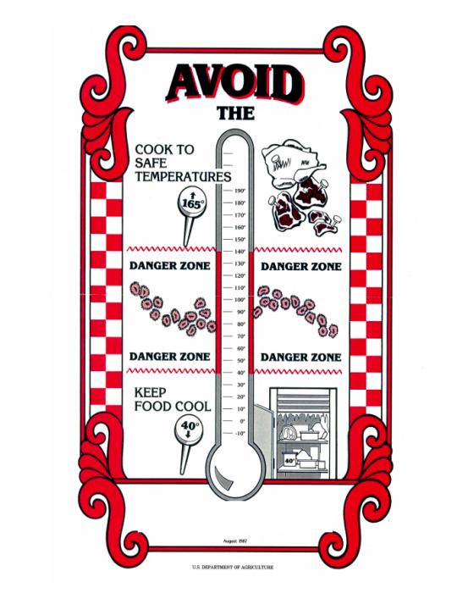
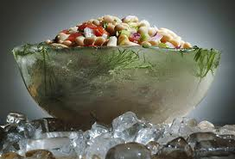
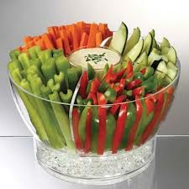
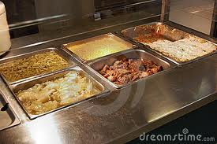
Temperature
Microorganisms thrives best around room temperature.
Keep food out of the danger zone- 40°-140° F.
Precaution: Keep cold food cold and warm food warm.

Slide 9
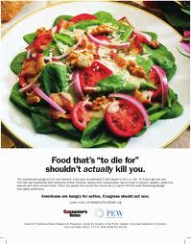
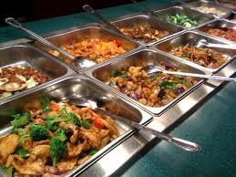
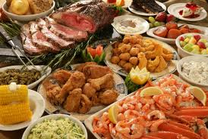
Time
Bacteria grow and multiply in a warm, moist environment with time. Growth doubles every 20 min.
PHF in the Danger Zone for long period of time promotes growth and multiplication of pathogens.
Precaution: Do not keep food in the danger zone for 4 hours!! Foods in the DANGER ZONE ≤ 2h

Slide 10
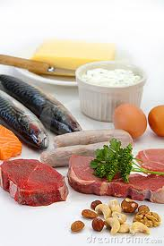
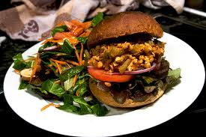
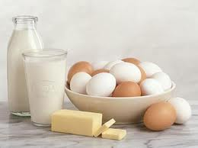
Oxygen
Aerobic bacteria = oxygen (air).
Anaerobic bacteria=grow in the absence of oxygen.
Most pathogens -Facultative microorganisms grow with or without oxygen.
Precaution: Potentially hazardous food exposed to air increase bacterial growth.

Slide 11
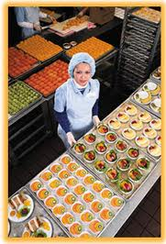
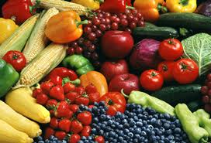

Moisture
Moisture content of food=Water activity, A_{W.} (0 -1).
Microorganisms grow best in moist foods (A_{W} =0.91-0.99). eg: meat (FEMM), vegetables and soft cheeses.
A_{W} ≤ 0.85 will not support the growth of pathogens.
Safer foods have less moisture. Eg: Dry foods such as crackers, cereal etc.

Slide 12

Q & A Time
What factors affect microbial growth?
Which of these food is not a PHF? Why?
    Meat
    Egg
    Cereal
    Yogurt
    Fish
    milk.

Slide 13
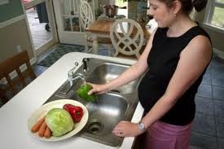
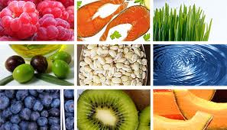
How food become unsafe
Key safety practices
  Time-Temperature abuse
  Cross-contamination
  Poor personal hygiene
Time-Temperature abuse
  Failing to hold, store or thaw food at required temperature.
  Failing to properly cool foods.
  Failing to cook or reheat foods to temperatures that kill microorganisms.

Slide 14
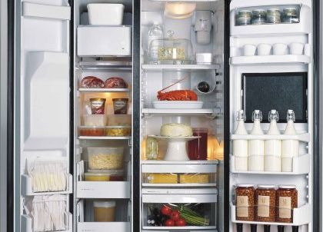
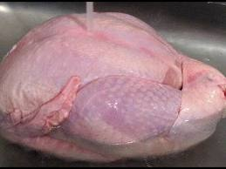
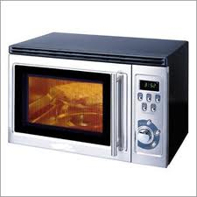
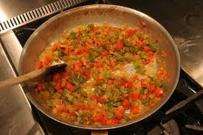
Thawing foods safely
Food can be thawed in:
  The refrigerator at 41 F or less.
  Running potable water at 70 F.
  Microwave oven
  As part of cooking

Slide 15
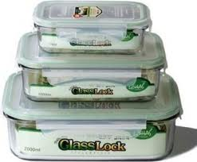
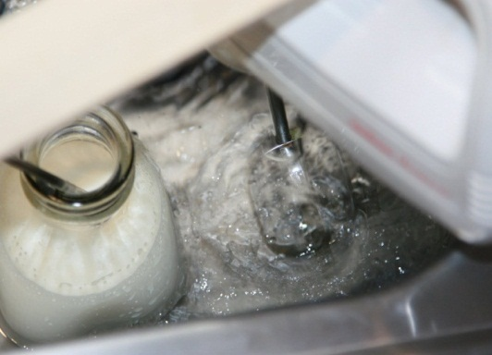
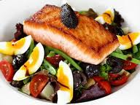
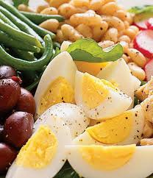
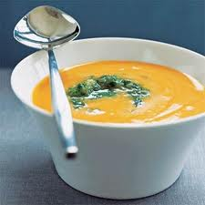
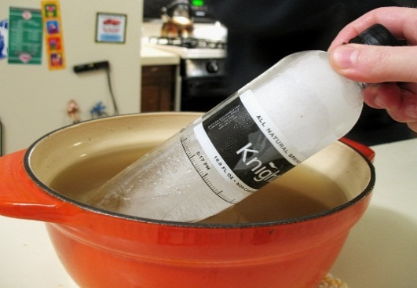
Cooling foods safely
Store hot food in smaller quantities.
Use ice to bring food temperatures down quickly
Stir food with cold paddles.

Slide 16
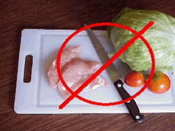
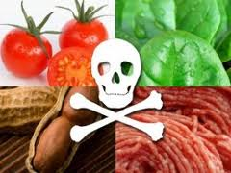
Cross-contamination and prevention
    Keep Kitchen towel clean.
  Do not touch contaminated (usually raw) food and then touch cooked or ready-to-eat food.
  Use separate cutting board for raw and ready-to-eat foods.

Slide 17


PREVENTING CROSS-CONTAMINATION
  Do not allow raw food to touch or drip fluids onto cooked or ready-to-eat food.

Slide 18




Poor Personal Hygiene
Failure to properly wash hands after using restroom.
Coughing or sneezing on food.
Touching or scratching sores, cuts, or boils and then touch food.

Slide 19

Fight germs through proper handwashing
Wet hands.
Lather and scrub hands for 20 sec.
Rinse for 10 sec.
Close tap with towel, NOT with washed hand!!
Dry with towel.
weltschmertzed.blogspot.com

Slide 20

Q & A time
What are the key practices for ensuring food safety.

Slide 21




Conclusion

Slide 22

A
B

Slide 23




