Slide 1
Contaminants in Foods
Rabin Gyawali
NCA&T State University

Slide 2
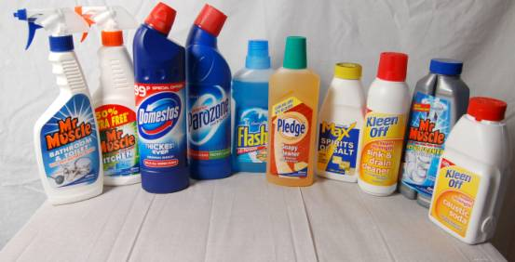
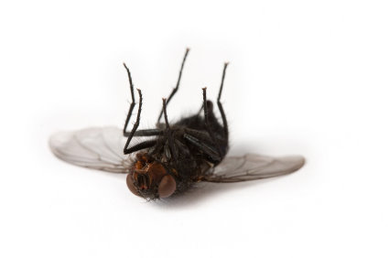
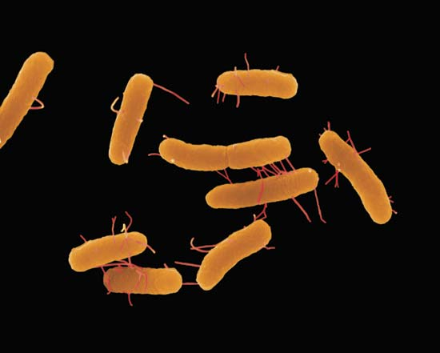
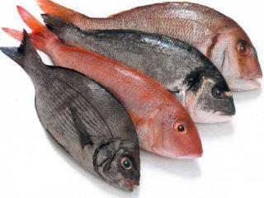
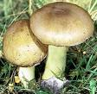
Types of contamination
Foreign matter
Chemicals
Organisms
Natural toxin

Slide 3
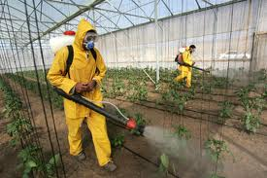
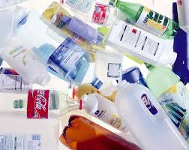

Chemicals contaminants
Pesticides and fertilizer
Sanitizers
Antibiotics and hormones
• Food additives
Other chemicals in plastics and
kitchenware

Slide 4
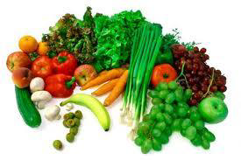
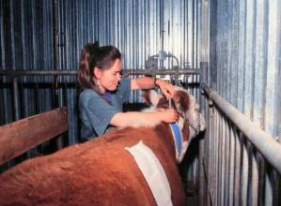
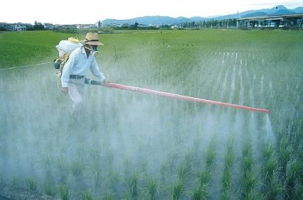
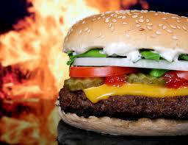
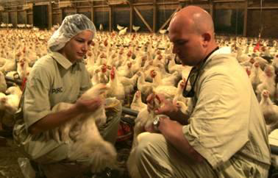

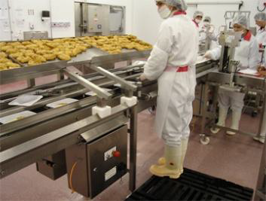
From where it comes ?
Pesticides and fertilizer
Treatment/prevention of disease
Processing and preparation

Slide 5
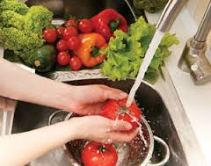
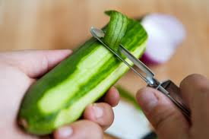
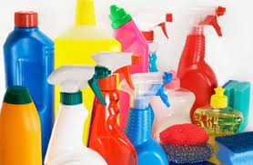
How to prevent contamination ?
Always read the safety direction
Chemicals should not be stored near food
Always labeled clearly
Washing, peeling, organic foods

Slide 6
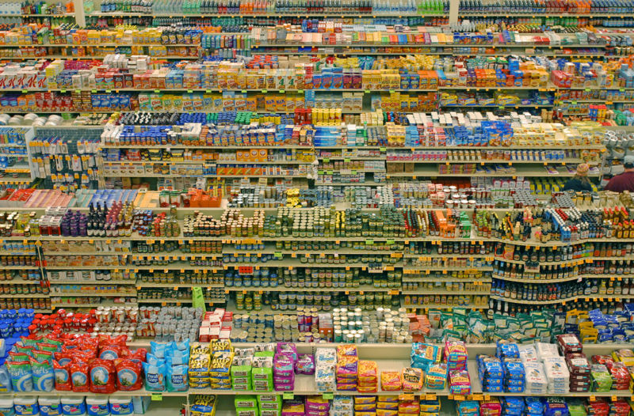

Food ingredients and chemicals
Food labels tell a lot about food
Chemicals in foods
Compare one food with another
Labels can help you make your choices

Slide 7
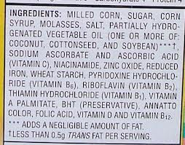
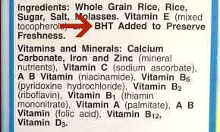
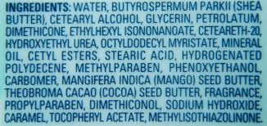
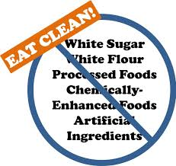
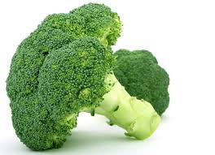
Chemicals in food
Chemicals in food
How about this ?
Chemicals in food

Slide 8
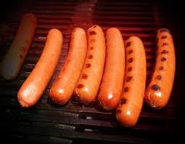
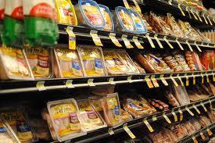
Sodium nitrates and sodium nitrites
Preservatives are found in processed meats like bacon, lunch meat, and hot dogs.
Health hazards: cancer and diabetes
Sodium nitrites Nitrosamines

Slide 9
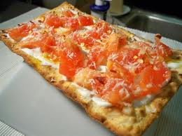
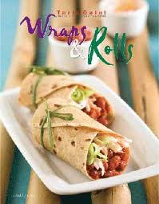
Potasium bromate (brominated flour)
Health hazards: kidney and nervous system disorders

Slide 10
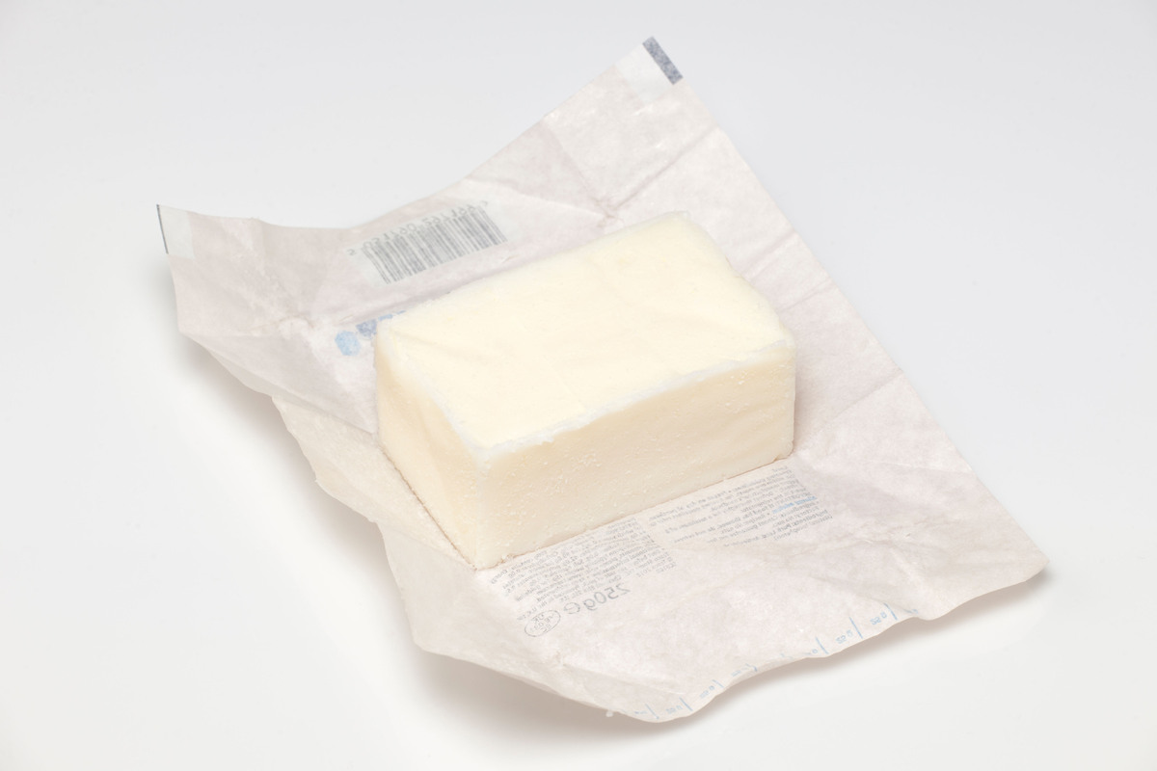
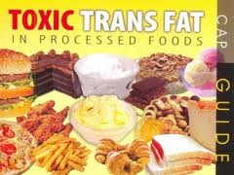
Trans fats
Enhancing the flavor, texture, and shelf life of many processed foods
Cause heart disease, and cancer

Slide 11
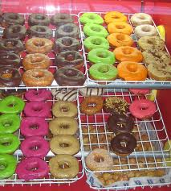
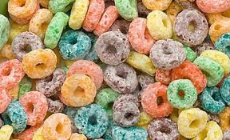
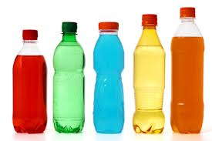
Artificial colors and sweeteners
Blue 1, Blue 2, Yellow 5, & Yellow 6
Health hazards: Thyroid, adrenal, bladder, kidney, and brain cancers.

Slide 12
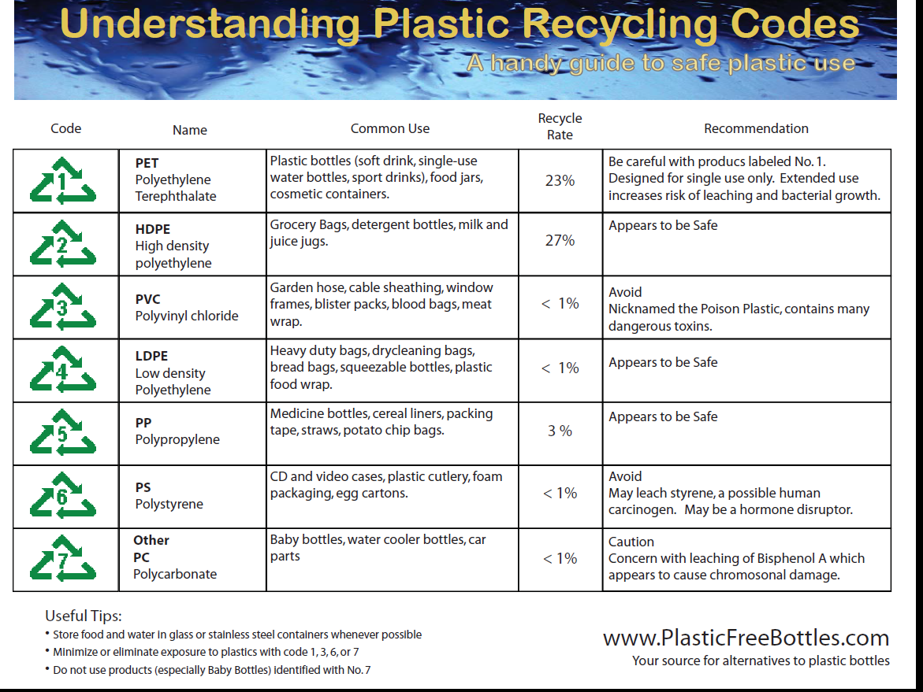
Know your plastic containers !!
Number 2, 4, & 5 appears to be safe

Slide 13
Which of the following is considered the least harmful ?
Saturated fats
Cholesterol
Unsaturated fats
Trans fats

Slide 14
What to avoid on the labels?
Sugar
Sucrose
High fructose corn syrup
Enriched bleached flour
All of the above

Slide 15

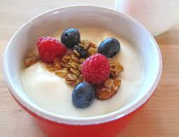
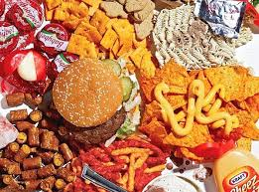
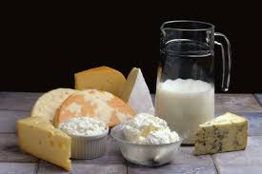
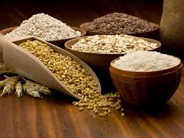
Which one is a healthier choice ?
Group A
Group B

Slide 16
Thank You !

