Slide 1
FRBR meets D
A
Understanding the Relationship Between FRBR and RDA
Jean M. Pajerek
Head of Information Management
Cornell Law Library
May 24, 2011

Slide 2
RDA is written in “FRBR-ese”
FRBR gives us a vocabulary and concepts with which to think about bibliographic entities, attributes, and relationships. FRBR also defines the “user tasks” that our bibliographic data must support.
Notes:
RDA is organized around the FRBR concepts of entities, attributes, and relationships. It also explicitly addresses the user tasks outlined in FRBR.

Slide 3
WEMI = Group 1 Entities
Let’s recap
Work—a distinct intellectual or artistic creation (i.e., the intellectual or artistic content)
Expression—the intellectual or artistic realization of a work in the form of alpha-numeric, musical or choreographic notation, sound, image, object, movement, etc., or any combination of such forms
----------------------------------------------------------------------------------
Manifestation—the physical embodiment of an expression of a work
Item—a single exemplar or instance of a manifestation
Abstract; has to do with content
Concrete; has to do with carrier
Notes:
Work, Expression, Manifestation, and Item are also referred to as Group 1 entities.

Slide 4
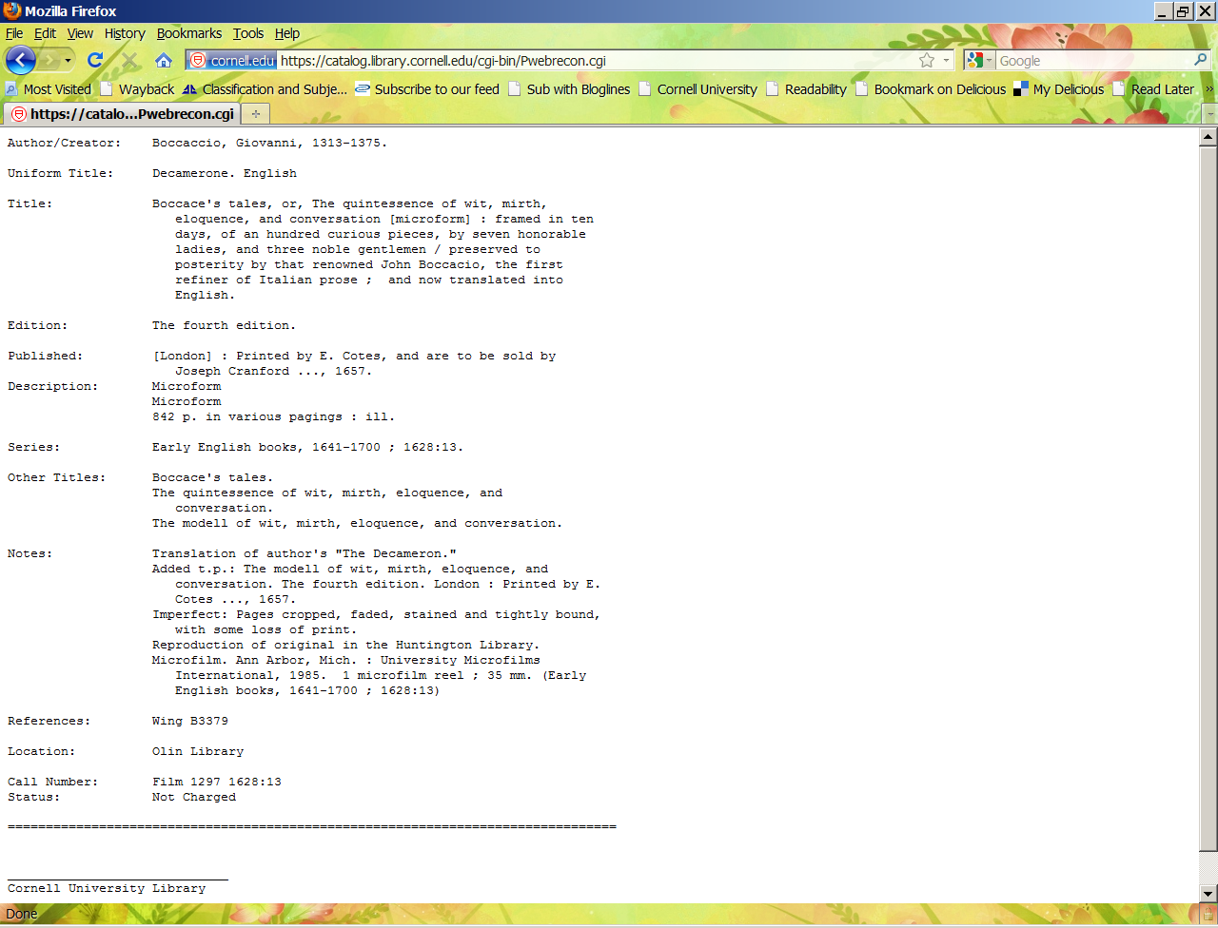
Notes:
FRBR gives us a new conceptual framework and vocabulary for understanding the bibliographic universe, but it doesn’t mean that the bibliographic universe will suddenly change the day we implement RDA. Pre-RDA bibliographic records include FRBR entities, attributes, and relationships. Let’s look at this pre-RDA record through the lens of RDA.

Slide 5

“Preferred title” of the WORK
Notes:
The idea of “Work” is partially analogous to what we are used to thinking of as the uniform title.

Slide 6
Language of the EXPRESSION
Work
Expression
Notes:
Language is an attribute of the Expression.

Slide 7
Manifestation
Item
Item
Notes:
Attributes of the Manifestation include the title of the Manifestation, statement of responsibility, edition designation, publisher, and many of the other elements of bibliographic description that we are familiar with. The vocabulary is new, but the FRBR concepts are ideas we are familiar with. Current catalog records concatenate attributes of entities at different levels within a single bibliographic record.

Slide 8
FRBR User Tasks
Find
Identify
Select
Obtain
Notes:
Hopefully, we are all beginning to get a handle on WEMI, also collectively referred to as “Group 1 entities.” Tracey’s FRBR presentation last month focused on entities, attributes, and relationships, but FRBR and RDA both incorporate the concept of four user tasks: find, identify, select, and obtain (sometimes referred to as “FISO”). RDA very deliberately incorporates the concept of the user tasks, in order to help us as catalogers to focus on why we are recording each data element. FRBR and RDA attempt to address the functions, or tasks, that the data elements need to support. Let’s look at the Group 1 entities in the context of the four user tasks.

Slide 9
Let’s start at the very beginning ... RDA section 0.0
The data created using RDA to describe a resource are designed to assist users in performing the following tasks:
Find—i.e., to find resources that correspond to the user’s stated search criteria – for example:
Find all resources associated with a particular person, family, or corporate body
Find all resources on a given subject
Notes:
Let’s say you want to find all the works by Mark Twain in the library. The success of such a search in the catalog depends upon the catalogers having brought together the appropriate data elements in the bibliographic records. For this particular user task, author and title are most important.

Slide 10
Identify—i.e., to confirm that the resource described corresponds to the resource sought, or to distinguish between two or more resources with similar characteristics – for example:
I’m looking for an English translation of a novel originally written in French.
Notes:
I want to read Flaubert’s Madame Bovary, but since I don’t read French, it has to be an English translation. In this instance, the I need information at both the Work level and the Expression level.

Slide 11
Select—i.e., to select a resource that is appropriate to the user’s needs – for example:
Select a resource that is appropriate to the user’s requirements with respect to the physical characteristics of the carrier and the formatting and encoding of information stored on the carrier, such as a large print edition of a printed text.
Notes:
If possible, I would like my English translation of Madame Bovary to be a large print edition. I definitely don’t want it in microform! This information is associated with the Manifestation. As another example, let’s say I’m looking for a movie version of Madam Bovary, also in English, and it has to be on DVD, not Blu-ray, because I don’t have the right equipment to play Blu-rays.

Slide 12
Obtain—i.e., to acquire or access the resource described – for example:
Access a resource electronically through an online connection to a remote computer
Check a book out of a library
Notes:
The “obtain” function often relies on item-level information. If the resource I need is a physical item on a shelf, I need the local call number to be able to locate and “obtain” it. Terms of availability (such as price) and restrictions on access are also elements associated with the “obtain” function (cf. RDA chapter 4). What we’re seeing is that the various user tasks are associated with different Group 1 entities.

Slide 13
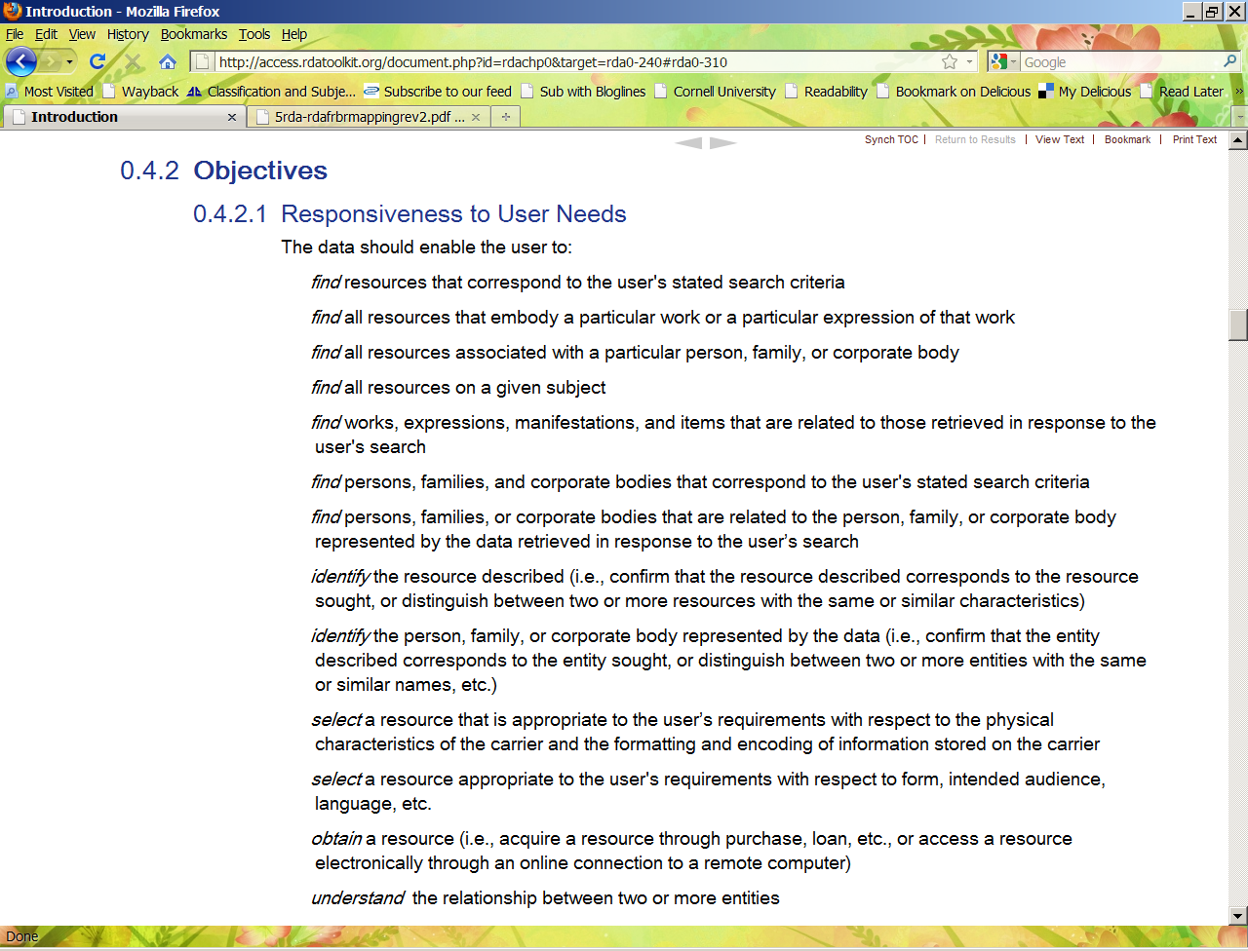
Notes:
In section 0.4.2, we see the stated objectives of RDA, which are: Responsiveness to user needs, cost efficiency, flexibility, and continuity. In section 0.4.2.1, the first objective (responsiveness to user needs) is elaborated, using the FISO vocabulary. The bibliographic data we record should support user needs.

Slide 14
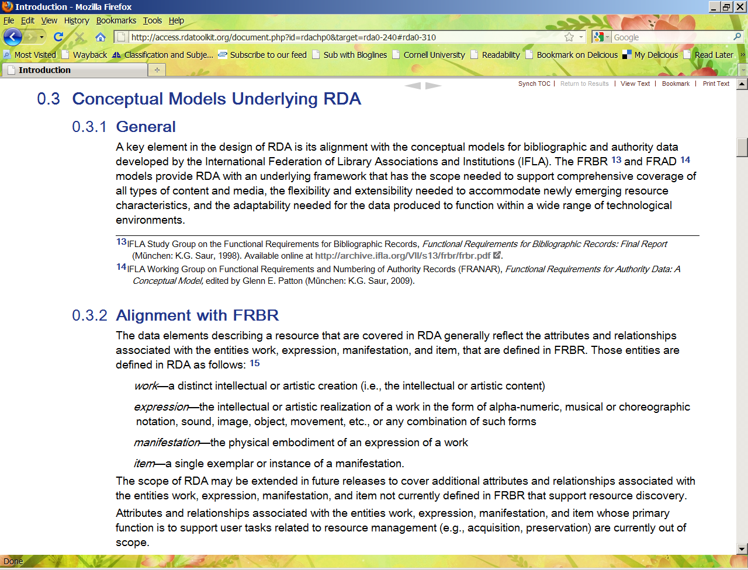
It’s our old friends, WEMI!
Notes:
Look, it’s our old friends WEMI! It’s like seeing a familiar face in a place you’ve never been before!
RDA tells us right up front in section 0.3 that RDA is designed to be in alignment with FRBR and FRAD (Functional Requirements for Authority Data). “The data elements describing a resource that are covered in RDA generally reflect the attributes and relationships associated with the entities work, expression, manifestation, and item, that are defined in FRBR.”

Slide 15
FRBR introduced us to the concepts of entities, attributes, and relationships
Group 1 entities
Group 2 entities
Attributes
Date of birth
Work
Person
Expression
Date of Publication
Family
Manifestation
Language
Corporate Body
Item
Place of publication
Notes:
Relationships are very, very important in RDA. Looking at this diagram, it’s not hard to think of relationships between these entities and attributes, and entity-to-entity relationships as well. A work has a creator or creators, most often a person or persons. Date of birth is an attribute associated with persons. A published manifestation has a place of publication, and a publisher is most often a corporate body. A published manifestation has a date of publication associated with it. Language is an attribute of expression. An item might have been created by or owned by a family, or an individual, or a corporate body. A person is a member of a family and a family has persons as its members. A person can have a relationship with a corporate body, such as being its founder or CEO. The list of attributes we see here is very small. Imagine all the relationships we could think of if we had a more complete list! Also, we are not even considering the Group 3 entities as this point. Recall that Group 3 entities have to do with subjects.

Slide 16
The Structure of RDA
Broadly speaking, the text of RDA is divided into sections devoted to the recording of attributes of bibliographic entities, and sections devoted to the recording of relationships between entities.
Notes:
In simplified terms, RDA is about describing entities, their attributes, and the relationships among all of them. There are 10 sections in RDA. The first four sections of RDA are devoted to recording attributes; the remaining six sections are devoted to recording different kinds of bibliographic relationships. Each section begins with a chapter on general guidelines, a definition of the scope of the chapter, and explanations of the terminology used in the section.

Slide 17
The first four sections (chapters 1-16) of RDA are devoted to the recording of attributes of bibliographic entities:
Attributes of Manifestation and Item
(chapters 1-4)
2. Attributes of Work and Expression
(chapters 5-7)
3. Attributes of Person, Family, and Corporate Body
(chapters 8-11) - Group 2 entities
4. Attributes of Concept, Object, Event, and Place – Group 3 entities (chapters 12-16, but 12-15 have not yet been developed)
Group 1 entities
Notes:
Chapters 1-7 cover the recording of attributes of the Group 1 entities. Chapters 8-11 are devoted to recording the attributes of Group 2 entities. Section 4 covers attributes of Group 3 entities, but only chapter 16, having to do with identifying places, has been developed.

Slide 18
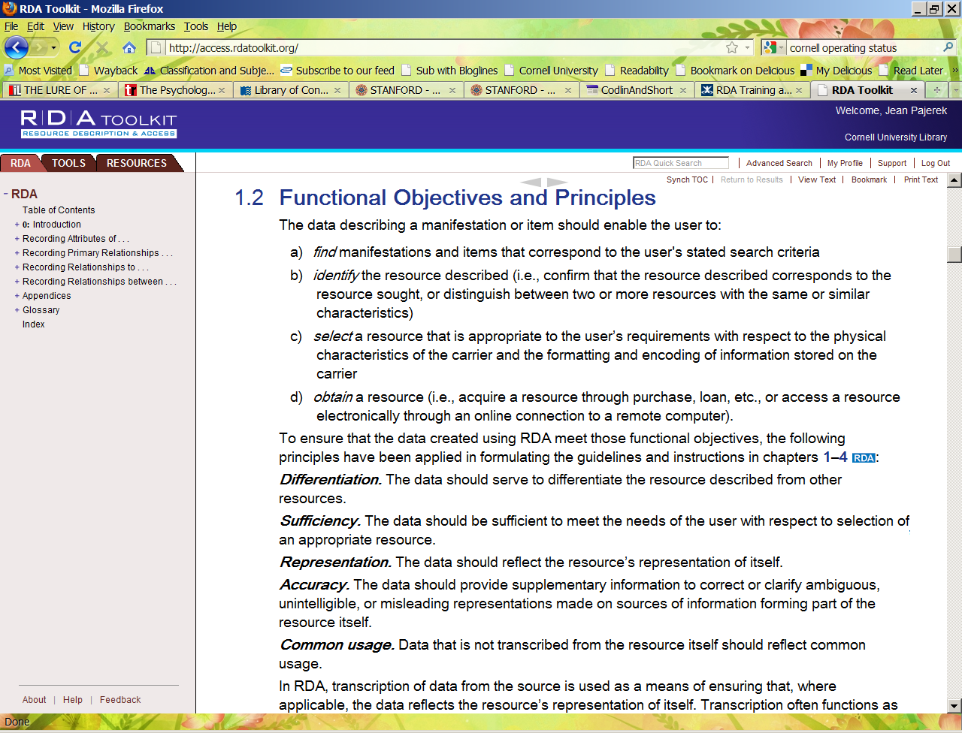
We are reminded of the four user tasks
Notes:
The Functional Objectives and Principles listed at the beginning of chapter 1 refer to the four user tasks.

Slide 19
Examples of associated FRBR tasks
Section 1: Recording attributes of manifestation & item
Chapter 1: General guidelines
Chapter 2: Identifying manifestations and items
FRBR task = Identify
Chapter 3: Describing carriers
FRBR task = Select
Chapter 4: Providing acquisition and access information
FRBR task = Obtain
Source: Chris Oliver (June 2008)

Slide 20
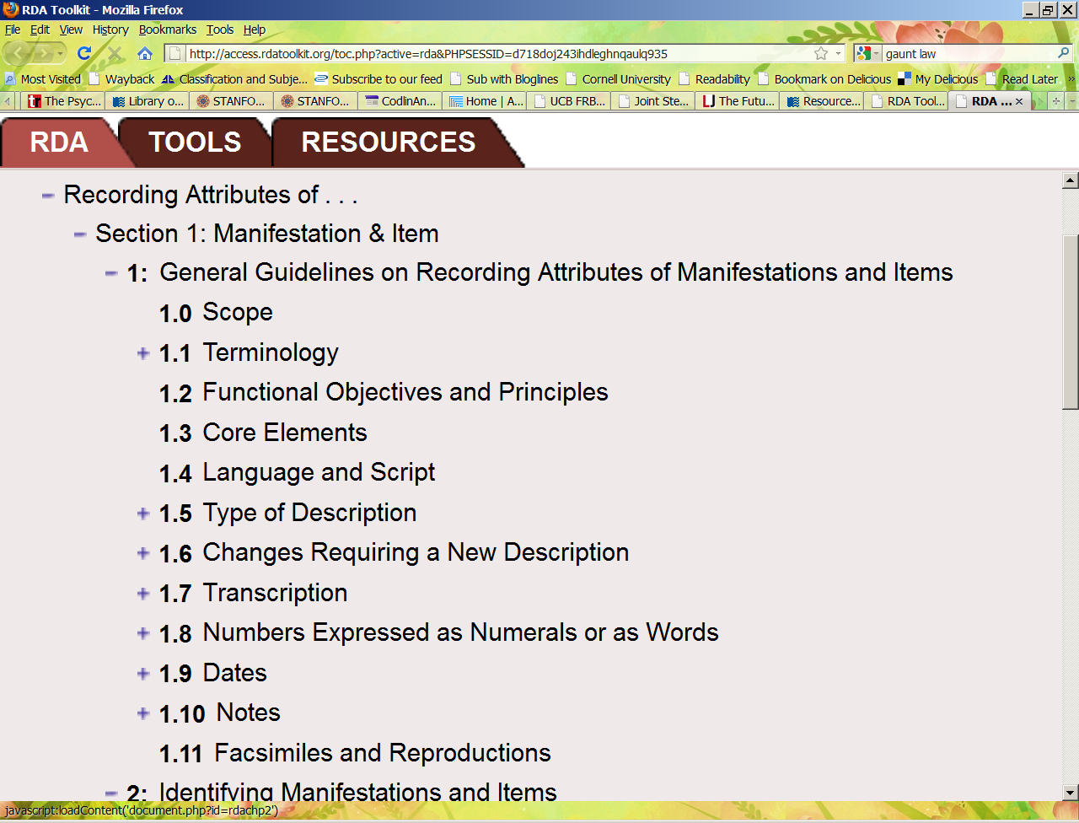
Notes:
Among many other things, Chapter 1 outlines the core elements (1.3) used to describe manifestations and items. As the word “core” suggests, core elements are the minimum data elements needed to fulfill the four user tasks. These elements include familiar pieces of information such as title, statement of responsibility, edition statement and series statement.

Slide 21
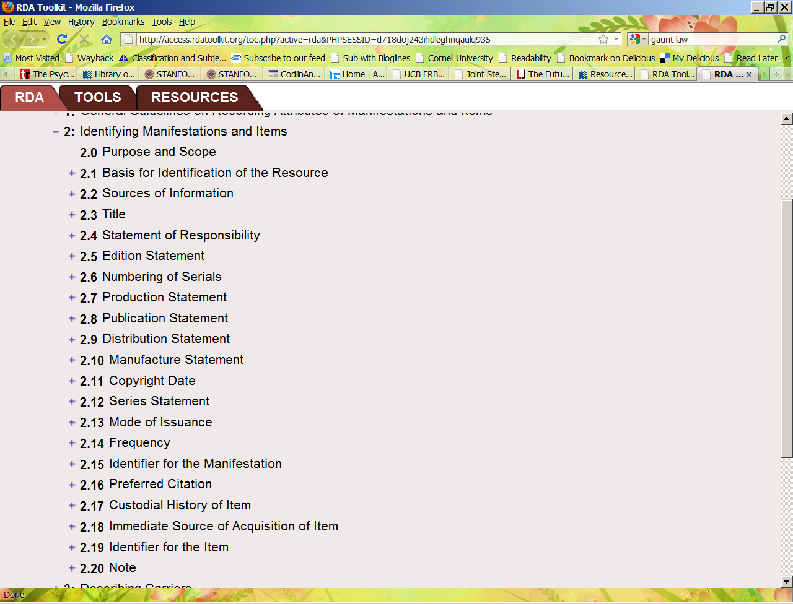
Notes:
Chapter 2 deals with identifying manifestations and items. “This chapter provides general guidelines and instructions on recording the attributes of manifestations and items that are most often used for purposes of identifying a resource.” Remember that “Identify” is one of the four user tasks.

Slide 22
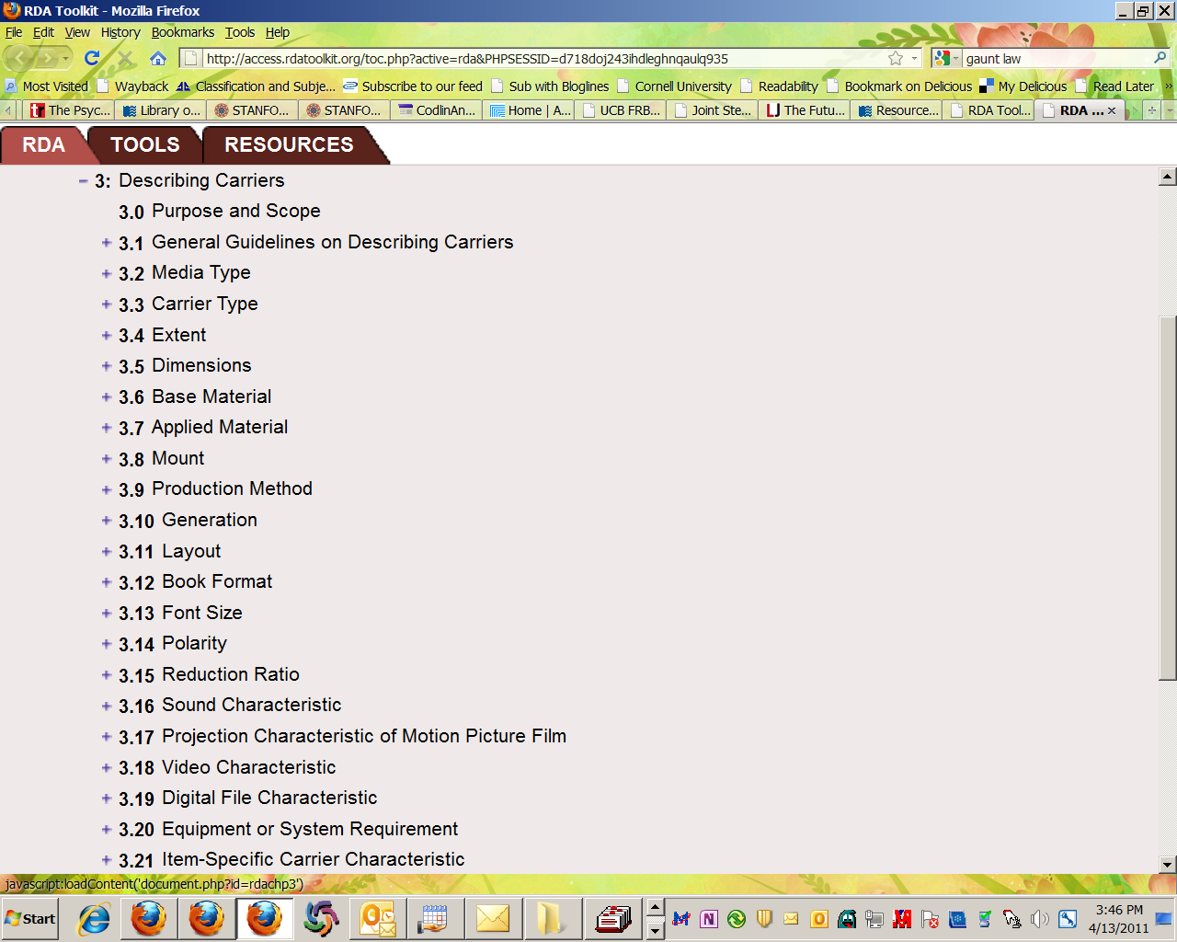
Chapter 3 covers what we used to call “physical description” of the resource. The description of the carrier is often associated with the Select user task.
Notes:
Chapter 3 covers elements that describe the characteristics of the carrier of the resource, what we are used to thinking of as the physical description of the resource. These elements convey information that users typically rely on when selecting a resource to meet their needs with respect to the physical characteristics of the carrier and the formatting and encoding of the information contained in or stored on the carrier. Users may also rely on characteristics of the carrier in order to identify a resource (i.e., to distinguish between resources with similar characteristics).

Slide 23
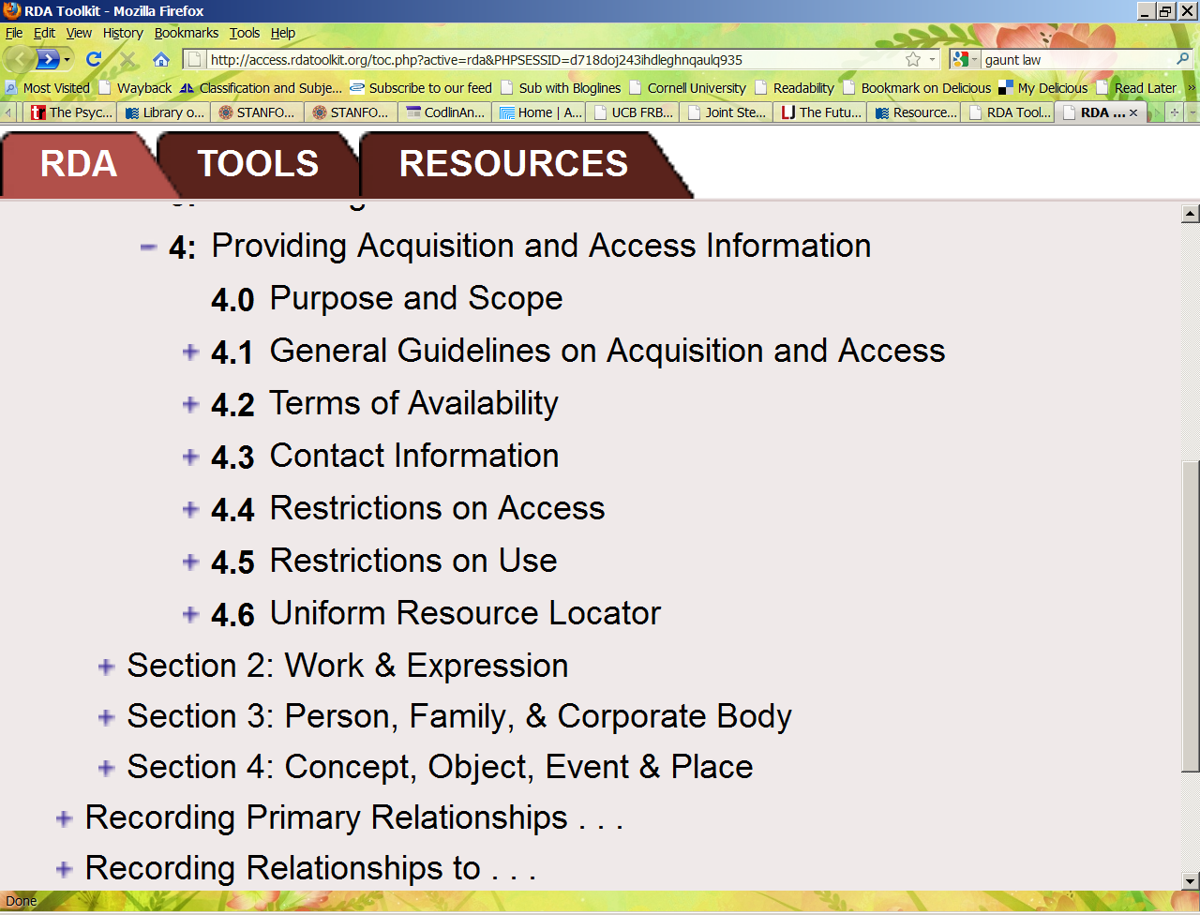
Notes:
Chapter 4: the elements covered include those used to obtain or access a resource—terms of availability, contact information, restrictions on access, etc. Restrictions on access, for example, might be indicated in a note on a record for an electronic resource that says “Access restricted to subscribers.” A URL is an example of information provided for access to a resource.

Slide 24
Section 2 (chapters 5-7): Recording attributes of work and expression
Chapter 5: General guidelines on recording attributes of works and expressions
Chapter 6: Identifying works and expressions
Chapter 7: Describing content

Slide 25
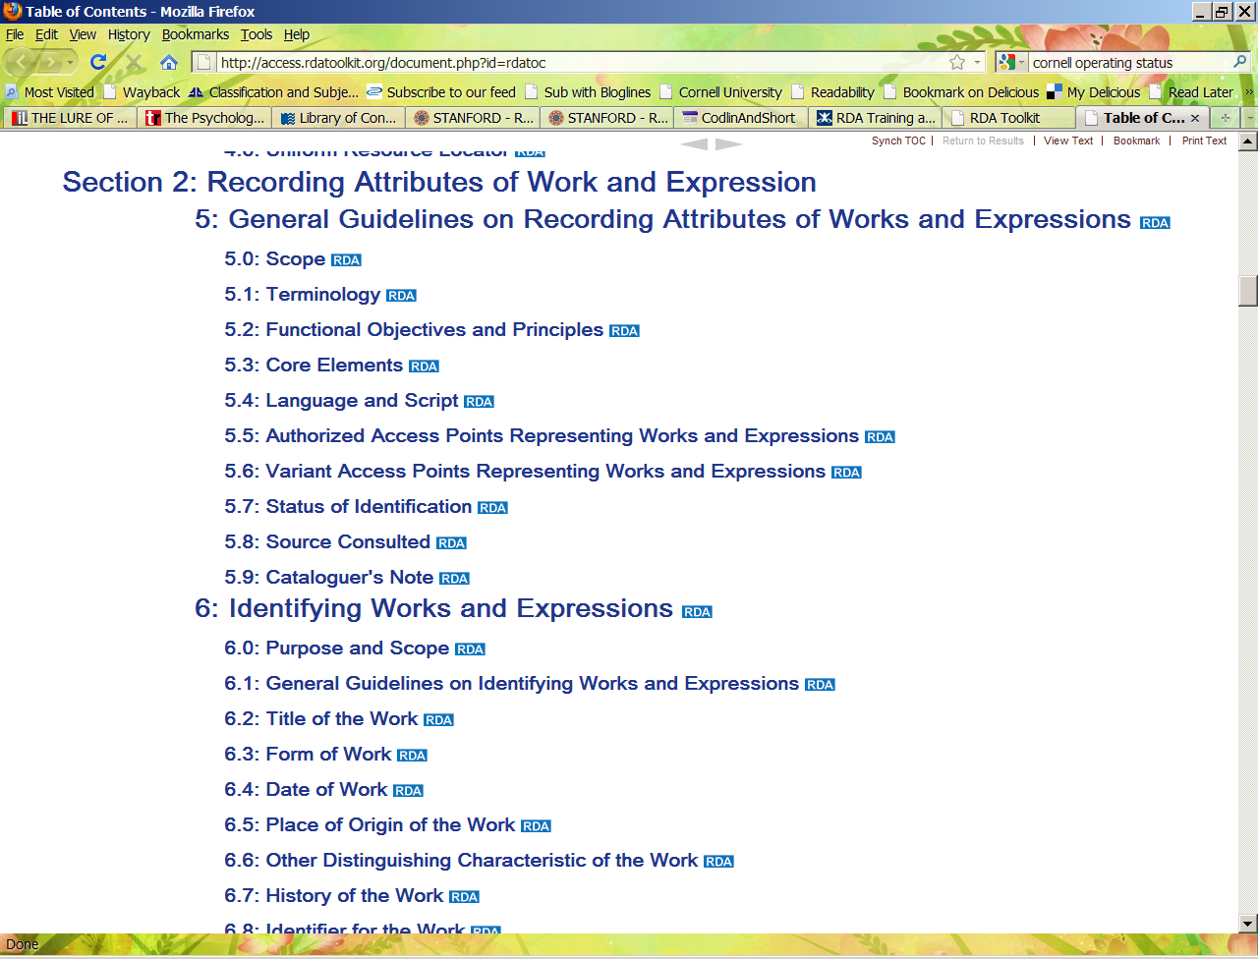
Notes:
This is the table of contents for chapter 5. Chapter 5 talks about information to be included in authority records for works and expressions. Notice that RDA uses the phrase “access point” instead of “heading.”

Slide 26
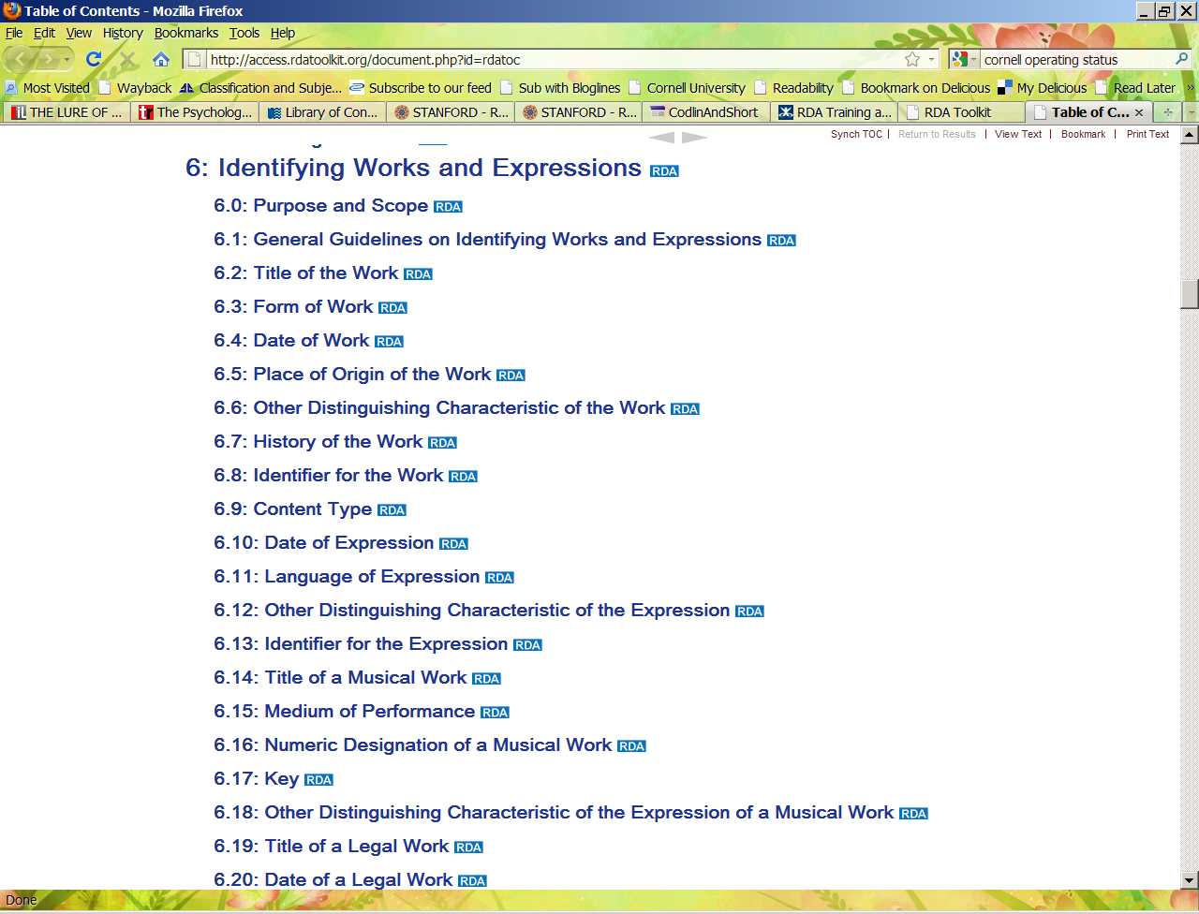
The title of a work is similar to a uniform title.
Notes:
Partial table of contents for chapter 6, Identifying works and expressions. Chapter 6 contains information on “choosing the preferred title” (6.2.2.3), what in AACR2 we referred to as the uniform title. It also talks about “changes affecting the identification of a work,” such as a title change to a serial (6.1.3.2).

Slide 27
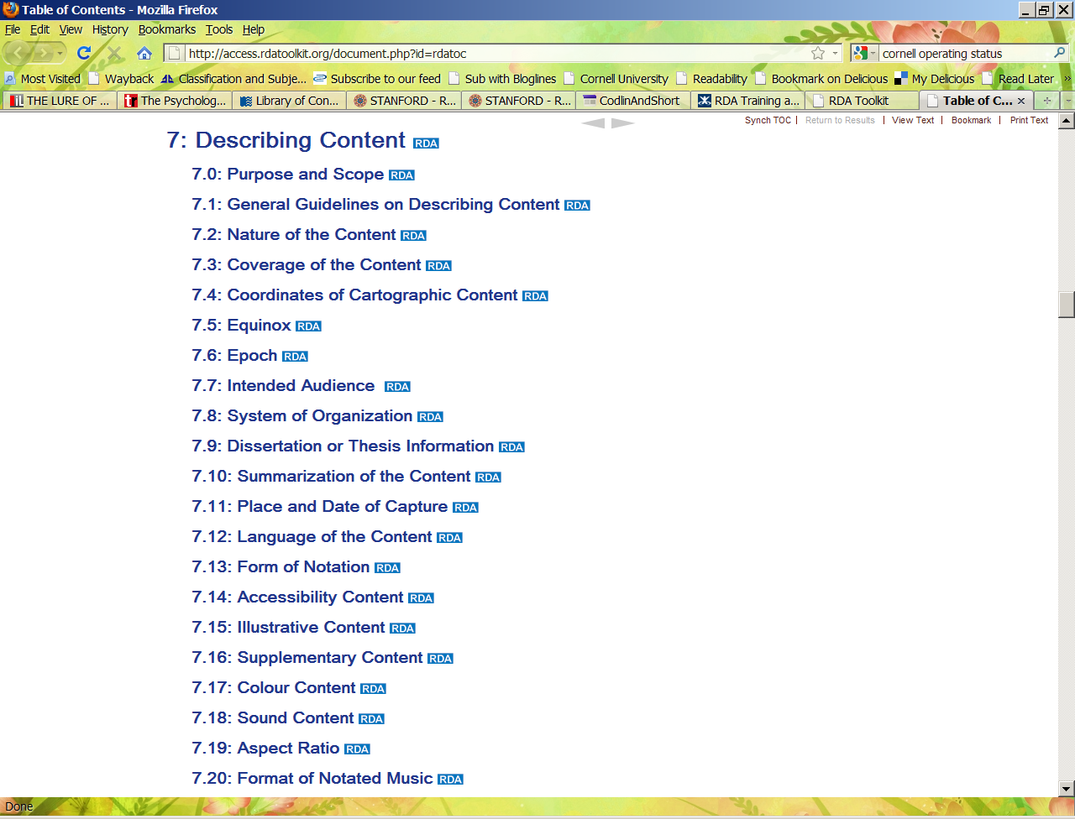
Notes:
Partial table of contents for chapter 7, Describing content. Chapter 7 contains a lot of information about describing cartographic content. It also has a section about recording thesis or dissertation information, among other kinds of content.

Slide 28
Examples of Group 2 entities and user tasks
Section 3 (chapters 8-11):
Recording attributes of person, family and corporate body
Chapter 8: General guidelines
Chapter 9: Identifying persons
FRBR task = Identify
Chapter 10: Identifying families
FRBR task = Identify
Chapter 11: Identifying corporate bodies
FRBR task = Identify
Source: Chris Oliver (June 2008)
Notes:
The instructions in section three refer to recording attributes of Group 2 entities – persons, families, and corporate bodies. Many of the instructions apply to the construction of authority records, as well as access points representing group 2 entities. RDA allows for the recording of much more, and more detailed, information in authority records than we are used to seeing. Gender, language, and profession or occupation, and place of residence are some of the data elements that you may find recorded in RDA authority records.

Slide 29
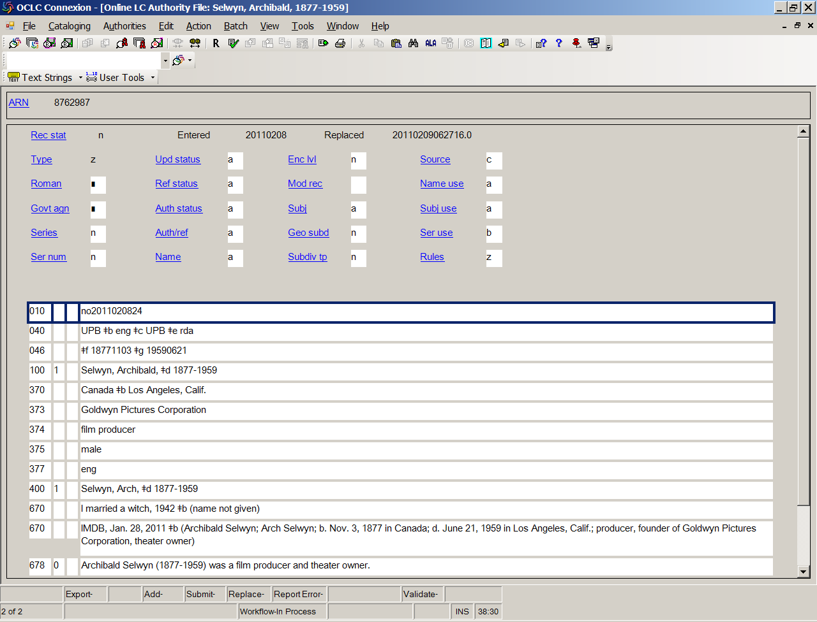
We are not used to seeing this type of information in authority records.
Notes:
Notice the information in the 37x fields. These new fields have been valid in MARC since October 2009. This is quite a bit more information than we are used to seeing in authority records. It’s kind of like we’re cataloging the person! In a later example, we’ll see that authority records can be used for recording relationships between separate Group 2 entities as well as attributes.

Slide 30
The next six sections (chapters 17-37) of RDA are devoted to the recording of relationships between entities:
5. Relationships between Work, Expression, Manifestation, & Item (also referred to as
“Primary relationships”) (chapter 17)
Relationships to Persons, Families, and Corporate Bodies associated with a resource
(chapters 18-22)
7. Subject Relationships (chapter 23; not yet developed)
Relationships between Works, Expressions, Manifestations, and Items
(chapters 24-28)
9. Relationships between Persons, Families, and Corporate Bodies
(chapters 29-32)
Relationships between Concepts, Objects, Events, and Places (chapters 33-37 ; section 10
has not yet been developed)
Notes:
Relationships are very, very important in RDA and great emphasis is placed on identifying and recording these relationships. Relationships are important in RDA because of the role they play in helping fulfill the user tasks. We only have to worry about four of these six sections right now, because two of them (sections 7 and 10) have not been developed yet; these are the sections dealing with subjects. Something to keep in mind is that some of the relationships described in these chapters are expressed in authority records, rather than bibliographic records.

Slide 31
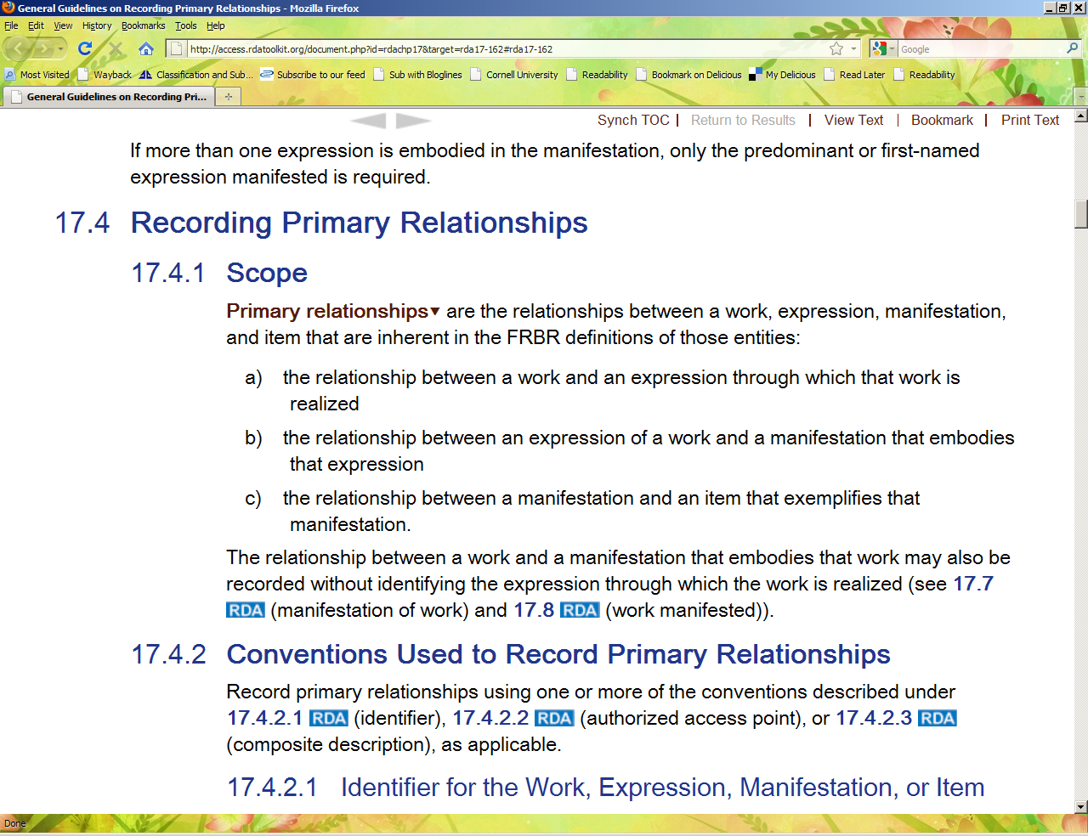
Notes:
Section 5, chapter 17 – note the definition of “Primary Relationships.” The definition is not comprehensible unless you have a firm grasp of the WEMI entities.

Slide 32
Section 5 (Chapter 17)
Relationships between Work, Expression, Manifestation, & Item (also referred to as “Primary relationships”)
These are relationships such as the relationship between:
The Work known as Pride and Prejudice and the Expression that is a German translation of that work: Stolz und Vorurteil
The 1939 motion picture The Wizard of Oz (a Work) on DVD (a Manifestation of the Work)
The 1933 Limited Editions Club Manifestation of The adventures of Huckleberry Finn , and CUL’s copy, which is signed by Carl P. Rollins (Item)
Notes:
These kinds of relationships, which should be becoming familiar to you, are referred to as “primary relationships” in RDA.

Slide 33
Different ways of expressing a primary relationship
Authorized access point:
100 $a Brown, Dan, $d 1964-
240 $a Digital fortress. $l French
245 $a Forteresse digitale.
700 $i Translation of $a Brown, Dan, $d 1964- $t Digital fortress.
Structured description:
100 $a Brown, Dan, $d 1964-
240 $a Digital fortress. $l French
245$a Forteresse digitale.
500 $a Translation of: Digital fortress / Dan Brown. --1st ed.--New York : St. Martin’s Press,
1998. --371 pages ; 22 cm
Source: Barbara Tillett (Jan. 2010)
Notice the relationship designator in subfield i of the 700 field.
Notes:
These examples show two different ways of recording a primary relationship between Dan Brown’s Digital fortress and its French translation: authorized access point (RDA 17.4.2.2) and structured description (RDA 17.4.2.3). Note that the structured description provides quite a bit of information related to a specific manifestation of Digital fortress, while the authorized access point refers to the authorized access point for the original work. Both of these approaches are allowed in RDA, but keep in mind that in many, if not most cases, we as catalogers have no idea which manifestation a translation is based on.

Slide 34
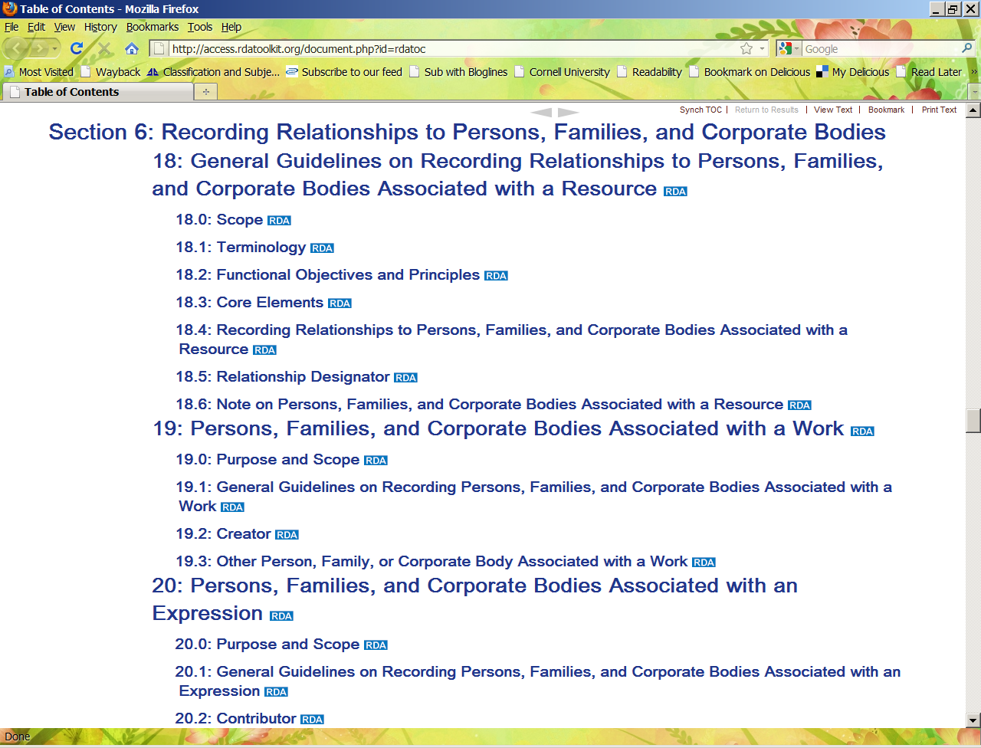
Creator is the most significant Group 2 entity associated with a Work.
Notes:
This shows part of the RDA table of contents for section 6, Recording Relationships to Persons, Families, and Corporate Bodies. Looking at chapter 19, we see that the person, family, or corporate body most commonly associated with a work is its creator.

Slide 35
Section 6 (chapters 18-22): Relationships to Persons, Families, and Corporate Bodies associated with a resource
100 $a Lindgren, Astrid, $d 1907-2002.
240 $a Pippi Långstrump. $l English
245 $a Pippi Longstocking / $c Astrid Lindgren ; translated by Tiina Nunnally.
700 $a Nunnally, Tiina, $d 1952-$e translator
Source: Barbara Tillett (Jan. 2010)
Note the use of the relationship designator
Notes:
Section 6, chapter 20 is about persons, families, and corporate bodies associated with an expression. Chapter 20.2.1 provides instructions about recording a specific entity called a contributor. RDA defines a contributor as: a person, family, or corporate body contributing to the realization of a work through an expression. Contributors include editors, translators, arrangers of music, performers, etc. Note the use of a relationship designator in subfield e of the 700 field. Relationship designators come from a controlled vocabulary list in Appendix I of RDA.

Slide 36
Section 8 (chapters 24-28):
Relationships between Works, Expressions, Manifestations, and Items
1 $a Grahame-Smith, Seth.
245 10 $a Pride and prejudice and zombies.
700 1 $i parody of (work) $a Austen, Jane, $d 1775-1817. $t Pride and prejudice.
Notes:
Section 8 deals with works, expressions, manifestations, and items that are related to the resource being described. The terms used to describe these relationships are in Appendix J of RDA. Here’s an example we’re already familiar with. In current cataloging, the relationship between the resource being cataloged (Pride and prejudice and zombies) and the work it’s a parody of (Pride and prejudice) would be described in a note, and the record would include an author-title added entry. In RDA, we are encouraged to express not only that this relationship exists between the two works, but also the specific nature of the relationship, i.e., that one work is a parody of the other. RDA allows the cataloger to make this relationship explicit, and machine-actionable, within the 700 field itself. A formatted relationship designator formulated in accordance with a controlled vocabulary, which is what the information in subfield i of the 700 field is, is much easier for a machine to interpret and act upon than a 500 note written in natural language, located in an indeterminate place in the record. You may be wondering, “How far do I have to go in specifying all these relationships?” The relationships outlined in section 8 are not core elements, but LC has made some exceptions in its LC Policy Statements. Preceding and succeeding titles for serials need to be recorded, for example, according to LC. In the service of our users, it may be helpful to keep in mind that some resources are not really useful without the resource they are related to, for example, an index is not that helpful without the resource it indexes. A concordance is another example of this kind of related resource, which FRBR calls “referential” to the original resource. If you are creating cataloging for a referential resource, the needs of the user are best supported if the cataloging makes explicit the relationship between the two resources. In the example above, Pride and prejudice and zombies, a parody is what FRBR calls an “autonomous” work; that is, it can stand on its own without reference to the original work. Making that relationship explicit in the catalog record is useful to the user, even if not required.

Slide 37
“It’s easier to generate human-comprehensible data from machine-comprehensible data than the other way around.”
–Kelley McGrath, University of Oregon, ALA Midwinter 2011, “Will RDA Kill MARC?”

Slide 38
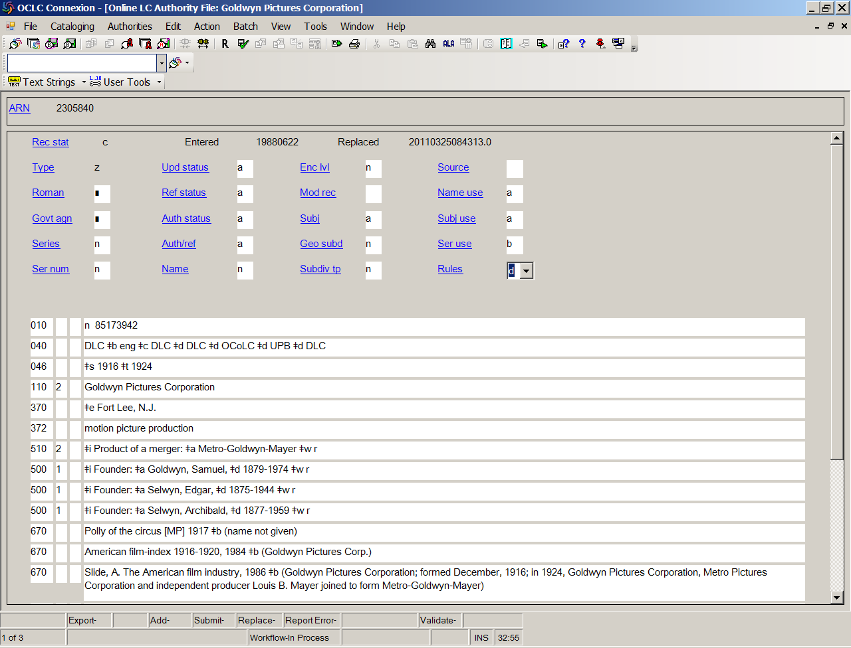
Section 9 – recording relationships between Group 2 entities
Note the use of relationship designators in subfield i of the 5xx fields.
Notes:
Section 9 is about recording relationships between persons, families, and corporate bodies, i.e., group 2 entities. These relationships are expressed primarily in authority records. This authority record expresses the relationships between the authorized access point (Goldwyn Pictures Corporation) and several other group 2 entities (three persons and one corporate body). Note the use of relationship designators in subfield i of the 5xx fields. Appendix K is the source for the controlled vocabulary terms used as relationship designators for expressing relationships between group 2 entities. “Product of a merger” is a relationship designator found in K.4.3.

Slide 39
Each chapter in RDA records data associated with a particular user task
RDA uses the vocabulary and concepts of FRBR and FRAD
RDA is organized according to the entities identified in FRBR and FRAD
RDA provides explicit explanation of the relation between the instructions and the user tasks
RDA emphasizes relationships and clarifying the nature of the relationships
Source: Laura May (Feb. 2010)
Notes:
To sum up …

Slide 40
Exercises
Which of the terms below refers to one of the four “user tasks” identified in FRBR and RDA?
Isolate
Articulate
Obtain
Fulfill
Surrender

Slide 41
The description of a resource’s carrier supports which of the four user tasks referred to in FRBR and RDA? Hint – two answers are possible!
A. Find
B. Identify
C. Select
D. Obtain

Slide 42
Which of the following is NOT an example of a relationship between a Group 2 entity and another Group 2 entity?
A. Corporate body -- Related corporate body
B. Founding family -- Descendants
C. Manifestation -- Publisher
D. Real identity -- Alternate identity
E. Employer -- Employee

Slide 43
True or False?
Relationships between Group Two entities are expressed in authority records.
True
False

Slide 44
Which one of the following exemplifies a “Primary Relationship?”
A. “Is a digest of”
B. “Is a commentary on”
C. “Is a concordance to”
D. “Is preceded by”
E. “Is a large print edition of”

Slide 45
References
May, Laura, "Making way for RDA," (PowerPoint presentation presented at Ottawa Public Library, Ottawa, Ont., February 2010), http://www.rda-jsc.org/docs/10_2_26_OttawaPublicLibrary.pdf (accessed June 22, 2011).
Oliver, Christine, "RDA: Resource Description and Access," (PowerPoint presentation presented to CASLIS, Ottawa, Ont. June 18, 2008), http://www.caslisottawa.on.ca/docs/rda_2008-06-18.pdf (accessed June 22, 2011).
“RDA test ‘Train the trainer’: Module 8, relationships,” (content as of Mar. 31, 2010),
http://www.loc.gov/catdir/cpso/RDAtest/module8.ppt, (accessed June 22, 2011).

Slide 46
References (cont’d.)
Screen images from the RDA Toolkit (www.rdatoolkit.org) used by permission of the Co-Publishers for RDA (American Library Association, Canadian Library Association, and CILIP: Chartered Institute of Library and Information Professionals).

