Slide 1

Stock Tank Mixing
Summer 2011
Aliya Adili, Christine Curtis, Justin Kim, Xuying Wang

Slide 2
Outline
Introduction
Experiment and results
--mixing experiment
--hydrometer measurement
New Idea: bicycle mixer design
Suggestion on future work

Slide 3
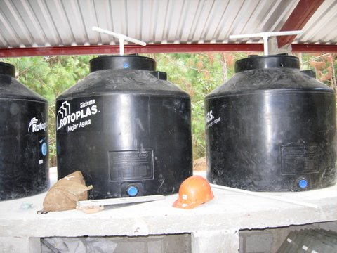
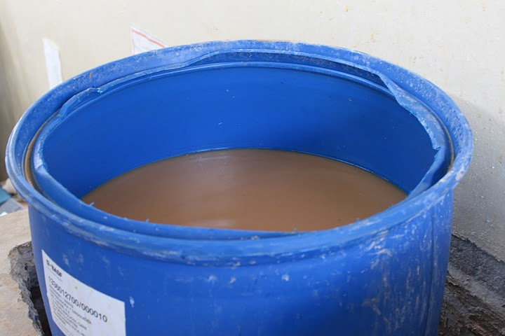
Introduction
current “Stock Mixing Tank” :
Tanks holding homogenized solutions of coagulants(PACl) for flocculation
Tank Volume: 55 gallons, or Rotoplas (200 gallons)

Slide 4
Introduction
Main purpose:
1) design high efficiency human power mixing system
2) find better methods to tell when the solution is fully mixed
As currently, operators only use hands to do mixing work and have to inspect visually to judge whether the solution is saturated or not.

Slide 5
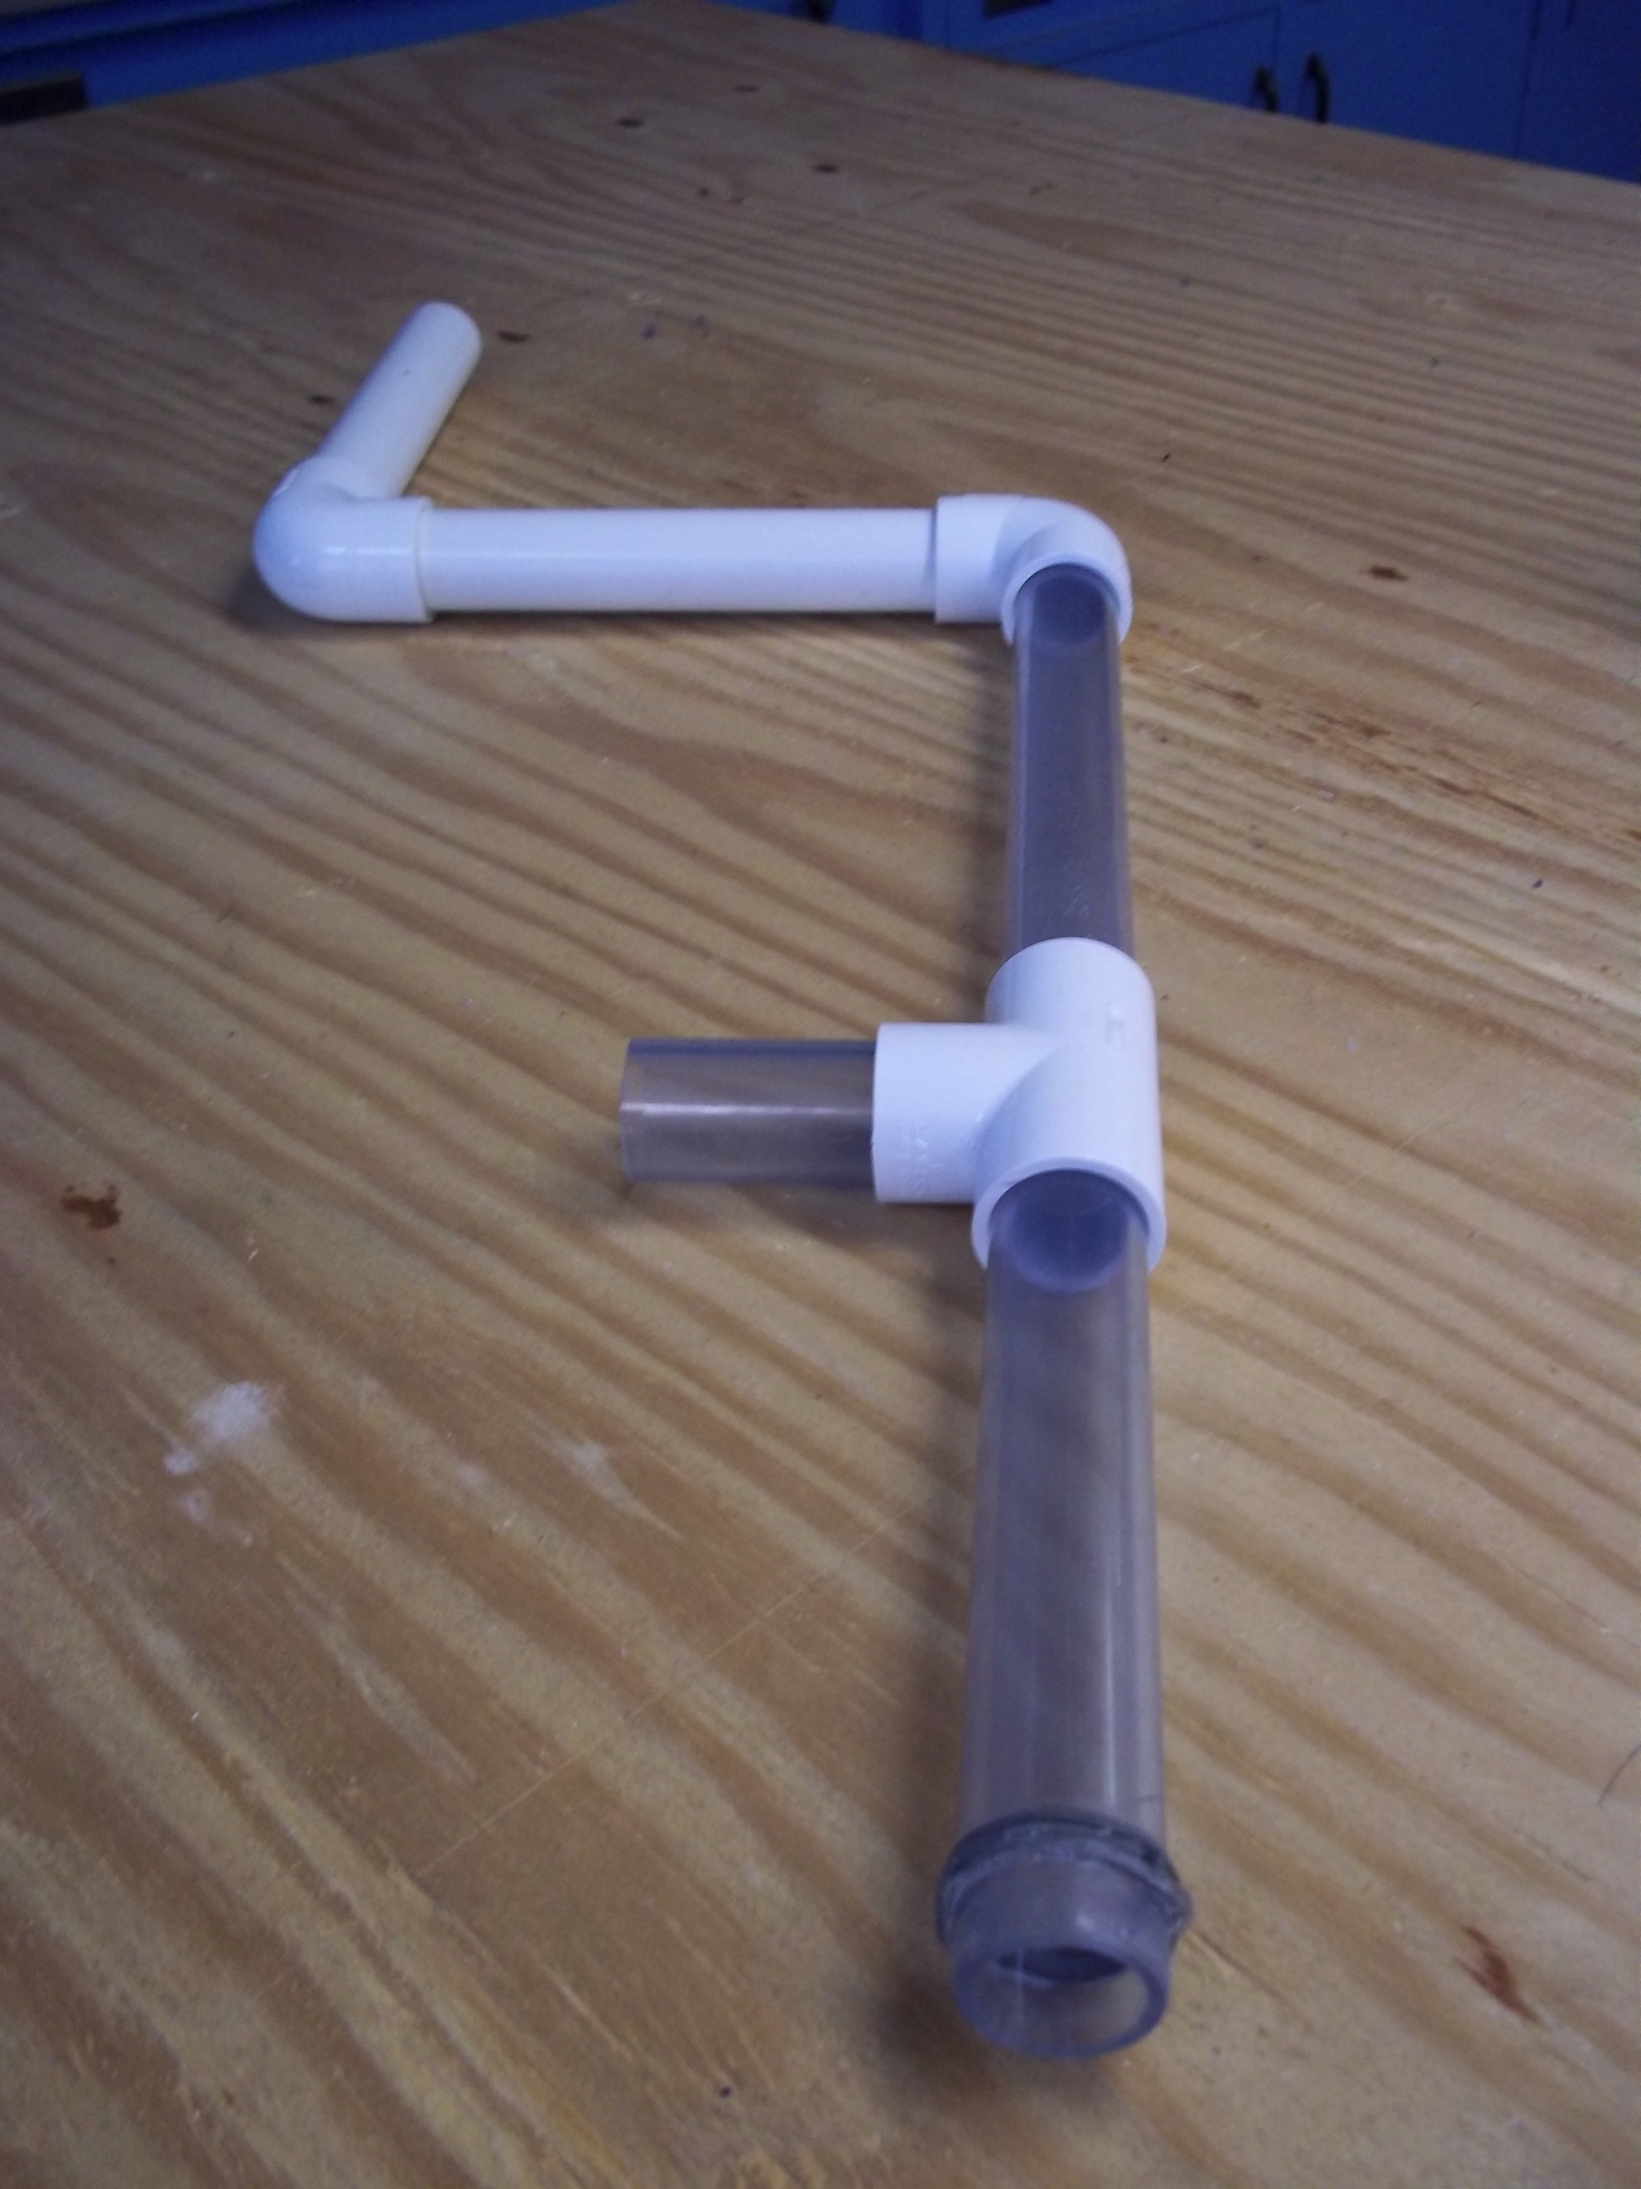
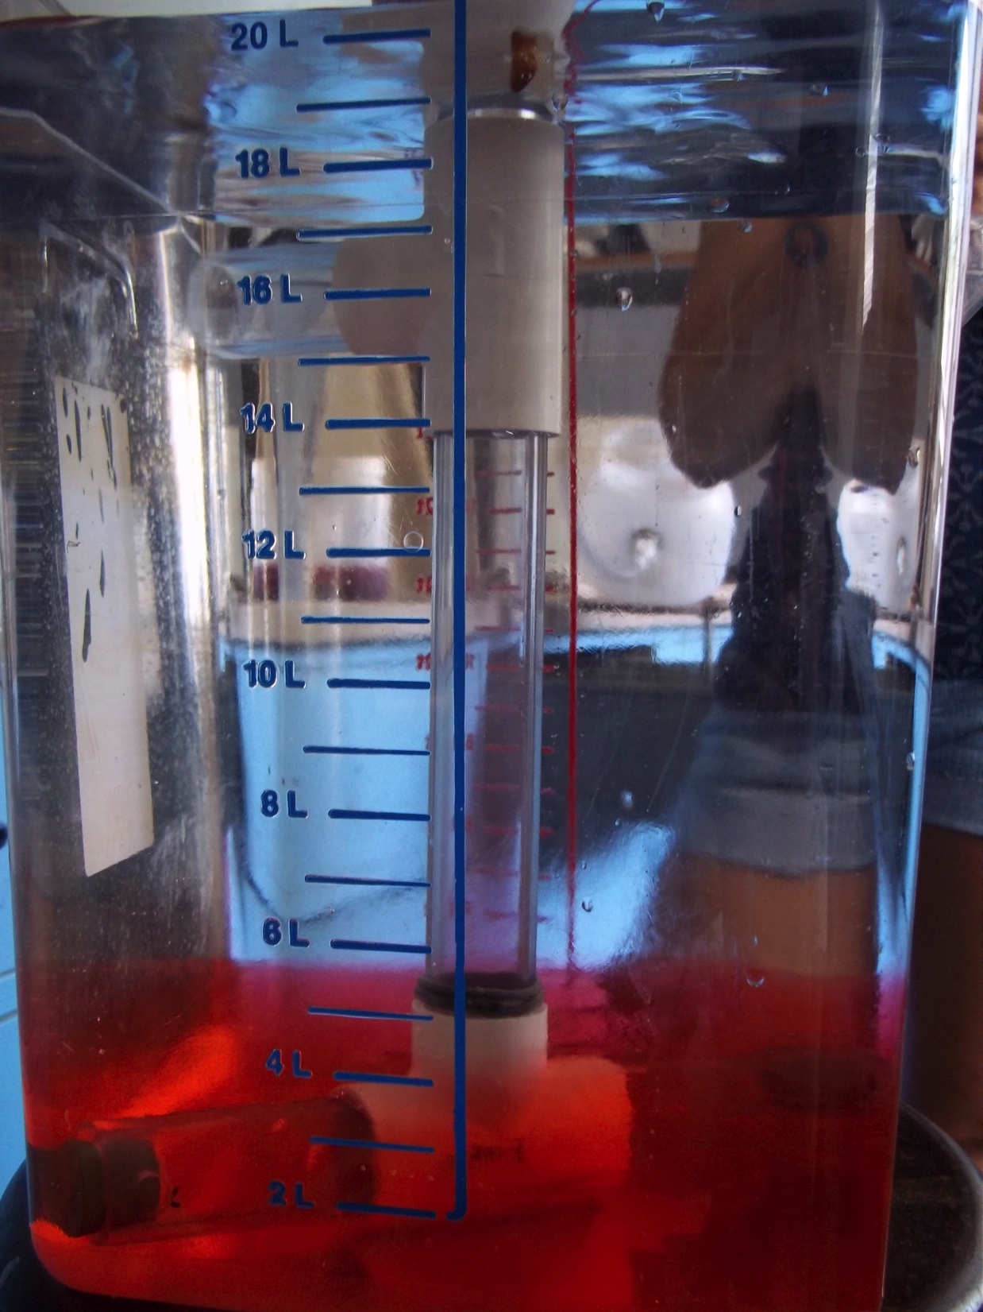
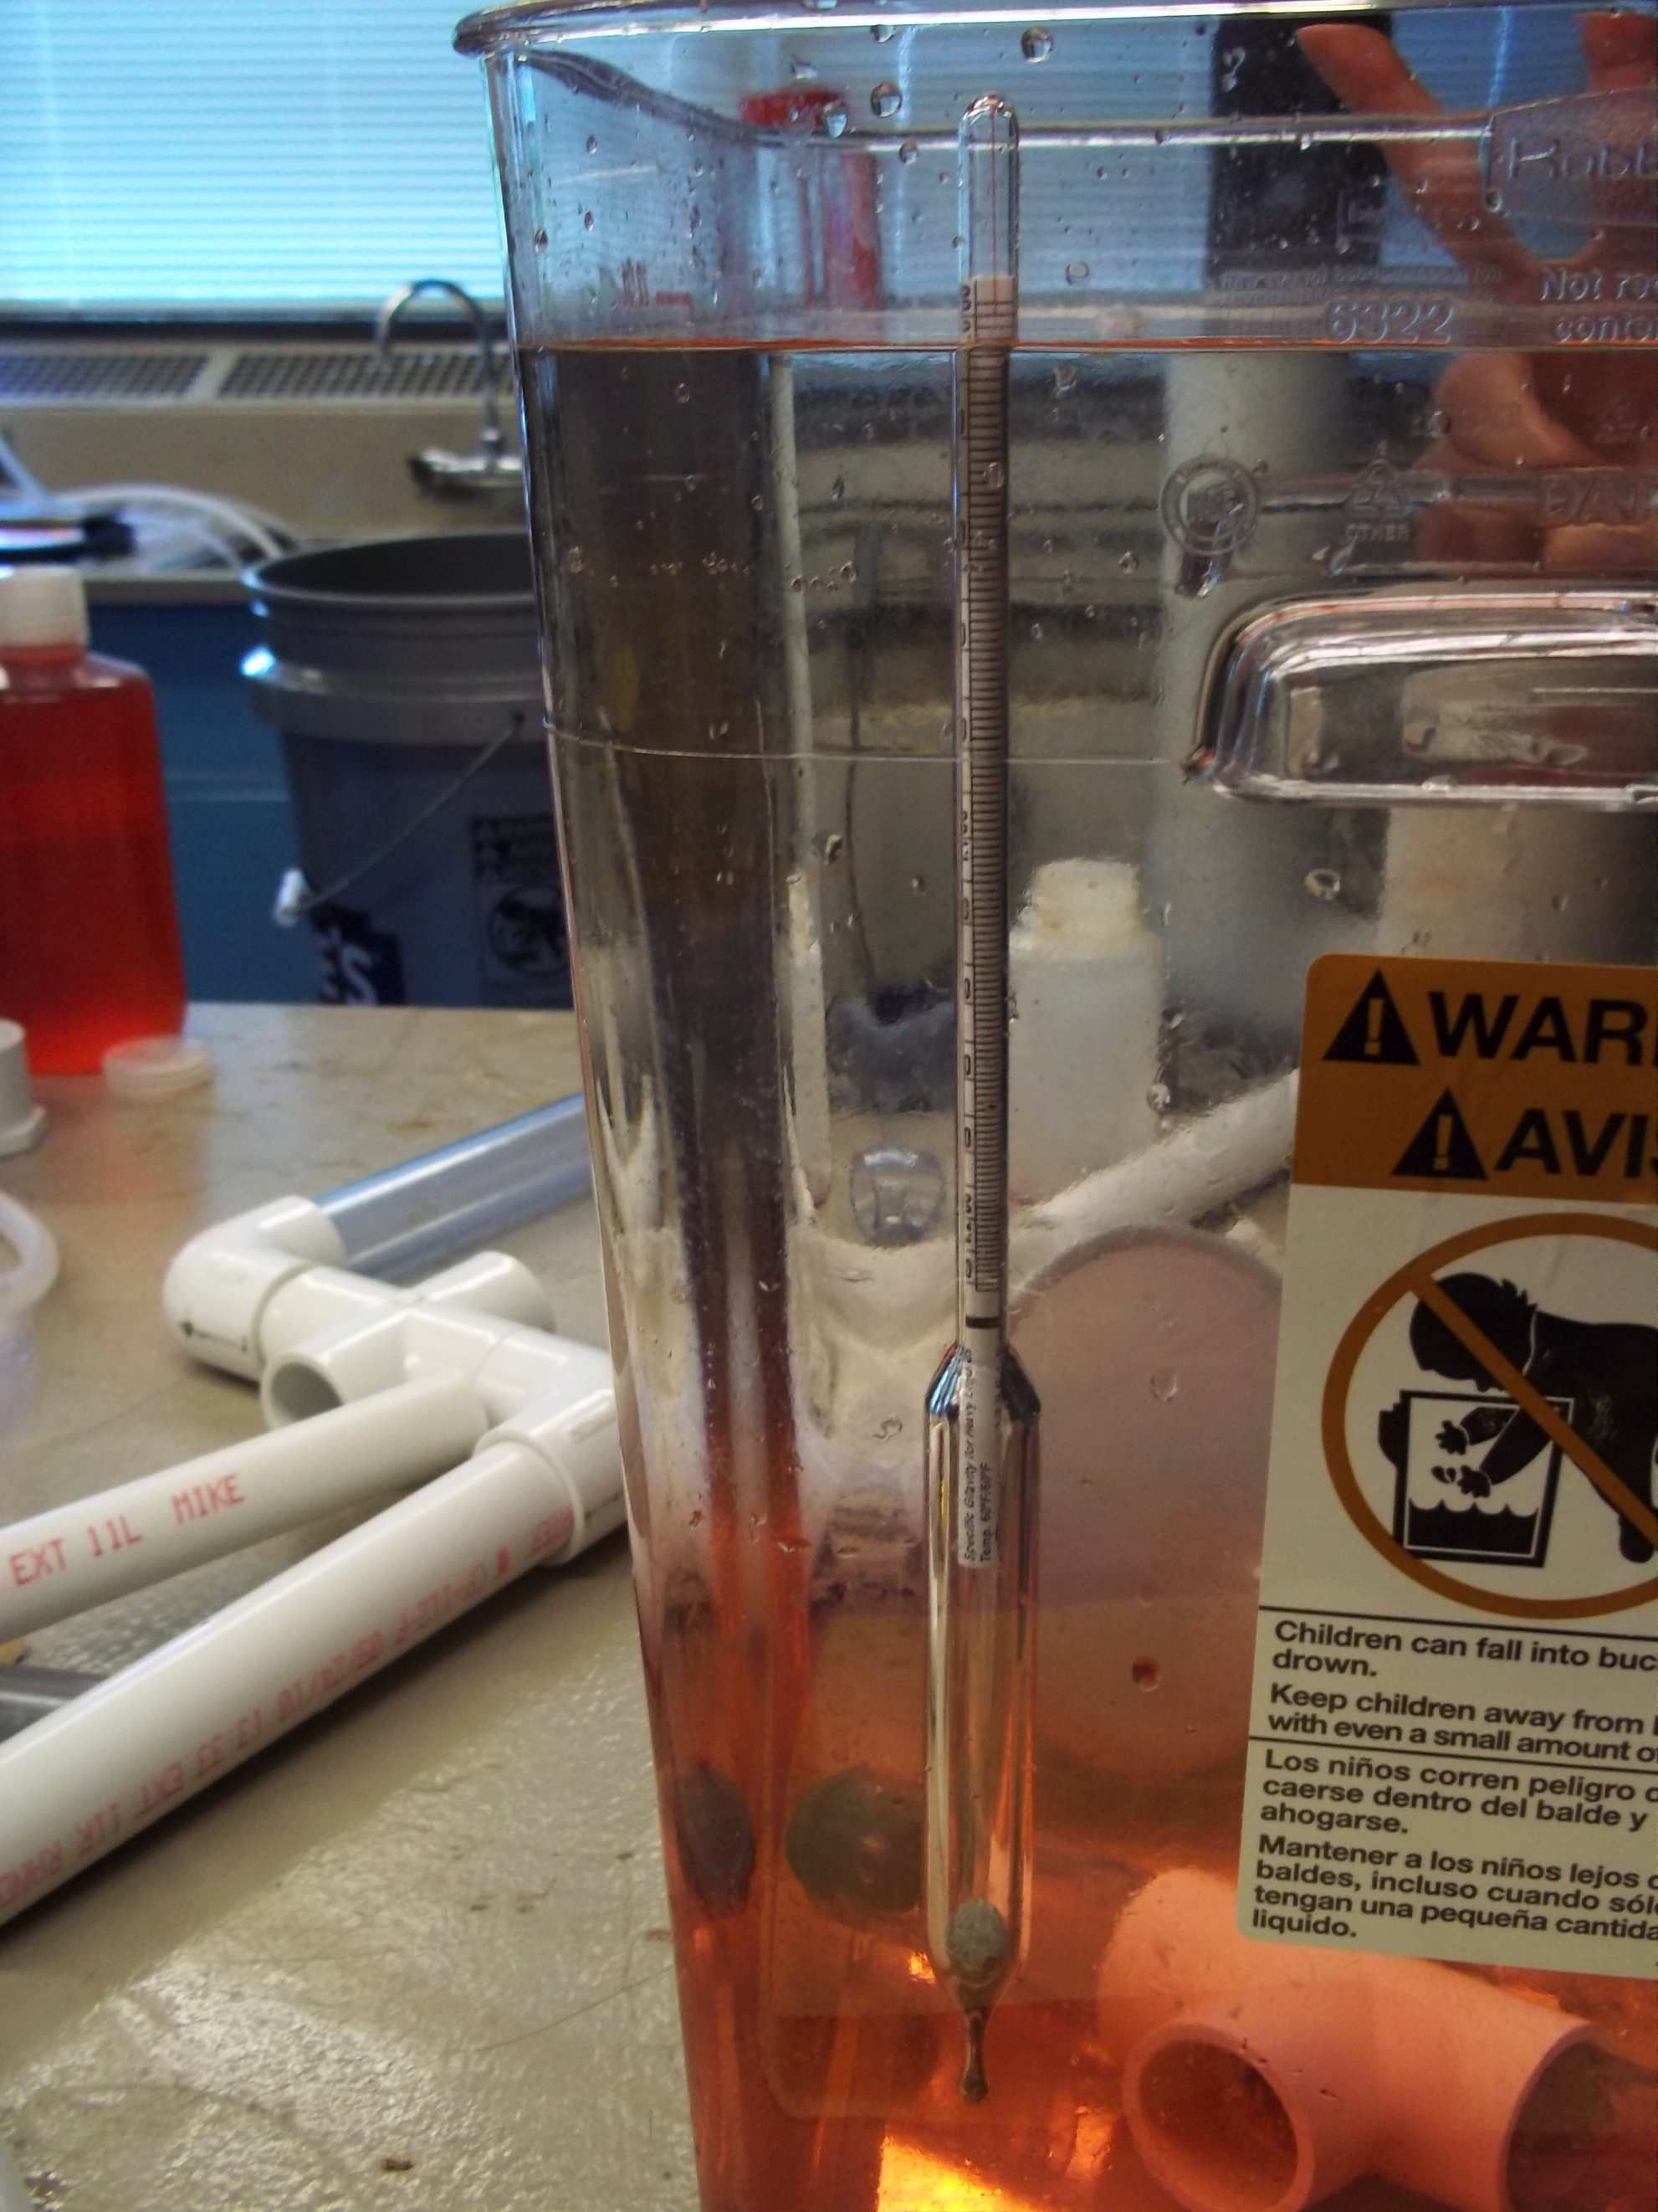
Experiment and Results
Experiment devices & materials:
scaled-down clear PVC vessel (22L),
mixing system(centrifugal pump made of clear PVC),
hydrometer,
sugar(as representation of PACl), red staining agent

Slide 6
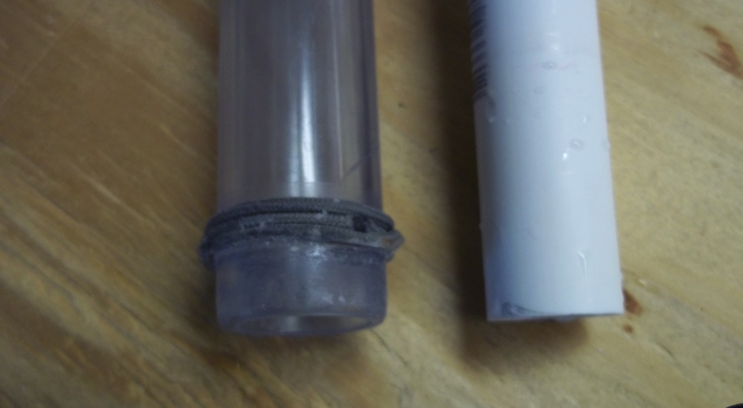
Experiment and Results
Improvement on mixing system:
clear PVC – good for observation
bottom part better sealed – to reduce head loss

Slide 7
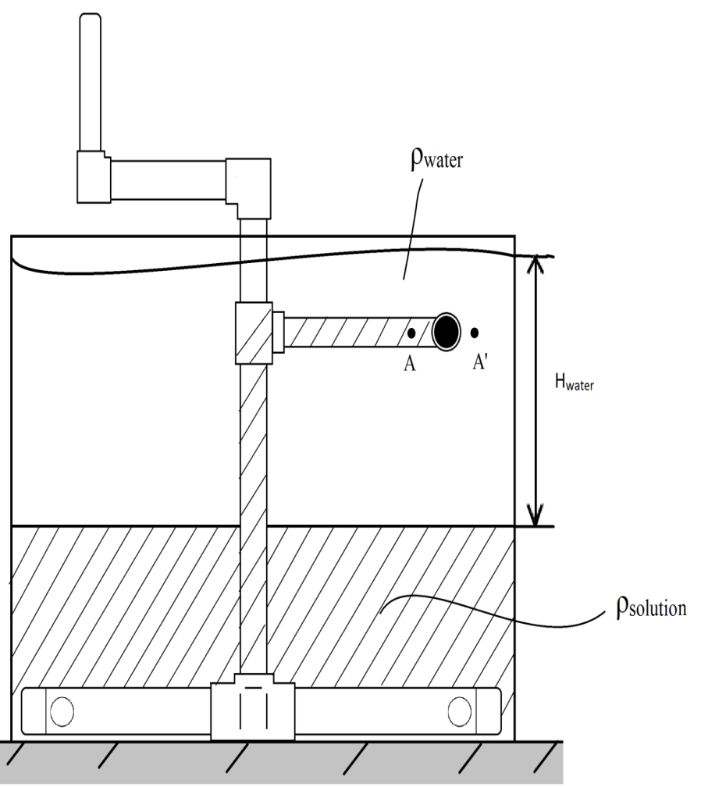
Experiment and Results
Mixing experiment:
how does a centrifugal pump work?
Show Time!

Slide 8
Experiment and Results
Mixing experiment:
(Centrifugal pump mixing system)
Table 1. mixing time at different rotating speed for new & old pump
X: solution did not reach spout.
the other numbers are average values based on original data.
Rotating speed (rpm) | Time (s), old pump | Time (s), new pump
30 | X | X
45 | 111 | 145
60 | 31 | 23
75(limit) | 20 | 10

Slide 9
Experiment and Results
Mixing experiment:
(Centrifugal pump mixing system)
.

Slide 10
Experiment and Results
Mixing experiment:
(Centrifugal pump mixing system)
Feasible rotating speed: ~45-75 rpm
Mixing time: ~140-10 s (new pump)
New pump seems to work better than old one, sealing is important.

Slide 11
Experiment and Results
Hydrometer measurement
1)standard curve of hydrometer: sugar concentration Vs. relative density

Slide 12
Experiment and Results
Hydrometer measurement
2) right after mixing, we used a hydrometer to measure the relative density of the mixed solution.

Slide 13
Experiment and Results
Hydrometer measurement
measured relative density of the solution after mixing = 1.012, very close to theoretical value calculated from standard curve 1.0114 (if we assume the solution was fully mixed after mixing).
It indicates that:
hydrometer can be used to tell the mixing condition of water and sugar.

Slide 14
New Idea: Bicycle Mixer Design

Slide 15
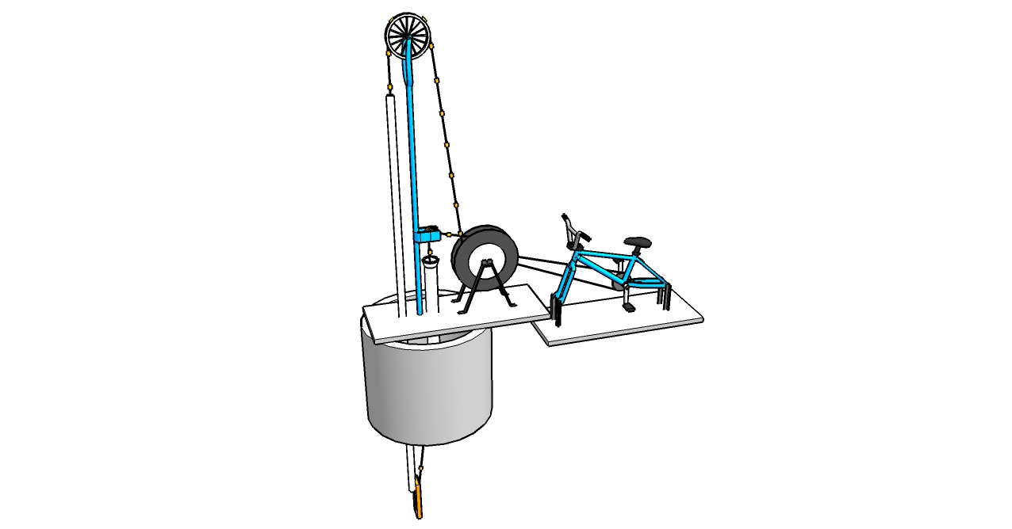

Slide 16
New Idea: Bicycle Mixer Design
Advantages:
-cycling: high efficient way to do work;
-legs provide power, easier for operation than hands;
-axial impellers: both vertical and horizontal direction mixing
Problems to be considered:
-choosing cost-effective and anticorrosion materials;
-fixing the device underwater,
-lots of design details to be decided, etc.

Slide 17
Suggestion on Future Work
Centrifugal pump mixing system:
-add baffles or impellers to improve mixing efficiency;
-scale up to see how the system works;
-provide a rotating guideline for stock tank mixing operators(by doing experiments and math work, to figure out the relationship between rotating speed and mixing time), such as stirring time needed at certain rotating speed, etc.
New design ideas:
-continue on our bicycle idea or other ideas if needed

Slide 18
Thank You!
Questions?

