Slide 1
Solar Lovin’
Technical update
Joe Beaudette, Sarah Clement, Margaret Ding, Catherine Hanna, Harrison Ko, Lauren Nielson, Leif Paulson, Rachel Philipson,
Julianne Schwartz
November 8, 2010

Slide 2
SUBTEAMS
Insulation
Concentrated Cooker
Small Solar Oven

Slide 3
INSULATION
Sarah Clement, Harrison Ko, Julianne Schwartz

Slide 4
Project Summary
Problem:
Current insulation unsatisfactory
Women’s group in Nicaragua observe material’s lack of longevity
Objective:
Investigate and identify materials of insulation that would improve performance and longevity

Slide 5
Project Summary
Process:
Design a new experiment which isolates the heat transfer of the system through a single wall with interchangeable insulation
Experimental observations will allow us to draw conclusions to improve the insulation in the solar box cookers

Slide 6
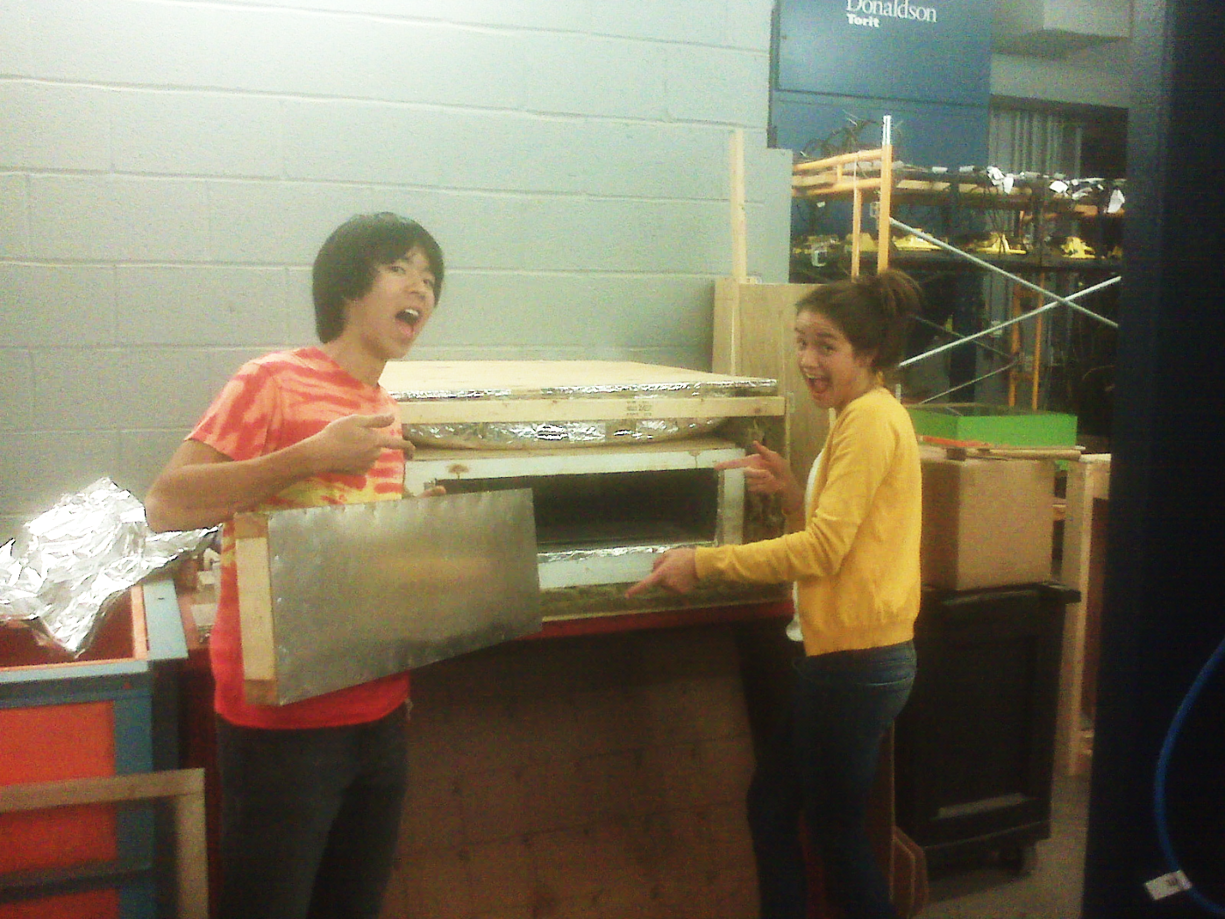
Work Accomplished to Date

Slide 7
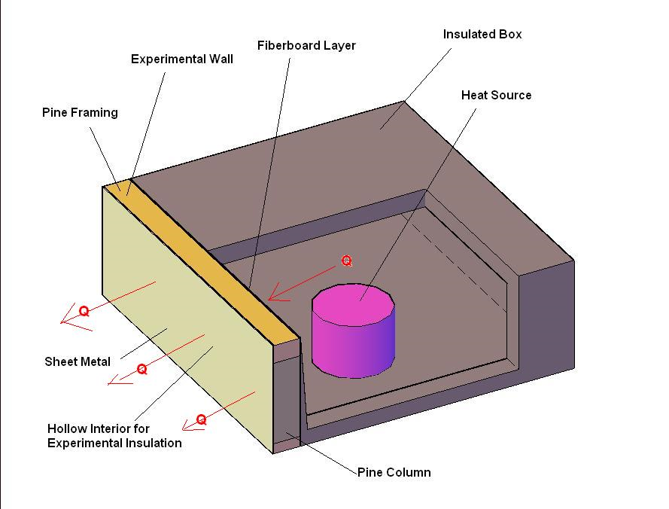
Experimental Design

Slide 8
Experimental Design
Insulation Testing Concept
Isolate heat transfer through single wall of solar oven
Heat inside the box will travel the path of least resistance
Experimental Wall
Will mimic the walls of a conventional solar oven
Main Difference: interchangeable interior of the wall
Insulated Box
Will have five non-experimental faces with a thermal resistivity far greater than that of experimental wall

Slide 9
Experimental Design
Measurements to be Recorded
  Measure temperature of the inside air, the outside air, and on many locations on the wall
Two Basic Factors of Insulation Effectiveness
The time it takes the oven to heat up to cooking temperature
How well the oven retains the heat
R-value
Initial goal of this experiment was to obtain an R-value for the experimental wall
Further research determined obtaining an official R-value is arbitrary as long as the data can be characterized in a logical and scientifically sound manner

Slide 10
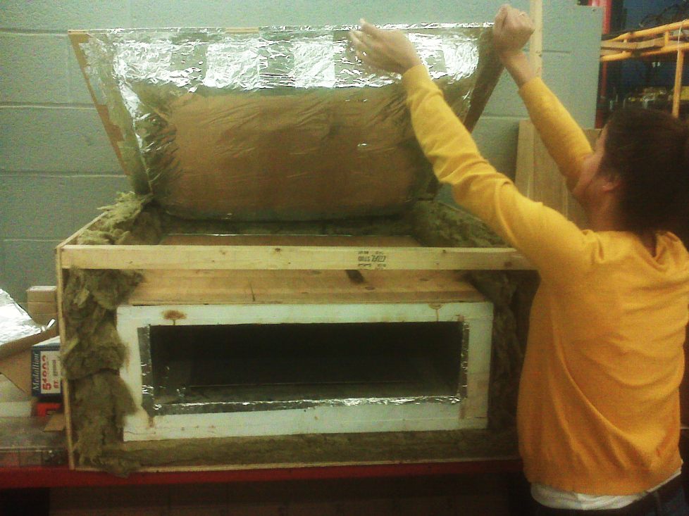
Construction
Outer frame
Insulated sides
Insulated lid
Experimental wall

Slide 11
Construction
Outer frame made of plywood, connected with metal brackets
Inside box is an old solar oven with door removed
Mineral wool used for extreme insulation on the five super-insulated sides
Experimental wall made of pine framing with construction almost identical to solar oven wall

Slide 12
Communication
Communication with community in Nicaragua determined:
Material of interest for insulation: fiberglass
Experimental wood shavings will differ, since the wood shavings used in Nicaragua are longer and more “oily,” leading to increased moisture resistance
Final materials of interest:
  Wood shavings
  Fiberglass
  Rice hulls

Slide 13
Problems Encountered
Replicating real life situation: Issue only exists after a year of using the oven
  Accelerating time may prove to be time consuming and difficult
  Matching experimental wood chips with those used in Nicaragua

Slide 14
Work Remaining
Implementing experimental design
  Determining and using a valid heat source
  Placing temperature sensors
  Defining our heating cycle
  Programming system for heating and cooling
Running experiments
  Plan is to run “half of years” worth of heating cycles for each insulation material
  Observations will made over time while monitoring temperature gradient and moisture to determine correlation and/or causation

Slide 15
Revisiting of Schedule

Slide 16
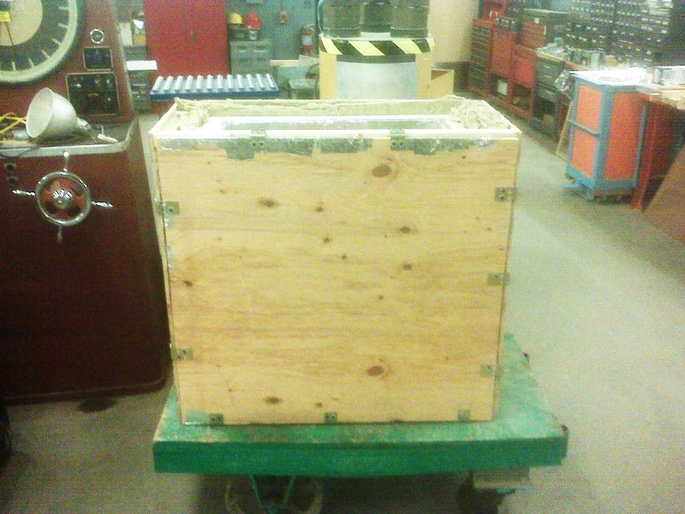
Recommendations/Conclusions
Difficulty with attaching the experimental wall to the device
Change in orientation of the insulated box to an upright position
Plan is to put weights on the experimental wall so that it is easily removable

Slide 17
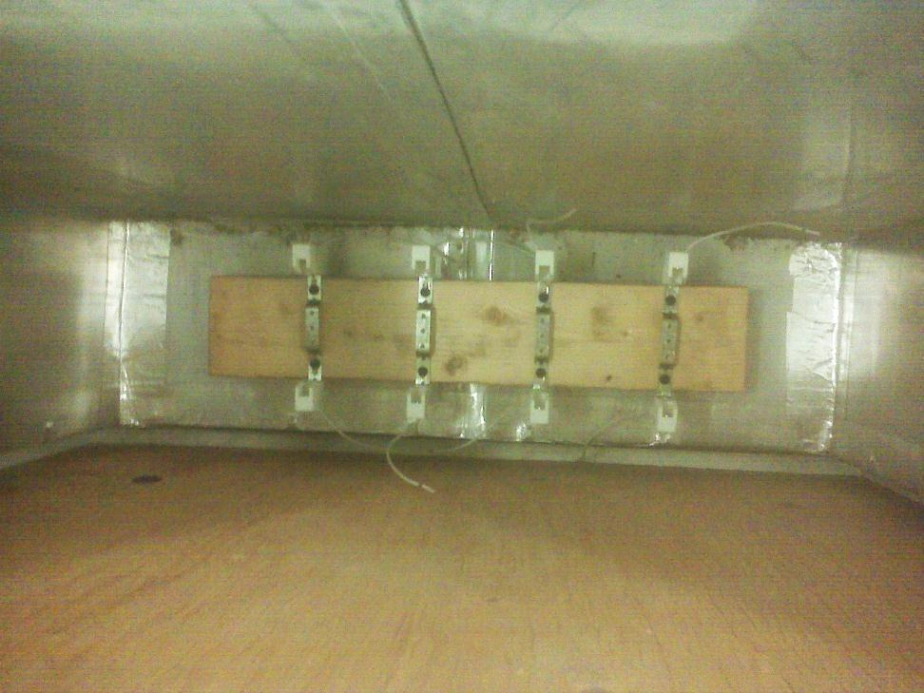
Recommendations/Conclusions
Encountered issue with the performance of the heat source under high temperatures (~200 degrees C)
Instead of using hotplates, a system of lights was determined to be a more adequate solution

Slide 18
CONCENTRATED COOKER
Margaret Ding, Catherine Hanna

Slide 19
Project Summary
Problem:
Current solar oven design does not reach high enough temperatures to fry foods
Current solar oven max temp = 180 C
Min temp needed to fry foods = 250 C
Objective:
Research, design, and build a concentrated cooker that meets temperature requirements

Slide 20
Work Accomplished to Date
Research
Design Choices
Initial Construction

Slide 21
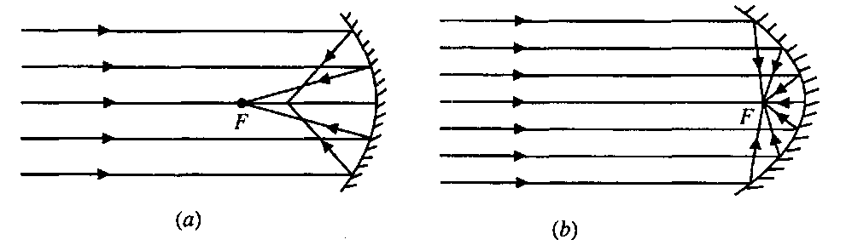
Design Choices
Spherical vs. Parabolic: Parabolic
  Spherical aberration
  Future Improvement on Parabolic Shape: Compound Parabola

Slide 22
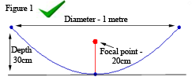
Design Choices
Paraboloid: Shallow vs. Deep
Safety hazards, maneuverability
Focal Point: 25 cm
Most effective is 1/3 down from top
Generates ~ 800 Watts of solar energy

Slide 23
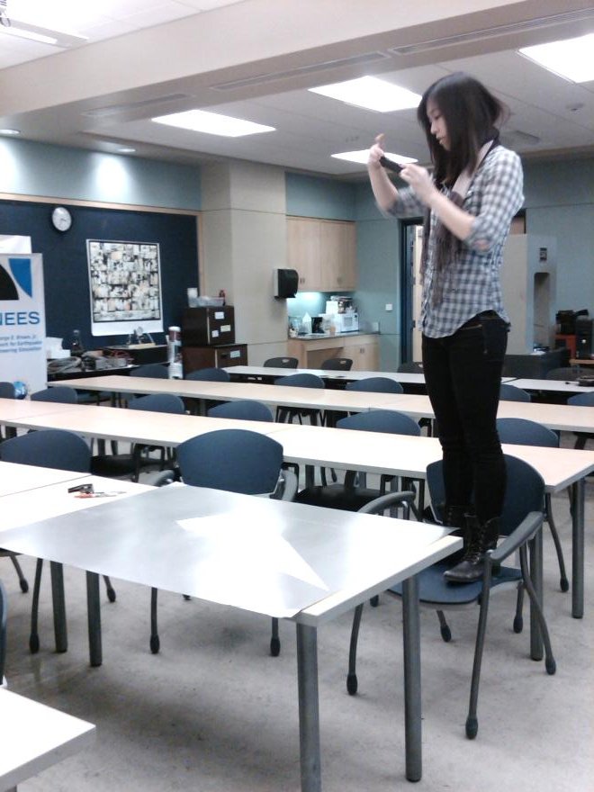
Design Choices
Paraboloid Material:
3’ x 4’ x .016” Aluminum Sheet
Still flexible
More durable than cardboard
Structural rigidity
Preserving rectangular shape

Slide 24
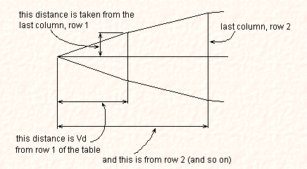
Construction: Paraboloid
row number | x | y | y1 | z | Vd | from centre
1 | 0 | 0.00 | 0.26 | 5.11 | 5.11 | 1.01
2 | 5 | 0.26 | 1.04 | 5.16 | 10.27 | 2.03
3 | 10 | 1.04 | 2.34 | 5.26 | 15.53 | 3.04
4 | 15 | 2.34 | 4.16 | 5.42 | 20.94 | 4.06
5 | 20 | 4.16 | 6.50 | 5.61 | 26.56 | 5.07
6 | 26 | 6.50 | 9.36 | 5.85 | 32.40 | 6.09
7 | 31 | 9.36 | 12.74 | 6.12 | 38.52 | 7.10
8 | 36 | 12.74 | 16.65 | 6.42 | 44.94 | 8.12
9 | 41 | 16.65 | 21.07 | 6.75 | 51.69 | 9.13
10 | 46 | 21.07 | 26.01 | 7.10 | 58.80 | 10.14
11 | 51 | 26.01
x increment | 5.1 | cm
f (focal length) | 25 | cm
sections | 16 | cm
= cutting line
= uncut region

Slide 25
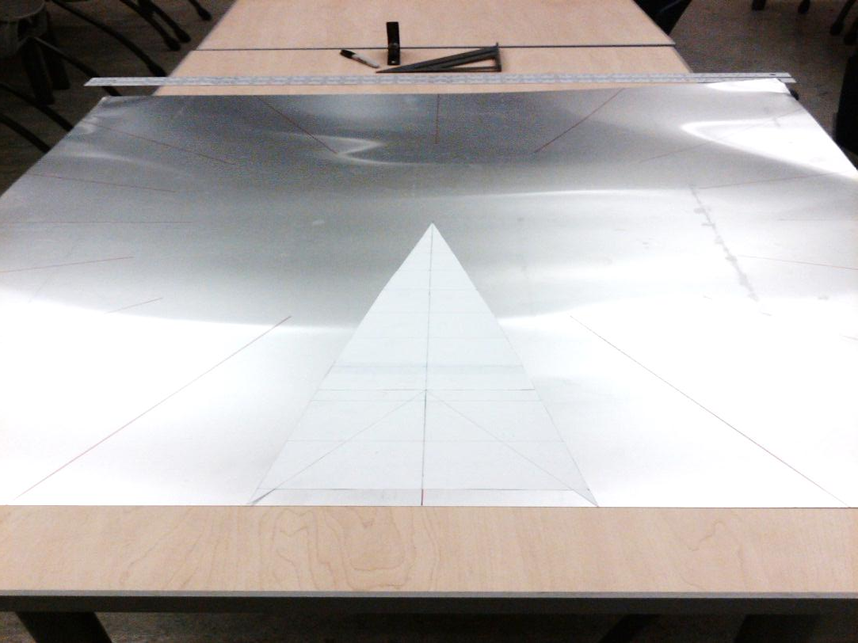
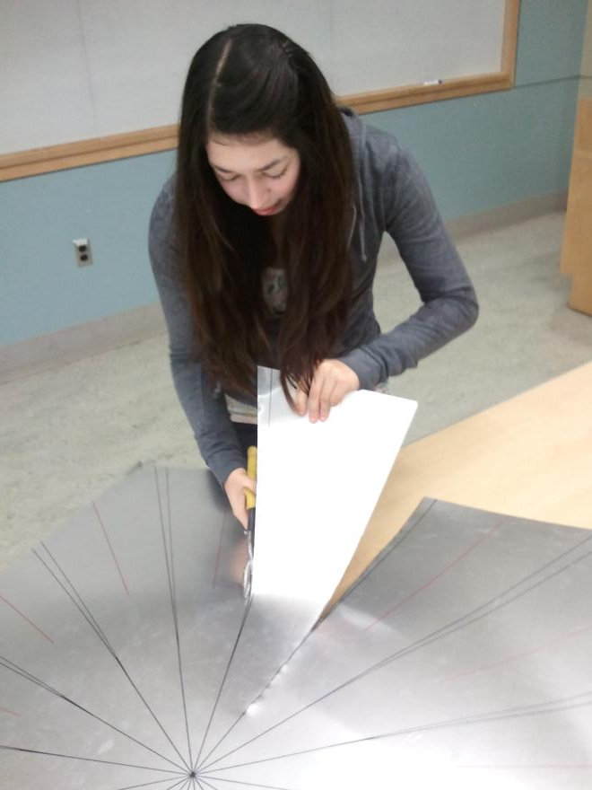
Construction: Paraboloid

Slide 26
Problems Encountered
Design of entire cooker (including cooking surface) cannot be finalized until paraboloid is constructed and tested
    Calculating the paraboloid’s theoretical focal point must be confirmed/adjusted with an empirical value
Design/build in phases:
Paraboloid
Frame and Cooking Surface

Slide 27
Work Remaining
Finish paraboloid construction
Temp test on paraboloid to find focal point
Design frame and cooking surface configuration
Build frame and cooking surface
Test final concentrated cooker

Slide 28
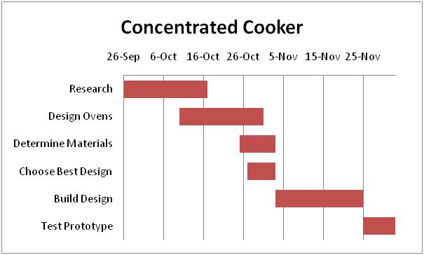
Revisiting of Schedule

Slide 29
Recommendations/Conclusions
Human error makes construction of parts contingent on one another
Design/Build split into phases
Dimension checks between phases (to confirm focal point location)
Final concentrated cooker will be base point from which improvements can be made

Slide 30
SMALL SOLAR OVEN
Joe Beaudette, Lauren Nielson, Leif Paulson, Rachel Philipson

Slide 31
Project Summary
The scope of our project is to design and build at least two solar ovens of smaller scale than the current design used in Nicaragua. The ovens will be optimized to work well in the Ithaca climate to be used in demonstration purposes locally. One oven will remain with the solar oven team, and one oven will be donated to the Cornell chapter of Engineers for a Sustainable World.

Slide 32
Work Accomplished to Date
Prop-rod redesign (additional project)
  Design formed
  Materials acquired and assembled
  Testing needed
Oven frame dimensions designed
AutoCAD design drawn
Construction phase begun
  Began cutting wood for frame

Slide 33
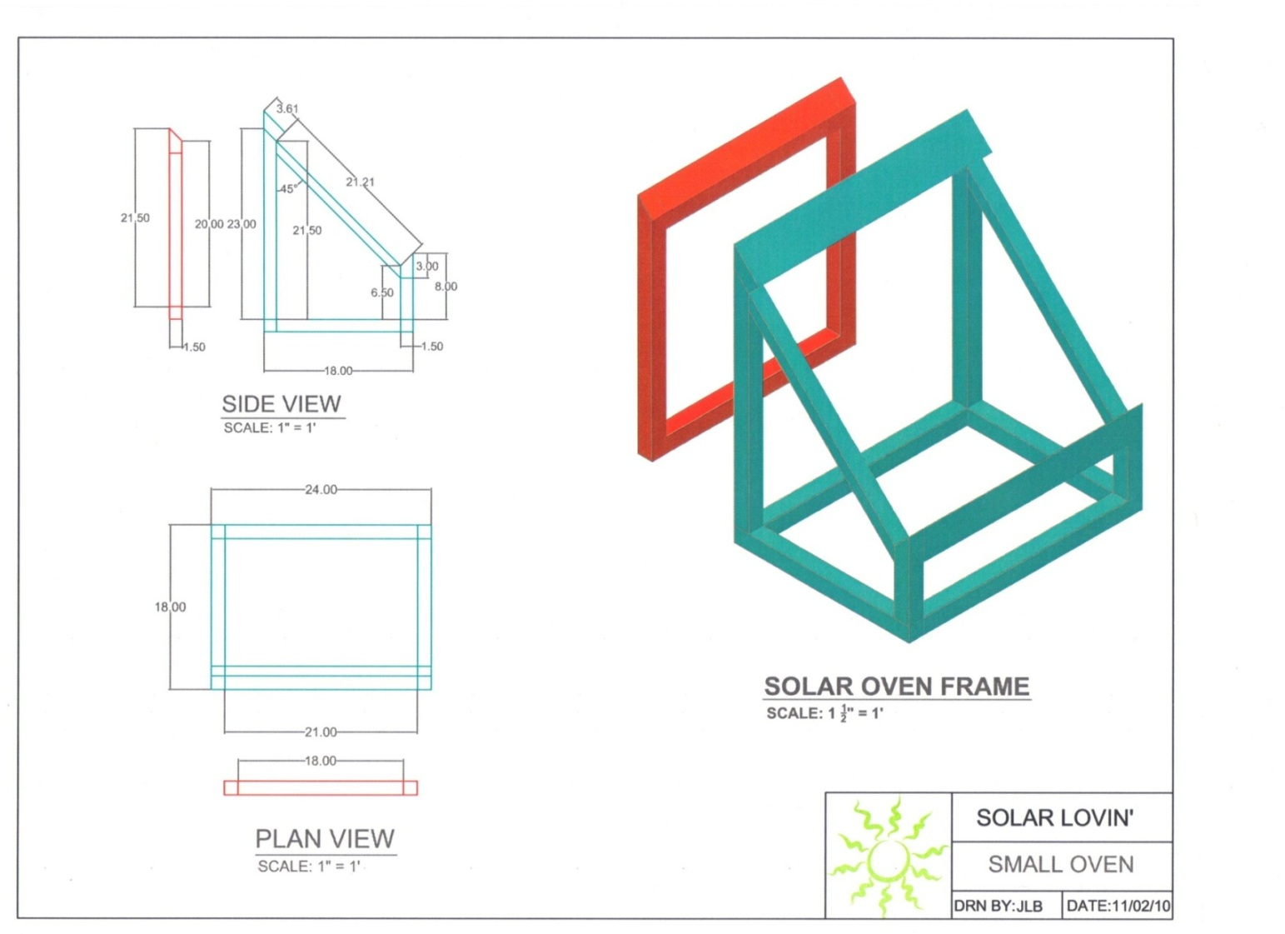
Small Solar Oven Design

Slide 34
Problems Encountered
Overall project has gone smoothly and is on track.
Window angle issue
  Rule of thumb: angle corresponds to latitude (42.4° for Ithaca)
  Engineering decision: make it 45°

Slide 35
Work Remaining
Assemble framing and install insulation, window, and siding
Test prop rod and tees
Demonstrate ovens
  As long as there is sunlight they will work

Slide 36
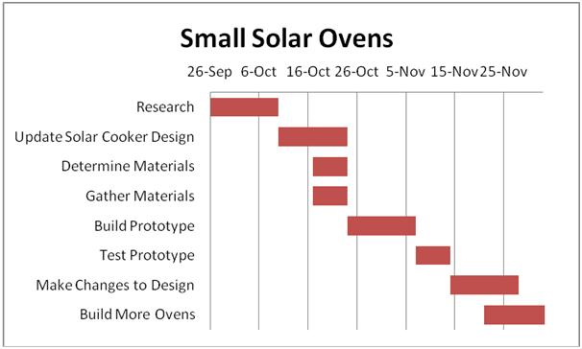
Revisiting of Schedule
Notes:
Right on schedule as of now- the building of the oven is taking longer than expected so we will revise the schedule to include more time for building

Slide 37
Recommendations/Conclusions
Need more time to build oven than expected
  Schedule will be bumped back
Since design is based off of a successful design, we don’t anticipate any need to redesign oven
  Testing/redesign period will be shorter

Slide 38
Updated Gantt Chart

