Slide 1
Solar box-cooker: Part I—modeling
T.C. Thulasi Das, S. Karmakar, and D.P. Rao

Slide 2
Overview
Provides theoretical view of methods of heat transfer in conventional solar box cooker
Mathematical model closely mirrors our current design
Provides team with better understanding of subject matter

Slide 3
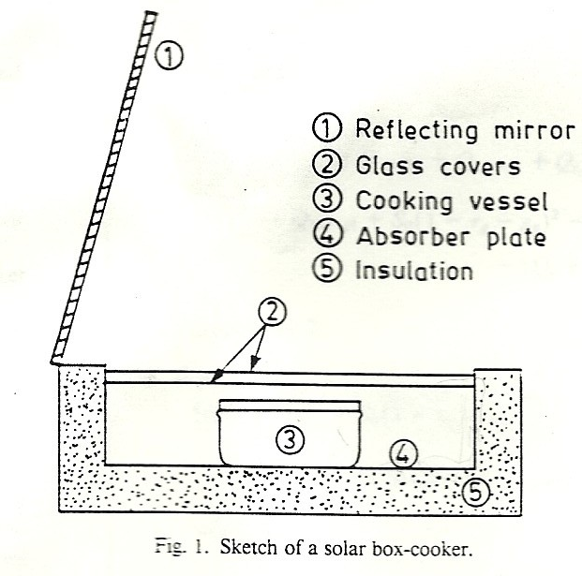
Solar box cooker

Slide 4
Key assumptions
Various components of the cooker (AIR INSIDE COOKER, EACH GLASS COVER, VESSEL, VESSEL COVER) are at different but uniform temperatures at any given time
Heat conduction (HEAT DIRECTLY TRANSMITTED) between the absorber plate and the side plates and that between the vessel cover and vessel side, is negligible
Solar radiation is incident only on the absorber plate and the vessel cover
There is no radiative transfer between the side walls of the cooker and the vessel cover
Heat loss due to air exchange between the cooker and the ambient (IMMEDIATE SURROUNDINGS) is negligible

Slide 5
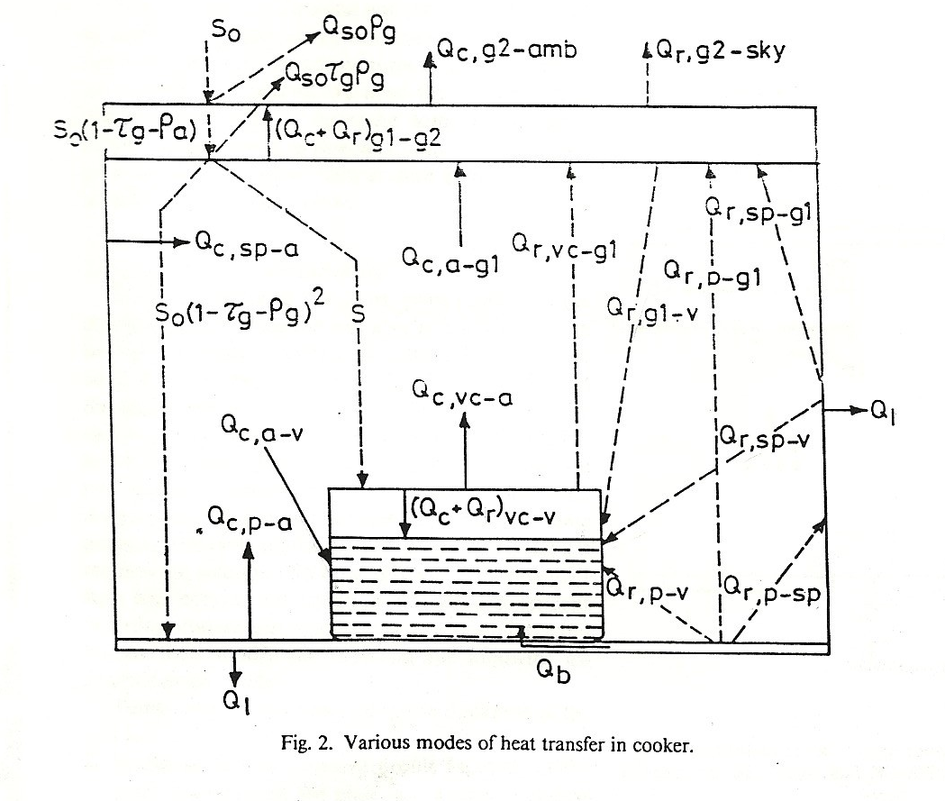
Heat transfer mechanisms

Slide 6
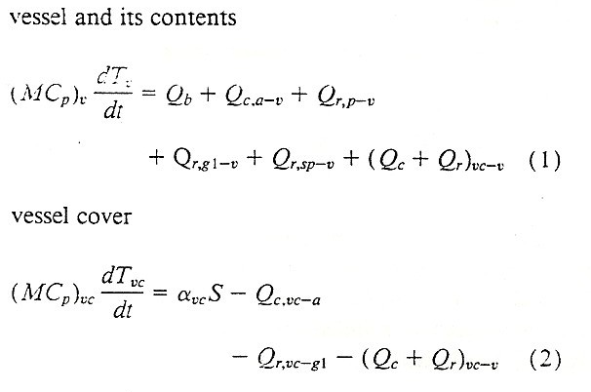
Energy Balance Equations

Slide 7
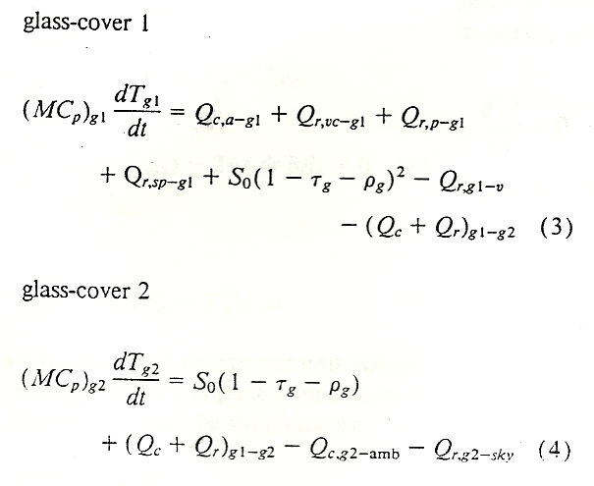
More equations!!!

Slide 8
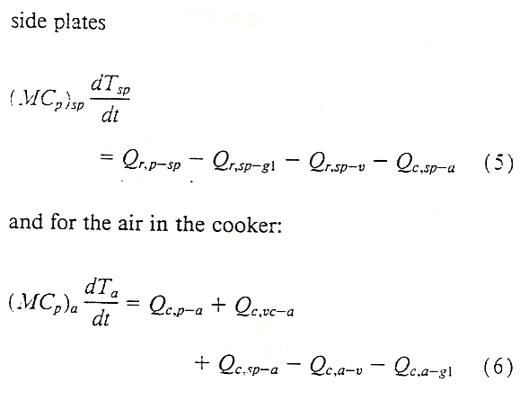
Even more equations!!!

Slide 9
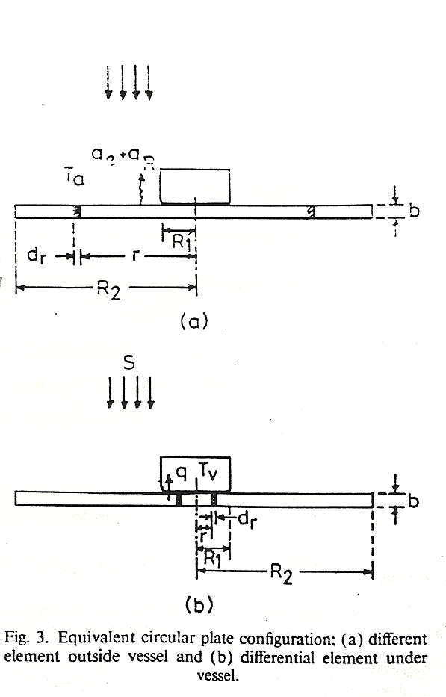
Absorber plate

Slide 10
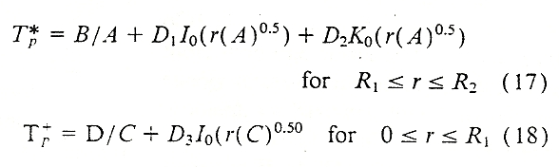
Absorber plate temperature profile

Slide 11

Reflector
S₀ = solar radiation incident on glass cover 2
I_{bg} = intensity of beam radiation falling on glass cover 2
I_{dg} = intensity of diffuse radiation falling on glass cover 2
ρ _{r} = reflectivity of the reflector
I_{br} = beam radiation falling on reflector
f_{rg} = exchange factor (fraction of the area of glass cover 2 exposed to the reflected radiation)
θ_{rg} = angle of incidence of the reflected on glass cover 2

Slide 12
Other information
Discussion of arrangement and number of vessels in the box cooker
Evaluation of heat fluxes

