Slide 1
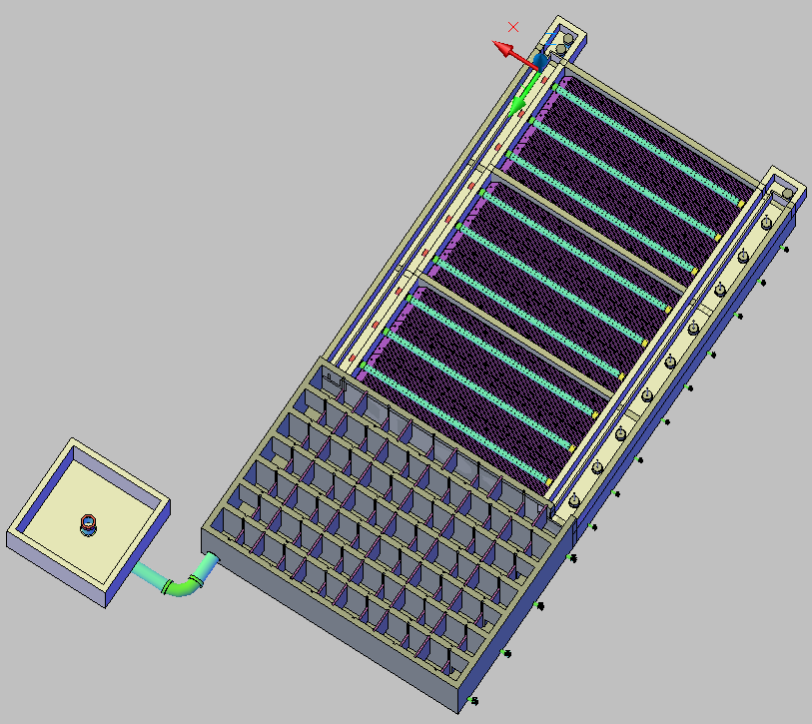
H
K
J
F
I
A
L
B

Slide 2
A
H
J
G
O
E

Slide 3
N
M
C
D

