Slide 1
Water, agriculture and poverty
Aguaclara
LW Harrington, Fall 2010
Research Director, CGIAR Challenge Program on Water and Food

Slide 2
Questions
What is the CGIAR Challenge Program on Water and Food? (CPWF)

Slide 3
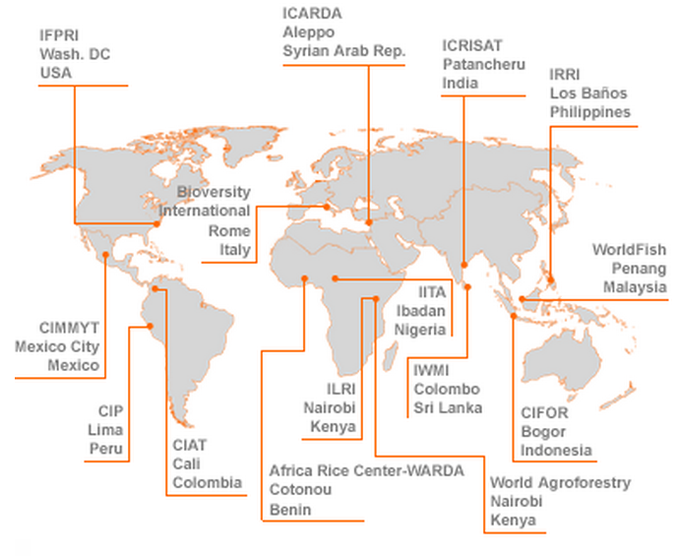

CGIAR Centers
food · water · environment · livelihoods

Slide 4
CGIAR Challenge Programs
2004
  Generation Challenge Program
  Harvest Plus
  Challenge Program on Water and Food (CPWF)
2005
  Sub-Saharan Africa Challenge Program
2008
  Climate change, agriculture and food security

Slide 5















CPWF partners
CGIAR Future Harvest Centers
Nat’l Agricultural Research and Extension Systems
Advanced Research Institutes
International River Basin Organizations
International NGOs
AREO
ARC
YRCC

Slide 6
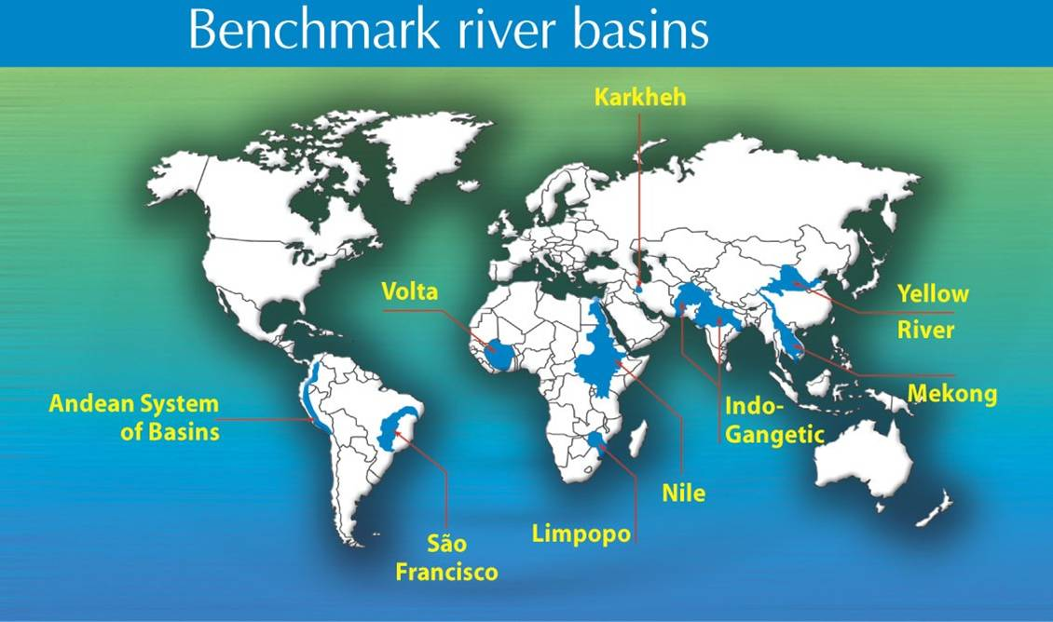

Slide 7
Questions
What does it mean for water to be scarce?
Where is water most scarce?

Slide 8
Water scarcity: the global picture

Slide 9
Source: Comprehensive Assessment of Water Management in Agriculture

Slide 10
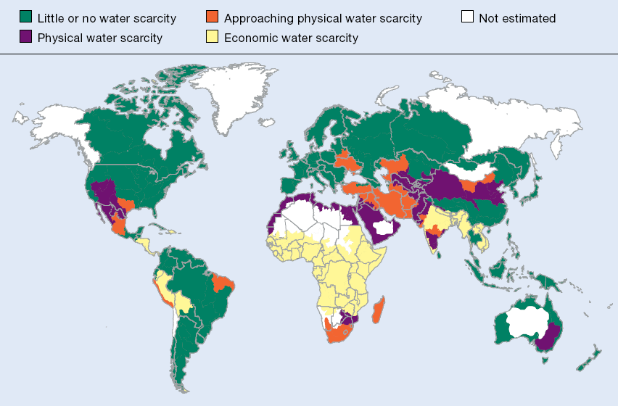
Source: Comprehensive Assessment of Water Management in Agriculture

Slide 11
Water scarcity: temporal and spatial distribution in basins

Slide 12
Temporal distribution of water - Limpopo basin

Slide 13
Limpopo basin
Ongoing research | Research approach | ABC’s in AWM research | CPWF I spotlight | Case studies | Vision for CPWF II

Slide 14
Water scarcity: quality

Slide 15
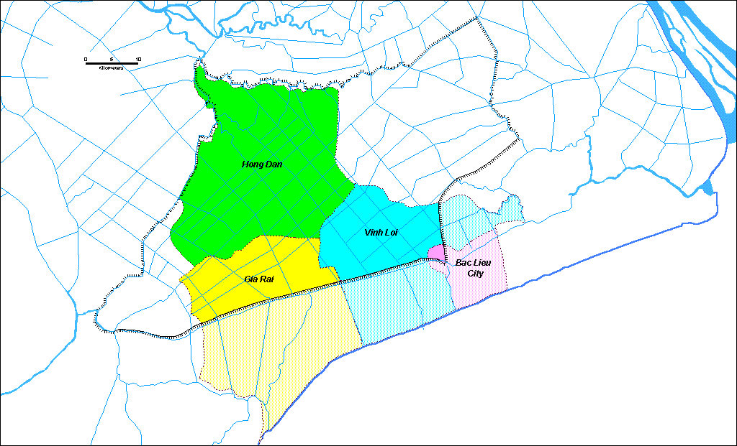
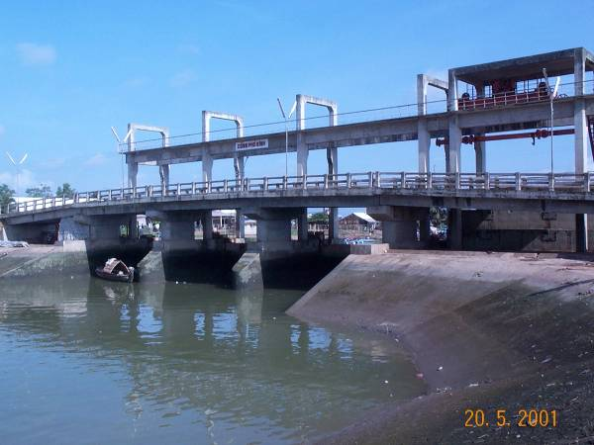
Mekong: conflict over fresh vs. brackish water
Fresh water
My Phuoc (1994)
Cai Trau (1994)
Bac Lieu province
Thanh Tri (1995)
Cau Sap (1996)
Bach Nguu (2000)
Vinh My (1997)
Pho Sinh (1998)
Chu Chi (1997)
Ca Mau (2000)
Lang Tram (1998)
Saline water

Slide 16
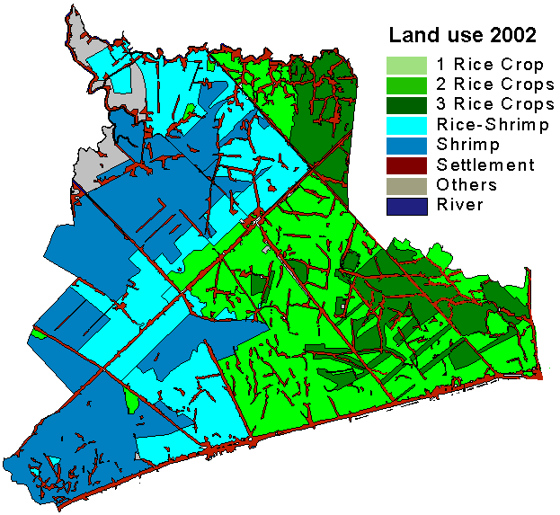
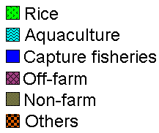
Ninh Hoa
Mekong: land use zoning for freshwater rice
vs. brackish water shrimp
Ninh Thanh Loi
Average
Very poor
Average
Poor
Phong Thanh Tay
Minh Dieu
Average
Poor
Average
Poor
Rich

Slide 17
Water scarcity: seasonality

Slide 18
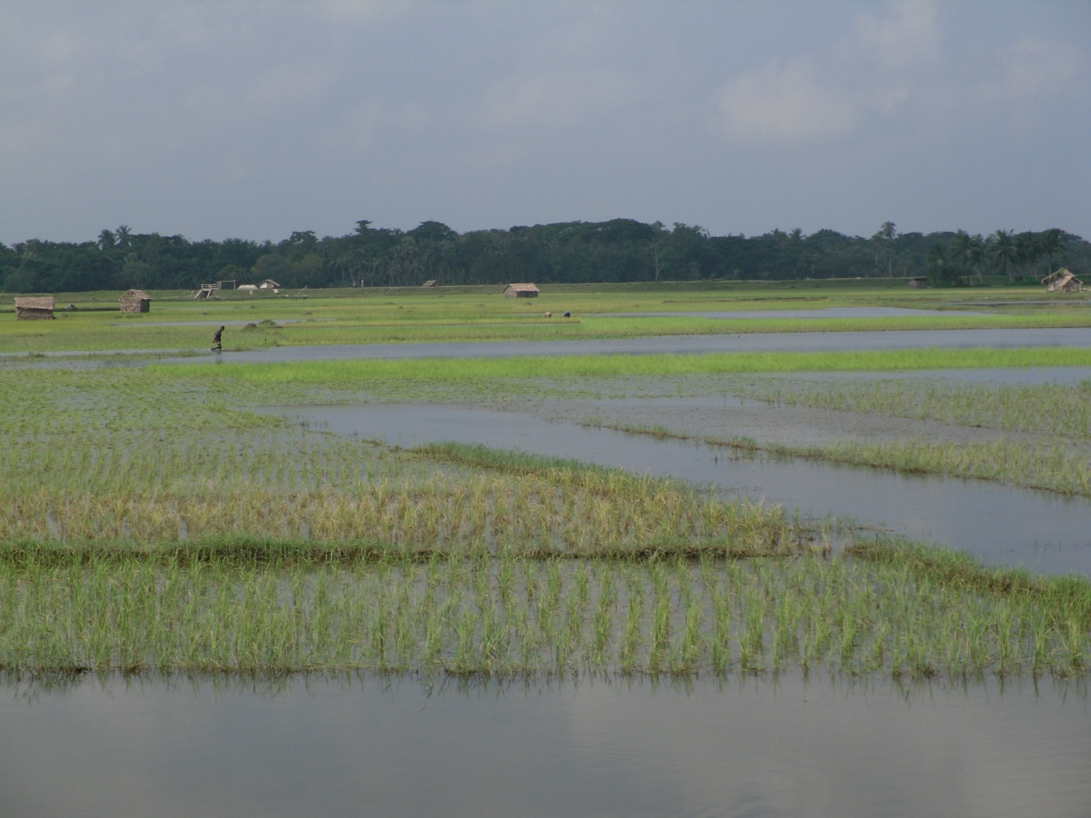
Is water scarce in coastal Bangladesh?

Slide 19
Water Scarcity: ecosystem services

Slide 20
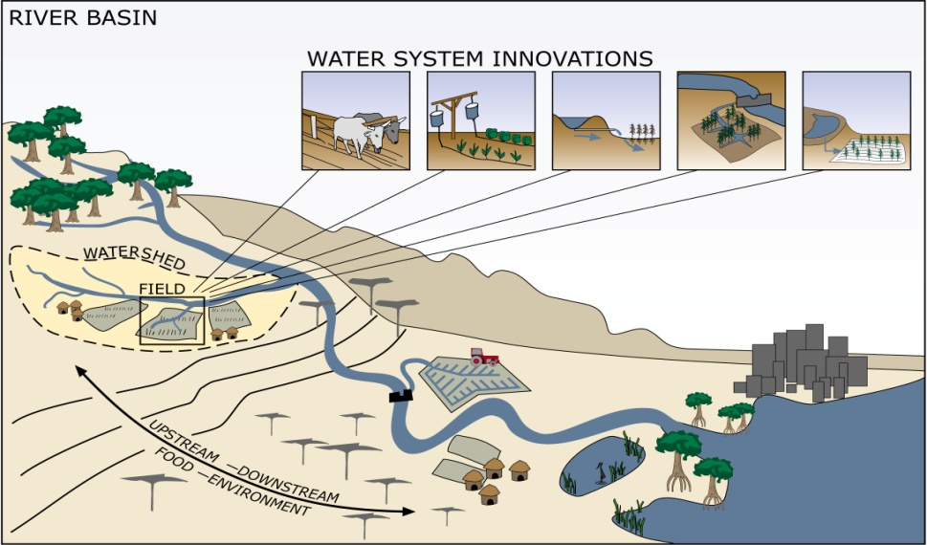
Scarcity of water for ecosystem services
Effects of upstream land and water management are felt downstream
What incentives do upstream people have to improve land and water management?
Source: Stockholm Environment Institute

Slide 21
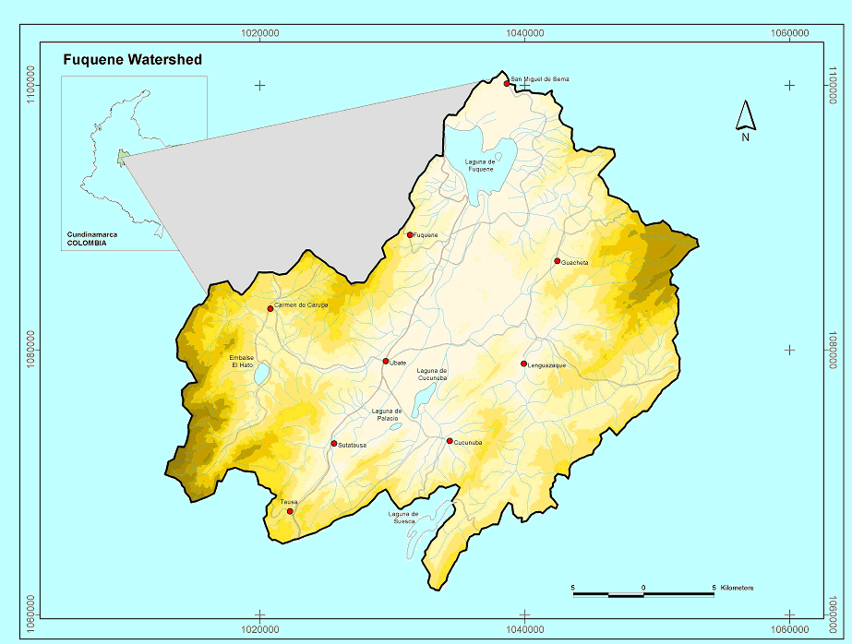
Problem context
“Laguna de Fúquene” (Colombia) *
Area 187,200 ha
Sediment from upstream farms
Loss of lake area
Water quality problems for downstream consumers
* Also, catchment Miskiyacu-Rumiyacu (Moyobamba, Perú), not described here
food · water · environment · livelihoods

Slide 22
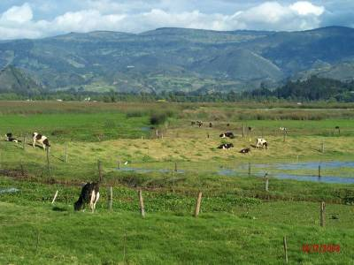
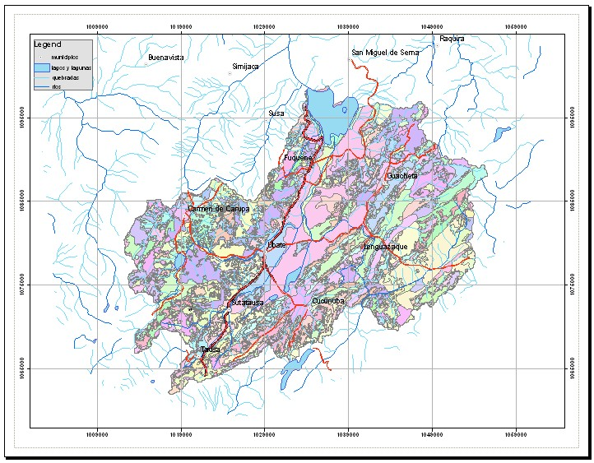
Mapping sediment sources

Slide 23
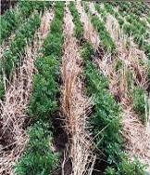
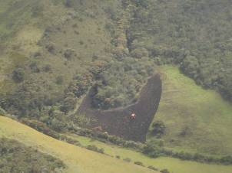
What can be done reduce sediment flow and improve water quality?
Normal intensive
agriculture
Conservation agriculture
Permanent
soil cover
No till
Green manures in the rotation
Fuquene (Colombia)

Slide 24
Water scarcity: downstream users

Slide 25
Water flows downstream – but money and power can flow upstream . . .

Slide 26
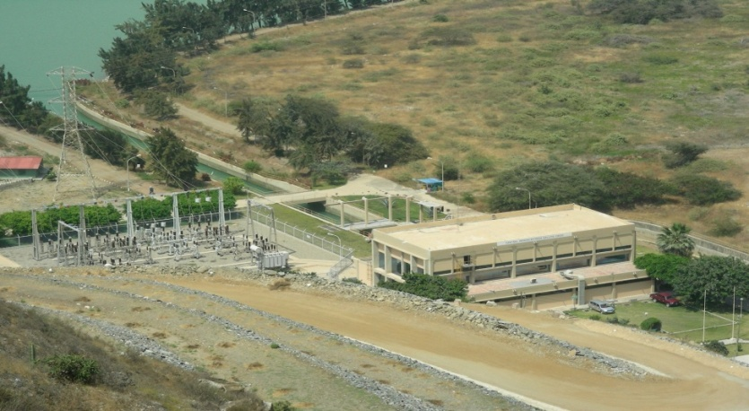
Benefit sharing mechanisms (BSM) in the Andes
Water scarcity felt by downstream urban/ industrial users
These users contributed to a “water supply trust fund”
Trust fund used to make investments in “productive technologies” in upstream communities
In exchange, upstream communities agree to reduce or eliminate cropping or grazing on key catchment areas, e.g., “paramos”
Photo: Gonzalo Pajares

Slide 27
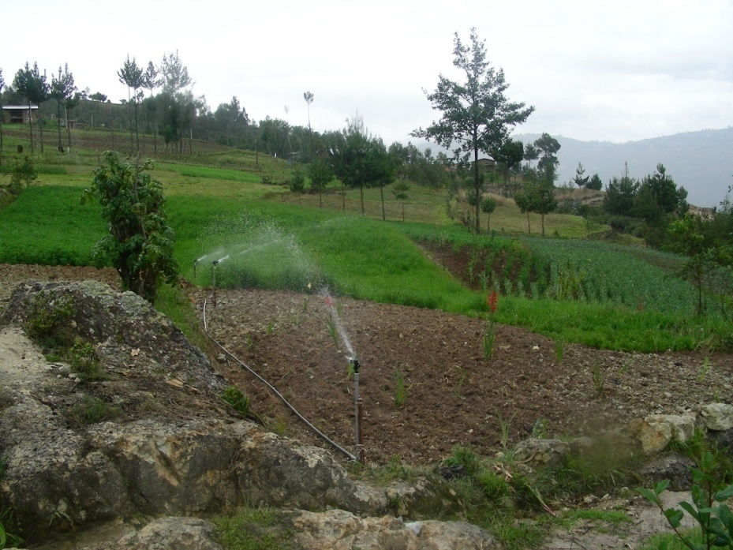
BSM in the Andes
Examples of investments:
  Market-led dairy intensification with improved pastures, milk collection points, vet services, market access
  Small irrigation for high value crops
  Specialized production and marketing of “legacy” crops
Photo: Gonzalo Pajares

Slide 28
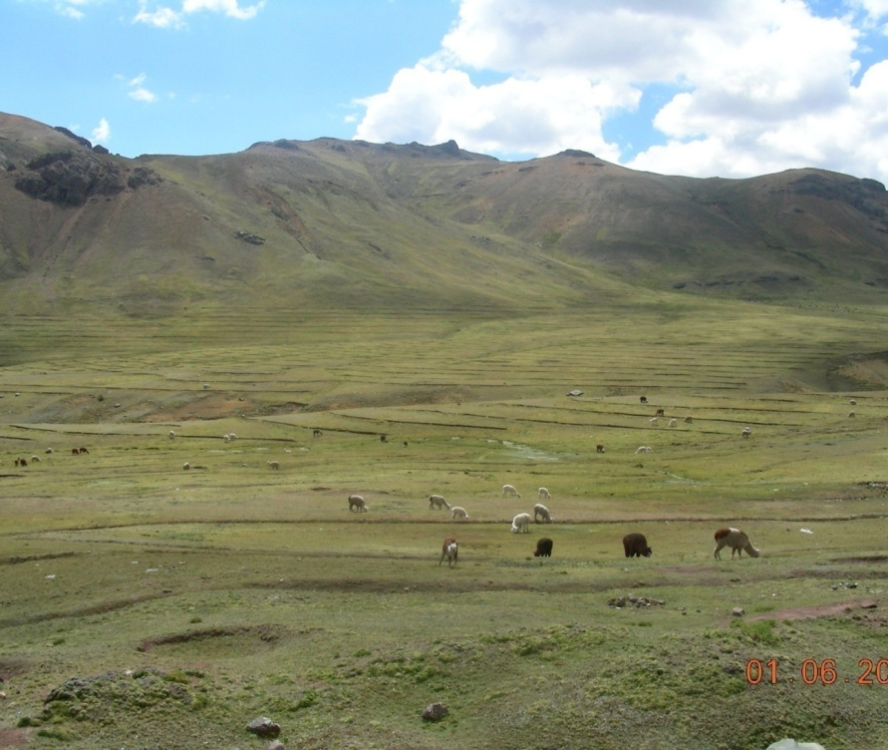
BSM in the Andes
Agreement to cease grazing on vulnerable uplands (“paramos”) community-enforced
Investments were at the community level, NOT the individual farm level
In fact, individual farmers categorically reject anything called “payment for environmental services”|
They fear that in some sense they might be selling some rights to their land
Photo: Gonzalo Pajares

Slide 29
Water scarcity: equitable access

Slide 30
Poverty & Water in South Africa

Slide 31
Questions
What is agricultural water productivity? How can it be increased?

Slide 32
Water productivity
Value of products and services (crops, livestock, fisheries, ecosystem services) per unit water depleted
Water depleted is that made unavailable for reuse, e.g., through evaporation, transpiration, contamination or flow to a saline sink

Slide 33
Water productivity in rice
response
WP
crisis
time
Notes:
Simon Cook

Slide 34
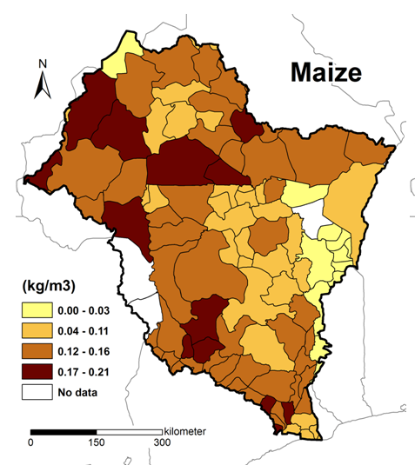
Crop water productivity in the Volta –
. . . up to 0.2 kg/m³

Slide 35
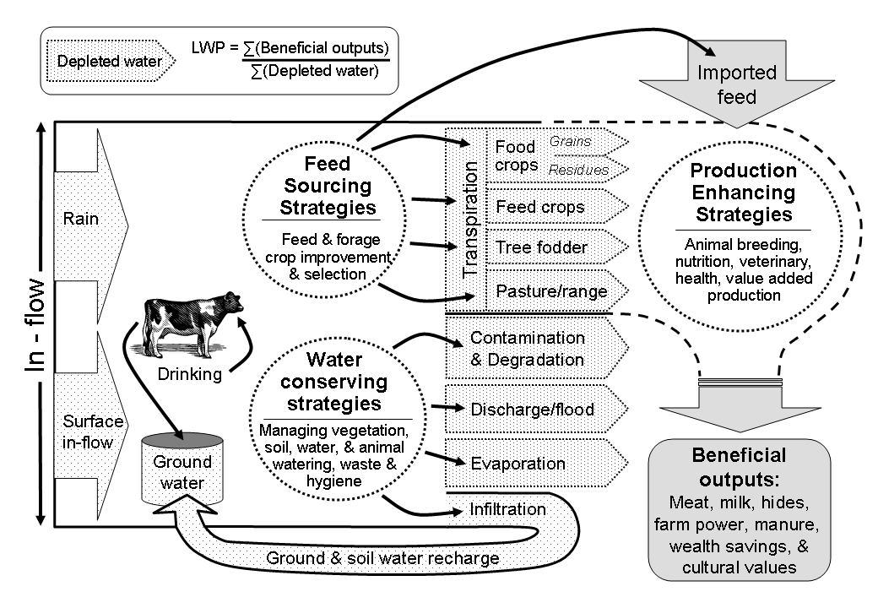
Livestock water productivity
Source: CPWF

Slide 36
Ways to increase agricultural water productivity
Maintain yields while using less water
  Aerobic rice
Raise yields by using water that otherwise would be “lost”
  Input use
  Less evaporation, more transpiration
  In-field water harvesting
Reallocate water from lower to higher value uses
  Across users in a basin or catchment
Diversify farming systems
  Livestock
  Aquaculture
  High value crops

Slide 37
Questions
How is water related to poverty?
How can water-related interventions reduce poverty?

Slide 38
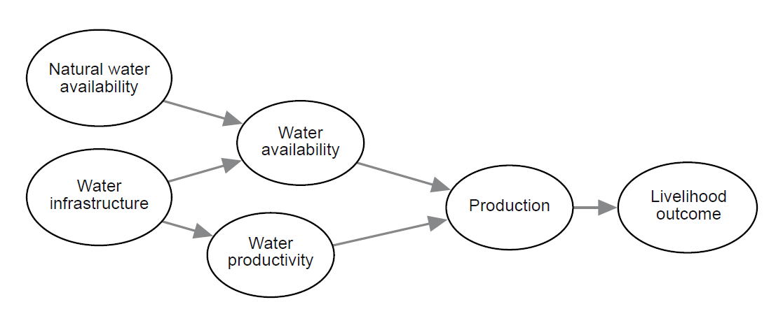
It’s easy to be naïve:
Simplistic view of water and poverty
Source: Eric Kemp Benedict, SEI

Slide 39
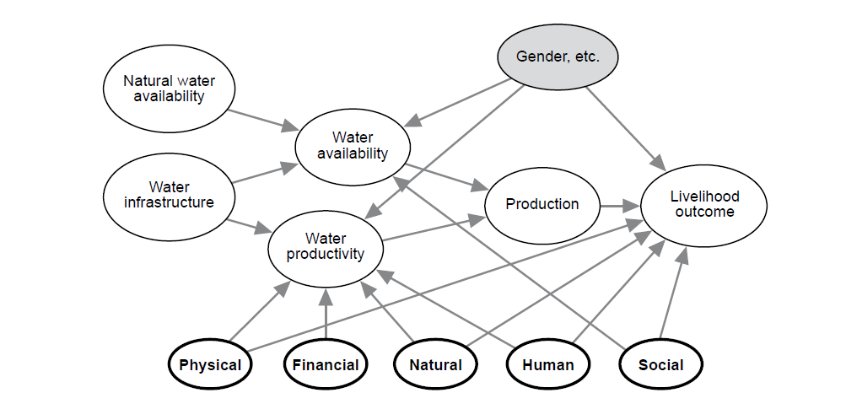
Adding the livelihoods framework
Source: Eric Kemp Benedict, SEI

Slide 40
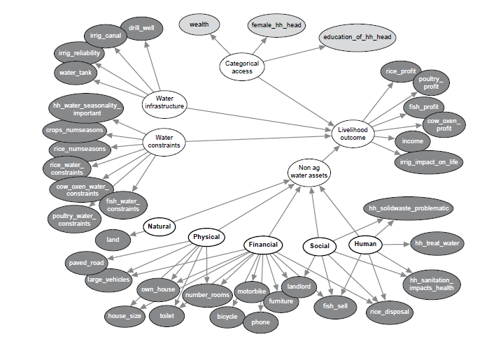
Setting up a Bayesian network model
Source: Eric Kemp Benedict, SEI

Slide 41
