Slide 1
ANC Control Team
Katie Weible
Ximena Aristizabal
Chengfeng Wu
Drew Hart

Slide 2
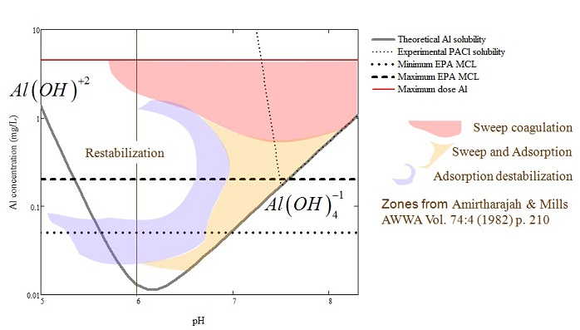
ANC Problem Overview
Lack of alkalinity in source waters in Honduras
Formation of aluminum hydroxides after alum dosing lowers pH
Ideal pH range for flocculation is 6.5-7.5

Slide 3
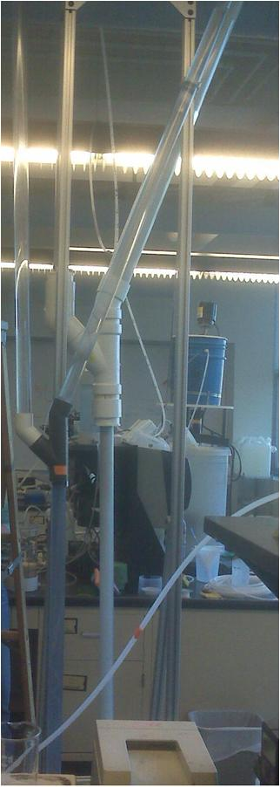
Objective
Design a lime feeder which:
  Is simple and easy to construct
  Delivers clean effluent at pH ~ 12.6 (saturated lime)
  Is easy for the operator to use:
    Easy place to feed lime
    Lime only added every 24 hours

Slide 4
Early in the Semester
Unexpected failures ruled out our first simple explanations
  Overloading
  Distilled water
    Calcium carbonate in lime mixture?

Slide 5
Important Parameters
Lime-water contact area-time
  Particle size distribution
  Solid lime ‘concentration’
  Residence time – reactor height
Rate of dissolution
  Kinetics
  Surface properties
  Solution properties

Slide 6

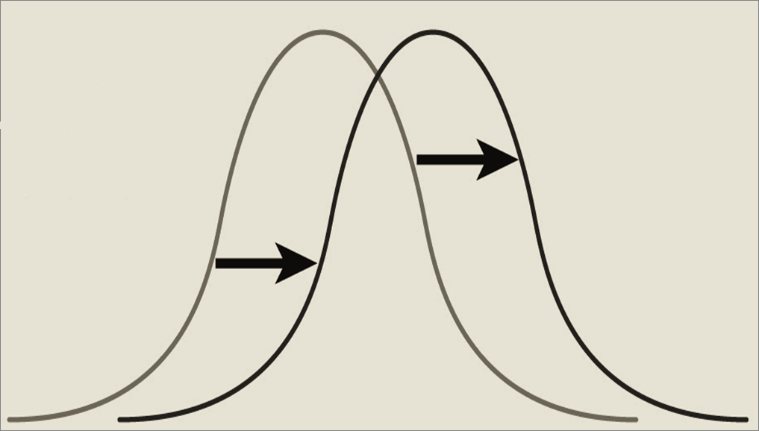
Particle Size Distribution
Smaller particles have higher SA to volume ratio
Possible shift towards larger particles
  Flocculation
  Small particles dissolve fastest
  Smallest particles carried out with effluent
Blending lime to get a better starting point

Slide 7
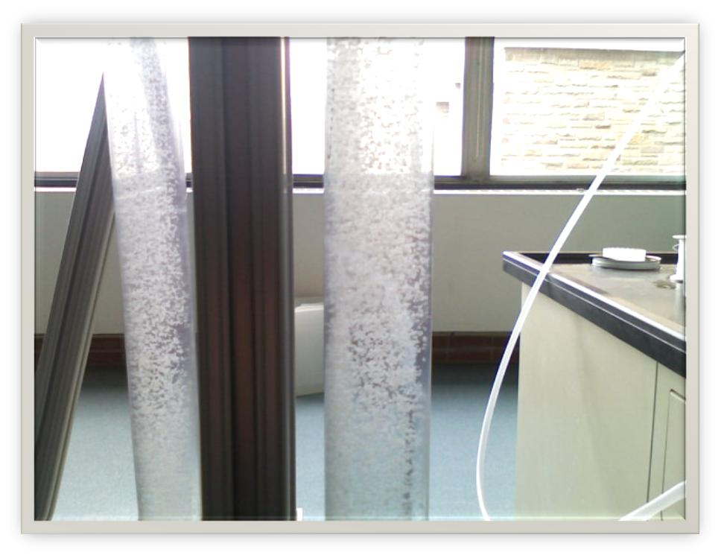
Other Important Mechanisms
Particle coalescence
  Possible relation to blending
  Eliminate settling surfaces
Preferential flow paths
  Want uniform performance
  over flow cross section

Slide 8
Hypothesis
OH
Ca
CO3
Lime Particle
OH
Substitution decided by solubility

Slide 9
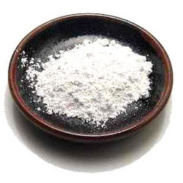
With the accumulation of carbonate in system, CaCO3 starts coating on lime

Slide 10
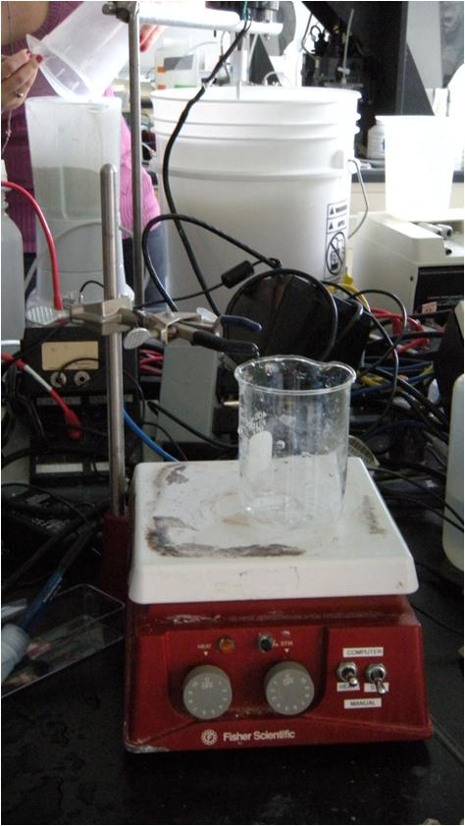
TESTING PH
Constant decrease in pH indicates that hydroxides were replaced and now it is a solution of carbonates that are reacting in an open system with CO_{2.}
Is the phenomenon happening with all residual lime in the reactor?

Slide 11
EXPERIMENTS 4 & 5
Overloading the reactors with lower flow rate
Overloading the reactors with different up-flow velocities in each one.
WHY
To improve the performance of experiment 3, determining its failure causes.
HOW
Reducing up-flow velocity and the amount of lime.
WHAT DID WE LEARN?
Lower up-flow velocities provide higher residence time allowing small particles to dissolve.
Having different up-flow velocities in both reactors.
By increasing up-flow velocity the amount of lime in the reactor can decrease rapidly and also the performance.

Slide 12
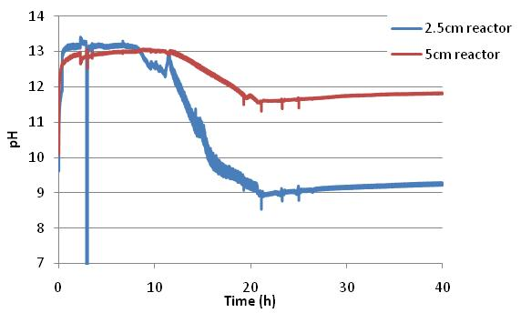
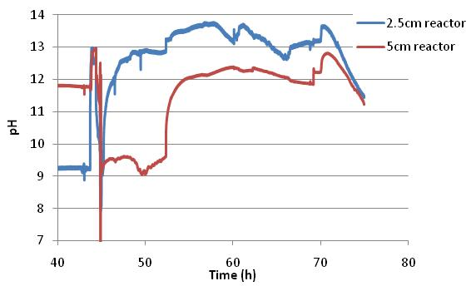
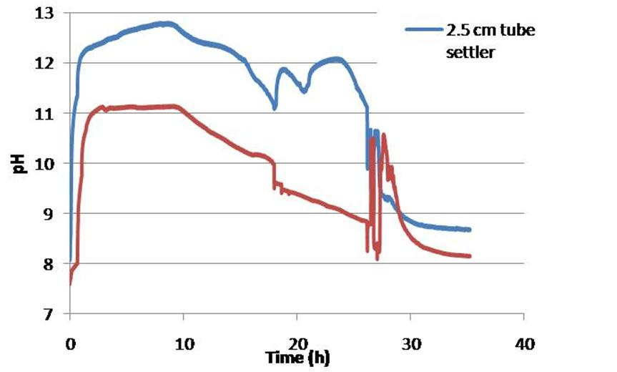
EXPERIMENT 4
EXPERIMENT 5
Notes:
Exp 4. A1 lasted for 12.5 hours and A2 for 18 hours
Exp 5. A1 above a pH of 12 for 14.6 hours. A2 never reached 12

Slide 13
EXPERIMENT 6: Blending the Lime Slurry
WHY
Producing smaller particles provides more surface area available for lime to dissolve in water.
HOW
Blending lime before adding it to the reactors.
WHAT DID WE LEARN?
Increasing contact surface area enhance the performance.
pH values are more stable over time.

Slide 14
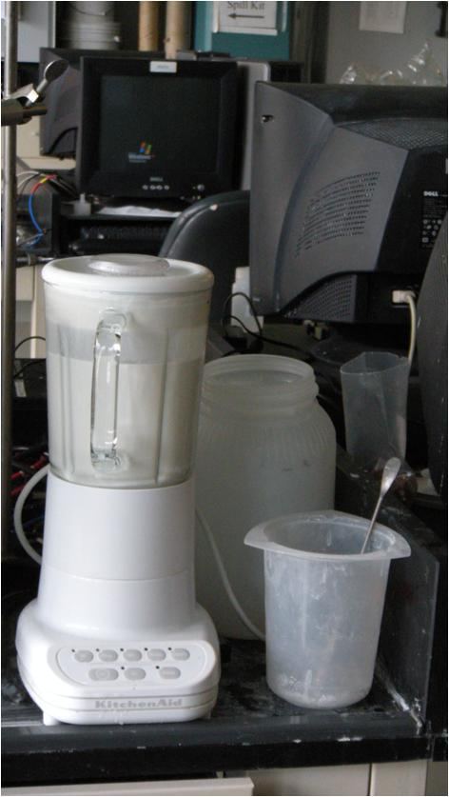
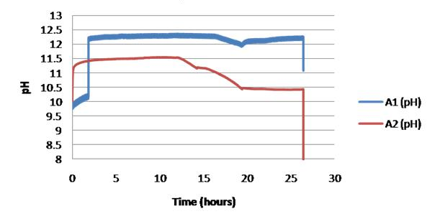
EXPERIMENT 6: Blending the Lime Slurry
Notes:
The experiment lasted approximately 12.5 hours for A2 and 16.5 hours for A1. Neither reached the saturation point for lime, with A1 reaching 12.3 and A2 reaching 11.6 as the peak pHs.

Slide 15
EXPERIMENTS 7 & 8: Pulsing in a Stock Solution of Lime
WHY
To test the effects of continuously adding lime, and also to formalize the preparation of the stock solution
HOW
Following an exact procedure for blending the lime; setting up a third peristaltic pump to pulse lime into the two apparatuses
WHAT DID WE LEARN?
The 100 grams of lime settles very slowly, keeping the pH steady for a while
The pH eventually dropped because the stock solution was not concentrated enough

Slide 16
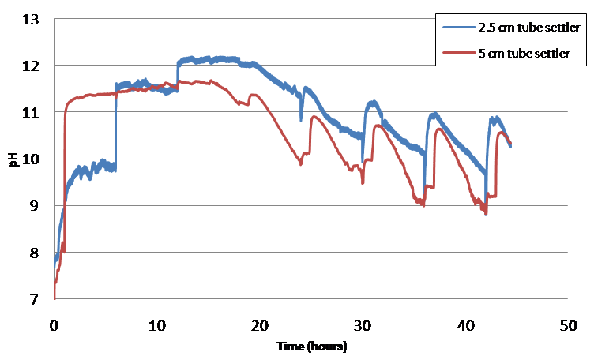
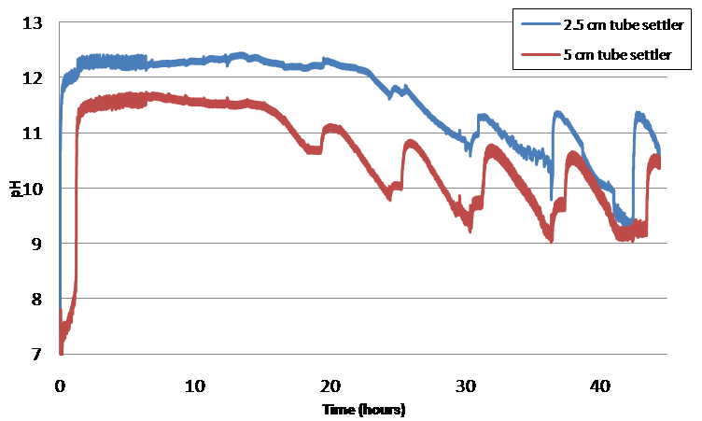
EXPERIMENTS 7 & 8

Slide 17
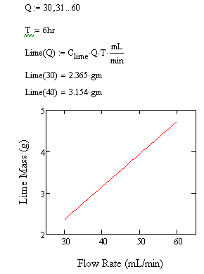
Experiment 7 & 8: Calculations
Using the K_{sp} and the flow rate, we determined how much lime was needed to maintain saturation for a given time of 6 hours

Slide 18
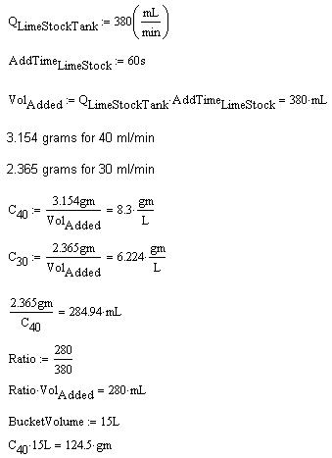
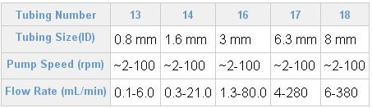
Experiment 7 & 8: Calculations
Calculations to determine the concentration of the lime stock solution
Had to take into account that the 2 apparatuses required different concentrations of lime but we could only put 1 pump on Process Controller

Slide 19
EXPERIMENT 9: Increased Lime Concentration
WHY
To determine if an increased concentration of lime stock solution will maintain the desired pH
HOW
Increased the concentration of lime by 5; all other variables held constant
WHAT DID WE LEARN?
The 2.5 cm tube settler can maintain a pH of approximately 12 for over a week!
The pH of the 5 cm tube settler rises and falls with each lime pulse; never reaches a pH of 12

Slide 20
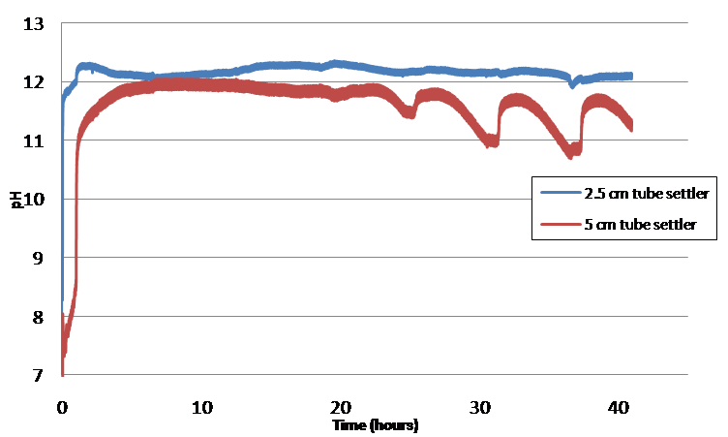
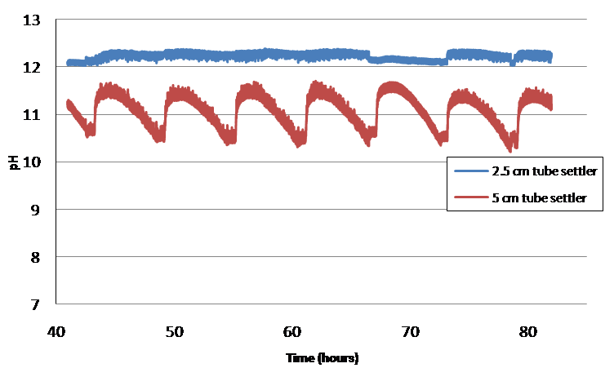
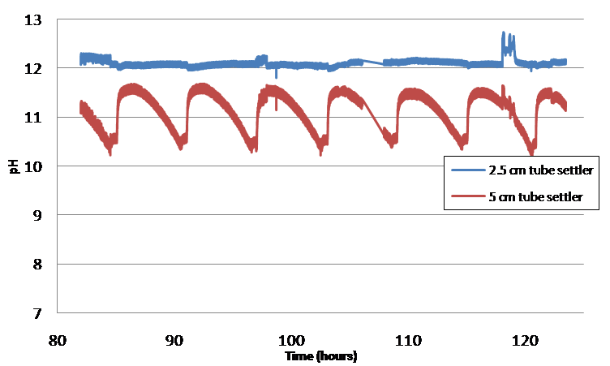
EXPERIMENT 9

Slide 21
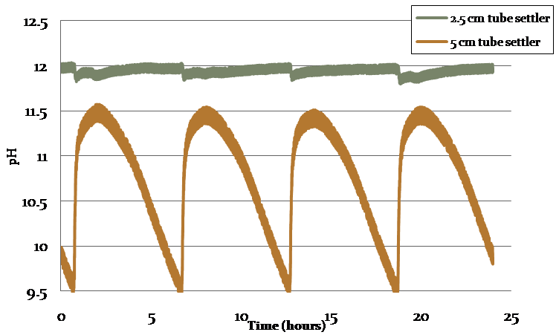
Experiment 9 – Up close!
The 2.5 cm tube settler does experience spikes and drops, but at a much smaller scale than the 5 cm tube settler.
Data taken from May 9th, 2nd to last day of experiment

Slide 22
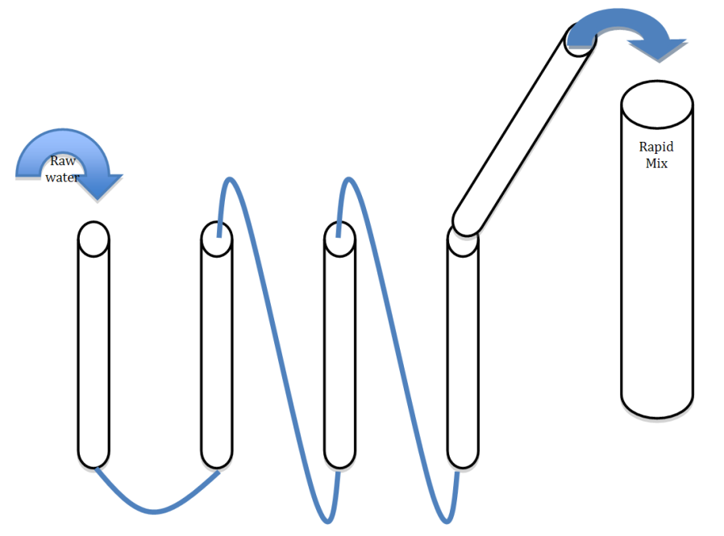

Future Challenges
Smaller, simpler experiments
Distilled water verses tap water - Carbonates hypothesis
Uniform particle size
Improved pH readings
pH Probe
Notes:
1. Work with smaller, simpler experimental set-ups so that experiments can be run more easily and the important mechanisms can be isolated. Working with the large feeders, while important, can be tedious and their behavior can be too complex to draw strong conclusions from. Investigating the behavior of lime in suspension may be more fruitful in smaller-scale, more controlled tests.
2. Continue to run controlled experiments with both distilled water and tap water in order to characterize the effect that carbonate ions have on the reactor's performance. Our work from this semester did not yield results from which we can confidently draw conclusions about the importance of this effect.
3. Try the Honduran lime to see if there's any significant difference.
4. Explore methods for getting more uniform particle size when electric blenders are not available.
5. Instead of trying to read the pH of flowing effluent water, try placing the pH probes in a small beaker through which the effluent flows. Set up hydraulic conditions that cause intermittent flow into the beaker. This will eliminate voltage fluctuations and may result in more accurate pH readings.
6. Explore entirely alternative methods of feeding lime or otherwise adding alkalinity to the plant flow. A possible new design is considered by the team.

Slide 23


Future Challenges (continued)
Investigate the lime used by the Spring 2010 team
  Use a Carbon analyzer (?)
  Use a furnace to burn off carbonates
Try using the Honduran lime!
  Composition is most likely Ca(OH)₂
Try a completely new design

Slide 24
New Design Proposal
Calculate the required lime per day to neutralize pH to 6.75, which is 2.5 kg/day

Slide 25
Assuming the lime concentration in stock tank is 5 gm/L, the required stock tank’s volume is 0.5 m³

Slide 26

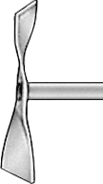
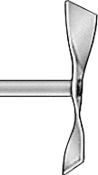


Generate turbine in the stock tank
Flow control 0.09 gal/min
Aguaclara dose control technology

Slide 27
Questions?

