Slide 1
Tube Floc Experiments
Final presentation Fall 2009
Laura Floyd
Tami Chung
Sophie Bernat
Alex O’Connell
Dali Sun

Slide 2
Table of Contents
Introduction
Data analysis
Results of our experiments
Conclusion

Slide 3
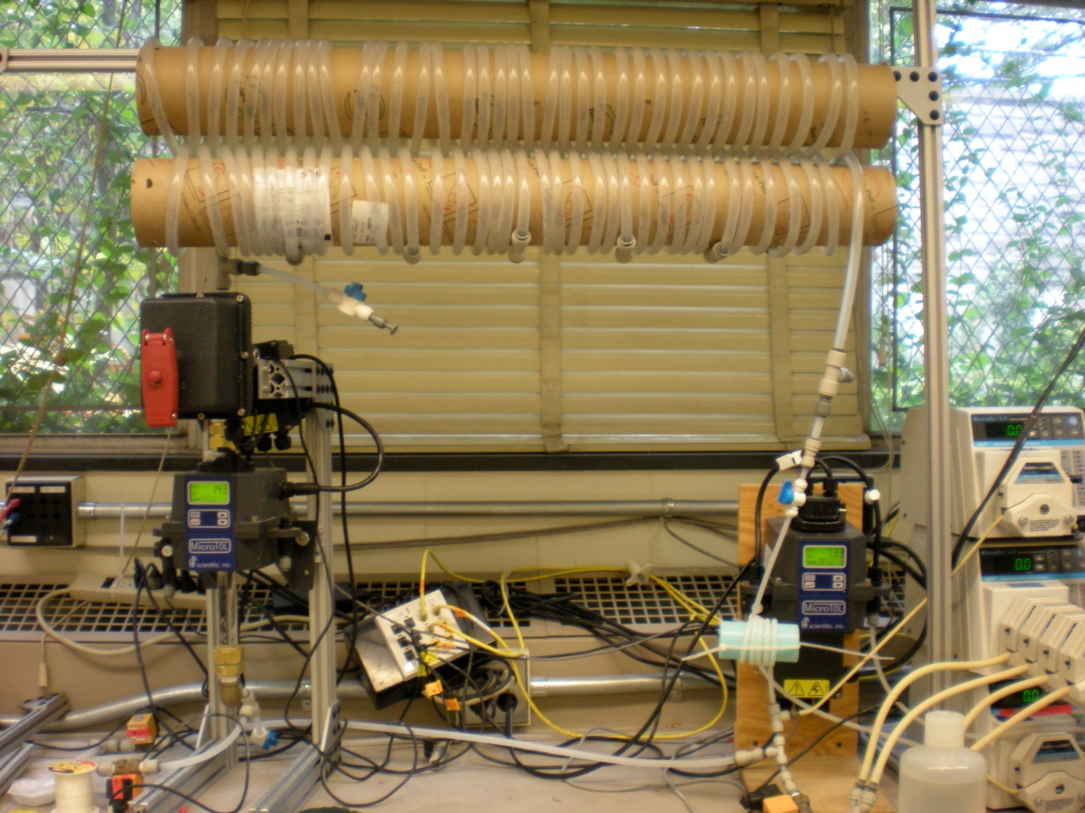
FReTA Experimental Setup:
The Equipment We Use to Analyze Flocculation

Slide 4
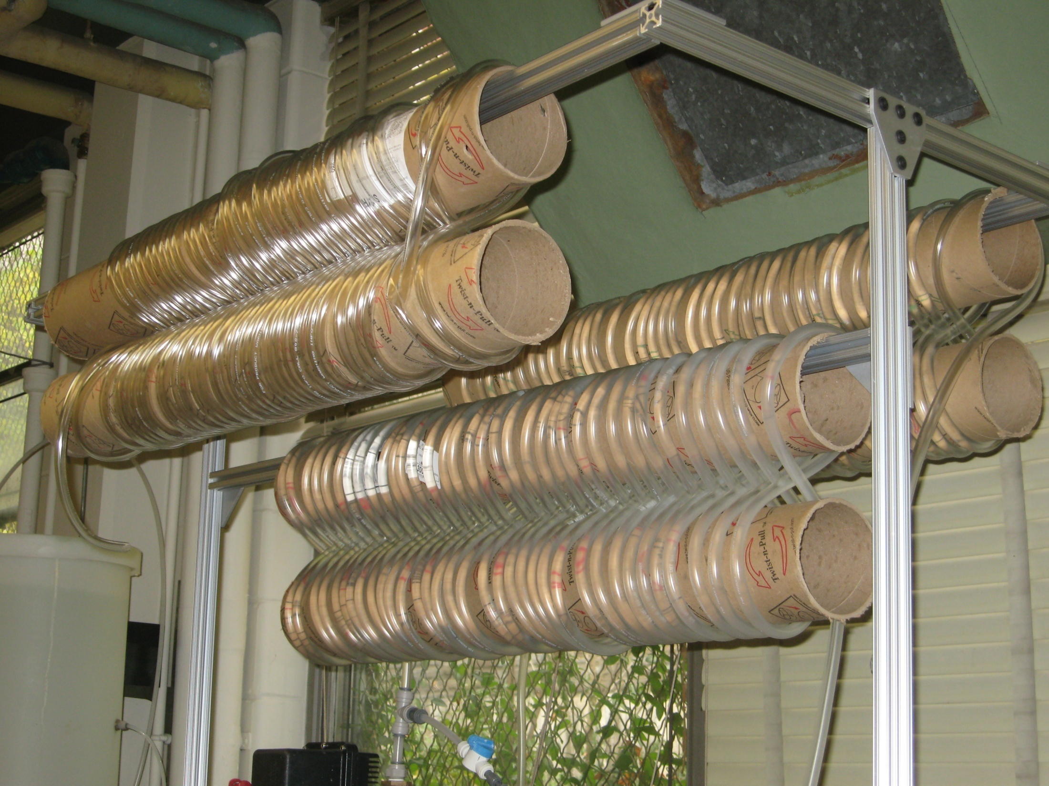
Tube Flocculator
In our current experiment, we are testing several different influent turbidities over a range of alum dosage and comparing the performance of flocculation over these ranges at different lengths

Slide 5
Alum Dose Ranges (mg/L) and Increments
Flocculator length(m) | 5 NTU | 25 NTU | 50 NTU | 100 NTU | 500 NTU
28 | 10-50 | 10-50 | 10-66 | 20-60 | 10-90
Increment | 5 | 5 | 7 | 5 | 10
56 | 10-50 | 10-50 | 10-66 | 20-60 | 10-90
Increment | 5 | 5 | 7 | 5 | 10
84 | 10-50 | 10-50 | 10-66 | 20-60 | 10-90
Increment | 5 | 5 | 7 | 5 | 10

Slide 6
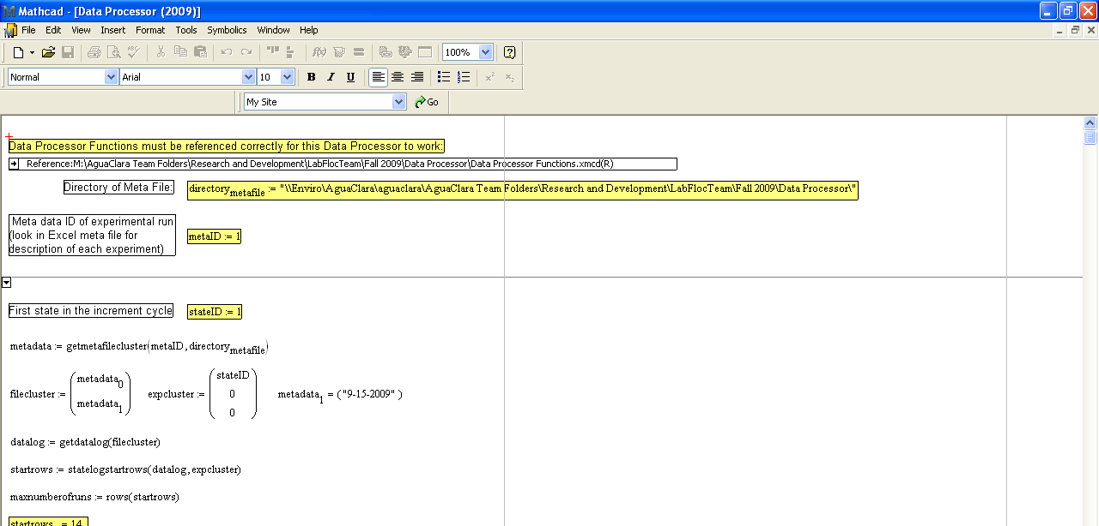
Data Analysis
Essential tool used for analyzing data
    MathCad

Slide 7
Data Analysis
MathCad
  Processes data and presents graphs plotting important information needed for data analysis
Main graphs we used for our experiment:
  Gamma PDF Graph
  Residual Turbidity Graph

Slide 8
Obtaining the Residual Turbidity Graph…
Plot of Raw data: Turbidity vs. Sedimentation Velocity throughout experiment
Focusing on Residual Turbidity: Residual Turbidity vs. Sedimentation Velocity

Slide 9
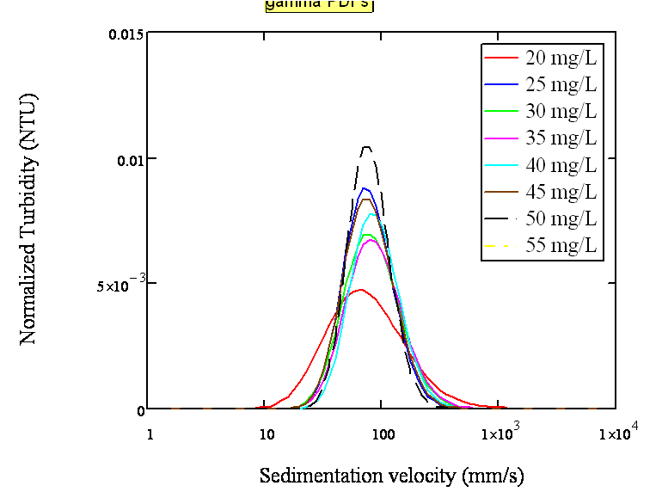
Obtaining the Gamma PDF Graph…
Probability distribution of the particle population with respect to Vs

Slide 10
Varying Alum Dose and Flocculator Length
Goal: To determine the effect of alum dosage and flocculator length on tube flocculation.
Varied alum dosage (increasing by constant increments)
Applied the set alum dosages to three different flocculator lengths.

Slide 11
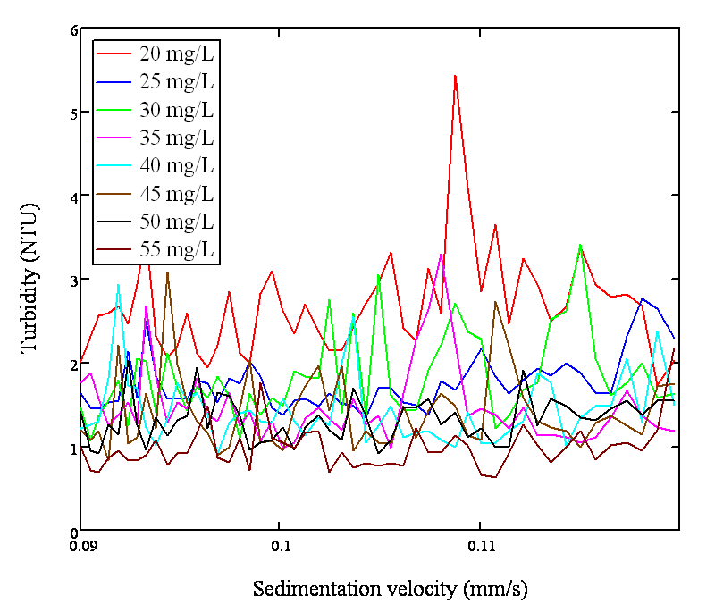
Residual Turbidity vs. Sedimentation Velocity
Alum Dose | Residual Turbidity
20 | 2.663
25 | 1.755
30 | 1.81
35 | 1.497
40 | 1.437
45 | 1.413
50 | 1.325
55 | 0.984
Notes:
100 NTU experiement @ 1st flocculator length.

Slide 12
Gamma PDF graph

Slide 13
Results
Effect of length of the flocculator on residual turbidity:

Slide 14
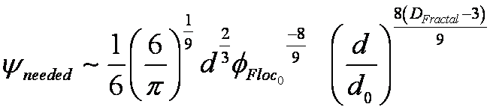
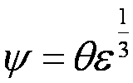
Results
Effect of length of the flocculator on residual turbidity:

Slide 15


Results
Effect of length of the flocculator on residual turbidity:
Break up flocs
Steady state
  Floc size disribution constant

Slide 16
Results
Effect of the alum dose on flocculation:

Slide 17
Results
Effect of the alum dose on flocculation:
Influent Turbidity | pC*
5 NTU | 0.38
25 NTU | 0.99
100 NTU | 1.84
500 NTU | 2.16

Slide 18
Conclusions…What We Know So Far
Extending flocculator length appears to improve flocculation at low influent turbidities but has less of an effect at higher influent turbidities
Increasing alum dose improves flocculation initially but with diminishing returns as dose increases beyond a certain level
Results are preliminary

Slide 19
What We Hope To Learn…
Complete our investigation of alum dose and flocculator length by collecting more data to fill in optimal alum dosages for the different influent turbidities
Begin investigating how pH affects flocculation

Slide 20
Thank you
Question ?

