Slide 1
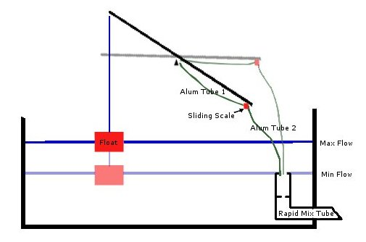
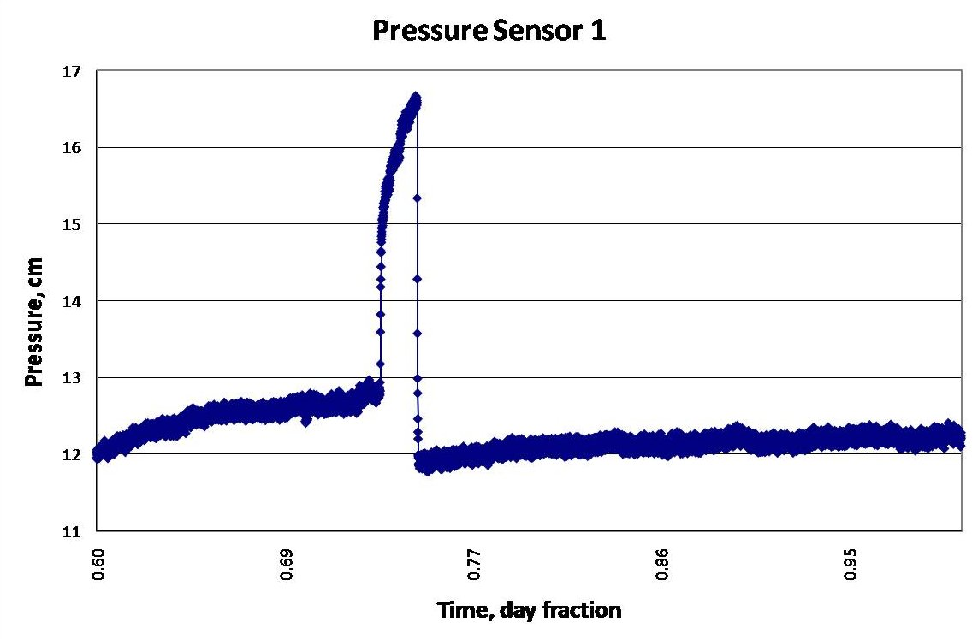
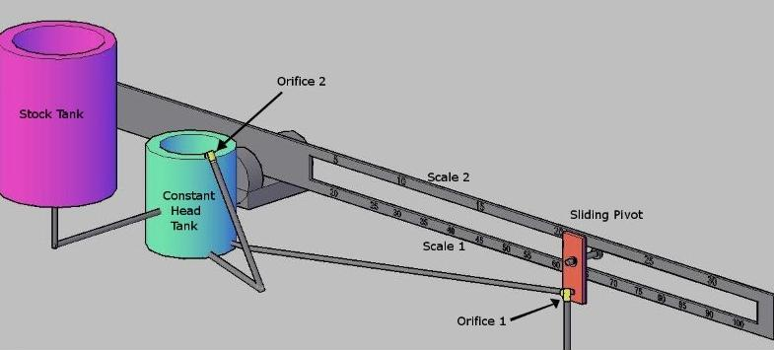
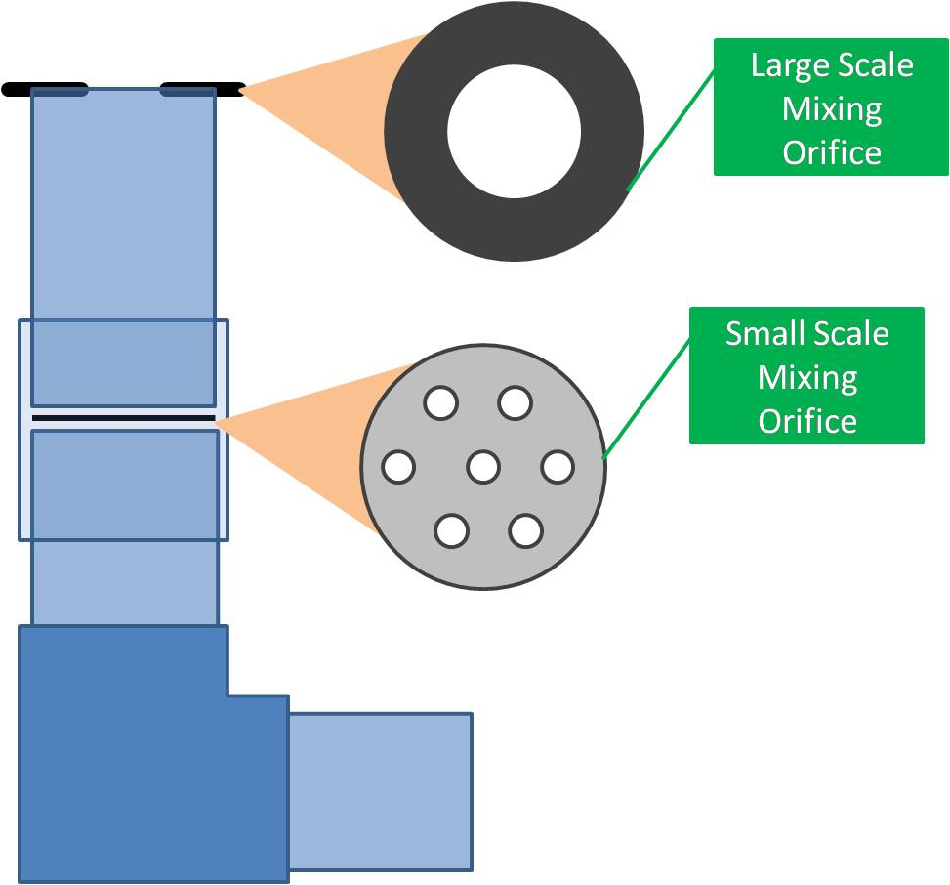
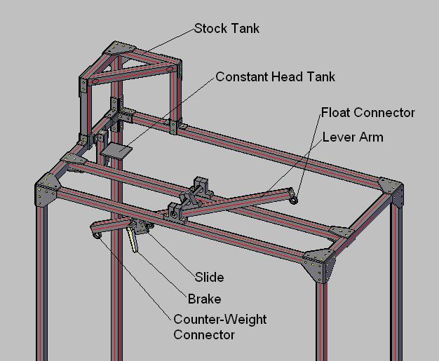
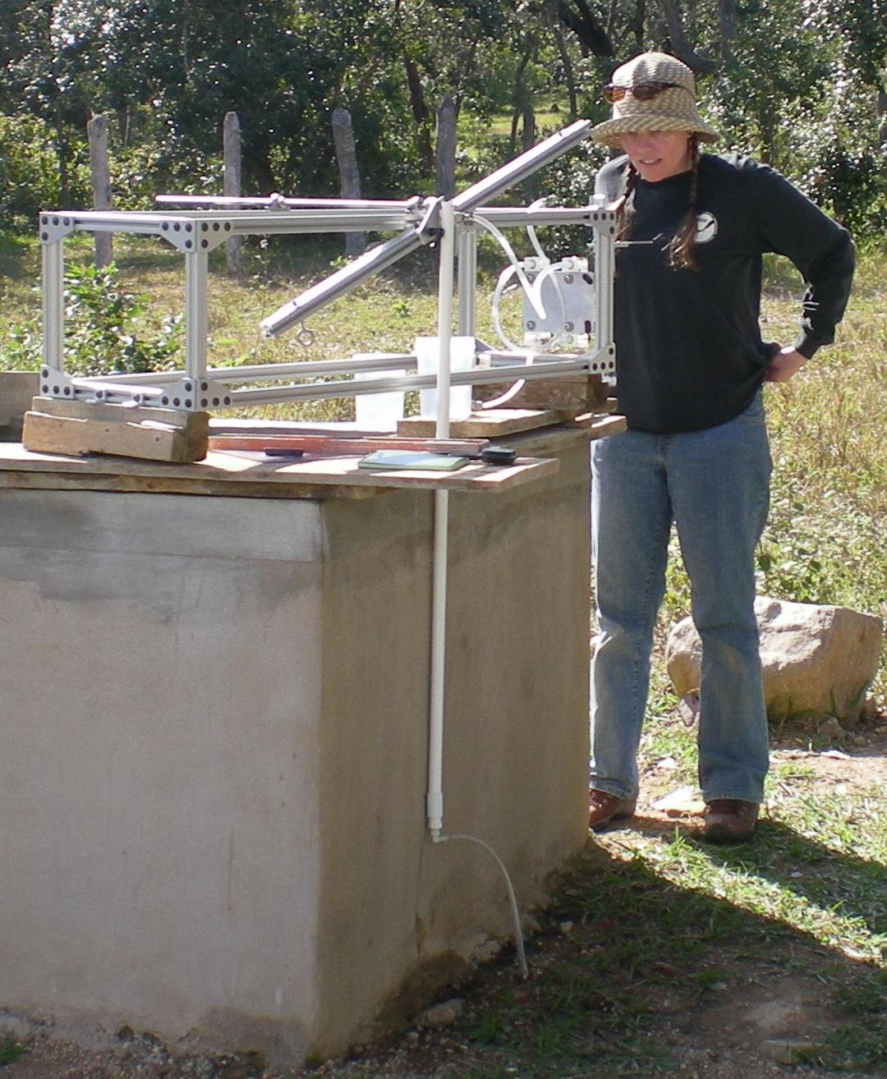
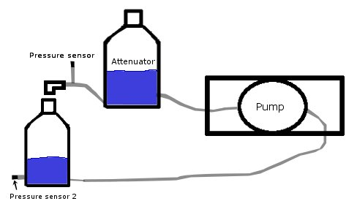
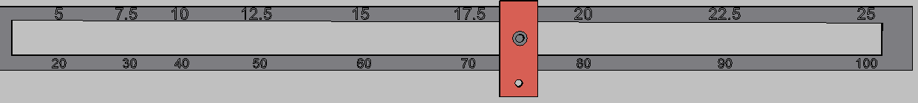
Nonlinear Chemical Dose Controller for AguaClara Plants
Kayti Curtis, Dale Johnson, Harrison Ko, Akta Patel, Karen Swetland, Monroe Weber-Shirk, Civil and Environmental Engineering, Cornell University
Abstract
AguaClara is a program in Civil and Environmental Engineering that is improving drinking water quality through innovative research, knowledge transfer, open source engineering and design of sustainable, replicable water treatment systems. As the AguaClara project grows, water treatment plants are being designed to serve larger communities. These plants have higher flow rates and a chemical dose controller must be designed to dose chemicals accurately at these higher flow rates.
Aluminum sulfate (alum) is used in AguaClara plants as a coagulant to allow particles in the water to stick together and settle out more easily. Accurate alum dosing is vital for plant operation because of its impact on the effectiveness of subsequent processes: flocculation and sedimentation. The nonlinear Chemical Dose Controller (CDC) is designed to handle turbulent flow in the dosing tube In contrast, the previously designed linear CDC requires that the chemical flow in the dosing tube is laminar. The nonlinear CDC is used in conjunction with the newly designed Rapid Mix Tube.
When the flow in the dosing tube is turbulent, there is no longer a linear relationship between flow rate and head loss in the tube. In this case, a nonlinear CDC, one that uses minor losses to control flow rates, can be used to maintain a constant chemical dose with the varying plant flow rates. By using an orifice to control chemical flow, the CDC will have the same nonlinear response to increasing flow as the plant flow rate, which is controlled by another orifice. A dual scale system on the lever arm will increase accuracy in dosing at smaller doses. The nonlinear CDC was installed in the new AguaClara-designed plant in Agalteca, Honduras in January 2010.
``
Controlling Dosing
Clogging Experiment Results and Conclusions
Figure 7: The results from the first experiment suggested that a clogged formed.
Figure 8: No clog formed in the second experiment . The results from the second experiment were inconclusive as there was no clear evidence of a clog.
Figure 3: A float controls the nonlinear Chemical Dose Controller’s response to changes in plant flow rate by adjusting alum flow.
It was concluded that clogging in the orifice would not occur frequently or predictably, but the orifice sizes in the design were increased to reduce the possibility of clogging.
the alum stock tanks which could have alum precipitate accumulating.
As the plant flow increases, the level of water in the entrance tank rises. This causes the float to rise and, as a result, a higher flow of alum is delivered. This system will allow the operator to specify one concentration of alum on the dosing arm. Independent of the plant flow rate, the chosen concentration will be maintained. Automatic adjustment of alum flow to plant flow rate will greatly facilitate plant operation and treatment effectiveness. The weight of the float is designed to create a zero moment around the pivot point on the dosing arm at maximum dosage. The diameter of the float is maximized, within reason, to provide stability and minimize dosing errors. The float design meets all required dosing needs of plants in Honduras and similar principles for chemical dosing can be used anywhere in the world.
Chemical Doser Overview
Rapid Mix Tube
The function of the Rapid Mix Tube is to provide adequate large and small scale mixing of the alum with the raw water. These two stages of mixing ensure maximum contact between the raw water and the alum. This optimizes the formation and aggregation of flocs in the flocculator. The mixture passes first through a large-scale mixing orifice and then through a small-scale orifice. The small-scale orifice is designed to provide significant head loss and energy dissipation rate for small-scale mixing of the alum with the water. A rapid mix tube was designed and a prototype was taken to the Agalteca Plant in Honduras.
New Doser Design
The prototype doser frame was designed to test the operation of the doser under various conditions. These tests are performed to validate the doser design and ensure optimal operation in the water treatment plants in Honduras.
Figure 1: Doser schematic showing the stock tank that stores alum, the constant head tank that ensures constant alum flow to the raw water, the dual scale to handle both laminar and turbulent flow, and the two orifices used to deliver alum.
Figure 9: The rapid mix tube with a large-scale orifice for turbulent mixing and a small-scale orifice to allow mixing at the molecular level.
Designing a Dual Scale
The Chemical Dose Controller Team has developed a dual scale, orifice-based doser in order to accurately deliver both turbulent and laminar alum flow to the water treatment plant. The doser automatically adjusts the alum flow rate to maintain an operator-specified alum concentration, based on influent turbidity, as the plant flow rate changes. The plant operator can choose between two orifices which correspond to two dosing ranges, a low dosage (5-25 mg/l) and a high dosage (25-100 mg/l). A certain flow of alum is required to maintain a certain coagulant concentration in the plant. These alum flows can be related to the head losses in the dosing system by the following orifice equation:
Where: K_{VC} = Vena Contracta coefficient = 0.63
A = Area of the orifice
h = Head loss
The orifice equation (above) can be used to solve for the head loss at any alum flow through an orifice. The head losses found can be converted to a distance along the dosing arm. A dual scale has been created for the two dosing orifices and can be seen in the figure below.
Figure 5: Prototype doser frame designed using 80/20 components.
Future Studies
Though much progress has been made in the development of a reliable and fully-functional nonlinear
Chemical Dose Controller, many challenges still remain. On the whole, the current designs need to be finalized and validated by various experiments. Anticipated experimentation includes: the effects of rapid mixing on overall plant performance, calculating head loss through a rotameter, flow measurements in the doser to ensure proper calibration, the combined effects of float placement, and orifice sizing on accurate dosing. Furthermore, an extensive report and display must be developed for the EPA competition in April 2010. A prototype doser will be constructed for demonstration purposes, along with a small-scale model of the plant and several posters.
Figure 4: Building the doser in Agalteca, Honduras.
Clogging Experiment
Dosers in current AguaClara-designed Plants are becoming clogged. An experiment was designed (Figure 6) to determine the cause of the clogging. Some hypotheses were that the clogging is caused by formation of precipitate, foreign material, or influent water chemistry. The experiment was run as the worst possible scenario with the smallest orifice size and the highest concentration of alum used.
Acknowledgements
We would like to give a special thanks to Yoon Choi and Monica Hill, team members in Fall 2009. We would also like to thank Monroe Weber-Shirk for guidance and instruction. Lastly, we would like to thank the EPA for the P3 Phase I grant.
Figure 2: Dual scale system for laminar and turbulent flows.
Figure 6: The attenuator reduces the pulse flow caused by the pump. Pressure sensor 1 was read to determine whether or not a clog occurred. Pressure sensor 2 is a safety valve.

