Slide 1
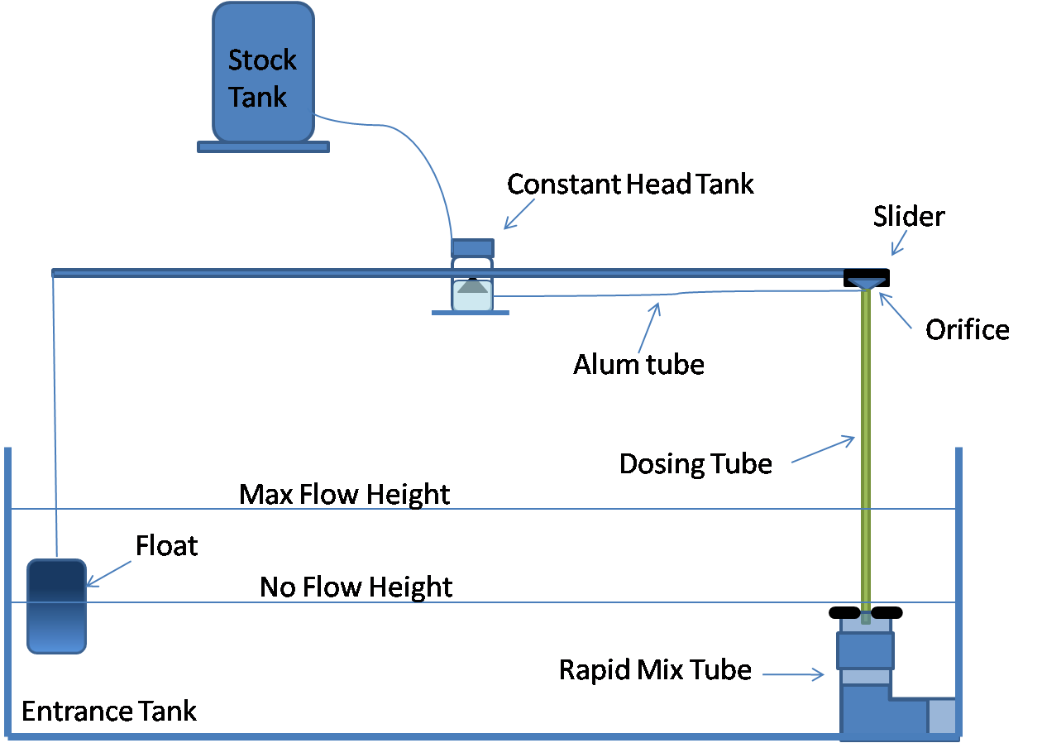
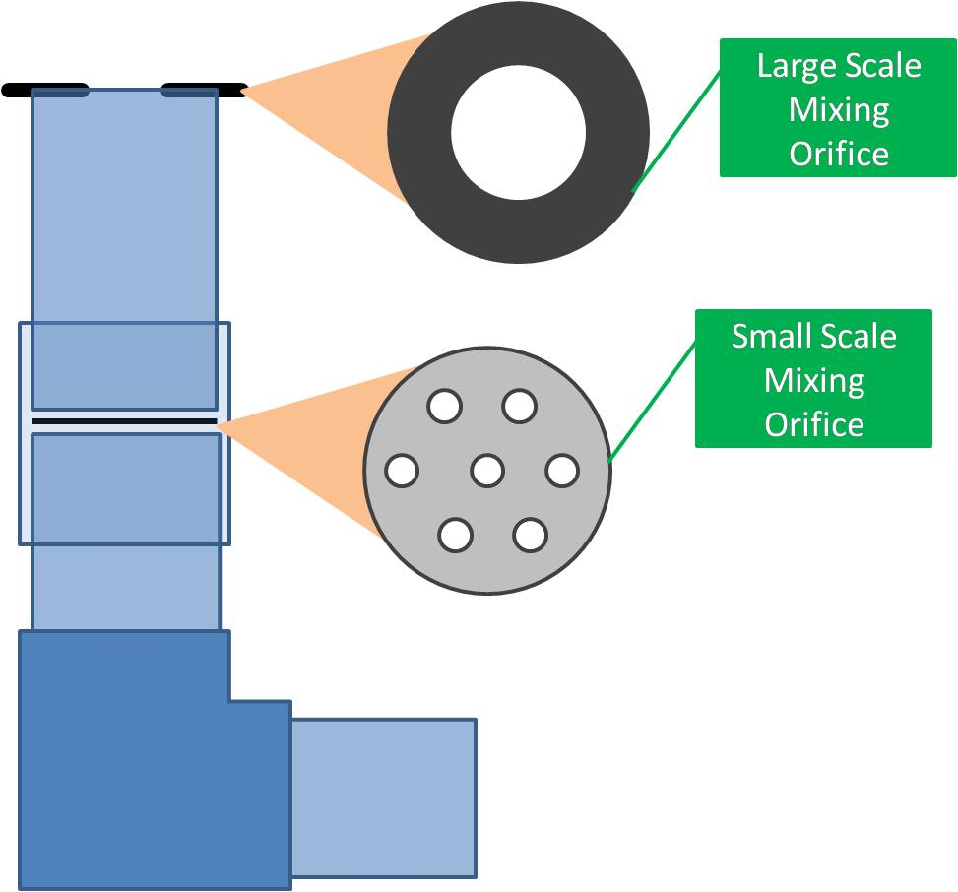
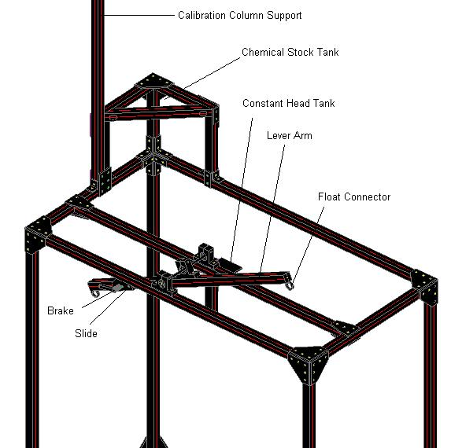
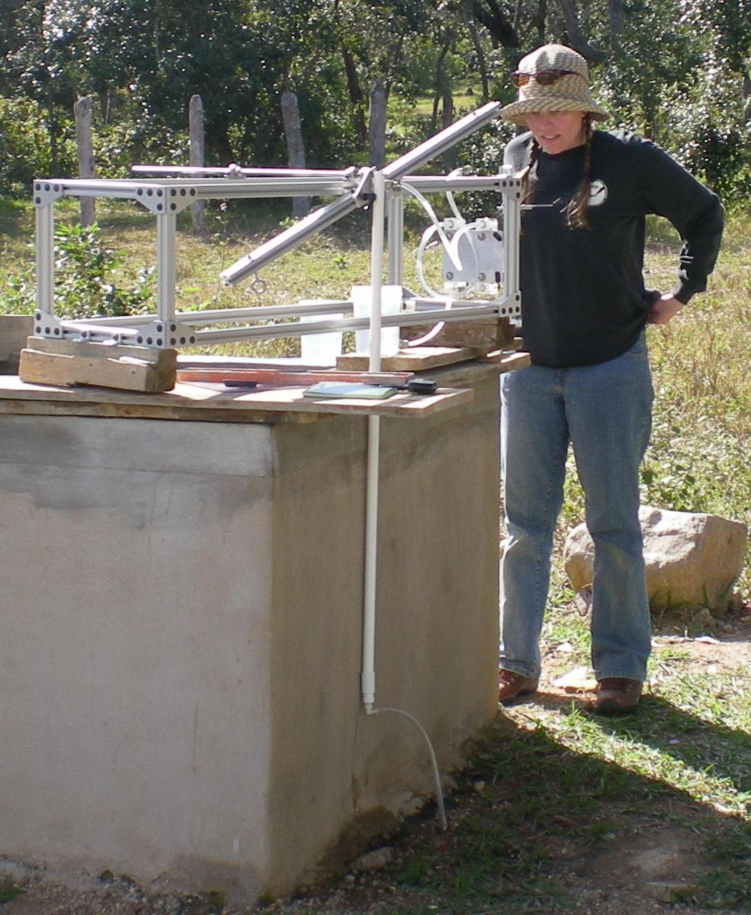
Nonlinear Chemical Dose Controller for AguaClara Plants
Kayti Curtis, Dale Johnson, Harrison Ko, Akta Patel, Karen Swetland, Monroe Weber-Shirk, Civil and Environmental Engineering, Cornell University
Abstract
AguaClara is a program in Civil and Environmental Engineering that is improving drinking water quality through innovative research, knowledge transfer, open source engineering and design of sustainable, replicable water treatment systems. As the AguaClara project grows, water treatment plants are being designed to serve larger communities. These plants have higher flow rates and a chemical dose controller must be designed to dose chemicals accurately at these higher flow rates.
Aluminum sulfate (alum) is used in AguaClara plants as a coagulant to allow particles in the water to stick together and settle out more easily. Accurate alum dosing is vital for plant operation because of its impact on the effectiveness of the subsequent processes: flocculation and sedimentation. The nonlinear Chemical Dose Controller (CDC) is designed to handle turbulent flow in the dosing tube. In contrast, the previously designed linear CDC requires that the chemical flow in the dosing tube is laminar. The nonlinear CDC is used in conjunction with the newly designed Rapid Mix Tube.
When the flow in the dosing tube is turbulent, there is no longer a linear relationship between flow rate and head loss in the tube. In this case, a nonlinear CDC, one that uses minor losses to control flow rates, can be used to maintain a constant chemical dose with the varying plant flow rates. By using an orifice to control chemical flow, the CDC will have the same nonlinear response to increasing flow as the plant flow rate, which is controlled by another orifice. A dual scale system on the lever arm will increase accuracy in dosing at smaller doses. The nonlinear CDC was installed in the new AguaClara-designed plant in Agalteca, Honduras in January 2010.
``
Controlling Dosing
Clogging Experiment Results
On the first run, the data suggested that a clog was formed from the increase in pressure and that it was removed by the decrease in pressure. However, because there was no clog formation in subsequent runs, It was concluded that clogging in the orifice would not occur frequently or predictably. The orifice sizes in the design were increased to reduce the possibility of clogging and it was recommeded that a strainer be added to reduce the possibility of extraneous material entering the dosing system.
Figure 4: The doser adjusts the alum flow rate to maintain a specific alum concentration, as the plant flow rate changes.
Figure 8: The results from the first experiment suggested that a clogged formed.
When there is no flow in the plant, the water level in the entrance tank is at the minimum level. The float and counterweight will balance each other and the lever arm will be completely horizontal. The dosing orifice will be at the level of the water level in the constant head tank and there will be no difference in height to drive chemical flow. As the plant flow increases, the level of water in the entrance tank rises. This causes the float to rise and, as a result, the orifice side of the lever drops, increasing the height difference between the orifice and the water level in the constant head tank. This delivers higher flow chemical flow rates into the system.
AguaClara Turbidity and Coliform Data
Figure 1 (left): Turbidity data from AguaClara plants in Marcala, Cuatro Comunidades, and Tamara. Note the turbidity of the water reaching the first house is almost always below the AguaClara standard of 5NTU.
Rapid Mix Tube
New Doser Design
The function of the Rapid Mix Tube is to provide adequate large and small scale mixing of the alum with the raw water. These two stages of mixing ensure maximum contact between the raw water and the alum. This optimizes the formation and aggregation of flocs in the flocculator. The mixture passes first through a large-scale mixing orifice and then through a small-scale orifice. The small-scale orifice is designed to provide significant head loss and energy dissipation rate for small-scale mixing of the alum with the water. A rapid mix tube was designed and a prototype was taken to the Agalteca Plant in Honduras.
The prototype doser frame was designed to test the operation of the doser under various conditions. These tests are performed to validate the doser design and ensure optimal operation in the water treatment plants in Honduras.
Figure 2 (right): Coliform data from AguaClara plants in Marcala, Cuatro Comunidades, and Tamara. These plants effectively reduced the number of coliforms (indicators of E.Coli), to zero.
Figure 9: The rapid mix tube with a large-scale orifice for turbulent mixing and a small-scale orifice to allow mixing at the molecular level.
Designing a Dual Scale
The Chemical Dose Controller Team has developed a dual scale, orifice-based doser in order to accurately deliver both turbulent and laminar alum flow to the water treatment plant. The plant operator chooses a alum concentration based on influent turbidity. The plant operator can choose between two orifices which correspond to two dosing ranges, a low dosage (5-25 mg/l) and a high dosage (25-100 mg/l). A certain flow of alum is required to maintain a certain coagulant concentration in the plant. These alum flows can be related to the head losses in the dosing system by the following orifice equation:
The head losses found can be converted to a distance along the dosing arm. A dual scale has been created for the two dosing orifices and can be seen in the figure below.
Figure 5: Prototype doser frame designed using 80/20 components.
Future Studies
Though much progress has been made in the development of a reliable and fully-functional nonlinear
Chemical Dose Controller, many challenges still remain. On the whole, the current designs need to be finalized and validated by various experiments. Anticipated experimentation includes: the effects of rapid mixing on overall plant performance, calculating head loss through a rotameter, flow measurements in the doser to ensure proper calibration, the combined effects of float placement, and orifice sizing on accurate dosing. Furthermore, an extensive report and display must be developed for the EPA competition in April 2010. A prototype doser will be constructed for demonstration purposes, along with a small-scale model of the plant and several posters.
Figure 6: Building the doser in Agalteca, Honduras.
Clogging Experiment
Safety Pressure
Sensor
Dosers in current AguaClara-designed Plants are becoming clogged. An experiment was designed (Figure 6) to determine the cause of the clogging. Some hypotheses were that the clogging is caused by formation of precipitate, foreign material, or influent water chemistry. The experiment was run as the worst possible scenario with the smallest orifice size and the highest concentration of alum used.
Orifice
Where: K_{VC} = Vena Contracta coefficient = 0.63, A = Area of the orifice, h = Head loss
Pump
Pump
Attenuator
Acknowledgements
We would like to give a special thanks to Yoon Choi and Monica Hill, team members in Fall 2009. We would also like to thank Monroe Weber-Shirk for guidance and instruction. Lastly, we would like to thank the EPA for the P3 Phase I grant.
Pivot Point
Data Pressure
Sensor
20
30
40
50
60
70
80
90
100
Figure 7: The attenuator reduces the pulse flow caused by the pump. Pressure sensor 1 was read to determine whether or not a clog occurred. Pressure sensor 2 is a safety valve.
5
7.5
10
12.5
15
17.5
20
22.5
25
Figure 3: Dual scale system for laminar and turbulent flows.

