Slide 1
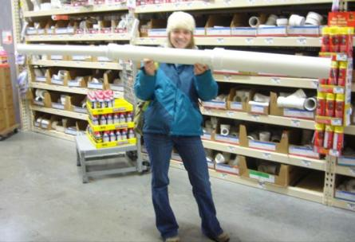
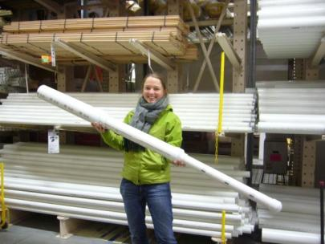
Step-Tapered Inlet Manifold
Mountaineers:
Kara Grant
Drew Hart
Julia Leung
Elena Vandebroek
CEE 4540
December 14th, 2009

Slide 2
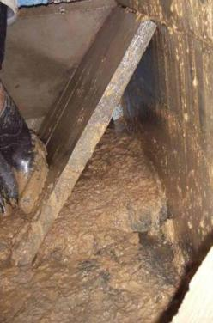
Objectives
Improve floc delivery into sedimentation tank
  Avoid floc break-up
  Prevent early settling
Design a manifold with:
  Even distribution of water
  No short circuits
  Scour velocity > 0.15 m/s
  Energy dissipation rate < 6 mW/kg

Slide 3
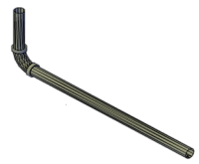
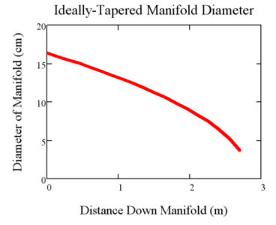
Background
Constant Diameter Manifold
  Current plan for Agalteca
  Flocs may settle in manifold
Ideally-Tapered Manifold
  Maintains scour velocity
  Not realistic to build

Slide 4
Design Steps
  Based on sedimentation tank dimensions
  Largest possible initial diameter with V > V_{Scour}
  Before V < V_{Scour,} reduce pipe diameter
  Port size based on max permissible ε
  MathCAD programming function models port flow and creates arrays of other parameters indexed by port number.
  Added 3 piezometric head change terms to the Ideally-Tapered Manifold function
Developed algorithm to fabricate manifold

Slide 5
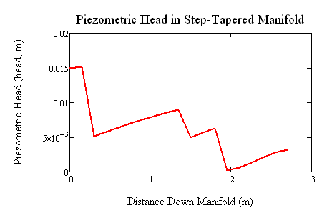
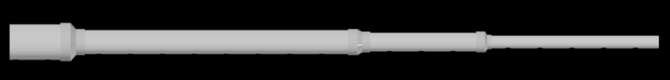
Piezometric Head Terms
Major head losses
Pressure recovery
Minor losses
Contraction conversion

Slide 6

Major Head Loss Between Ports
Fully Developed Flow
Uniform Flow
Previous manifold model uses Darcy friction factor, assumes fully developed flow between ports
Flow is likely not close to fully developed
We analyzed the other extreme – uniform flow following each port

Slide 7


Major Head Loss Between Ports
We modeled the walls of the pipe as a flat plate in a constant-velocity stream
Used boundary layer equations to approximate shear force, balanced with pressure forces to get head loss
Difference in major head loss models does not dramatically affect manifold model

Slide 8
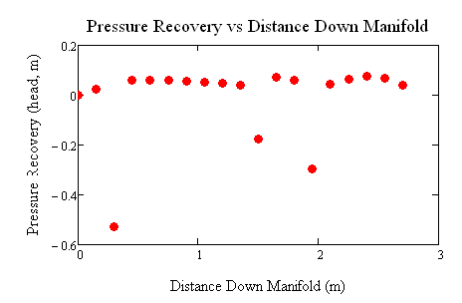


Pressure Recovery
Change in pressure head associated with flow leaving through ports
Causes piezometric head to become negative at last pipe reduction

Slide 9
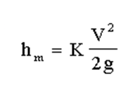
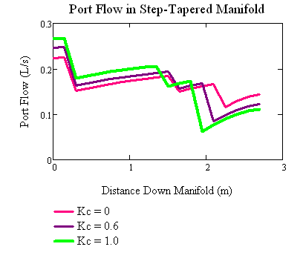
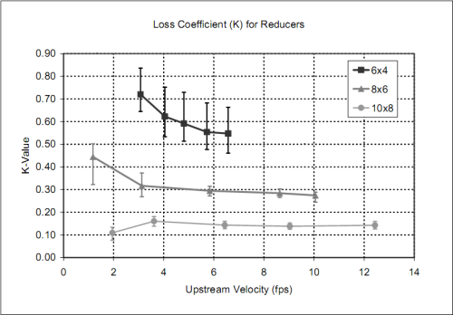

Minor Head Loss
Loss coefficient related to pipe size and upstream velocities.
Assumed K_{c} ≈ 0.6
Source: Chengwei Ding, et. al, Pressure Loss Coefficients of 6, 8, and 10-inch Steel Pipe Fittings. St. Anthony Falls Laboratory at University of Minnesota.
Notes:
Minor head loss is pretty much insignificant. Intuitively you might think that if we had many more pipe diameters, and many more contractions, the minor losses might become important. However, when there are more contractions, velocity is less variable across the contraction. Since V₂ – V₁ is becomes much smaller, minor losses become smaller too.

Slide 10



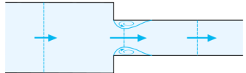
Energy Conversion in Contractions
In the Ideally-Tapered Manifold Model, velocity is constant, so this term can be omitted.
Energy Conserved
Rearrange for ∆H_{Piezo}
Ignore elevation
Assumed constant elevation
Max ∆Z = 5 cm
V₁ < V₂
Notes:
Here we assume that the contraction is efficient (we take inefficiencies into account in the minor loss term explained above).

Slide 11
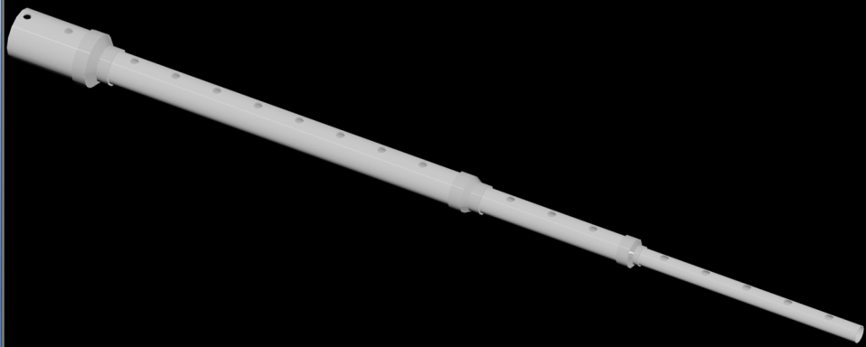
Step-Tapered Manifold
Notes:
Here we’re showing a step tapered manifold using reducing couplings, since these are the easiest reducers to find. You’re actually looking at the bottom side because we want the ports to point towards the bottom of the sedimentation tank. Ideally we would use eccentric reducers, which would keep all the ports at the same level.

Slide 12
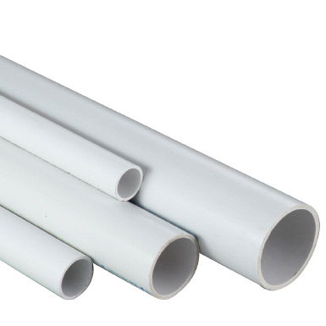
Fabrication
Function calculates approximate pipe lengths
  Input →Array of diameters before each port
Another function calculates exact pipe lengths
  Inputs → Array of approximate pipe lengths
  Reducer dimension array

Slide 13
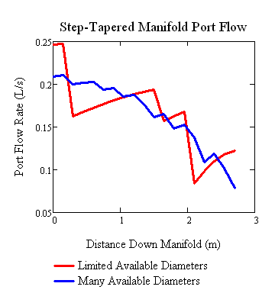
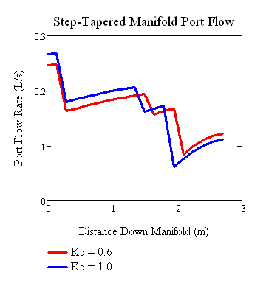
Constraint: Available Supplies
Limited by available pipe diameters
Limited by available reducers

Slide 14
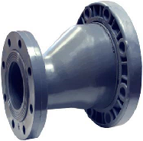
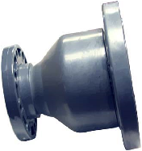
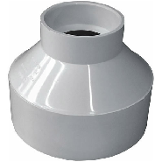
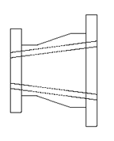
Selecting a PVC Reducer
Eccentric Reducer
Concentric Reducer
Reducing Coupling
Maintains constant elevation
Smooth taper
Almost impossible to find in PVC
Smooth taper
Hard to find in PVC
Abrupt taper
Readily available
Cheap

Slide 15
Conclusions
Material availability is a significant constraint
Port flow uniformity is a big problem for step-tapered case
Recommendation
  Step-tapered inlet manifold
  Smooth contractions
    Follow vena contracta
  Many available pipe diameters

Slide 16
Next Steps
Continue experimenting with flow development in the pipe in order to more accurately calculate major head losses.
Re-examine the contribution of pressure recovery term to piezometric head.
Re-evaluate contraction minor loss term.
Research availability of reducers and pipe diameters in Honduras.
Try a step-tapered manifold in an experimental setting.

Slide 17
Questions?

