Slide 1
CAPSTONE INVENTION
CEE 4540
INLET MANIFOLD DESIGN APPROACH
TEAM AGUAPATODOS
Michael Brancato, Maggie Reuter,
Pablo Gomez, Jesus Rodriguez

Slide 2
Project Goals
Improve the design of the inlet manifold
Satisfy several design constraints
  Energy dissipation
  Scour velocity
  Uniform flow distribution
Strategy = Taper the Manifold
Why?
This is a current problem in AguaClara plants
Notes:
Don’t break flocs, Don’t let flocs settle, have equal flow through all the ports

Slide 3
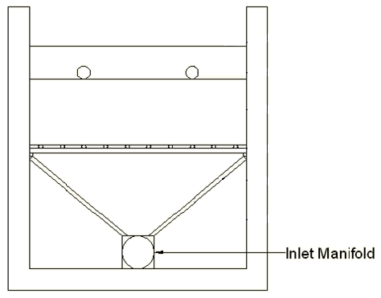
Inlet Manifold
Objectives
  Provide a design algorithm with the following input variables:
    Tapering Ratios
    Tapering Geometries
    Port Diameter
    Spacing between Ports
Notes:
Our primary focus for this project was finding the optimal tapering method for the inlet manifold. We knew that a tapered manifold, theoretically, produces constant velocity in the manifold, creating a more even distribution of flow through the ports. We calculated the ratio of the diameter at the last port to the diameter at the entrance of the manifold. Then we varied the shape of the manifold between those ports by decreasing the manifold area linearly, parabolicaly, etc.

Slide 4
Tapering Parameters
Tapering Ratio: final diameter to initial diameter
Tapering Geometry
  Y = Y₀ - ax^{exponent}
Notes:
We want to find the right relationship (equation) for the manifold shape
Regardless of how easy that shape is to build

Slide 5

Tapering Ratio
D_{M0}
D_{MF}
L_{Manifold}
D_{M0} = Initial Manifold Diameter
D_{MF} = Final Manifold Diameter
L_{Manifold} = Length of Manifold

Slide 6
Tapering Geometry
Linear Taper
Parabolic Taper
Vary the diameter according to the equation:
  Y = Y₀ - ax^{exponent}
Vary the exponent to vary the tapering geometry
Notes:
Since we vary the diameter: area depends on square of the diameter
vary diameter linearly = vary area parabolically
if we want to vary the area linearly we make exponent = 0.5

Slide 7
ITERATIVE APPROACH – DESIGN STEPS
DESIGN INPUTS
MAXIMUM ENERGY DISSIPATION RATE
CALCULATE OPTIMAL PORT DIAMETER; VARIATION OF PARAMETERS
IMPLEMENT ALGORITHM
Energy Head
Port Flow rate
Manifold Flow rate
Manifold Area variation
OBTAIN OUTPUTS

Slide 8
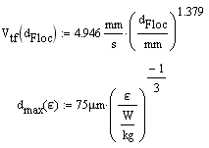
Energy Dissipation
Empirical Relationship
  Floc terminal velocity and floc size (diameter)
  Floc size and energy dissipation rate
Notes:
Using the two empirical relationships we can get an equation for emax based on the capture velocity
Account for varying floc size by saying Vt = 10Vc

Slide 9
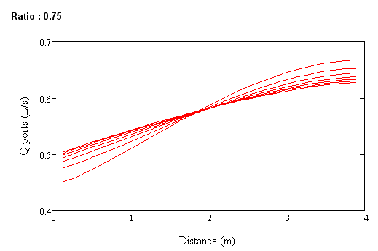
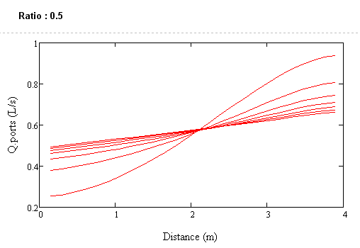
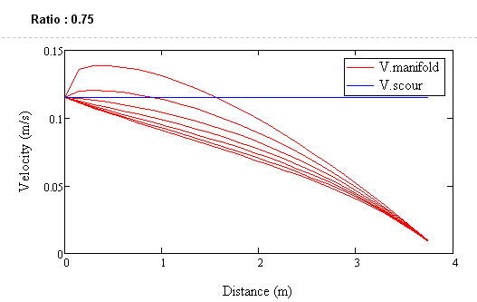
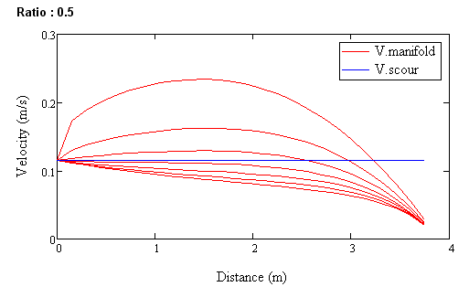
Influence of the Tapering Ratio

Slide 10
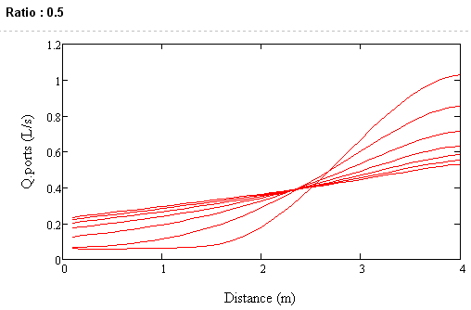
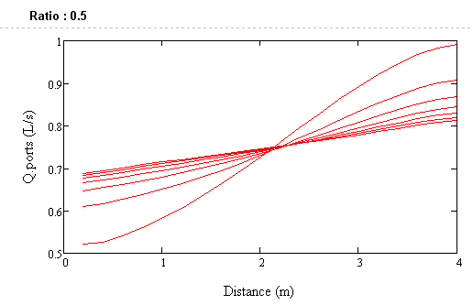
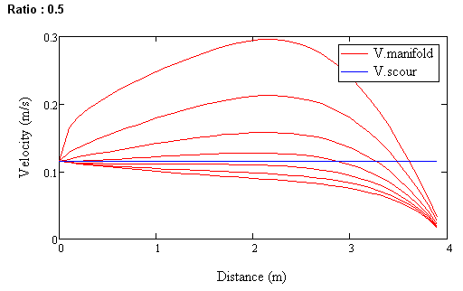
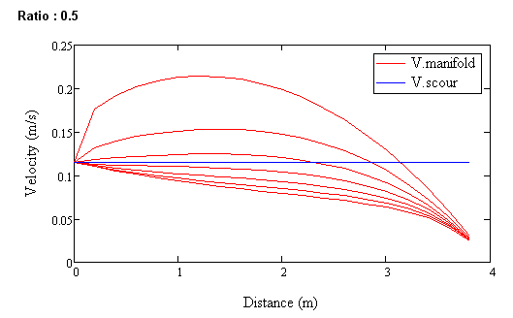
Influence of Port Spacing
Spacing = 10 cm
Spacing = 20 cm

Slide 11
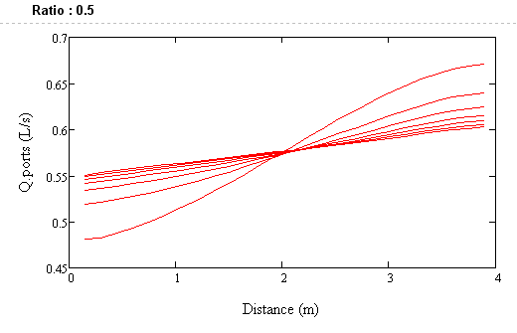
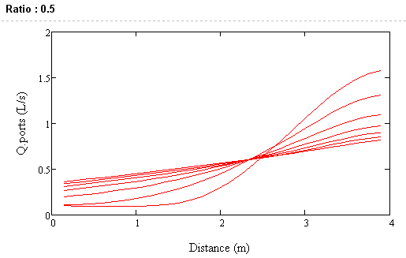
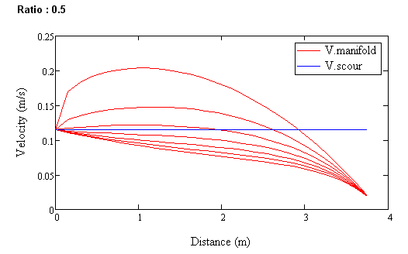
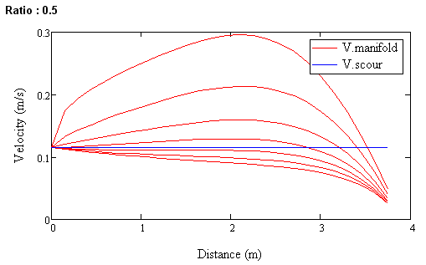
Influence of Port Diameter
Port Diameter = 6 cm
Port Diameter = 10 cm

Slide 12
Conclusions
Design of the inlet manifold is a complex process involving many interconnected parameters.
Changing a parameter improves certain aspects of the manifold while worsening other aspects.
Meeting all of the constraints simultaneously is a challenge that requires further investigation.

Slide 13
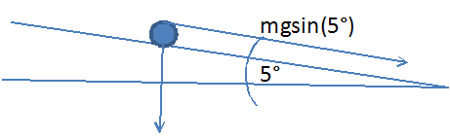
Future Research Suggestions
Finding Optimal Tapering Ratio using head loss and pressure recovery
Tilting the inlet manifold
  Lab research:
    Shape of flocs
    Eliminate the need for scour velocity

