Slide 1

Foam Filtration
Katie Edwards, Walker Grimshaw,
Bradshaw Irish, Kelly McBride, Nadia Shebaro

Slide 2

Foam Filtration
Serves smaller scale communities
Easily scalable
Readily available materials
Simple to operate and maintain
Ideal for water kiosks, emergency situations

Slide 3
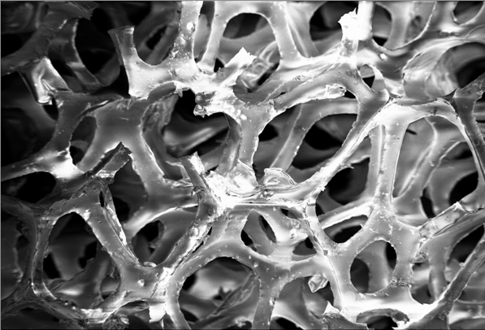
Foam as Filtration Media
Advantages:
High solids loading capacity
High porosity
Lightweight
Depth filtration vs. surface filtration
Easy cleaning mechanism

Slide 4

Pores Per Inch
Pores per inch (ppi): the number of pores within a linear inch of foam
Higher ppi foam has more, smaller pores
(a)
(b)
1/10 inch
(a) 30 ppi foam
(b) 90 ppi foam

Slide 5
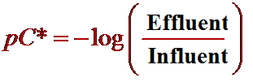
pC*
Notes:
pC* is the log removal of the system. When varying the influent turbidity, it is often more straightforward to compare effluent turbidities than compare pc* values. Theoretically, when two filters are put in series, the pC*s of the two filters should be additive for the entire system. We are hoping to achieve a pC* of approximately 1.5 - 1.6 so that we can reduce turbidity from 100 to EPA approved 3
5

Slide 6


Final Design Schematic
Hand pump
Coagulant
Finishing Filter
15 inches
90 ppi foam
Chlorine
Disinfectant
Entrance
Tank
Dirty Water
Source
Roughing Filter
30 inches
30 ppi foam
Clean Water Reservoir

Slide 7
Features of the Prototype
Flexible tubing for adjustability
Scalable design based on PVC diameter
LFOM for linear flow
Chemical dosing with constant head tanks
Addition of handles for foam decompression

Slide 8
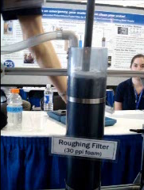
Cleaning the Filter

Slide 9
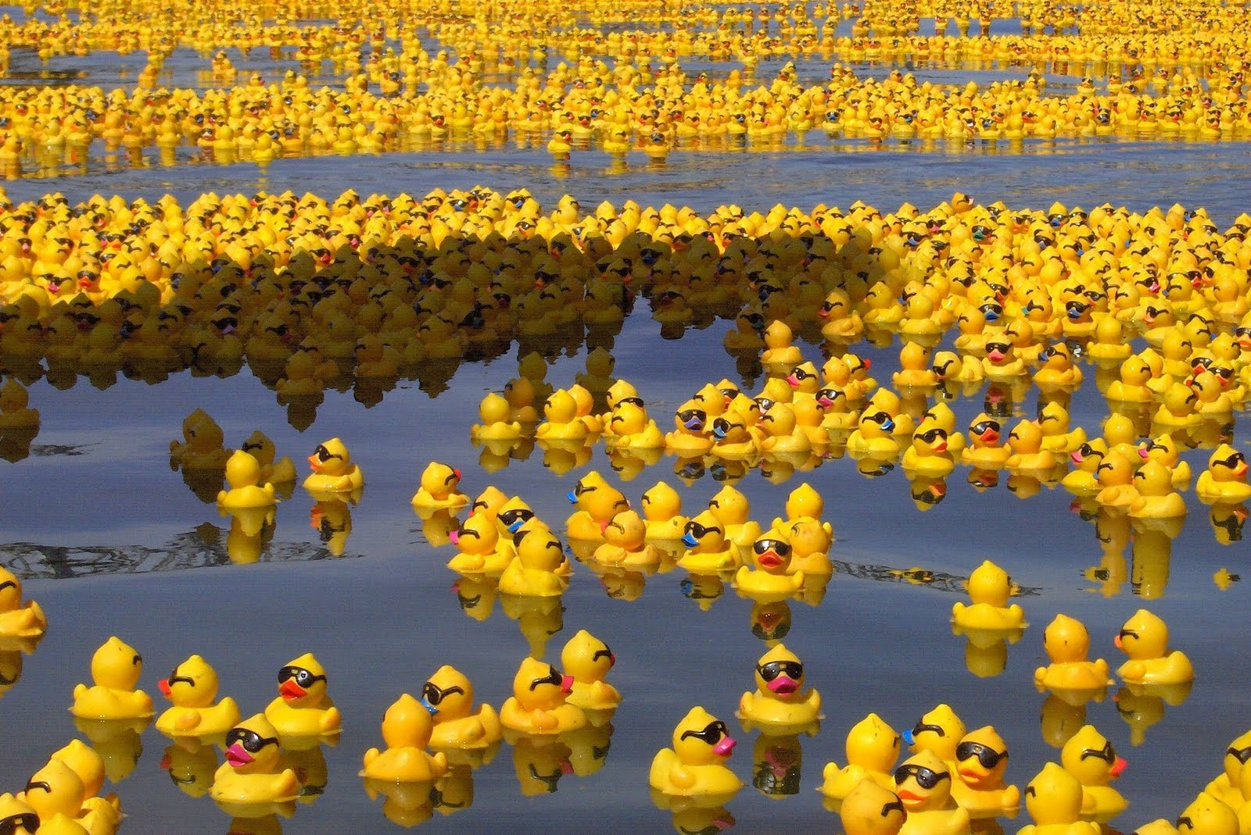
Features of the Prototype
Rubber ducks
FOAM

Slide 10

P3 Competition
Preparation
  Grant Proposal

Slide 11
Poster

Slide 12
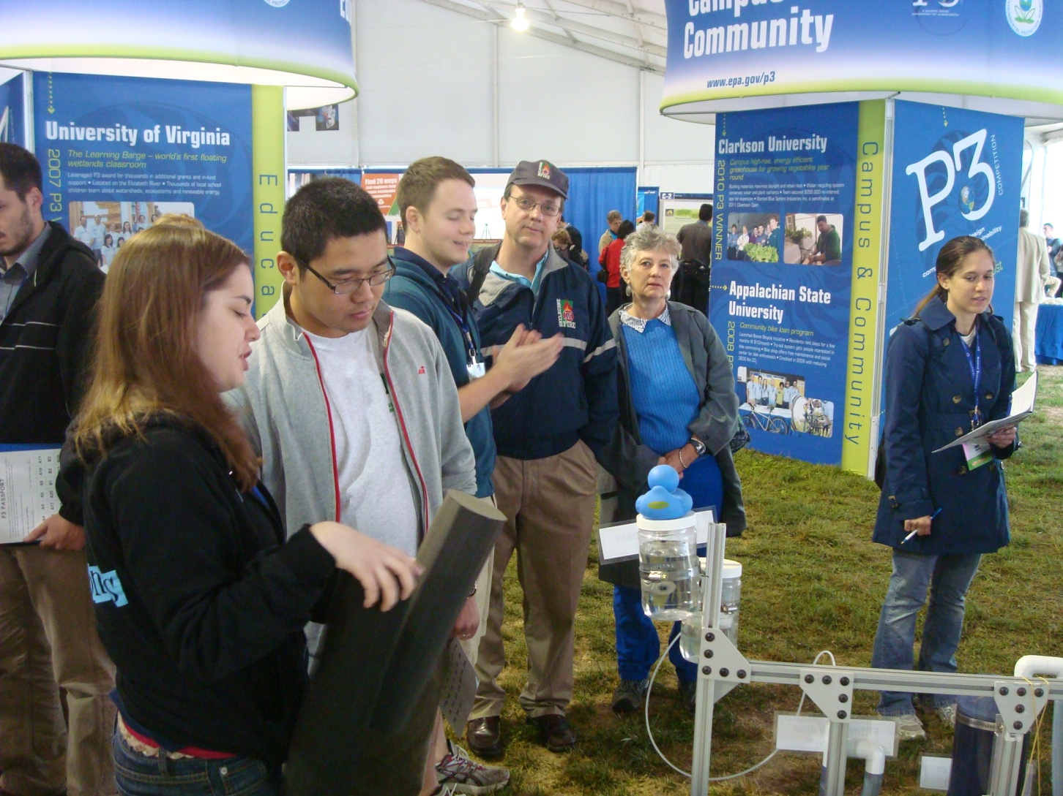
Talked…

Slide 13
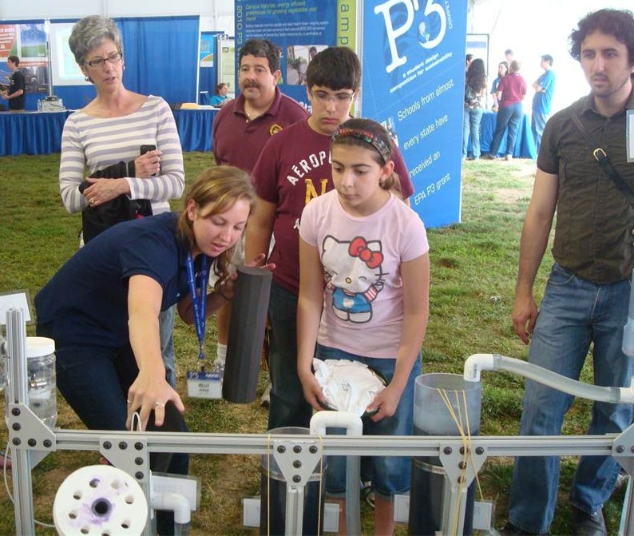
Talked…

Slide 14
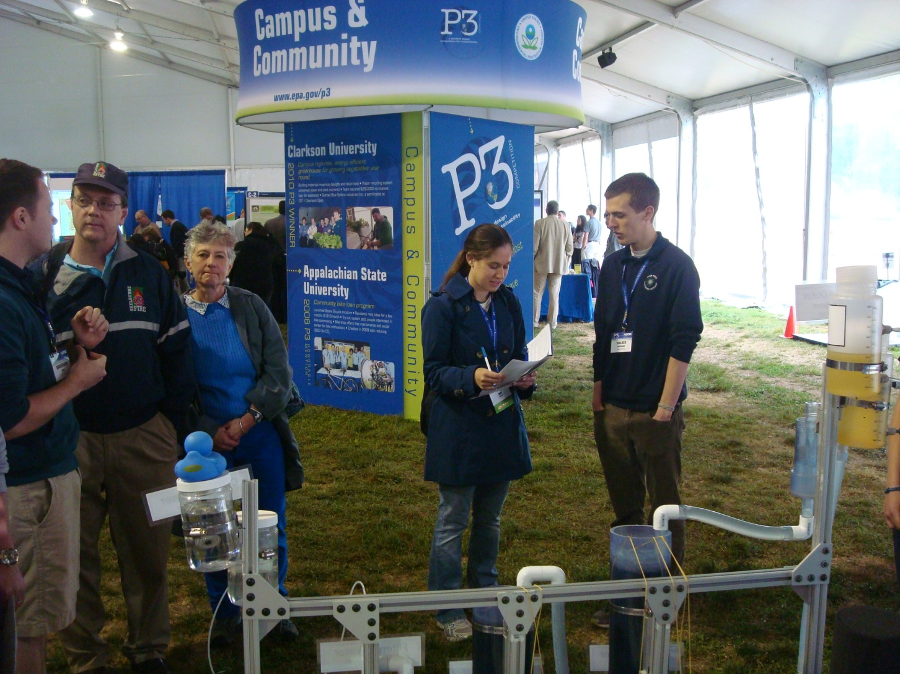
And talked

Slide 15

“Data”
Influent: 180-250 NTU
Effluent: 0.2-0.5 NTU
pC* = 2.55-2.70
Being Green: Recycling PACl
Poorly Calibrated Turbidimeter
Children in Water

Slide 16
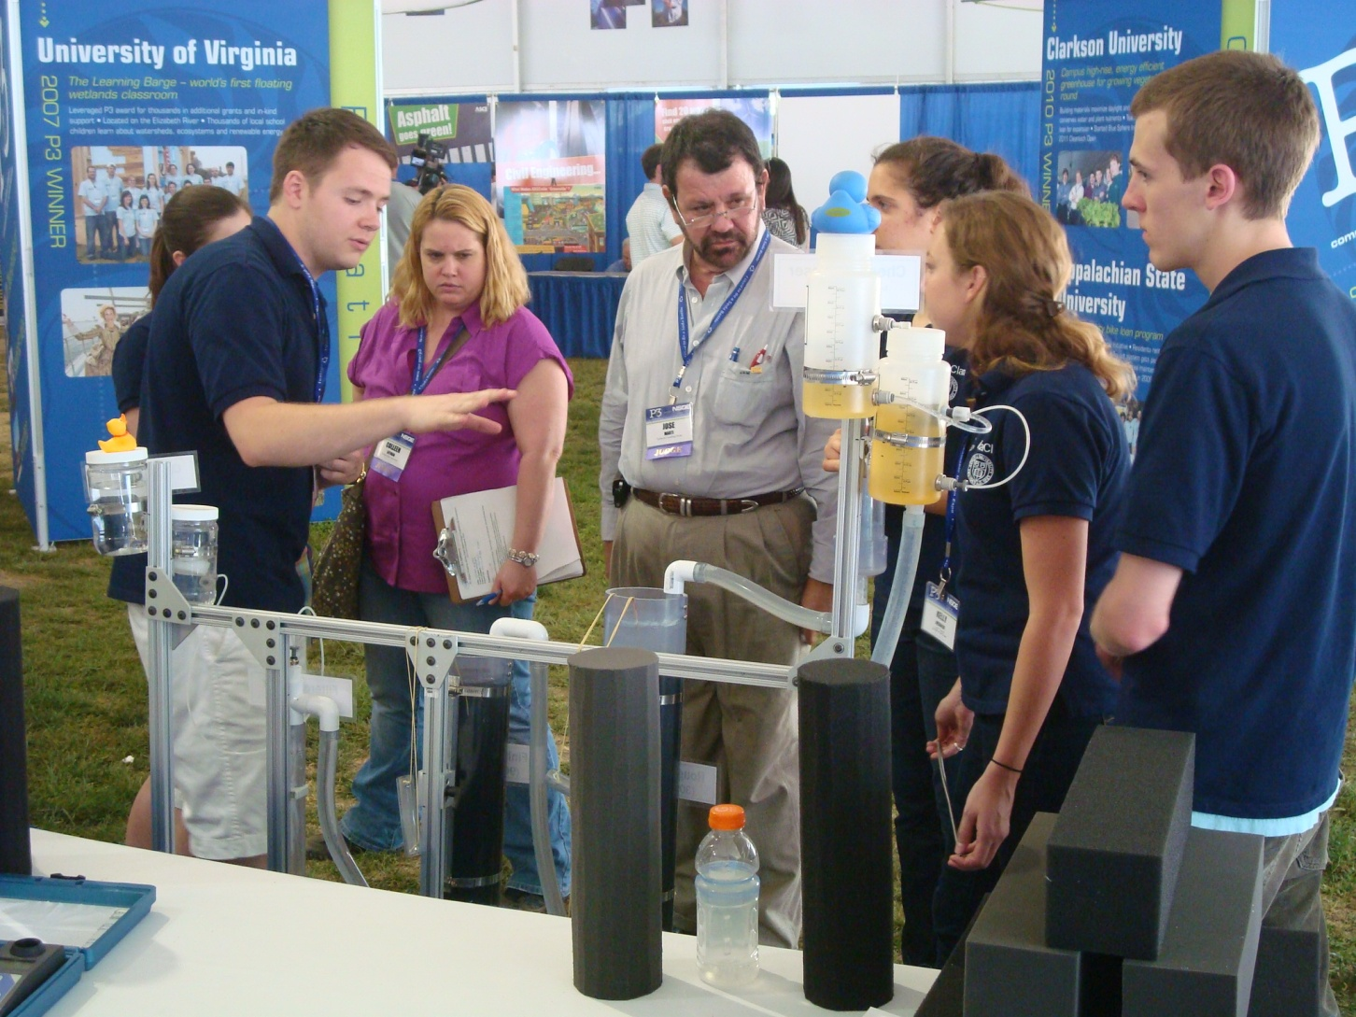
Judging

Slide 17
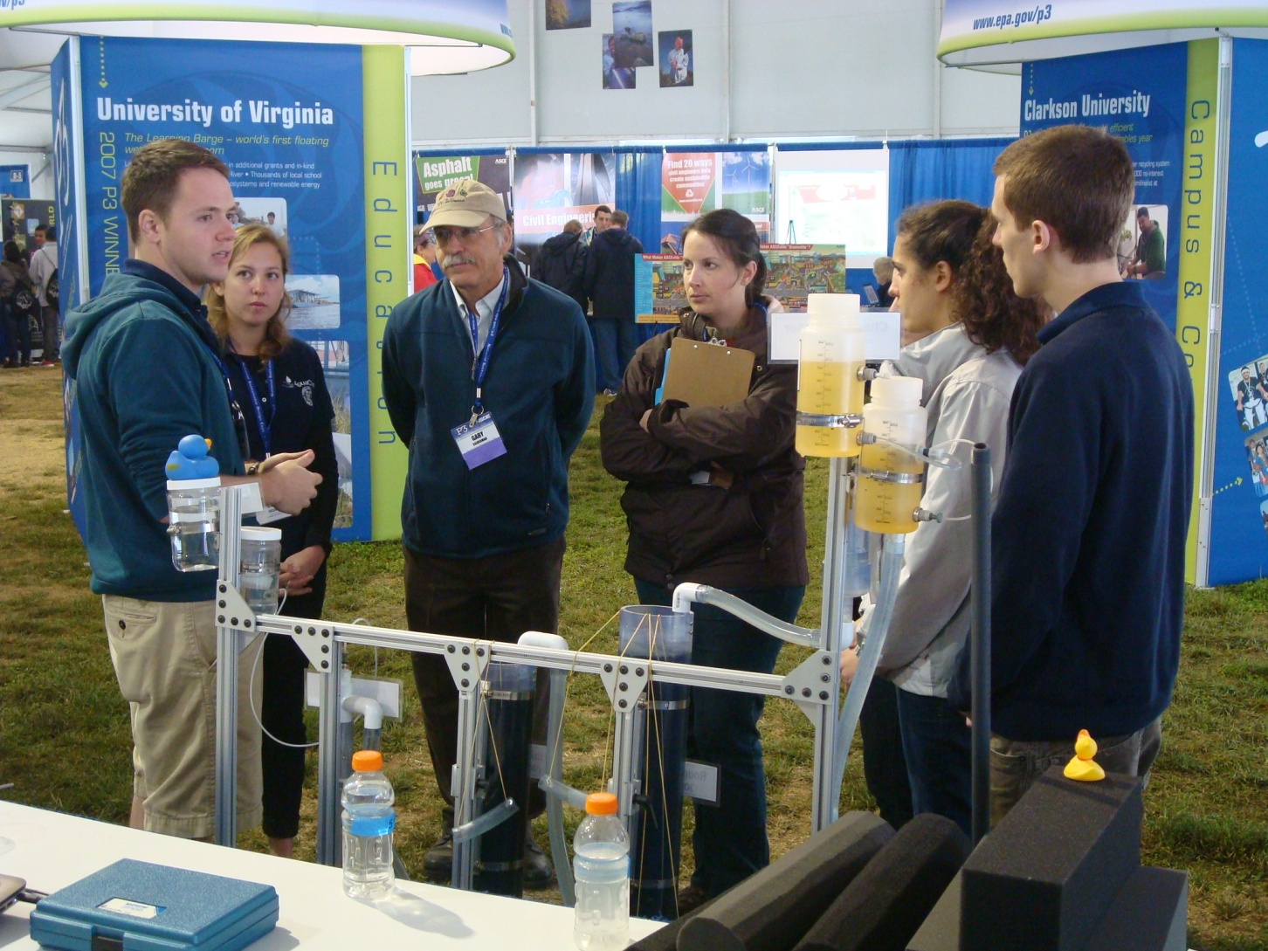
More judging

Slide 18
Outcome
No money
But…what did we learn?

Slide 19


Equanimity
… meh
… meh

Slide 20
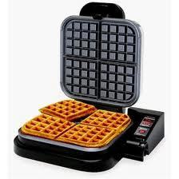
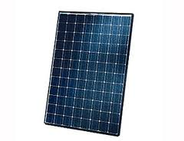
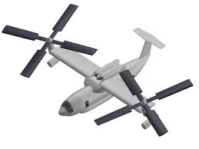
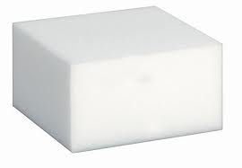
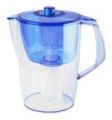
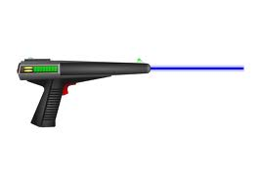
So?
EPA
AguaClara
Crazy
Foam?
Gravity?
WOW!
Cool

Slide 21
Takeaways
Contacts
  Already one order for a filter!
What do we still have to learn?
  Lots

Slide 22
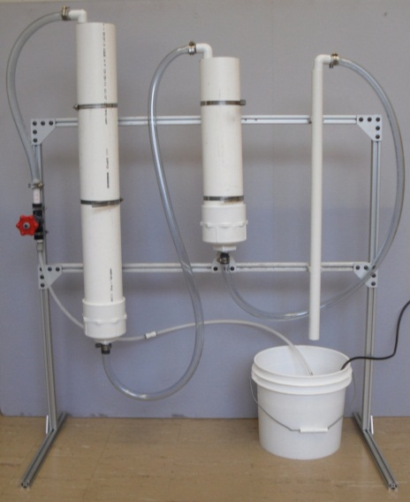
Future Work
Prototype Improvements
  Determine actual filter performance
  Examine cleaning method further
  Test for leaching
?

Slide 23
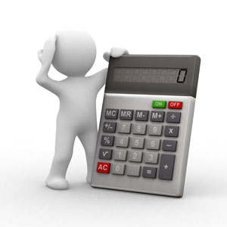
Future Work
Calculations
  Determine head loss between columns
  Life expectancy of prototype and foam

Slide 24

Future Work
Documentation
  Develop an “Owner’s Manual”
  Detailed parts list and construction guide
  Research alternate sources of foam

Slide 25
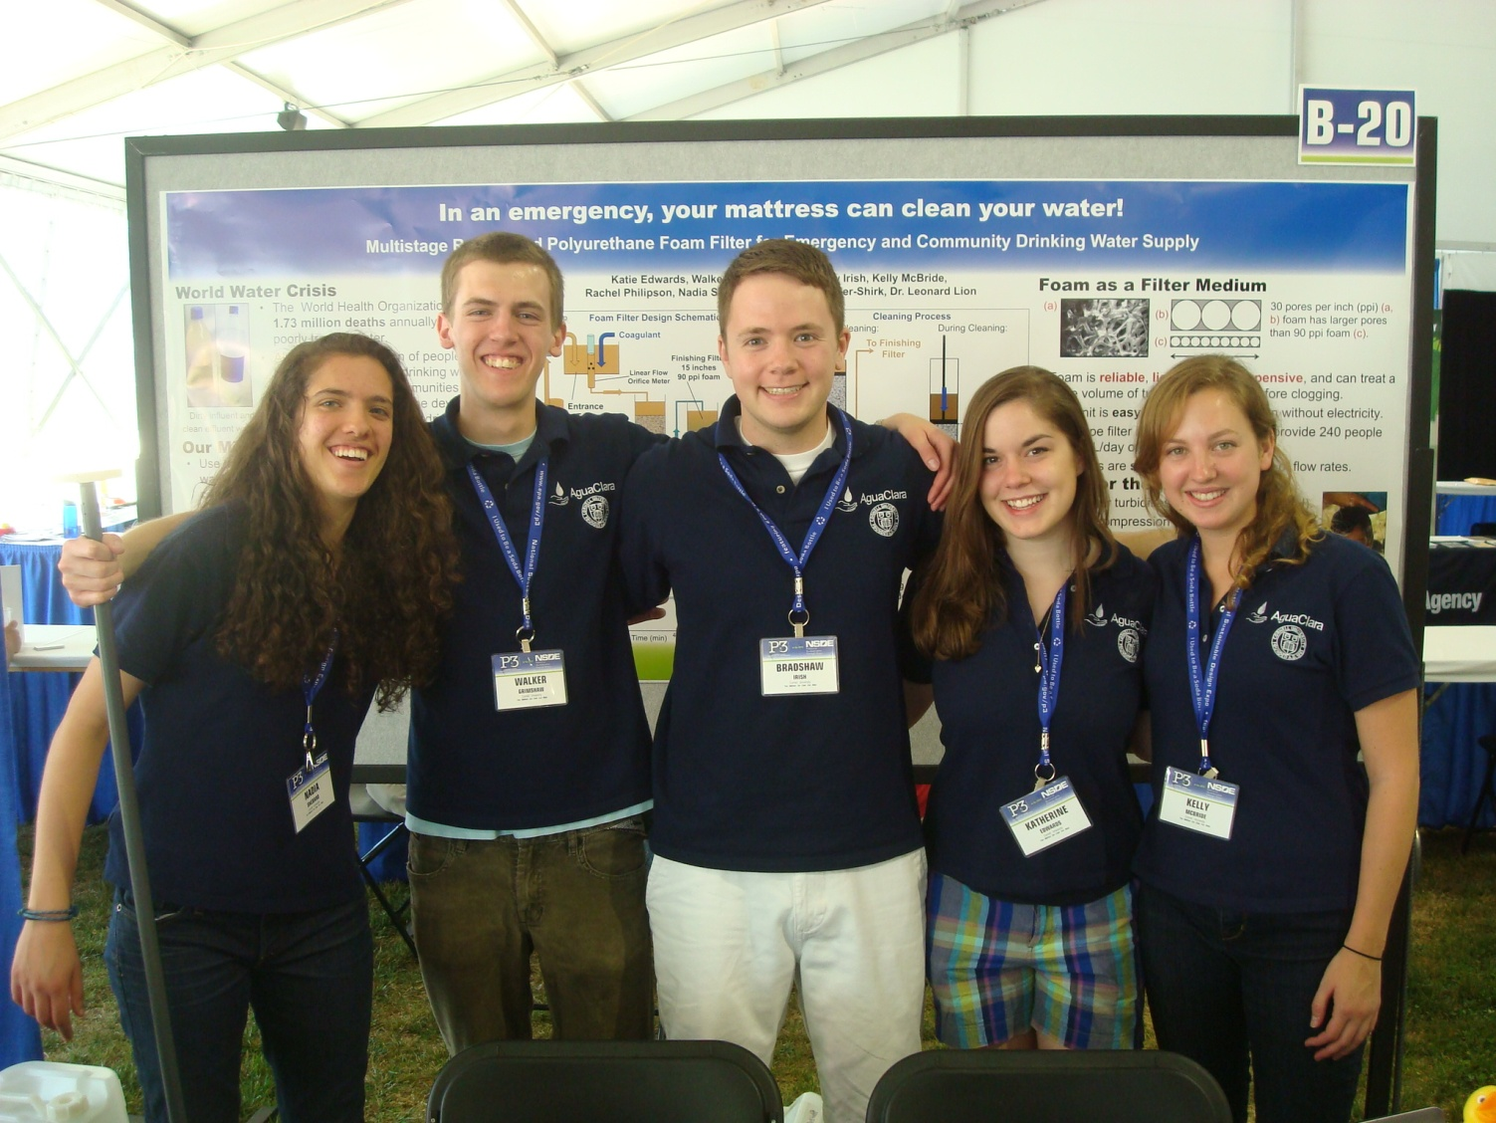
Questions?
Thank You!

