Slide 1
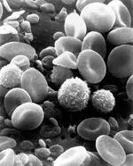
Ischemia Reperfusion Injury
Kelly Blackstock
August 11, 2010
Resident Board Review

Slide 2

Definitions:
Ischemia: inadequate blood supply to a part of the body, usually caused by a partial or total blockage of an artery
-Cold v. Warm Ischemia
Hypoxia: reduction of oxygen supply to a tissue below physiological levels
Reperfusion injury: damage sustained to a tissue following the return of blood supply after a period of ischemia
Notes:
Cold-transplantation, Warm-organs or tissues in the body
=Ischemia itself triggers apoptosis whereas reperfusion accelerates the process and may lead to an enhancement of apoptosis, as reperfusion restores the energy required for the completion of apoptosis
=Experiments comparing ischemia/reperfusion to sustained ischemia; where cell death was only 17% in the group of sustained ischemia verus 73% in the reperfused group

Slide 3

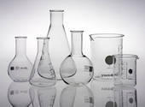
History of IR research
Possibility first discussed in 1935
First documented report in 1960 by Doctor R. Jennings
Large body of research geared towards cardiovascular disease, especially myocardial infarction
Literature in veterinary medicine is lacking

Slide 4
Common Syndromes
Humans
Myocardial infarction
Cardiac bypass surgery
Organ transplantation
Hemorrhagic shock
Head trauma
Small Animals
GDV
ATE
Hemorrhagic shock
Diaphragmatic hernia
Head trauma
Intestinal incarceration
CPCR

Slide 5
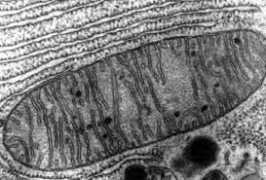
Normal conditions
90-95% of oxygen is reduced in mitochondria to water
Remaining 5-10% of oxygen metabolism results in the production of reactive oxygen species (ROS)
Protective mechanisms against ROS
-Antioxidants
-Compartmentalization
Notes:
oxidative phosphorylation. This is where positively charged hydrogen ions in the mitochondria help to bond phosphate and adenosine diphosphate (ADP) which then forms ATP, aerobic process because hydrogen must be oxidized so that it can help form ATP. For every glucose molecule, about 36 ATP are formed during aerobic respiration
Separate microenvironments exist for mitochondria, lysosome, and peroxisome, each with its own ROS generating system and antioxidant defense.
Iron is bound in hemoglobin and myoglobin in the blood and muscle to transferrin while circulating in plasma, and to ferritin in cells. Free or loosely bound iron is never present in health

Slide 6
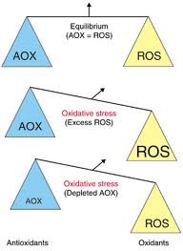
Fine Balance
Increased ROS come from:
1) Antioxidant system overwhelmed/depleted
2) Overproduction ROS
Notes:
IR injury does both

Slide 7
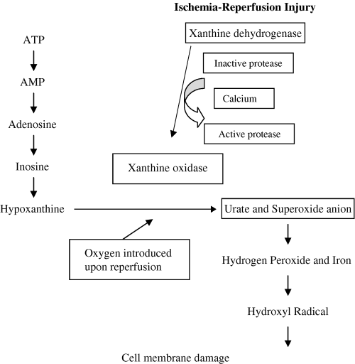
0
XYANTHINE
And
URIC ACID
NAD
SOD
Fe⁺⁺
CATALASE
GSH
O2 and Water
Taken from McMicheal, JVECC 2004, 14(4); 231-41

Slide 8

Antioxidants
PROTEINS- albumin, ferritin, haptoglobin, ceruloplasmin
INTRACELLULAR ENZYMES- superoxide dismutase (SOD), catalase, glutathione peroxidase
SMALL MOLECULE:
-WATER SOLUBLE- Vitamin C, uric acid, bilirubin, glutathione (GSH), zinc, selenium
-LIPID SOLUBLE- tocopherols (vit E), β- carotene, ubiquinol-10 (co-enzyme Q10), lycopene
Notes:
These are the substances that can delay or prevent oxidative damage

Slide 9
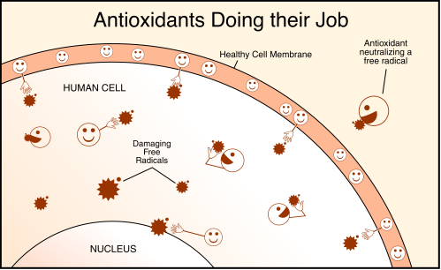

Slide 10
Glutathione
Considered the first line of defense against ROS
Reduces hydrogen peroxide to water, acting as substrate for peroxidase
Can act as a chain-breaking antioxidant
Metal chelator (preventing the formation of hydroxyl radical)

Slide 11
Vitamin E
Second line of defense.
Inhabits the lipophilic interior of cell membrane
Chain-breaking scavenger
Easily regenerated by Vit C
Vitamin C
Most abundant water soluble antioxidant
Can directly scavenge ROS
Regenerates Vit E
Notes:
Contact with free radical oxidizes to free radical itself, then combines with the C radical forming a poorly reactive vit C free radical

Slide 12
superoxide dismutase (SoD)
Catalyzes the dismutation of superoxide to oxygen and hydrogen peroxide
cATALASe
Heme protein located in peroxisomes
Converts hydrogen peroxide to water and oxygen

Slide 13
What are ROS?
Free Radical v. ROS
Main players in IR injury
a) Superoxide (O₂•)
b) Hydrogen peroxide (H2O2)
c) Hydroxyl radical (OH•)
d) Peroxynitrite (ONOO⁻)
Normally cleared by SOD, catalase and glutathion peroxidase system
Notes:
Free Radical: molecule with one or more unpaired electrons in the outer shell however Oxydative damage can be done by species other than free radicals (eg H2O2) therefore the more appropriate term is ROS

Slide 14
0
NAD
XYANTHINE
SOD
Fe⁺⁺
CATALASE
GSH
O2 and Water
Taken from McMicheal, JVECC 2004, 14(4); 231-41

Slide 15
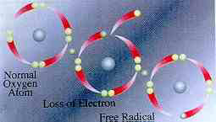
Basic Mechanism of Damage
Free radical reacts with a non-radical, non-radical loses an electron and then transforms into a free radical itself
Self perpetuating cycle
Damage to lipids, proteins and DNA
Notes:
Once formed ROS can react with another radical to form a covalent bond or, more commonly react with a non-radical

Slide 16
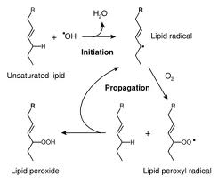
Lipid peroxidation
All molecules susceptible to damage but lipid peroxidation occurs most frequently
ROS abstracts a proton from PUFA, forms peroxyl radical (RO•₂), this can then attack other PUFAs
Antioxidants can break the chain reaction
Notes:
Mammalian cells are rich in polyunsaturated fatty acids (PUFAs), which are highly susceptible to oxidative stress. Includes linoleic, linolenic arachadonic acids, and structure of triglycerides and phospholipids
The 2 major free radicals that can initiate lipid peroxidation are the hydroxyl radical and peroxynitrite

Slide 17

Ischemia Reperfusion Cascade
Intracellular changes
Creation of ROS
Role of Complement
Role of Leukocytes
Endothelial effects
Notes:
Events can occur in a linear and circular fashion.

Slide 18
Intracellular Changes
1. Degradation to ADP leads to hypoxanthine accumulation
2. Xanthine dehydrogenase (XD) undergoes conformational change to xanthine oxidase (XO)
3. Intracellular pH decreases as lactate and hydrogen ion accumulate
4. Translocation of bax protein to mitochondrial membrane, inducing efflux of cytochrome c
5. Dysregulation of ion homeostasis
6. Cellular swelling +/- apoptosis
Notes:
BAX is a proapoptotic (bcl2) family member protein, the efflux of cytochrome c via opening of the permeability transition pore into the cytosol where cytochrome c activates effector caspases and initiates apoptosis
Intracellular enzymes and regulatory proteins are damaged leading to even greater cellular dysfunction

Slide 19
Dysregulated Ions
Cells become more depolarized
Na+/H+ ATPase inhibited
Na+/K+ ATPase inhibited
Na+/Ca+ channel reverses
End result is net efflux of K⁺ and an influx of Na⁺, Ca²⁺, and Cl⁻
Notes:
Key mechanism for maintaining pH is Na/H exchanger, this is inhibited during ischemia. Na travels down its concentration gradient resulting in increased intracellular Na. Because the Na/K ATPase is also inhibited the Na/Ca exchanger reverses allowing for the influx of Ca

Slide 20
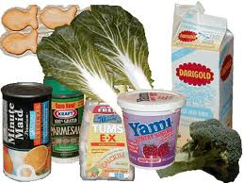
Role of Calcium
Increased intracellular Ca²⁺ :
a) ATP channels
b) release from organelles
c) generalized influx
Activates
    1) Calpin
    2) Proteases and endonucleases
    3) PLA₂
Notes:
*the increase in intracellular Ca is one of the earliest events in IR injury and the damage is dep upon both the duration and the extent of the increase.
Calpin is a protease that converts xanthine dehydrogenase (XD) to xanthine oxidase(XO)

Slide 21
0
CALPIN
SOD
Fe⁺⁺
CATALASE
GSH
O2 and Water
Taken from McMicheal, JVECC 2004, 14(4); 231-41
Notes:
Normally hypoxanthine is converted to xanthine by XD with NAD, does not require oxygen. The XD is converted to XO in presence of calpin (Ca). XO does require oxygen and converts Hypoxanthine to superoxide radical and urate

Slide 22
Formation of ROS
Hypoxanthine accumulation
Increased intracellular Ca²⁺
Xanthine dehydrogenase (XD) undergoes conformational change to xanthine oxidase (XO)
Return of perfusion: O2 now available, excessive production of O₂•
O₂^{-•} and H₂O₂ in the presence of iron combine to form Hydroxyl Radical

Slide 23
Haber-Weiss reaction
O₂• + H₂O₂ → OH• + O₂ + OH⁻
Fenton Reaction
Fe²⁺ + H₂O₂ → OH• + OH⁻ + Fe³
Cannot occur without metal catalyst
Fe²⁺ required for hydroxyl formation
Conversion of Fe³⁺to Fe²⁺ via XO, NO and O₂•
Notes:
Second equation is iron-catalyzed haber-weiss reaction
Ferrous (Fe2+) form of iron required for hydroxyl formation
O₂^{•-} may contribute to toxicity by 1) liberation of iron and 2) conversion of ferric to ferrous

Slide 24
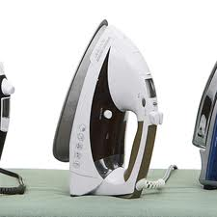
Release of free iron
Acidosis
Superoxide radical mobilized from ferritin
Hydrogen peroxide mobilizes from heme
Proteolytic degradation of ferritin
Red blood cell hemolysis
Notes:
Remember that normally iron is carefully sequestered, bound to hemoglobin and myoglobin and transferrin in plasma and to ferritin in cells.

Slide 25
0
CALPIN
Haber-Weiss
Taken from McMicheal, JVECC 2004, 14(4); 231-41

Slide 26
Inflammatory Overdrive
Cellular breakdown products
  Inflammatory cytokines (TNFα, IL-1β)
  Toll-like receptors (TLR)
ROS
  Inhibits NO
  Stimulates PLA₂
  Stimulates NF-κB
  PARP
  Attraction, adhesion and activation of leukocytes
Notes:
ROS stimulate leukocyte activation and chemotaxis by activating plasma membrane phospholipase A2 to form arachidonic acid,
an important precursor for eicosanoid synthesis (e.g., thromboxane A2 and leukotriene B4).
ROS also stimulate late leukocyte adhesion molecule and cytokine gene expression via activation of transcription factors such as
nuclear factor-kB
In addition to causing direct cell injury, ROS thus increase leukocyte activation, chemotaxis, and leukocyte– endothelial adherence after I-R.
PARP: is poly ADP-ribose polymerase, it is upregulated with DNA damage, overactivated in IR, leads to high consumption of ATP which may exaccerbate mechanisms leading to cell dysfunction and cell death.

Slide 27
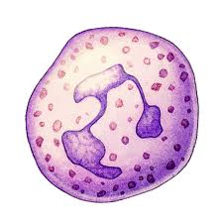
Inflammatory Mediators
IL-1β
ROS
TLR
Ca
TNFα
NF-κB
PLA₂
ICAM-1, E-selectin
TXA2
PAF, Cytokines
LTB4
Complement
Notes:
Important cytokines are TNF alpha, IL1, IL6, IL8 and MCP-1

Slide 28

Inflammatory Mediators
IL-1β
ROS
TLR
Ca
TNFα
PLA₂
ICAM-1, P-selectin
TXA2
PAF, Cytokines
LTB4
Complement

Slide 29
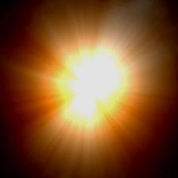
Neutrophils induced Injury
  ROS synthesis during respiratory burst
  Chemotaxis (positive feedback loop)
  Release of intrinsic proteolytic enzymes (Elastase, most predominant)
  Physical obstruction of capillaries
  Increased microvascular permeability as well as GI mucosal permeability
Notes:
It has been suggested that neutrophils mediate the majority of mucosal and microvascular injury observed with IR.
Respiratory or Oxydative burst consists of oxygen derived cytotoxic products including superoide anion and hypochlorus acid as well as proteases.
Results of these compounds leads to increased vasc permeability, edema, thrombosis and cell death.

Slide 30
Neutrophils Adhesion
1) “Rolling:” IR injury up-regulates P and E selectins on endothelium
2) Neutrophil activation: release of PAF, chemokines and ↑affinity for ICAM-1
3) Firm adhesion: binding via integrins, CD11/CD18 to ICAM-1
4) Diapedesis: PECAM-1
Notes:
Step 1: TNF alpha and IL-1 stimulate endothelial cells. Loose interaction with the L selectins located on Neutrophils
Step 2: PAF, cytokines or locally secreted chemoattractants.
Step 3:
Stem 4:Leukocyte transmigration into the interstitial compartment is facilitated by platelet– endothelial cell adhesion molecule 1, which is constitutively expressed along endothelial cell junctions

Slide 31
2 Phases of Adhesion
Phase 1: mediated by PAF and (XO-derived) hydrogen peroxide, Receptors: I-CAM P- selectin, β2 integrins
Phase 2: mediated by PAF & mitochondrial oxidants. Transcription activator NF-KB mediates upregulation of E-selectin
Notes:
NF-kB is normally present in the cytoplasm and must be translocated into the nucleus to elicit a response. E-selectin is later due to transcriptional dependent upregulation, mediated by NF-kB

Slide 32
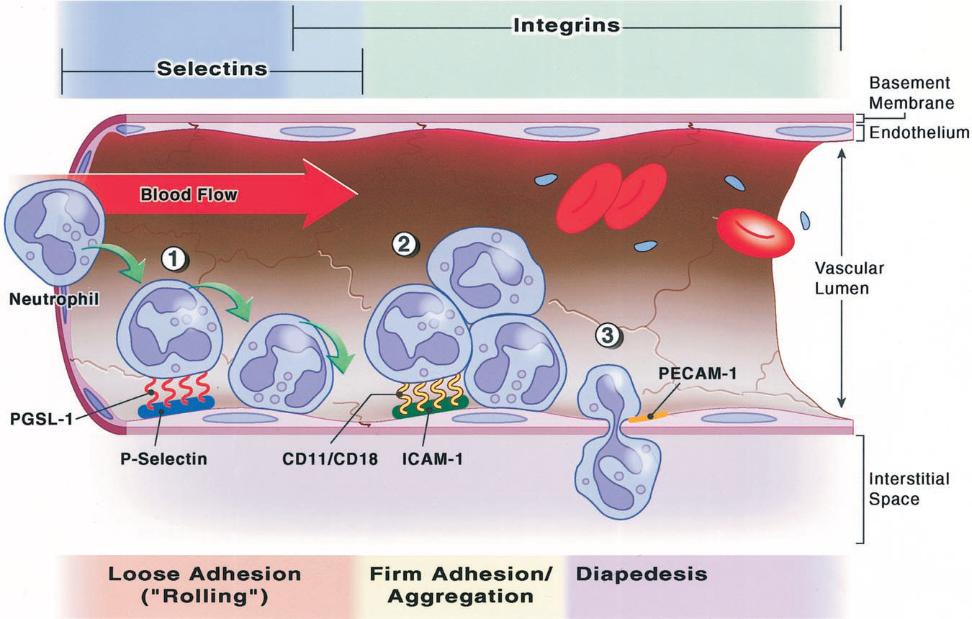
Anesthesiology, V 94, No 6, Jun 2001
Notes:
tethering/rolling, firm adhesion, transmigration and chemotaxis

Slide 33
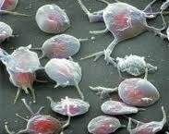
Platelets
Rapidly adhere to exposed subendothelium
Recruit additional neutrophils
Initiate selectin and integrin dependent leukocyte adhesion
May promote fibrin deposition or thrombus formation (+ PAF, - prostacyclin)
Notes:
.

Slide 34
Nitric Oxide
End product of nitric oxide synthase
3 isoforms: inducible, endothelial, and neuronal
Arginine and oxygen are required for its synthesis
Exact role in IR injury is still unclear
Notes:
Free radical gas
Affects almost every tissue in the body
Hypoxia induces the transcription of iNOS, but because oxygen is required as a substrate for NO production, NO may not increase despite significant elevations in iNOS.

Slide 35
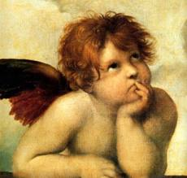

Nitric Oxide
Bad
Good
Large amounts cause severe non-responsive vasodilation
superoxide radical to form peroxynitrite (ONOO⁻)
vasodilation via cGMP,
↓platelet aggregation
↓leukocyte adhesion
↓ cytokines
neutralizes ROS
anti-microbial and anti-apoptotic effects
block endothelin’s effect
GI protective
Notes:
GI protective: ROS inhibition contributed to increased intestinal mucosal permeability.
Few studies:
GOOD= NO to cats, improved endothelial function, improved hemodynamics and liver function in pigs and cats. BAD=Blockade of iNOS markedly reduced liver injury in several studies.

Slide 36
Role of Complement
C5_{a}
C5_{b}-9
C5_{a}
Chemotaxis of neutrophil
Release of proteases
Production of oxygen radicals
May stimulate
  TNF-α
  IL-1 and 6
  MCP-1
General tissue injury
Stimulate NF-κB
Alter vascular tone
  Inhibiting endothelium dependent relaxation
  Decreasing c-GMP
Notes:
Research has shown that IR injury results in activation of the complement system in several organ systems and that both pathways (classical and alternative) are involved

Slide 37
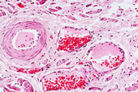
Endothelial Cell Damage
Cell Swelling
Increased membrane permeability
Cytoskeletal derangements
Recruitment of inflammatory cells
Impaired vasodilation
Notes:
Endothelial cell dysfunction occurs as a consequence of cell injury during IR and is likely caused by the concert of oxidative damage to membranes, dysregulation of ion homeostasis and osmotic stress.

Slide 38
Impaired Vasodilation
Mechanisms:
  Decreased NO, prostacyclin
  Increased Endothelin
  Thromboxanes and Leukotrienes
  Complement
Contributes to “No Flow Phenomenon”
Notes:
* One of the most sensitive indicators of EC dysfunction
Within the endothelium, ischemia promotes expression of certain proinflammatory gene products (e.g., leukocyte adhesion molecules, cytokines) and bioactive agents (e.g., endothelin, thromboxane A2), while repressing other “protective” gene products (e.g., constitutive nitric oxide synthase, thrombomodulin) and bioactive agents (e.g., prostacyclin, nitric oxide).

Slide 39
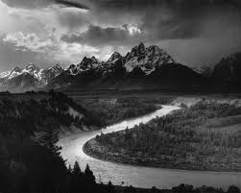
No Flow
Phenomenon
Diminished or absent blood flow to an area after relief of ischemia.
Occurs secondary to:
  Impaired vasodilation
  Endothelial swelling, narrowed lumen
  (Cellular infiltrate, neutrophils and platelets)*
Notes:
Longer periods of ischemia are more likely to lead to no-reflow phenomenon.
Endothelial swelling secondary to influx of water and sodium during ischemia , also increased fluid filtration at the capillary level and macromolecular leakage results in reduced capillary perfusion
McMicheal articles state that the primary cause of no flow is the cellular infiltrate, however most human articles now focus on other mechanisms

Slide 40
Quick Review
Quick Review
Notes:
Complex array of inflammatory processes initiated
Can aggravate local injury and may induce impairment of remote organ function
Cell damage or death, increased vascular permeability, necrosis, SIRS, MODS
Severity determined by magnitude and length of decreased blood flow

Slide 41
Molecular effects
ATP depletion
Increased hypoxanthine
Activation of XO
Generation ROS
Antioxidant depletion
Intracellular Na and Ca overload
Activation of PLA₂
Activation of NF-κB
Activation of Toll-like receptor signaling

Slide 42
Subcellular Effects
Mitochondrial dysfunction
Translocation of bax
Efflux cytochrome c
Lipid peroxidation
DNA strand breaks
Cell membrane damage
Increased cell membrane permeability

Slide 43
Cellular Effects
Endothelial cell dysfunction/swelling
Leukocyte recruitment
Impaired vasodilation
Enhanced vasoconstriction
Oxydative burst
Increased endothelial permeability
Expression of adhesion molecules
Liberation of proteases

Slide 44
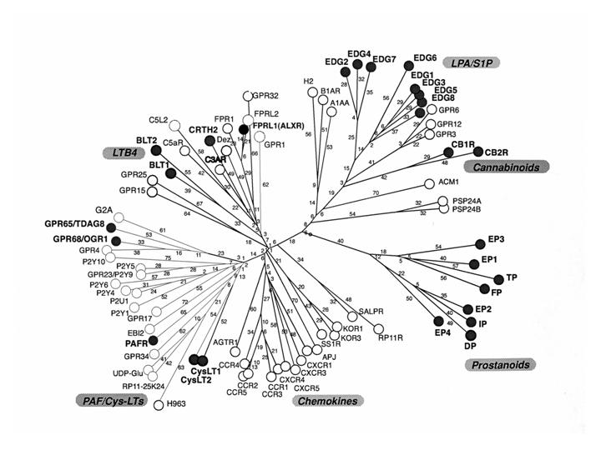
Mediators
Cytokines
- Il-1β, IL-6, TNF-α
Chemokines
- IL-8, MCP-1
Acachidonic acid metabilites
  -LTB₄, TXA₂
Activated complement
-C3a, C5a, C5b-9

Slide 45
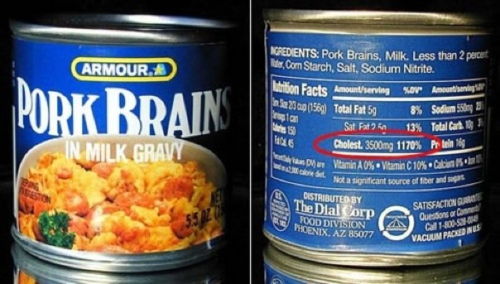
QUESTIONS?

