Slide 1
Nutrition

Slide 2
Outline
Physiology
Pathophysiology of inadequate calorie intake
Enteral feeding
Total parenteral nutrition
Partial parenteral nutrition
Nutrition in sepsis
Litterature review canine and feline patients

Slide 3
Physiology

Slide 5
Pathophysiology
Inadequate nutritional intake in healthy patient
  Utilizes glycogen storage
  Mobilizes amino-acids from muscles
  Will mobilize fat> amino acids after some time
    Loss of fat > muscle
Inadequate nutritional intake in ill patient
  Catabolic state
  Abnormal cytokines and hormonal response
  Loss of protein > fat
    Loss of lean body weight > fat

Slide 6
Consequences:
Negatively impact wound healing
Decrease immune function
Decrease strength (skeletal and respiratory muscles)
Worsens prognosis
  Humans with weight loss have poorer outcome than those without..

Slide 7
Identification of patients at risk of malnourishment
History
  Vomiting
  regurgitation
  chronic diarrhea
  Anorexia
  Unintended weight loss
Physical examination
  weight loss
  muscle loss
  Poor haircoat
  Signs of poor wound healing
Lab results
  Hypoalbuminemia
  Lymphopenia
  Anemia
  Coagulopathy
Anticipated course of recovery

Slide 8
Malnourished patients
Already malnourished
  Poor haircoat, weight loss, poor muscle mass, hypoalbumenia, lymphopenia, anemia, coagulopathies, signs poor wound healing, vomiting, regurgiatation..
Not malnourished yet but high risk for developing malnourishment
  Anorexia > 3 days, sepsis, trauma, pancreatitis, peritonitis, large draining wounds..
Not malnourished yet and low risk for developing malnourishment

Slide 9
Enteral feeding vs Parenteral feeding?

Slide 10
Parenteral nutrition and gut atrophy..
Parenteral nutrition: increases risk of complication and worsens outcome per humans studies
Gut atrophy
  with bacterial translocation
  gut-associated sepsis
  can occur w PN administration
  occurs with deprivation of enteral nutrients

Slide 11
Enteral nutrition too soon?
Early enteral nutrition:
  parvoviral enteritis and hemorrhagic gastroenteritis
  well tolerated and produces little complications

Slide 12
Enteral nutrition

Slide 13
Calculate energy requirement
Calories necessary to maintain homeostasis while animal is at rest
Multiply by a illness or activity factor
RER = 70 x BW ^{0.75}
In critical illness, no longer recommending to use a illness factor

Slide 14
Different types of diet
Polymeric diets: intact macronutrients (protein fat carbohydrates) normal or near normal GI tract
Defined formula diets: modified to accommodate disease associated liitation of nutrient intake.
Feeding modules: concentrated one form of nutrient

Slide 15
Proteins
17-22% of the kcals has to be delivered as proteins
Commercial diets: Low quality proteins and low digestibility
  Give 25-40% of Kcals as proteins

Slide 16
Other nutrients
Lipids
  essentials fatty acids
Minerals
Vitamins

Slide 17
Feeding options
Syringue feeding
Nasogastric intubation
Esophagostomy tube
Gastrotomy tube
  Surgically placed
  Endoscopic percutaneous placement
  Blinded percutaneous placement
Enterostomy tube placement

Slide 18
Seringue feeding
Can cause learned aversion
Liquid diet
Risk of aspiration pneumonia

Slide 19
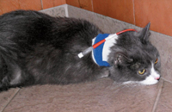
Esophagostomy tube
Indications:
  by pass oral cavity or oropharynx
  dysphagia
  infection
  inflammation
  neoplasia
  fracture
  oronasal fistula
  surgical procedure
  trauma

Slide 20
Esophagostomy tube
Complications
  Local infection, swelling cellulitis,
  Coughing
  Gastroesophageal reflux
  Vomiting and aspiration
  Esophageal erosion
  Esophagitis
  Premature displacement

Slide 21
Esophagostomy tube
Pros:
  Inexpensive
  Easy
  Quick learning curve
  No need for specialized equipment
  Maintained for weeks to months
  Easy to use by the owners

Slide 22
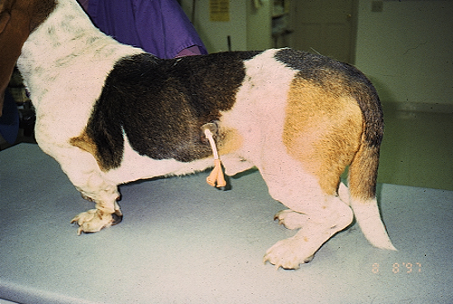
Gastrotomy tube
Placement
  Surgical
  Percutaneous endoscopic guidance
  Blinded percutaneous

Slide 23
Gastrotomy tubes
Indications:
  Comatose
  Bypass oral cavity larynx, or esophagus as result neurologic, neuromuscular disease
  Dysphagia
  Stricture
  Neoplasia
  Inflammation
  After surgical procedures head and neck.

Slide 24
Gastrotomy tube
Should remain in place for a minimal of 5-7 days preferably 4 days to allow firm adhesion or a stoma tract to form.
Large board mushroom tipped Pezzer catheter
Long term: low profile tip

Slide 25
Gastrotomy tube
Complications:
  Leakage around the side
  Peritonitis
  Necrotizing fasciitis
  Sub cutaneous abscessation
  If tube is secured to tightly: ischemia
  Vomiting
  Regurgitation
  Gastroesophageal reflux
  Aspiration pneumonia.

Slide 26
Gastrotomy tube
Initial feeding volumes: 5-10 ml/kg / feeding
Should aspirate prior to feeding. If > ½ recovered: skip the feeding

Slide 27
Enterostomy tube
Indications:
  Pancreatitis
  Pancreatic surgery
  Hepatobiliary surgery
  Proximal gastrointestinal obstruction
  Neoplasia
  Extensive gastrointestinal surgery.

Slide 28
Enterostomy tube placement
Contraindication
  Uncontrollable vomiting
  Diarrhea
  Adynamic ileus small intestinal obstruction
  Severe mucosal disease cannot guard their airway.

Slide 29
Enterostomy tube
Small 5 fr or 8 fr red rubber catheter.
Essential point:
  Need to be passed through the right body wall and enter the small intestine at the level of the descending duodenum or the proximal loop of jejunum to maximize surface absorption.

Slide 30
Enterostomy tube
Complications:
  Hemorrhage
  Cellulitis
  Infection
  Leakage around the catheter site into the peritoneal cavity
  Premature tube displacement
  Colic
  Diarrhea

Slide 31
Complications from enteral feeding

Slide 32
Mechanical
Clogged tube
Rapid administration of high osmotic substances to the GI tract -> cramps and vomiting
  Adding fiber rich diet or reducing the feeding rate
Cold feeding - > Diarrhea?.

Slide 33
Metabolic
Rapid absorption of high carbohydrate solutions
  Hyperglycemia
  Osmotic diuresis
  Ultimately non ketotic hyperosmolar coma.

Slide 34
Metabolic
Fat malabsorption:
    Pancreatic disease
    Biliary obstruction
    Ileitis
    Bacterial overgrowth
    Gastric surgery
    Intestinal resection

Slide 35
Diarrhea
Antibiotics rather than the liquid tube diet
  Penicillins, aminoglycosides, cephalosporins, chloramphenicol, clindamycin, aminopylline
Other drugs:
  cimetidine, potassium chloride, digoxin, magnesium containing antiacids, theophylline, codeine, acetaminophen cimetidine, isoniazid, vitamins.

Slide 36
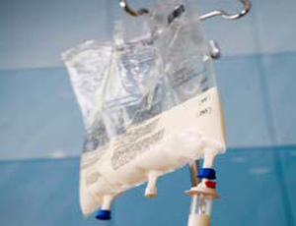
Parenteral nutrition

Slide 37
Definitions
Total parenteral nutrition:
  Delivered via central vein
  Provision of all of the animal’s calorie and protein requirement (ideally all of the micronutrients as well).
  Osmolarity: > 1000 mOsm/L
Partial parental nutrition:
  Central or peripheral vein
  Only supplies part of the animal’s energy, protein, and other nutrition requirement.
  Osmolarity: < 700 mOsm/L

Slide 38
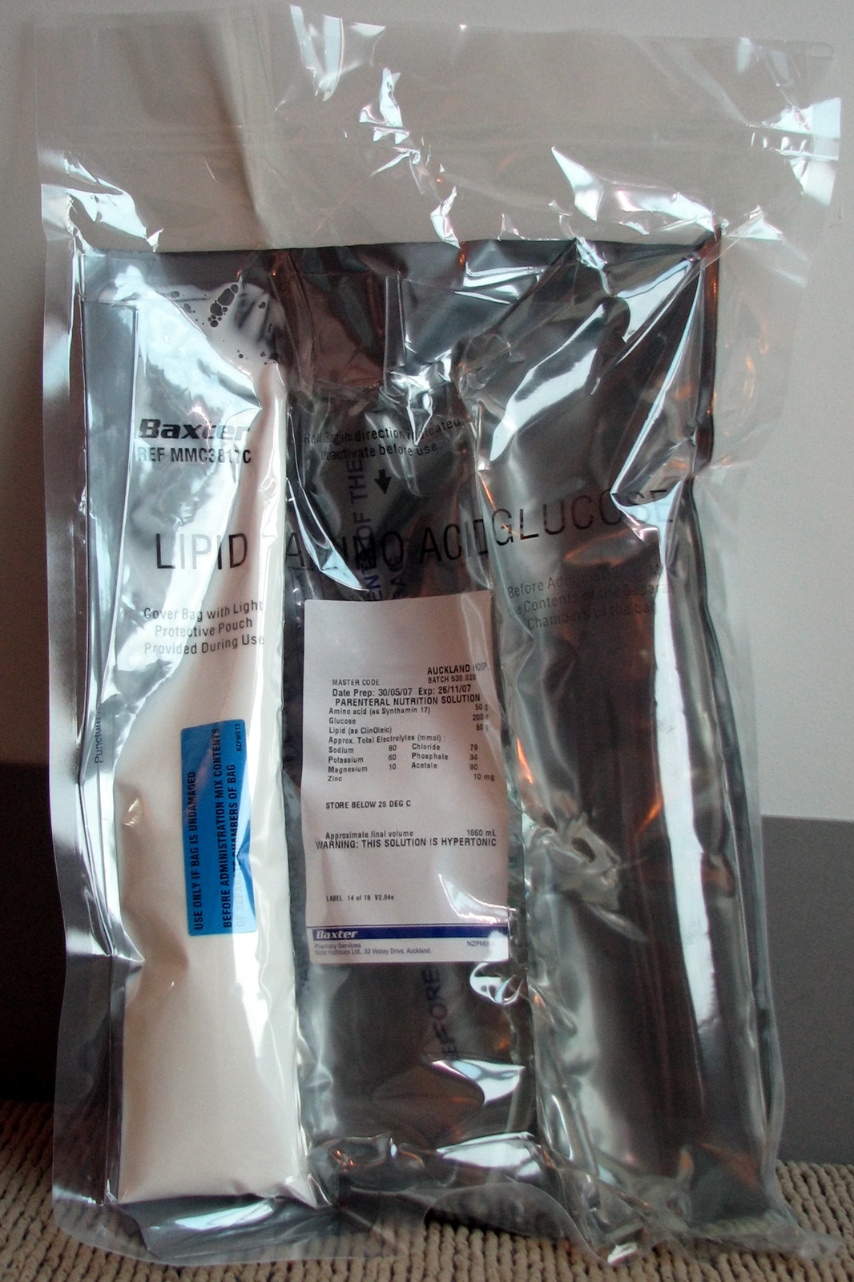
Composition
Animo acids
Dextrose
Lipids

Slide 39
How to formulate TPN

Slide 40
1. Determine the animal’s calorie requirement
RER= maintaining homeostais while animal rests quietly.
RER= 70 x BW ^{0.75}

Slide 41
2. Multiply by illness factor
However recent studies: avoid overfeeding and use more conservative equations.
  Avoid hyperglycemia and maintaining euglycemia +/- beneficial in humans.

Slide 42
3.Protein requirement
Standard amount of proteins: 4-5g/ 100kcal for dog
6g/100kcal per cat
Reduced in patients with protein restriction:
  HE or severe RF
Increased if increased need
  hypoalbuminemia, large draining wounds.

Slide 43
Arginine
Essential AA:
  Maintenance of immune function
  Precursor for nitric oxide
Critical illness ;
  depleted
  up-regulation of nitric oxide synthase
Supplementation of arginine to critically ill patients:
  nitric oxide can lead to vasodilation
  Compromise systemic perfusion
  Septic patients: Harmful
  Elective surgical patients has arginine supplementation demonstrated to be beneficial.

Slide 44
Glutamine
Non essential AA:
  preferred fuel source for enterocytes
  cells of the immune system
  Hepatocytes
Depletion:
  Compromise immune function
  Contribute to gut-derived sepsis
Difficulties stabilizing glutamine in solutions : providing it as a dipeptide: stable compound.
Low glutamine admission ICU: predictor mortality

Slide 45
Glutamine
Parenteral nutrition:
  Single center study w multiple organ failure + PN +/- glutamine:
    Improved in survival w glutamine
  Other study:
    no difference in outcomes
    Decreased infection rate
    Decreased insulin requirement
Enteral nutrition:
  Some positive results, but not as conclusive

Slide 46
Glutamine in animals
cats treated with methotrexate. enteral glutamine:
  no reducing intestinal permeability
Enteral glutamine on plasma glutamine concentrations and prostaglandin E₂ concentrations in radiation-induced mucositis :
  No measurable benefit
Possible reasons for the apparent failures:
  inadequate doses used
  enteral form not effective in these conditions

Slide 47
4. Essentials fatty acids
Dog: linoleic acid dog
Cat: linoleic and arachidonic acid
Source of essential fatty acids and fat soluble and vitamins
Soy based safflower oil.
  Made of artificial chylomicrons, rich in triglycerides and stabilized with glycerolphospholipids, and a smaller proportion of phospholipid rich liposomes
  Composed of n-6 fatty acids
High dose lipid:
  Imunosupression via granulocyte and reticuloendothelial cell dysfunction
  Alter gene expression of integrins and selectins, altering cell adhesion
  Inhibition of both bacterial phagocytosis and neutrophil function
  Inflammatory effects: inflammatory eicosanoids produced from n-6 fatty acids.

Slide 48
Lipids and inflammation
Parenteral administration ofn-6 fatty acids may be immunosuppressive
Omega-3 fatty acids compete with omega-6 fatty acids(arachidonic acid) as substrates for cyclooxygenase and lipoxygenase pathways.
  Eicosanoids produced from n-3 fatty acids :
    Reduced inflammatory and vasomotor potencies compared to the arachidonic-derived mediators.
  Conventional lipid emulsions increase the availability of linoleic acid, the precursor of arachidonic acid
Alteration in the ratio of omega-6: omega-3 (n-6:n-3) fatty acids in cell membranes:
  Modulates production of interleukins and TNF in response to LPS stimulation
In the presence of sepsis, SIRS and other serious conditions up-regulation of inflammatory prostanoids occurs.

Slide 49
Lipids
Max dose: 2g/kg/day avoid immunosupression
Dose reduction or elimination of lipids indicated in patients w hypertriglyceridemia
Supplementation w antioxydant to reduce risk of free radical formation and lipid perodixation

Slide 50
Lipid free TPN?
Critically ill populations and lipid –free TPN:
  Lower incidences of
  No difference in survival
  Decreased length of hospital stay, length in ICU stay, and ventilator-free days were shown to decrease
  T-cell function:
    improved 5 days after initial injury in lipid free PN
    Worsened in individuals receiving lipid-containing PN

Slide 51
5. Dextrose
Provides ½ of the non protein calories by dextrose.
  Increase the proportion of lipid if the animal develops hyperglycemia to decrease the amount of dextrose in the solution.
50% dextrose in TPN = 1.7 kcal/ ml
5% dextrose PPN= 0.17 kcal/ml

Slide 52
6. Vitamins
B vitamins:0.2 ml/100 kcal provides enough riboflavin
Debilitated animals or TPN for long time: TPN vitamin complex: A, D, E, C + B.
Vitamin K ?
  Not recommended if give lipids
  Can give injection SC if no lipid given in the TPN

Slide 53
7. Trace elements
Zinc, magnesium, copper
Not commonly supplemented if short term
Will supplement if on TPN for more than 5 days

Slide 54
8. Adjusment per disease
Restrict:
  Sodium in cardiac patients
  Lipids in hyperlipidemic patients

Slide 55
Commercial combination:
Administration of one of the component alone:
  Not efficient and/ or not feasible through a peripheral cathether.
Commercial solutions mix aa and dextrose when break the seal.
  50ml/kg/day cat or 66 ml/kg/day dog: all of the protein’s requirement and 30% of the energy requirement.

Slide 56
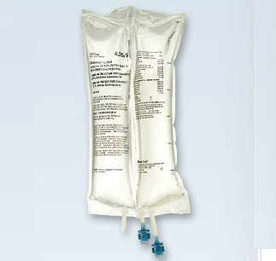
Administration
Aseptic placement of intravenous catheters:
  Silicone
  Polyurethane
  Tetrafluoerthylene
Avoid:
  Polyvinyl chloride
  Polyethylene

Slide 57
Material | Catheter
Polyurethane | Arrow multilumen Mila multilumen
Polyethylene | Cavafix (Venacath)
Vialon TM | Intracath
 | Monoject (regular ones)

Slide 58
Administration
Delivered via infusion pump and with a 1.2 micron filter
  prevents lipid globules and precipitates (calcium phosphate)
Gradual increase in RER requirement over 2 or 3 days
Daily aspetic bandage and line change

Slide 59
TPN and PPN complications

Slide 60
Mechanical
Line breakage, chewed, disconnected, perivascular infiltration, catheter occlusion, phlebitis, thrombosis
Reduce risk: aseptic placement and handeling of the lines. E collar and change bandages daily.

Slide 61
Metabolic
Hyperglycemia
Hypoglycemia (discontinuing)
Hyper/hypo K, Na, Ph, Cl, Magnesium
Hyperbilirubinemia
Hypertriglyceridemia
Hypercholesterolemia
Refeeding syndrome ( hypophosphatemia, with or without hypokaliemia and hypomagnesiumia)
Reduce risk: use a conservative RER, initiate TPN gradually, monitor glucose and electrolytes

Slide 62
Sepsis
Definition:
  Positive blood culture
  Positive catheter tip culture
Reduce risk:
  Dedicated catheter
  Aseptic technique
  Changing catheters after 3-5 days
  Low thrombotic materials

Slide 63
Discontinuing TPN
Need to have at least 50% RER orally w or without having a feeding tube
Gradually decreased over 4-8 hours (monitor BG).

Slide 64
Litterature review use of TPN and PPN in veterinary medicine

Slide 65
Questions

Slide 66
Which of the following cathethers is not recommended to administer TPN?
Cavafix
Arrow multilumen
Monoject
Intracath

Slide 67
Where should a enterotomy feeding tube enter the small bowel
Proximal duodenum, close to the sphincter of Odi
Mid duodenum
Distal duodenum
Mid jejunum

Slide 68
Which of the following is the most inflammatory fatty acid when administered parenterally
Omega n-3
omega n-6
omega n-9
omega n-12

Slide 69
Which of the following is not a mechanism of action of immusupression of parenteral lipid administration
  Imunosupression via granulocyte and reticuloendothelial cell dysfunction
  Alter gene expression of integrins and selectins, altering cell adhesion
  Inhibition of both bacterial phagocytosis and neutrophil function
  Inflammatory eicosanoids produced from n-3 fatty acids.

Slide 70
Which of the following aminoacids have shown a benefit in survival in critical illness?
Arginine
Glutamine
Taurine
Lysine

Slide 71
Which of the following defines refeeding syndrome?
Hypophosphatemia, Hypokaliemia, Hypomagnesimia
Hyperglycemia, hypophosphatemia, hypokaliemia
Hyperkaliemia, Hyperphosphatemia, hypocalcemia
Hyperglycemia, hyperkaliemia, hyperphosphatemia

Slide 72
Which is the most common metabolic complication encountered w TPN administration?
Hyperglycemia
Hypokaliemia
Sepsis
Hypomagnesemia

Slide 73
What is the new recommendation to reduce the risk of hyperglycemia in TPN in cats?
Do not multiply RER by an illness factor to avoid overfeeding
Gradual increase in feeding over 2-3 days

