Slide 1
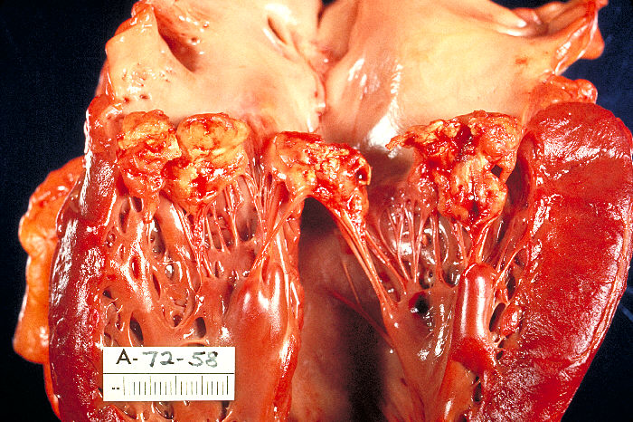
Endocarditis
Board review
Dr Julie Menard

Slide 2

Definition
Infection of one or more of the endocardial surfaces of the heart
Almost always involves the cardiac valves
Commonly bacterial
Few fungal cases reported
Notes:
fungal: aspergillus

Slide 3
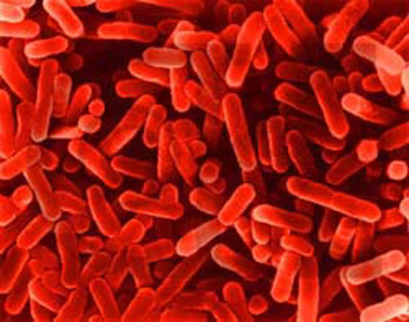
Bacteremia
Bacteria present in the blood stream
Occurs on a daily basis
Dogs: 30 to 67% dogs bacteremia after dental procedure
  preventive antibiotic prophylaxis inefficient
Notes:
brushing 40% humans bacteriemic afetr teeth extraction, 25% after brushing teeth. Dogs: 67% to 30% dogs have bacteriemia after dental procedure. Pen G did not decrease the incidence of bacteriemia. the normal immune system takes care of the bacteriemia

Slide 4
Pathophysiology
Endothelium integrity impaired
  Valve motion causes endothelial trauma
  Mitral > aortic> tricuspid> pulmonic
Hemostatic function impaired
Host immune function impaired
Notes:
bacteriemia: The mitral valve is affected in 86% of human patients and is subjected to approximately 116 mm Hg systolic pressure, the aortic valve is affected in 55% of human cases and is subjected to approximately 72 mm Hg diastolic pressure, the tricuspid valve is affected in 20% of cases and is subjected to approximately 24 mm Hg systolic pressure, and the pulmonic valve is affected in 1% of cases and is subjected to approximately 5 mm Hg diastolic pressure.²

Slide 5
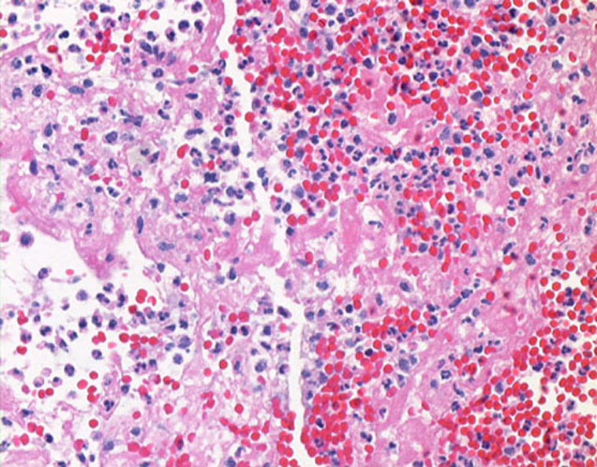
Pathophysiology
Non bacterial thrombotic vegetation
  Platelet matrix, fibrin, red blood cells histiocytes and lymphocytes
  Scaffold for bacteria implantation secondary to bacteremia
  Matrix : nidus slow replication
  Bacteristatic antibiotics not recommended

Slide 6
Predisposing factors in humans
Humans:
  Previous cardiac disease
  Poor dental hygiene
  Long term hemodialysis
  HIV
  Drug use
  Long term indwelling intravenous catheter
  Diabetes mellitus
  Prosthetic valve replacement
Notes:
previous cardiac disease but not congenital cardiac disease

Slide 7
Predisposing factors in dogs
11% Congenital cardiac disease
  SAS (Aortic valve)
  MVD
Dental disease
  No correlation between dental, oral procedure or oral infection and IE
  Increase risk for endocarditis with severe periodontal disease

Slide 8
Predisposing factors
46% possible cause
  Balloon dilation
  Non oral surgery or GA
  Infection (oral cavity, skin, diskospondilitis)
  30% acquired defect of innate or adaptive immunity (neoplasia, barrier defect, heaptic disease, long term steroids, immunosuppresive)
  Indewelling catheters

Slide 9
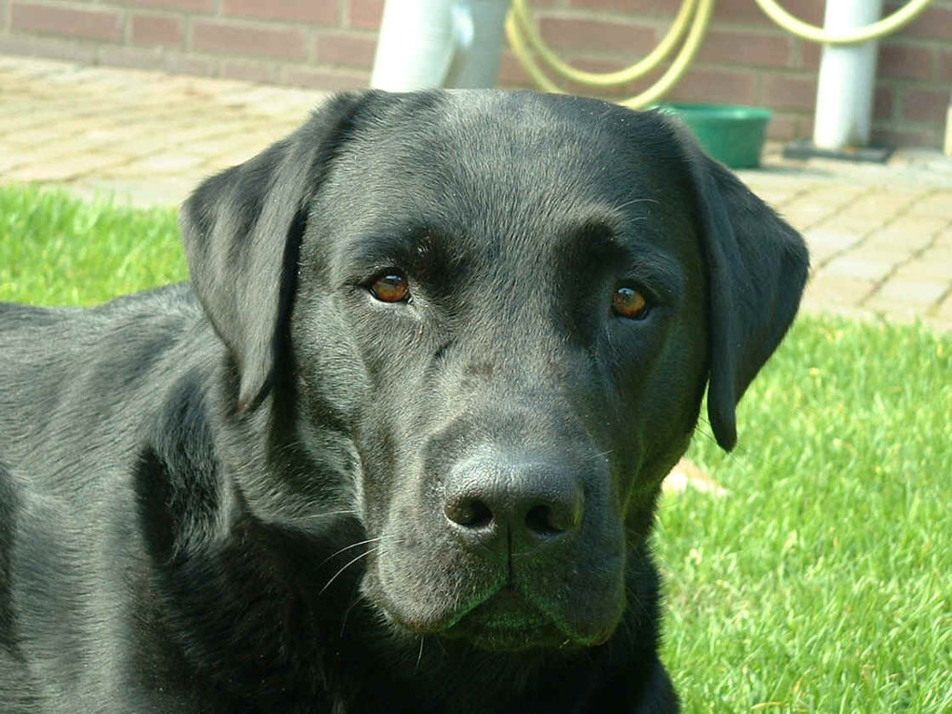
Clinical signs
92% Large breed (purebreed) dogs
  German Shepherd dog or mix
  Labrador retriever
  Golden retriever
  Rottweiler
  Boxer
8% small breed dogs
Male > female (2:1)
Middle age (> 4 yo) median 7 yo

Slide 10
Presenting complaint
Non specific: systemic illness 10 days
  Lethargy 61%
  Inappetance 57%
  Locomotor issues 33%
  Vomiting 27%
  Respiratory 20%
  Weight loss 13%
  Coughing 13%
  Fever 40 %

Slide 11
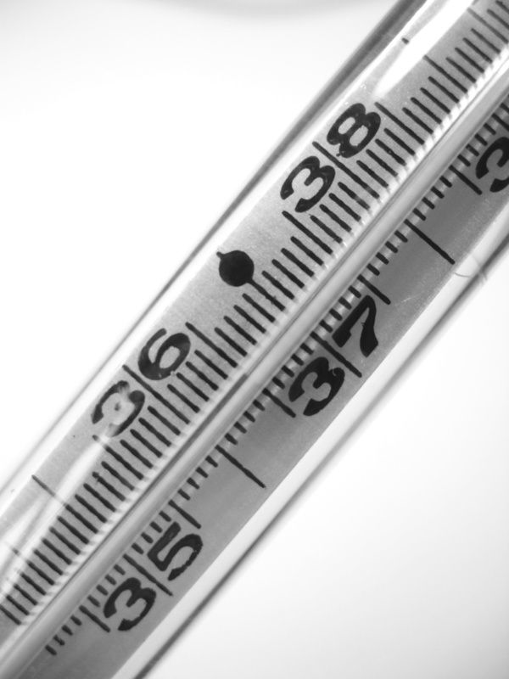
Physical examination
Febrile (38%)
Cardiac murmur 59% new in 41%
  Systolic murmur left apex ( 92%Mitral)
  Diastolic ( 8% only diastolic)
Tachycardia 50%
Arrhythmia 19%
81 % cases cardiovascular +/- fever
Notes:
new HM grade 3/6 in young febrile dog endocarditid should be the primary differential until proven otherwise

Slide 12
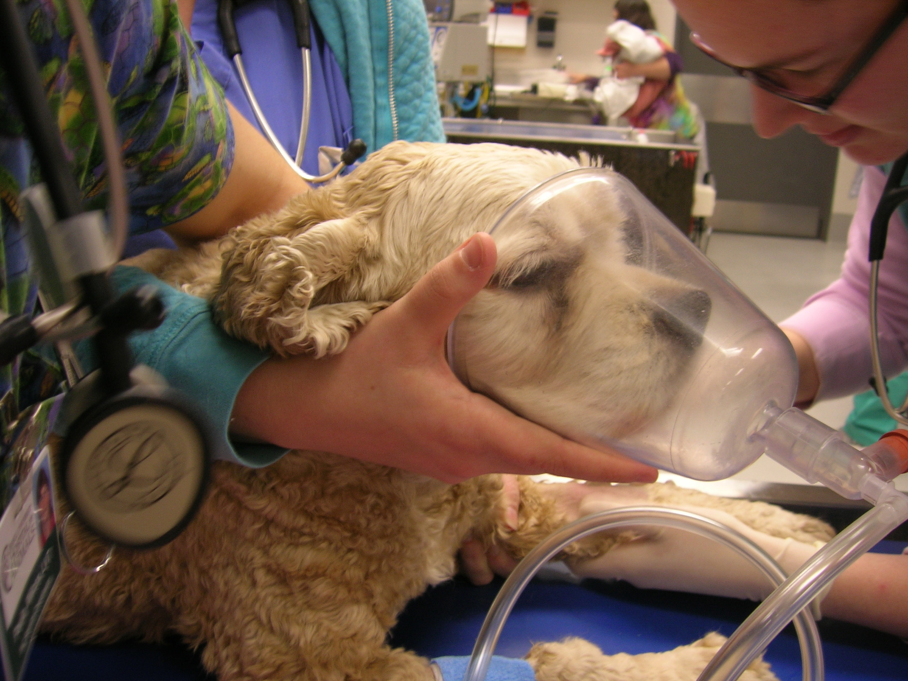
Physical examination
Respiratory issues 50%
Neurologic 23%
Recumbent-reluctant to stand-weak 57%
Peripheral edema
Dull mentation
Dehydration

Slide 13

Diagnosis
Based on clinical / biochemical/ echocardiogram findings
Humans:
  AV block, BBB
  Signs of embolus
  Leukocytosis, anemia, elevated protein C and elevated erythorcyte sedimentation rate

Slide 14
Duke Criteria
Major Criteria | Minor Criteria
Positive blood culture Typical microorganism consistent w IE from 2 separate BC Microorganism consistent with IE from peristently + BC Evidence of endocardial involvement Positive echocardiogram New valvular regurgitation | Predisposition Fever > 38 C Vascular phenomena (aortic or septic emboli) Immunologic phenomena (glomerulonephritis etc..) Microbiological evidence : + BC that do not meet Major Criteria Echocardiographic evidence that do not meet Major Criteria
Notes:
Typical microorganisms: viridans streptoccoci or HACEK group or staph aureus or enteroccoci
peristent positive BC: 2 + more than 12 h apart or all of 3 or a majority of > 4 with first and last sample drwan > 1 hour apart
Positive echo: oscillatin intracardiac mass o n valve or supporting structures in the path of regurgitant jest or on implanted materials n the abs of an alternative anatomic explanation, abcess or new partial dehiscnce of prothestic valve

Slide 15


Duke criteria
Definitive:
  Pathological criteria
  Clinical criteria:
    2 major
    1 major and 3 minor
    5 minor
Notes:
pathological criteria: microrganism on culture or histo of vegetations, emboli or intracardiac abscess. pathological lesions: vegetation or intracerdaic abscess gisto showing active IE

Slide 16
Duke criteria
Possible IE:
  findings consistent w IE that fall short of definitive or rejected
Rejected:
  firm alternate diagnosis
  Resolution of manifestation < 4 days ATB
  No pathological evidence of IE after sx or autopsy < 4 days ATB

Slide 17
Adapted Criterias for dogs
Major Criteria | Minor Criteria | Supporting Evidence
Positive echocardiogram findings Positive blood culture Recent onset of diastolic murmur or aortic regurgitation w/o SAS | Fever Large dog (> 15kgs) New worsening systolic murmur | Embolic disease Immunologic disease SAS in dog > 5 yo

Slide 18
Adapted Duke Criteria to dogs
Definite or Very Probable Infective Endocarditis
  Pathologic criteria
  Clinical criteria (see Box 24-1)
    Two major criteria, or
    Positive echocardiographic finding plus one minor criterion, or
    Three minor criteria

Slide 19
Adapted criteria for dogs
Possible Infective Endocarditis.
  One major criterion
  Two minor criteria
  Supporting evidence with at least two minor criteria
Rejected
  Identification of alternative diagnosis to explain signs compatible with infective endocarditis
  Resolution of clinical signs with short-term antibiotic therapy
  No pathologic evidence of infective endocarditis

Slide 20
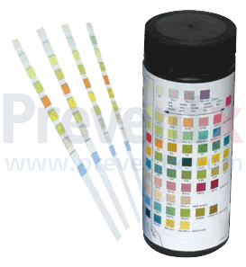
Clinical Pathology : UA
62 % Hematuria
62% Proteinuria
60% Pyuria
25% Cylinduria
10% Bactiuria
10% Glucosuria

Slide 21
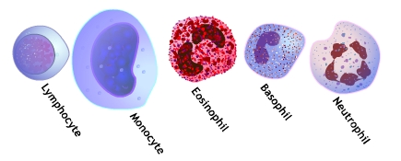
Clinical pathology : CBC
52 % Non regenerative anemia
22% Regenerative anemia
89% Leukocytosis
50% Thrombocytopenia

Slide 22
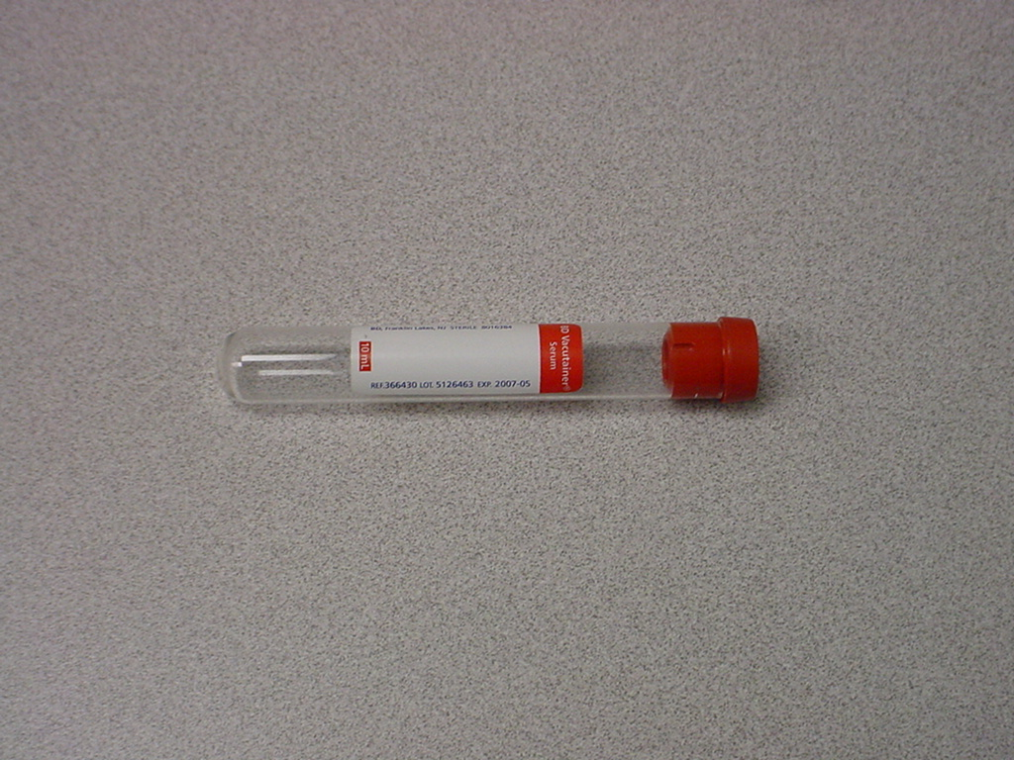
Clinical pathology: Chemistry
95 % hypoalbuminemia
42% azotemia
  23% ⬆ BUN and Creat
70% ⬆ liver enzymes (ALT, AKLP, GGT)
20% ⬆ T bili

Slide 23
Clinical pathology: Coag
PT: short 25% elevated: 8%
⇧ PTT: 88%
⇧ Fibrinogen: 83%
+ D-dimers or FDPs: 87%

Slide 24
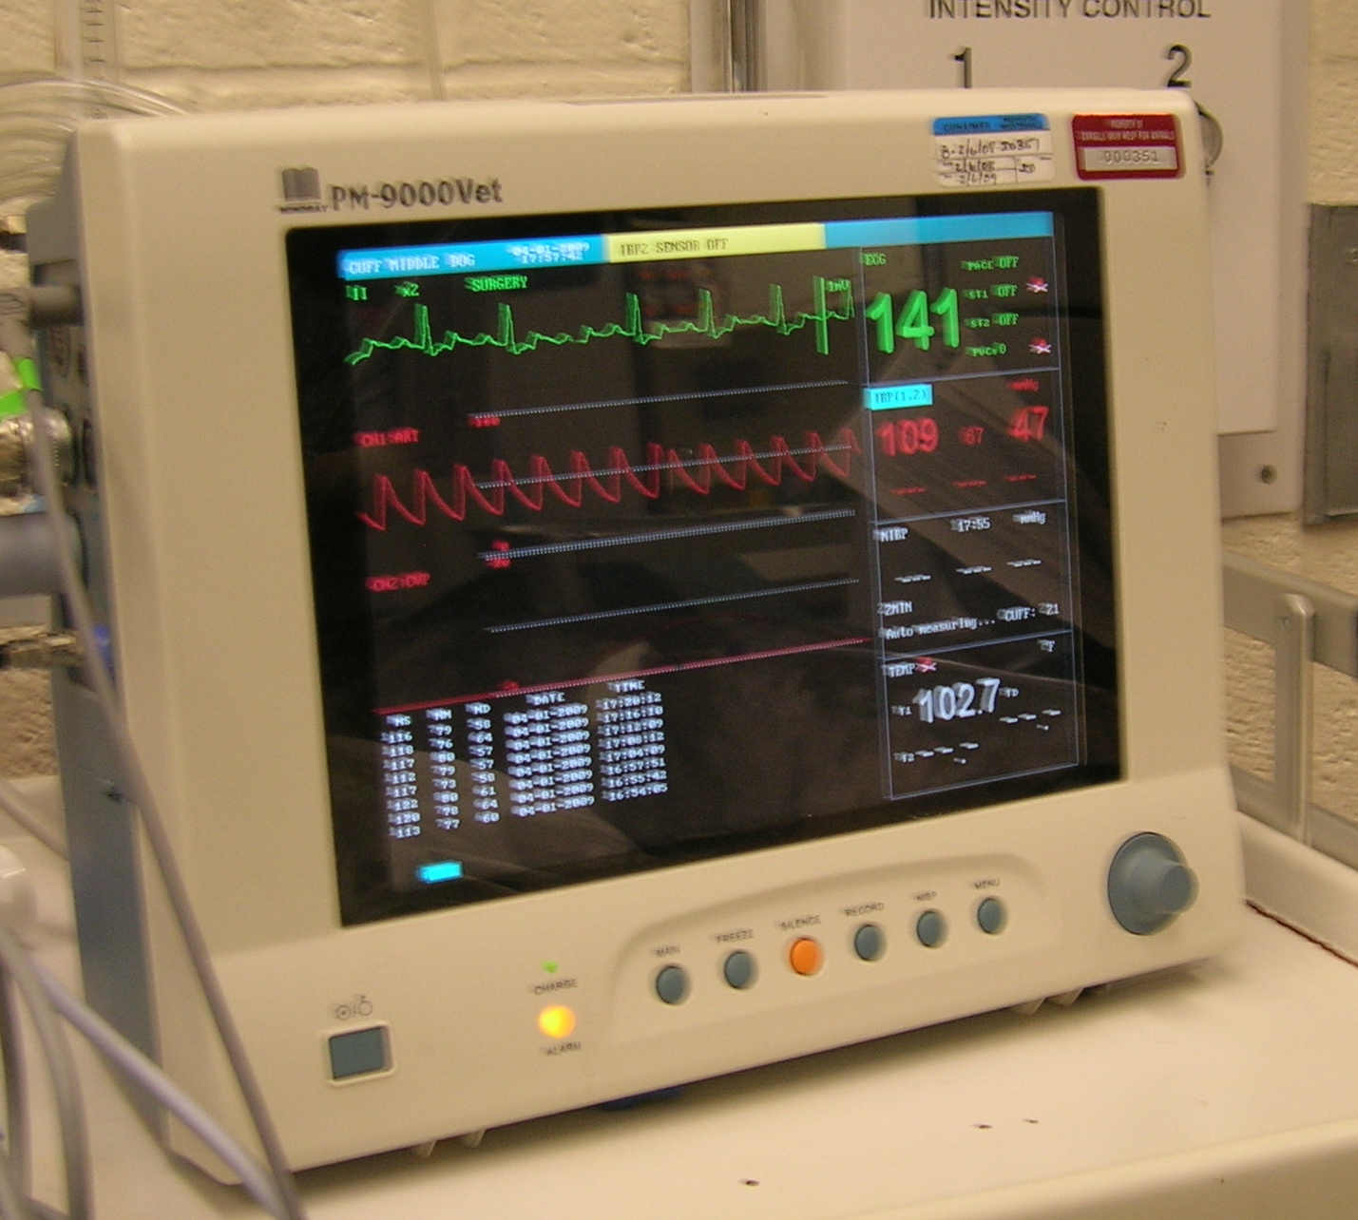
ECG
45% arrhythmia or conduction abnormalities
  77% ventricular
  32% atrial
Poorly correlated w necropsy findings

Slide 25
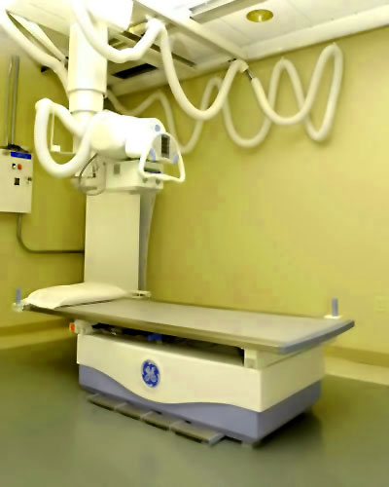
Imaging : Radiology
Normal in 24%
Abnormal:
  CHF
  Alveolar infiltrates
  Pneumonia
  Microcardia
  Enlarged LA or cardiomegaly, pulmonary vessels

Slide 26
Imaging: Ultrasound
Hepatic lesions
Pancreatitis
Gastro intestinal
Splenic
Renal
Abdominal lymphadenopathy
Thrombosus

Slide 27
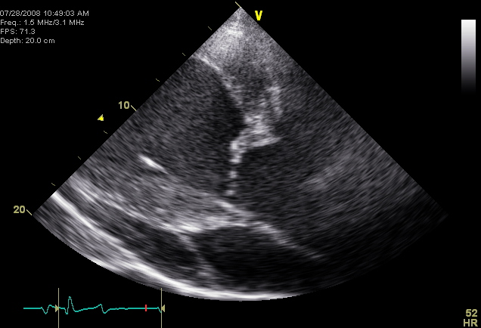
Echocardiogram
84% Sensitivity
Single Valve 73% of the cases

Slide 28
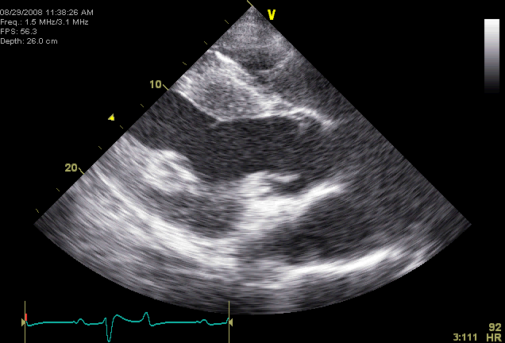
Echocardiogram

Slide 29
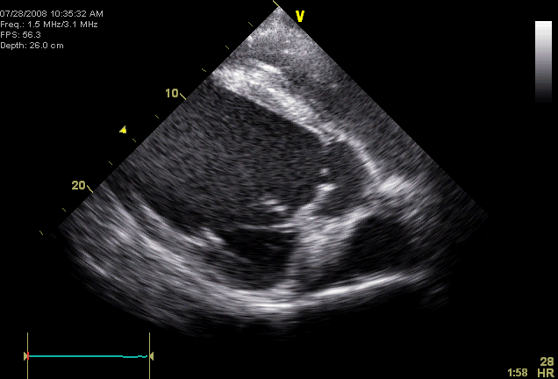
Echocardiogram

Slide 30
Echocardiogram
54% valves: combination proliferative mobile and shaggy
Mitral regurgitation
LA enlargement
Mural lesion: 8% detected in necropsy
Notes:
valvular abnormalities: hyperchogenicity, thicknening, irregularity, proliferative or vegetative lesion
vegetation hat oscillates, shaggy moth eaten or fluffy
nodular changes or focal discrete lesions.

Slide 31
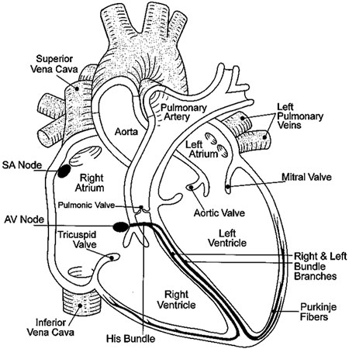
Incidence of valve involvement
Mitral valve: 59%
Aortic valve: 51%
Tricuspid: 7%
Pulmonic: 3 %
AV + MV: 15%

Slide 32
Complications from IE
Valve prolapse
Acquired stenosis
Defect in the mitral and aortic leaflet
Ruptured chordae tendinae
Acquired interventricular septal defect
Pericardial effusion

Slide 33
Blood cultures
Causative organism : 52% cases by BC
Antibiotics within 2 weeks of BC doesn’t affect the likelihood of positive result
Median # submitted: 3
Positive 1 or 1+2 or 2 only

Slide 34
Blood cultures
Sterile venipuncture:
  Multiple sites
  Freshly sterily placed long line
Arterial sample no better than venous
Adequate blood volume (5 to 10 ml)
Aerobic and anaerobic mediums
Isolation occurs within 7 days
Notes:
chances of obtaining a positive blood culture directlt related to the volume sampled. Small number of bacteria in each sample. blood culture brothratio 1:10 recommended to counteract the bactericidal activity of the serum
anticoagulant and antiphagocytic effects of broth additives are diminished f the dilution of blood in media is less than 1:8.
maintained at room temperature incubation at 37 C

Slide 35
Blood cultures
Negative blood cultures:
  Prior antimicrobial therapy
  Chronic low grade infections (disko or IE)
  Intermittent shedding of the organism
  Causative agents other than bacteria
  Uremia
  Righted sided lesion
Notes:
ATB prior: 2-3 days should be ok but if longer period of time, can ave a negative effect. if can slow down the isoloation but not prevent it.

Slide 36
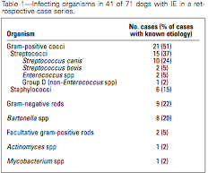
Most common pathogens
EE. Coli

Slide 37
Other Pathogens
  Pseudomonas aeruginosa
  Erysipelothrix
  Pasteurella Multocida
  Klebsiella
  Corynbacterium
  Proteus Vulgaris
  Actinomyces Turicensis
  Aspergillus
Notes:
diagnosis for bartonella using antemortem serology and post mortem PCR assays in culture negative dogs

Slide 38
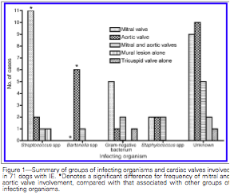
Association pathogen and valve localization
Bartonella
Streptococcocuss

Slide 39
Association pathogens and outcome
Gram negative bacteria: less likely to develop heart failure
Streptococcus:
  more likely to be on mitral valve
  more likely to have neutrophilic polyarthritis

Slide 40

What’s so special about Bartonella?
Northern California
25- 28% dogs w Bartonella
  Elevated antibodies titer
  PCR on necropsy
Anaplasma +
Same clinicopathologic and complications

Slide 41
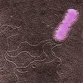
Bartonella
Negative blood cultures
Afebrile
More likely to involve Aortic valve
More likely to develop CHF
Negative correlation w outcome

Slide 42
Complications
30% Neutrophilic polyarthritis
44% Thromboembolism
31% Congestive heart failire
45% Arrhythmia
24% Neurologic
52% Renal disorder

Slide 43
Polyarthritis
Septic polyarthritis
Immune mediated: immune complex deposition
Shifting lameness, peripheral edema and pain

Slide 44
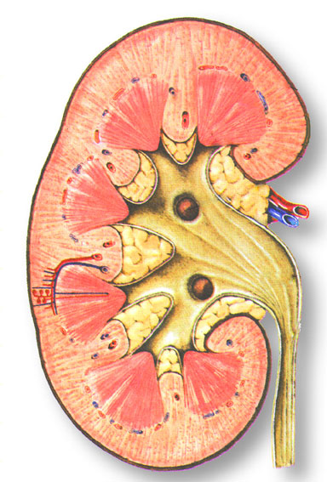
Renal complication
52% cases
15% Glomerulonephritis or PLN
Pyelonephritis

Slide 45
Thromboembolism
44% dogs
  Kidneys 74%
  Spleen 32%
  Lungs 23%
  Myocardium 19%
  Peripheral arteries 19%
  Brain 13%
Mitral valve alone> aortic
Vegetative lesion not correlated w TE

Slide 46

Treatment
Antibiotics selected upon results of blood culture
While we wait: broad spectrum
Avoid bacteriostatic

Slide 47
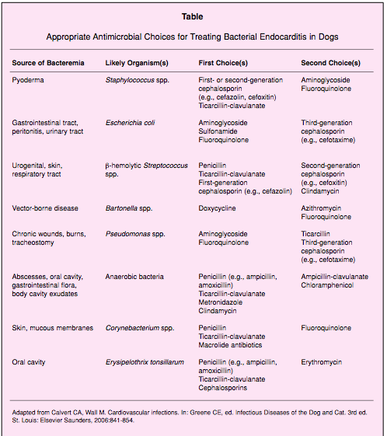

Slide 48
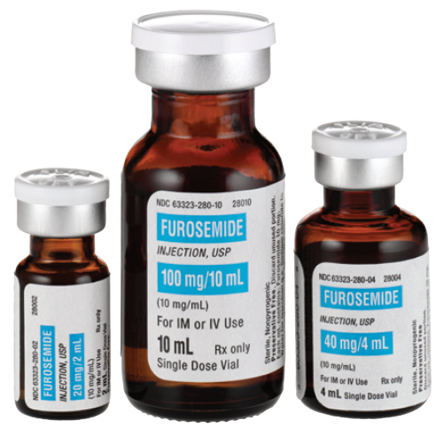
Treatment
Congestive heart failure
  Diurectic
  ACE inhibitor
  Pimobendan
  Digoxin
  Afterload reducer

Slide 49
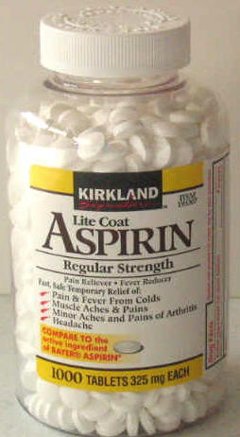
Treatment
Anticoagulant
  No longer recommended in humans
  Increase risk of intracranial bleed
  Doesn’t decrease the risk of embolization

Slide 50
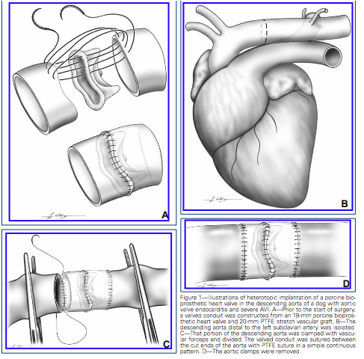
Treatment
Prostatic valve replacement

Slide 51
Prognosis
47%- 80% mortality
56% mortality rate in Sykes’ study
Risk Factors:
  Thrombocytopenia
  High serum creatinine
  Renal complications
  Thromboembolic events

Slide 52
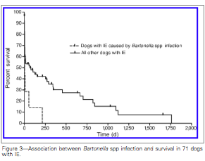
Prognosis

Slide 53
Questions?
List the 4 most common pathogens in Canine IE?
  Streptococcus
  Staphylococcus
  E. Coli
  Bartonella

Slide 54
Question
What qualifies as a definite IE based on the modified Duke criteria?
Definitive: 2 major criteria or 1 major and 3 minor or 5 minor criteria
  Possible: findings consistent w IE that fall short of definitive or rejected
Rejected: firm alternate diagnosis

Slide 55
Question
In Skyes article from 2007, what was the most common cardiac valves involved in IE?
  Aortic
  Mitral
  Tricuspid
  Pulmonic

Slide 56
Question
True or False?
  Bartonella IE is more likely associated with aortic valve?
    True
  Bartonella IE has a lower mortality rate than other pathogens?
    False
  Bartonella IE are less likely to develop CHF?
    False
  Bartonella IE are more likely to be afebrile on presentation?
    True

Slide 57
Special thanks
Dr Waxman
Dr Rogers

Slide 58
References
Sykes J.E and al. Clinicopathologic findings and outcome in dogs with IE: 71 cases. JAVMA, 2006
Sykes J.E and al. Evaluation of the relationship between causative organisms and clinical carateristics of IE in dogs : 71 cases. JAVMA, 2006
MacDonald K.A and al. A prospective study of Canine Infective Endocarditis in Northen California: Emergence of Bartonella as a prevalent Etiologic agent. JVIM, 2004

Slide 59
References
Durack and al. New Criteria for diagnosis of infective endocarditis: Utilization of specific echocardiographic findings: Duke Endocarditis Service. Am J Med, 1994
Mylonakis and Calderwood, Infective Endocarditis in Adults, NEJM, 2001
Bayer and al. Diagnosis and Management of IE and its complications, Circulation, 1998
Prevention of infective Endocarditis, Guidelines from the American Heart Association, 2007

