Slide 1

Cats

Slide 2
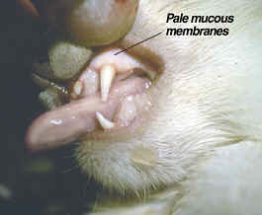
IMHA

Slide 3
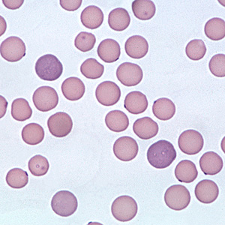
Pathogenesis
Primary
Secondary:
  FeLV
  FIP
  Mycoplasma Hemofelis
  Drugs
  Tumors
  SLE
  Blood transfusion incompatibility

Slide 4
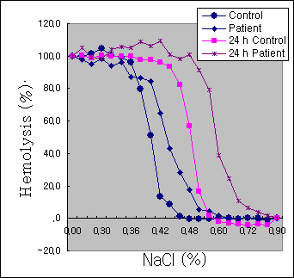
Diagnosis
Differentiating Coombs’s test
  Detection of eythrocyte bound IgG, IgM, or C3b
Spherocytes:
  Difficult to identify in cats
  No central pallor
Osmotic fragility test:
  Measures stability of RBC in NaCl solutions (.85%-0%)

Slide 5
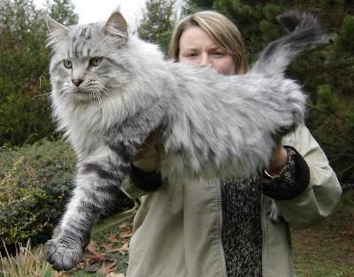
Signalement
Breed:
  DSH (59%)
  Oriental shorthair
  Maine Coon
  Abyssinian
Age:
  Median: 2 year (0.5-9)
  Males (58%) > females (42%)

Slide 6

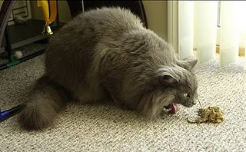
Clinical signs
Lethargy
Inappetence
Pica
Vomiting
Pruritus
Dyspnea
Epistaxis
PUPD
Obstipation

Slide 7
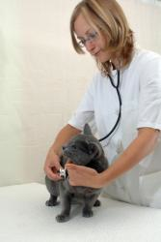
Clinical signs
Pale and/ or icteric mm
Lymphadenopathy
Systolic heart murmurs
Gallop

Slide 8
Diagnosis
Complete blood count
  Median PCV: 12%
    79% severe anemia PCV < 15%
  Increased MCV
  Non regenerative anemia (58%) > regenerative
  Nucleated RBCs w regenerative anemias
  Lymphocytosis
    +/- left shift
  Platelet count normal > low
    1 Evans syndrome
  No to few Heinz bodies

Slide 9
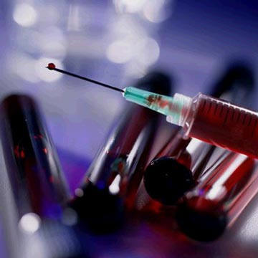
Diagnosis
Chemistry
  Hyperbilirubinemia
  Hyperglobinemia
  Mild increase in BUN

Slide 10
Diagnosis
Coombs test
  Positive 15/19 cats
  4/19 persistent agglutination
Osmotic fragility
  Significantly increased

Slide 11
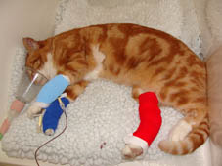
Treatment
Immunosupressive
  Glucocorticoids
Blood transfusion
Doxycycline

Slide 12

Outcome
Mortality rate: 23.5%
Relapse:
  31% cats monitored > 1 month

Slide 13

IMT cats

Slide 14

Signalement
Rare condition
Median 6 years (18 mo-12 y)
No gender
DSH
  Abyssinian
  Somali
  British shorthair

Slide 15

History and PE
Epistaxis
Petechiae
Ecchymosis
Hematochezia
Hematuria
Hemotypsis
Decreased appetite
Weight loss

Slide 16
Diagnosis
Platelet counts < 50, 000 and bleeding
  rule out pseudothrombocytopenia (common in cats)
Assays- not validated yet
  Increased PSAIg found with:
    Fat necrosis
    FIP
    FeLV
    FIV
    Lymphoma
    Leukemia
    Hepatitis
    Pyelonephritis
    Hyperthyroidism

Slide 17

Treatement
Immunosuppressive
  Steroids
  Reports of azathioprine, cyclosporine, vincristine and hIVIgG

Slide 18

Outcome
80% survival 15 months to 5 years
Median recovery platelet > 50, 000
  7 days
Long term therapy
Frequent relapses if weaned off

Slide 19
References

Slide 20
Cyclophosphamide exerts no beneficial effect over prednisone alone in the initial treatment of acute immune-mediated hemolytic anemia in dogs: a randomized controlled clinical trial.Mason N, Duval D, Shofer FS, Giger U.J Vet Intern Med. 2003 Mar-Apr;17(2):206-12
Prognostic factors for mortality and thromboembolism in canine immune-mediated hemolytic anemia: a retrospective study of 72 dogs.Carr AP, Panciera DL, Kidd L.J Vet Intern Med. 2002 Sep-Oct;16(5):504-
Correlation between leukocytosis and necropsy findings in dogs with immune-mediated hemolytic anemia: 34 cases (1994-1999).McManus PM, Craig LE.J Am Vet Med Assoc. 2001 Apr 15;218(8):1308-13
Treatment of immune-mediated hemolytic anemia in dogs with cyclophosphamide.Burgess K, Moore A, Rand W, Cotter SM.J Vet Intern Med. 2000 Jul-Aug;14(4):456-62
Immune-mediated hemolytic anemia: 70 cases (1988-1996).Reimer ME, Troy GC, Warnick LD.J Am Anim Hosp Assoc. 1999 Sep-Oct;35(5):384-9
Intravenous administration of human immune globulin in dogs with immune-mediated hemolytic anemia.Scott-Moncrieff JC, Reagan WJ, Snyder PW, Glickman LT.J Am Vet Med Assoc. 1997 Jun 1;210(11):1623-7
Vaccine-associated immune-mediated hemolytic anemia in the dog.Duval D, Giger U.J Vet Intern Med. 1996 Sep-Oct;10(5):290-

Slide 21
Anti-endothelial cell antibodies in dogs with immune-mediated hemolytic anemia and other diseases associated with high risk of thromboembolism.Wells R, Guth A, Lappin M, Dow S.J Vet Intern Med. 2009 Mar-Apr;23(2):295-300. Epub 2009 Feb 2
Concurrent immune-mediated haemolytic anaemia and severe thrombocytopenia in 21 dogs.Goggs R, Boag AK, Chan DL.Vet Rec. 2008 Sep 13;163(11):323-
Anti-erythrocyte antibodies and disease associations in anemic and nonanemic dogs.Morley P, Mathes M, Guth A, Dow S.J Vet Intern Med. 2008 Jul-Aug;22(4):886
Idiopathic immune-mediated hemolytic anemia: treatment outcome and prognostic factors in 149 dogs.Piek CJ, Junius G, Dekker A, Schrauwen E, Slappendel RJ, Teske E.J Vet Intern Med. 2008 Mar-Apr;22(2):366-73. Epub 2008 Mar 1
Detection of activated platelets in dogs with primary immune-mediated hemolytic anemia.Weiss DJ, Brazzell JL.J Vet Intern Med. 2006 May-Jun;20(3):682-6
Primary immune-mediated hemolytic anemia in 19 cats: diagnosis, therapy, and outcome (1998-2004).Kohn B, Weingart C, Eckmann V, Ottenjann M, Leibold W.J Vet Intern Med. 2006 Jan-Feb;20(1):159-
Evaluation of prognostic factors, survival rates, and treatment protocols for immune-mediated hemolytic anemia in dogs: 151 cases (1993-2002).Weinkle TK, Center SA, Randolph JF, Warner KL, Barr SC, Erb HN.J Am Vet Med Assoc. 2005 Jun 1;226(11):1869-
Assessment of lipid peroxidation and serum vitamin E concentration in dogs with immune-mediated hemolytic anemia.Pesillo SA, Freeman LM, Rush JE.Am J Vet Res. 2004 Dec;65(12):1
Case-control study of blood type, breed, sex, and bacteremia in dogs with immune-mediated hemolytic anemia.Miller SA, Hohenhaus AE, Hale AS.J Am Vet Med Assoc. 2004 Jan 15;224(2):232

Slide 22
J Vet Intern Med. 2010 Use of Serum Concentrations of Interleukin-18 and Monocyte Chemoattractant Protein-1 as Prognostic Indicators in Primary Immune-Mediated Hemolytic Anemia in Dogs.Kjelgaard-Hansen M, Goggs R, Wiinberg B, Chan DL.
The association of blood lactate concentration with outcome in dogs with idiopathic immune-mediated hemolytic anemia: 173 cases (2003-2006).Holahan ML, Brown AJ, Drobatz KJ.J Vet Emerg Crit Care (San Antonio). 2010 Aug;20(4):413-20
Immune-mediated hemolytic anemia and severe thrombocytopenia in dogs: 12 cases (2001-2008).Orcutt ES, Lee JA, Bianco D.J Vet Emerg Crit Care (San Antonio). 2010 Jun;20(3):338-45
Treatment of immune-mediated hemolytic anemia with individually adjusted heparin dosing in dogs.Helmond SE, Polzin DJ, Armstrong PJ, Finke M, Smith SA.J Vet Intern Med. 2010 May-Jun;24(3):597-605. Epub 2010 Ap
Plasma antithrombin activity as a diagnostic and prognostic indicator in dogs: a retrospective study of 149 dogs.Kuzi S, Segev G, Haruvi E, Aroch I.J Vet Intern Med. 2010 May-Jun;24(3):587-96. Epub 2010 Apr 2
Use of thromboelastography in dogs with immune-mediated hemolytic anemia: 39 cases (2000-2008).Sinnott VB, Otto CM.J Vet Emerg Crit Care (San Antonio). 2009 Oct;19(5):484
Use of human immunoglobulin in addition to glucocorticoids for the initial treatment of dogs with immune-mediated hemolytic anemia.Whelan MF, O'Toole TE, Chan DL, Rozanski EA, DeLaforcade AM, Crawford SL, Cotter SM.J Vet Emerg Crit Care (San Antonio). 2009 Apr;19(2):158-6
Splenectomy as an adjunctive treatment for dogs with immune-mediated hemolytic anemia: ten cases (2003-2006).Horgan JE, Roberts BK, Schermerhorn T.J Vet Emerg Crit Care (San Antonio). 2009 Jun;19(3):254-6

Slide 23
Underlying diseases and clinicopathologic variables of thrombocytopenic dogs with and without platelet-bound antibodies detected by use of a flow cytometric assay: 83 cases (2004-2006).Dircks BH, Schuberth HJ, Mischke R.J Am Vet Med Assoc. 2009 Oct 15;235(8):960-
A prospective, randomized, double-blinded, placebo-controlled study of human intravenous immunoglobulin for the acute management of presumptive primary immune-mediated thrombocytopenia in dogs.Bianco D, Armstrong PJ, Washabau RJ.J Vet Intern Med. 2009 Sep-Oct;23(5):1071-8. Epub 2009 Aug
Treatment of Evans' syndrome with human intravenous immunoglobulin and leflunomide in a diabetic dog.Bianco D, Hardy RM.J Am Anim Hosp Assoc. 2009 May-Jun;45(3):147-50
Primary immune-mediated thrombocytopenia in 30 dogs (1997-2003).Putsche JC, Kohn B.J Am Anim Hosp Assoc. 2008 Sep-Oct;44(5):250-7

Slide 24
Questions

Slide 25
Which of the following is associated with a poor outcome in dogs w IMHA?
a) Increased CI
b) Normal CI
c) Lactate < 4.3
d) Ht < 20% on admission

Slide 26
Which of the followings is the gold standard for diagnosis of primary AIHA?
Positive coombs test
Spherocytosis
Autoagglutination
Direct flow cytometry ethrytocyte antibodies
None of the above
all of the above

Slide 27
Of the following which anticoagulant has shown an improvement in survival?
Clopidogrel
low molecular weight heparin
unfractionated heparin normal dose
tailored dose unfractionated heparin
Fresh frozen plasma within 24 hrs of diagnosis

Slide 28
Leukoctysosis in dogs with IMHA has been associated with
Improved outcome
Longer length of hospitalization
Increase need for blood transfusions
Increase hepatic necrosis on necropsy

Slide 29
IMHA is considered what type of hypersensitivity?
Type 1
Type 2
Type 3
Type 4
It is not considered a hypersensitivity disease

Slide 30
Dogs with Evans syndrome are considered to have a
same outcome as patients w IMHA
worse outcome
better outcome

Slide 31
True or False?
Administration of hIVIG in dogs w presumptive ITP have a shorter hospital stay than dogs not receiving ITP?
True

