Slide 1
Acute liver failure
Board review
Julie Menard
Cornell University

Slide 2
Liver Function
Recognition and detoxification of xenobiotics and endogenous wastes
Elimination of toxins
Manufacturing of substances
Storage of metabolic products
Metabolic activation
Metabolic elimination

Slide 3
Definition
1970 Trey and Davidson
  Severe liver injury w onset of encephalopathy within 8 weeks of symptoms appearance and without pre-existing liver disease
1986 Bernuau: Time from icterus to HE
    Fulminant: 0-2 weeks
    Subfulminant: 2-12 weeks
1993 O’Grady: Time from icterus to HE
    Hyperacute: 0-1 week
    Acute: 1-4 week
    Subacute: 4-12 week

Slide 4
Etiology
Etiology | dog | cat
Infectious agent | canine adenovirus-1 Acidophil cell hepatitis virus Canine herpes virus Gram positive septicemia Gram negative septicemia Salmonella spp. Clostridia spp. Bartonellosis Leptospirosis Liver abcess Tularemia Hepatozoonosis Rickettsia Rickettsii Histoplasmosis Coccidiomycosis Blastomycosis Leishmaniasis Toxoplasmosis Dirofilaria Immitis Ehrlichia Canis | Feline infectious peritonitis Clostridiosis liver abscess Histoplasmosis Cryptococcosis Toxoplasmosis Liver Flukes

Slide 5
Etiology
Etiology | Dogs | Cats
Drugs | Acetaminophen Aspirin Phenobarbital Phenytoin Carprofen Tetracycline Macrolides Trimethoprim-sulfa Griseofulvin thiacetarsamide Ketoconazole, Itraconazole Halothane | acetaminophen Aspirin diazepam halothane griseofulvin ketoconazole itraconazole methimazole methotrexate Phenobarbital phenytoin

Slide 6
Etiology | dog | cat
Chemical agents and toxins | Xylitol industrial solvent plants (sago palm) envenomation heavy metals mushrooms alfatoxins blue green algae cycad seeds carbon tetrachloride dimethynitrosamine Zinc phosphide | same as dog
Traumatic, thermal, hypoxic | Diaphragmatic hernia Shock liver torsion heat stroke massive ischemia | same as for dogs

Slide 7
Etiology | Dogs | Cats
Miscellaneous | Chronic hepatitis, Cirrhosis Idiopathic Copper storage disease leptospirosis induced Idiosyncratic drug reaction lobular dissecting hepatitis Granulomatous hepatitis Hepatic amyloidosis (Shar Pei) Hepatic neoplasia (primary or metastatic disease) Portosystemic shunting portal venous hypoplasia/ microvascular dysplasia (YST and Cairn T) | Feline hepatic lipidosis inflammatory bowel disease pancreatitis cholangitis cholangiohepatitis septicemia endotoxemia hemolytic anemia neoplasia (lymphoma, mastocytosis) Mestasis amyloidosis (abyssinian, Oriental and siamese cats)

Slide 8
Drug reaction: mechanism
Most pharmacological active substance: lipophyllic
Enhancement or elimination: need to be transformed to hydrophyllic
Liver metabolism:
  Phase I
  Phase II
Smooth endoplasmic reticulum of the liver

Slide 9
Phase I
Usually precedes phase II (not always)
Activation or inactivation of the drug
  Oxidation
  Reduction
  Hydrolysis
  Cyclization or decyclization
Cytochrome P450 mono-oxygenase (CYP), NADH and O2

Slide 10
Phase II
Conjugation reaction
  Methylation
  Sulphanation
  Acetylation
  Glucorinidation
Most often detoxification in nature

Slide 11
Pathophysiology
Cytotoxic:
  direct injury to hepatocyte caused by virus, drugs and their toxic metabolites or toxins
Cytopathic
  Immune mediated response to hepatocytes that express abnormal cell surface antigens (idiosyncratic drug reaction)
Both

Slide 12
Tissue ischemia/ hypoxia
Cytoprotective cofactor depletion
Cholestatic injury
Cell membrane injury
Free radical oxidative injury
Immunogenic injury
Toxins binding to cells proteins
Membrane peroxidation Phospholipase injury
Endotoxin initiated injury
Intracellular toxin production P 450 cytochromes interacting w macromolecules
Microbial, viral, parasite initiated injury

Slide 13
Pathophysiology
Damage to hepatocyte cell membrane
Decrease mitochondrial energy function
Leakage of enzymes
Retention of irritative waste: bile acids
Initiation of apoptosis
Inflammatory cascade w cytokine
Formation free radicals
  LIVER NECROSIS

Slide 14
Consequences
Hemodynamic instability
Hepatic encephalopathy
Cerebral edema
Coagulopathy
Renal failure
Sepsis
Metabolic disturbances
  DEATH…

Slide 15
Hemodynamic instability
High cardiac output + decreased systemic vascular resistance
Marked splanchnic and systemic arteriolar vasodilation -> hepatic arterial blood flow and portal flow decreased
Hyperdynamic circulation
Low arterio-venous O2 content ≠
Tissue hypoxia

Slide 16
Hepatic encephalopathy
Pathophysiology poorly understood
1893: Nencki and Pavlov: meat intoxication syndrome:
  Increase ammonia levels after a meal associated w behavioral disturbances in dogs w surgical PSS
1991: Direct evidence ammonia in HE
  ⬆ NH₃ uptake into brain in HE vs. healthy

Slide 17
Pathophysiology HE
Accumulation non metabolized NH₃
Production of false neurotransmitters
Activation GABA-benzodiazepine receptors by ligands from endogenous origin
Altered cerebral metabolism
Disturbed Na K ATP ase activity
Zinc deficiency of zinc dependant enz of urea cycle
Manganese deposition of basal ganglia

Slide 18
Ammonia- NH₃
Central role in HE
Origin:
  Colonic urease-producing bacteria
  Enterocytes SI (glutamine breakdown)
Liver: metabolizes ammonia to urea
Kidney: Produce and excrete NH₃
Muscles: detoxifies during hyper NH₃
NH₃ ➔ Glutamine

Slide 19

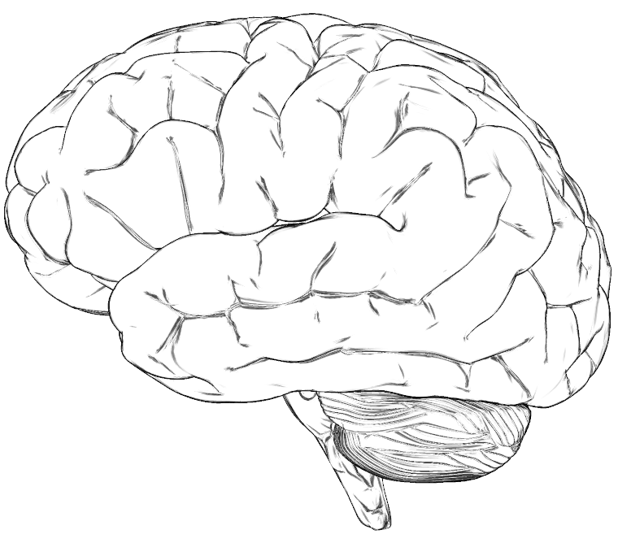
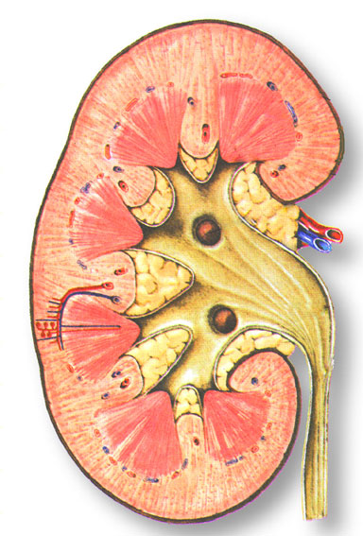
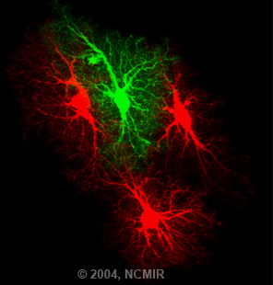
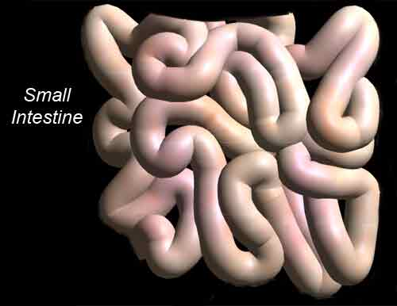
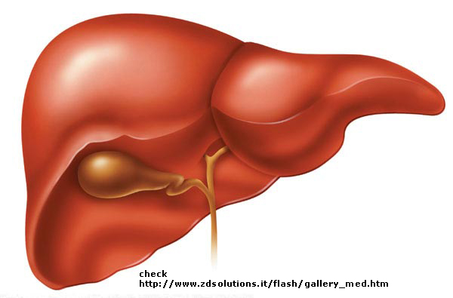
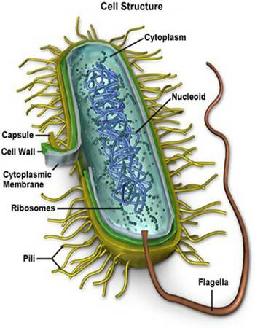
NH₃ ➔ Glutamine
Glutamine⬇
NH₃
Astrocyte
NH₃
Enterocytes
Bacteria urase +
NH₃ ➔ UREA

Slide 20
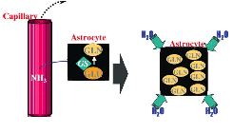
Pathophysiology of NH₃ in HE
Astrocyte: site of NH₃ detoxification
  NH₃ converts to glutamine
“Ammonia-glutamine- brain edema hypothesis”
  Accumulation of glutamine in astrocyte
  Osmotic stress
  Swollen astrocytes

Slide 21
Astrocyte swelling
Endosomal activation (Ion channel and aa transport)
Activation extracellular protein kinase
Increase intracellular calcium
Deposition glycogen and
inhibition glycogenolysis
Neurosteroids
Upregulation benzo receptors
Increase inhibitory GABA neurotransmitter activity

Slide 22
Role of NH₃ in HE
Decrease excitatory neurotransmitter
  Down regulating NMDA receptors
  Blocks chloride extrusion: inhibitory neurotransmitter is ineffective
Cerebral energy failure
Neuronal oxidative stress
Impaired mitochondrial function
Notes:
NMDA: excitatory receptors
cerebral energy failure: inhibition of ketoglutarate dehydrogenase

Slide 23
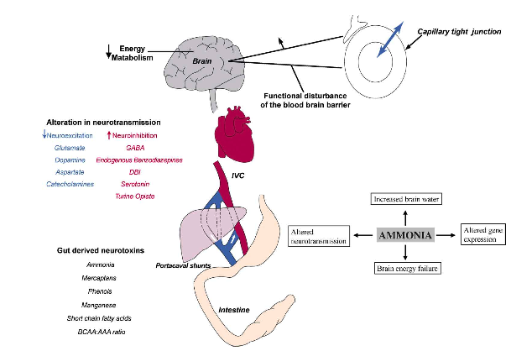
Other factors

Slide 24
Tryptophan
Tryptophan:
vasculature
Glutamine
BBB
Tryptophan
cerebral parenchyma
Serotonin
quinolate
Inhibitory
excitatory

Slide 25
Other molecules
Amino acid imbalance:
  Branch > aromatic = production false neurotransmitters
  Deficiency arginine and citruline
Hypoglycemia
Hypoxemia
Endotoxemia
Hypotension

Slide 26
Summary
Toxins | Mechanisms suggested
Ammonia | Increase brain tryptophan and glutamine brain edema decreases ATP availability Increases excitatibility Increases glycolysis Decreases microsomal Na, K ATP ase in brain
Glutamine | alters blood brain barrier aa transport
Aromatic amino acids | Decreases dopa neutrotransmitter synthesis Alters neurorecptors Increases production of false neurotransmitters
Short fatty acids | Decreases microsomal Na, K ATPase in brain Uncouple oxidative phosphorylation Impairs oxygen utilisation Displaces tryptophan from albumin Increases free tryptophan

Slide 27
False neurotransmitter | Mechanism suggested
Tyrosine -> octopamine | Impairs norepinephrine action
Phenylalanine -> phenylethylamine | Impairs norepinephrine action
Methionine -> mercaptans | Synergistic with ammonia and short chain fatty acids Decreases ammonia detoxification in brain urea cylcle GIT derived Decreases microsomal Na, K APTase
Tryptophan | Directly neurotoxic increases serotonin and quionlate
Phenol (from phenylalanine and tyrosine) | Synergistic w other toxins Decreases cellular enzymes Neurotoxic and hepatotoxic
Bile acids | membrane cytolytic effects, alter cell membrane permeability impairs cellular metabolism due to cytotoxicity
GABA | Neuronal inhibition Increases BBB permeability to GABA
Endogenous benzodiazepines | Neuronal inhibition hyperpolarize neuronal membrane

Slide 28
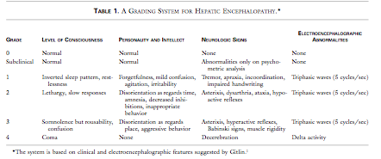
Classification of HE
http://www.youtube.com/watch?v=zxdz_m5gcpU&NR=1
Grade III- IV: subclinical seizure
Improved w phenytoin and ⬇ cerebral edema in 2000 england. 2004 study showed no benefit

Slide 29
Cerebral edema
Present in 70-80% of grade IV HE
30 % humans cerebellar herniation

Slide 30
Pathophysiology cerebral edema
Multifactorial
Astrocyte swelling
Vasogenic, cytotoxic, intertitial edema
Damaged BBB barrier: ⬆ permeability
Loss of CBF regulation and hypoperfusion
Local increase in lactate concentration

Slide 31
Coagulopathy
Abrupt and profound decrease in synthesis of coagulation proteins
Consumption of clotting factors and platelets
Thrombocytopenia
Qualitative platelet defect (⬇ adhesion and aggregation)
Deficiencies in anticoagulant: Protein C and S, AT

Slide 32
Renal failure- Humans
Common in humans = hepatorenal syndrome
Reported in small animals
Pathophysiology
  Relative hypovolemia
  Microcirculatory disturbances
  Acute tubular necrosis
  Complicating sepsis
  Direct nephrotoxicity

Slide 33
Sepsis
Impaired reticuloendothelium function
Decreased opsonisation
Impaired neutrophil chemotaxism
Impaired neutrophil and Kuppfer cell phagocytic function
Decrease complement level
Bacterial translocation
Invasive procedures

Slide 34
Sepsis
Present in 80% cases
  50% gram positive: Staph and Strep
  Coliformes
1/3 patients: afebrile and normal WBC
Fungal infection in 30%

Slide 35
Pulmonary abnormalities
33% humans: pulmonary edema
  Altered permeability pulmonary vessels
  Vasodilation
  ARDS
  +/- Hypoalbuminemia

Slide 36
Portal hypertension
Usually secondary to cirrhosis
In acute liver failure
  Massive sinusoidal collapse -> blockade against intrahepatic circulation
  Ascites
  Poor prognostic indicator

Slide 37
Cholestasis
Early or late in FHF
  Biliary hyperplasia secondary to massive injury
  Increase in ALP
  Hyperbilirubinemia develops several days after

Slide 38
Metabolic derangements
Hypoglycemia:
  Impairement of glycogen storage
  Reduced glycogenisis
  Reduced hepatic synthesis of insulin like growth factor 1 -> increase protein degradation in muscles

Slide 39
Metabolic derangements
Hypokalemia
  Inadequate K⁺ intake
  Increase loss: V⁺, D⁺, potassium wasting diuretics
  Worsens HE: decreases NH₃ renal excretion
Hyponatriemia
  impaired excretion of free water
  Failure of Na K ATP ase pump: accumulation Na w/i the cells

Slide 40
Metabolic derangements
Hypophosphatemia
  Respiratory alkalosis: Phosphate moves into intracellular space
    Ventilatory failure
    Nausea and diarrhea
    Decrease HCO₃⁻ excretion
    Impaired myocardial function
    RBC fragility and left shift O₂ dissociation curve
    Decrease leukocyte activity
    Decrease platelet survival
    Worsens HE
    Insulin resistance

Slide 41
Metabolic derangements
Lactic acidosis
  Tissue hypoxia
  Altered tissue oxygen extraction
  Decrease liver function, unable to metabolize
Respiratory alkalosis
Hypoventilation in final stage

Slide 42
Clinical signs
Severity and duration of impairement of:
  Synthetic
  Biotransformation
  Endotoxin scavenging effects
  Systemic effects of toxins released from necrotic liver
  Extend and rate of regeneration

Slide 43
Clinical signs
Anorexia
Depression
Vomiting
Polydyspsia
  Low BUN: defective renal medullary gradient
  Decrease release and/ or responsiveness of collecting duct to ADH
Hematochezia/ melena
Hematemisis

Slide 44
Physical examination
Dehydration
Shock
Cranial abdominal pain
Hepatomegaly
Icterus

Slide 45
Clinical pathology- CBC
Target cells
Acanthocytes
Anisocytosis
Non regenerative anemia > regenerative anemia
Thrombocytopenia
Leukocytosis or leukopenia

Slide 46
Clinical pathology- Chemistry
ALT and AST:
  Increase within hours of the insult
  Peak after 3 days
  Gradual decrease
AST/ ALT ratio:
  If AST> ALT mitochondrial damage

Slide 47
Clinical pathology- Chemistry
ALT: acts like an acute phase protein
  Increase after day 2
  Will remain elevated until resolution of the intrahepatic cholestasis, cholangiohepatitis, and hepatic regeneration
GGT: elevated
    Cats: early detection of parynchemal inflammation and cholestasis
    ALP> GGT hepatic lipidosis

Slide 48
Clinical pathology-Chemistry
Bilirubin
  Increase early in disease when hepatic necrosis around portal triad
  Late in disease when hepatic necrosis periacinar
  Remains elevated until return of sinusoidal blood flow

Slide 49
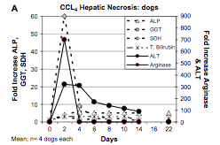
Clinical pathology- dogs

Slide 50
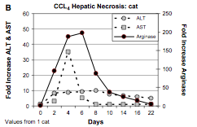
Clinical pathology-cats

Slide 51
Clinical pathology
Albumin
  70 % loss of functional hepatic tissue
  Negative acute phase protein
  25% of the protein produced by the liver
Glucose
  75% loss of functional hepatic tissue
  Depletion of the glycogen stores
  Impaired gluconeogenesis

Slide 52
Clinical pathology
Cholesterol
  Up to 50% synthetized in the liver
  If altered cholesterol elimination could be normal or elevated despite decrease synthesis
BUN
  Produced from NH₃ Urea cycle

Slide 53
Clinical pathology
Functional testing
  NH₃ tolerance test: more specific
  Bile acids: not feasible icterus
  BSP and ICG: Anion indicator dyes: earliest indication

Slide 54
Clinical pathology- Coagulation
Prolongation of PT and PTT
Decrease in fibrinogen
Decrease in factor V and factor VII
Decrease in Plasminogen
Decrease in Protein C?
Platelets have adhesion and aggregation deficiencies

Slide 55
Coagulation - humans
Degree of prolongation of PT : relates to severity of liver damage
Factor 7:
  Vit K dependant
  Shortest ½ life
  Failure to improve 25% after IV vit K: little hepatic reserve
Factor 5:
  Non vit K
  Shortest ½ life?
  Most sensitive index for impaired synthesis
Factor 8/5 ratio > 30 poor prognosis

Slide 56
Cytology
Poor correlation w histology
Will diagnosis infiltrative disease
Histology needed for firm diagnosis

Slide 57
Histology
Ultrasound guided –poor correlation w sx biopsy
Key hole
Laparoscopy
Laparotomy
Transjugular –humans
Risk of bleeding

Slide 58
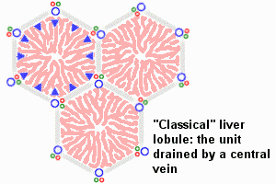
Histology
Portal triad
Hepatic vein

Slide 59
Histology
Periportal or zone 1 lesions
Toxins:
Synthaline
Other:
IBD
Pancreatitis

Slide 60
Histology
Midzonal or zone 2 lesion
Drugs:
Berylium, paraquat

Slide 61
Histology
Periacinar or centrolobular or zone 3 lesions
Hypoxemia
Hypoperfusion
worsened by anemia and hypoxemia
Acetaminophen

Slide 62
Histology
Paracentral lesion involving the entire acini
Diazepam
Menbendazole

Slide 63
Treatment
General treatment principles
  Adress underlying cause if known
  Reduce and prevent inflammation
  Reduce and prevent oxidative damage
  Provide adequate nutrition
  Reduce and prevent fibrosis
  Reduce and prevent copper accumulation

Slide 64
Fluid therapy
Resuscitation
  Guided by PE, HR, MAP, CVP..
Supplementation with potassium
Avoid Lactate Ringer’s Solution
  Decrease hepatic ability to metabolize lactate to HCO₃⁻

Slide 65
Metabolic derangements
Monitor glucose
  Supplement if necessary
  Central vein if high supplementation
Phosphate
  Avoid hypophasphatemia

Slide 66
If in need of blood transfusion..
Prefer fresh whole blood > Pack red blood cells
  Minimizes exposure to:
    NH₃
    Pyrogens
    Microorganisms

Slide 67
Coagulopathy
Fresh frozen plasma
  Hemorrhagic diathesis
  Give in preparation of invasive procedure
Vitamin K1
  Subcuteneous injection
  0.5 mg/kg q 12-24 hrs for 3 days or as long as PT is prolonged

Slide 68
Antibiotics
Prevent bacterial translocation
  Good hepatic penetration
  Broad spectrum anbitiotic
  Reduce urease producing bacterias
Antifungals
  Humans use of clotrimazole and amphotericin B

Slide 69
Gastro intestinal bleeding
Prophylatic use of sucralfate > antiacids
  Predisposes to gastric bacterial overgrowth
  Predisposes to nosocomial pneumonia
Antiacids
  Proton pump inhibitor
  Prostaglandin analogue
  H2 blockers (cimetidine> famotidine)

Slide 70
Nutrition
Enteral route > parenteral
Low protein diet?
  Vegetal protein > animal
  Increase fiber: increase transit
  Controversies in cirrhotic patients w low protein diet vs normal
    Similar protein synthesis
    Higher protein breakdown in low protein group

Slide 71
Seizures
Controversial
Avoid benzodiazepines, barbituates
Treat with propofol?
Prophylactic treatment of subclinical seizures in grade 2 HE w phenytoin: No benefit

Slide 72
Renal replacement therapy
Prefer CVVHD to hemodialysis
  Avoids fluids shifts

Slide 73
N-acetylcysteine
Cystein donor
Enters hepatocytes
  Stimulate GSH synthesis
  Enhance glutathione S transferase activity
  Promotes detoxification of certain hepatotoxins
  Direct antioxydant (HOCl, O₂^{•-}, H₂O₂)

Slide 74
N acetylcysteine
Medical applications
  Enhance RBC GSH in hypoxic patients
  Improve/ preserve hepatocyte membrane fluidity and antioxydant in biliary tree occlusion
  Enhance hepatic detoxification of toxins
  Augments NADP and GSH reduction and reductive detoxification of xenobiotics
  Protective effect in Ischemia reperfusion injury

Slide 75
N acetylcysteine
Benefit treatment of
  Acetaminophen
    Improve hemodynamic stability
    Decrease incidence MOF
    Improve survival
    Most benefical given w/I 12 hrs
    Beneficial up to 36 hrs
  Heavy metals

Slide 76
N-acylcysteine
Treatment of HE:
  Improved O2 delivery
  Improved global tissue consumption
  Improved CBF and cerebral O2 consumption
FHF and NAC:
  Decrease incidence of renal dialysis
  Beneficial regional effect on hepatosplanchnic circulation

Slide 77
N-acetylcysteine
Given IV
  Non-pyrogenic filter (0.25μm)
  10% solution diluted 1:2 w saline
  Administer over 20-30 min
  Initial: 140 mg/kg followed by 70 mg/kg q 8 hrs

Slide 78
S-Adenosylmethionine
Diet
Methionine
MAT 1 + ATP
AMINOPROPYLATION
SAMe S-adenosylmethionine
METHYLATION
POLYAMINES
Cysteine
Stimulates hepatocellular regeneration
Necessary for DNA replication
May inhibit toxin induced proteases
Ameliorates necrotizing effects of some toxins
TRANSSULFURATION
DETOXIFICATION
GLUTATHIONE
TAURINE
SULPHATES

Slide 79
S-Adenosylmethionine
Diet
Increased in ALF
Role in HE
Methionine
LIMITED IN ALF
MAT 1 + ATP
AMINOPROPYLATION
SAMe S-adenosylmethionine
METHYLATION
POLYAMINES
Cysteine
Stimulates hepatocellular regeneration
Necessary for DNA replication
May inhibit toxin induced proteases
Ameliorates necrotizing effects of some toxins
TRANSSULFURATION
DETOXIFICATION
GLUTATHIONE
TAURINE
SULPHATES

Slide 80
SAMe
Shown to influence
  Gene expression
  Apoptotic cascade
  Cell response to cytokines
  Membrane integrity
  Mitochondrial function
  Redox status

Slide 81
SAMe
Hepatoprotection
  Toxins
    Acetaminphen
    Bile acids hepatitis
  EHBDO
  IRI

Slide 82
SAMe
Side effects:
  Nausea
  Decreased appetite post pill ingestion
  Anxiety
  Vomiting post pill cats
20 mg/kg SID Fasted animal
Peak plasma:
  1-4 hrs dogs
  2-8 hrs cats

Slide 83
Vitamin E
Tocopherol and tocotrienol
  Lipophyllic requires bile and pancreatic juice for GI absorption
Prevents lipid perodixation
Needs Vit C to regenerate
Meta-analysis humans: increased mortality when dose> 150 u/ d
10 IU/kg per day

Slide 84
Milk thistle
Silymarin
  Antioxydant and free radical scavenger
  Decreases lipid peroxidation
  Antifibrotic effects
  Anti inflammatory effects
    Decreases NF-κβnuclear DNA binding
  Immunomodulatory effects
  Increase gene transcription/ translation
  Accelerates hepatocellular regeneration
  Induced synthesis of ursodeoxychloic acid
Notes:
decrease amanita toxin uptake by hepatocytes

Slide 85
Milk Thistle
Shown benefit in hepatoxin
  Acetaminophen
  Carbon tetrachloride
  Radiotion
  Iron
  Amanita
  Aflatoxin B₁
  Ethanol
  Thioacetamide
  Microcystin (cyanobacteria)
  Cysplatin
  Methotreaxte
20-50 mg/kg q 24 h

Slide 86
Milk thistle - hepatoprotective
Anti- inflammatory effects
Cell and mitochondrial membrane protection
Blockade of cell membrane transporters or receptors
Altered xenobiotics metabolisms
Augmented toxic adduct elimination

Slide 87
Treatment of HE- ALF
Rapid onset and progression of HE
Almost always complicated by cerebral edema
Goal: Limit development of cerebral edema
  Mechanical ventilation
    Paralysis and fentanyl
  Head elevation
  Mannitol

Slide 88
Acute HE treatment
Hypothermia (international trial in progress)
    ⬇ systemic production amnd decrease cerebral uptake of NH3
    Adverse effects
      coag disturbances
      impairement of hepatic regeneration
      increase risk of infection
Nacetylcysteine
  Improves cerebral blood flow
  Improves cerebral metabolic rate for oxygen
Prostaglandin I₂
  Improves metabolic rate for oxygen

Slide 89
Reduction of production and absorption of NH₃
Restricting dietary protein intake
  Vegetable protein > animal
Non absorbable disaccharides
  Lactulose- Lactitol
  Cathartic effect
  Reduces luminal pH
    Hostile environment for urease bacteria
    Reduces net NH₃ absorption
    Net mouvement NH₃ from blood into lumen

Slide 90
Reduction production and absorption of NH₃
Antibiotics
  Metronidazole
  Neomycin
    Ototoxicity and nephrotoxicity
  Rifamixin
Should we combine both therapies?
  Additive effects

Slide 91
Reduction of production and absorption of NH₃
Populating colonic lumen non urease producing bacterias
  Lactobacillus acidophilus may be beneficial w other treatments
  Enterococcus Faecium pulse therapy
      As effective as lactulose even in the non treatment weeks

Slide 92
Increase metabolism of NH₃ in tissues
Muscles
  Conversion site NH₃ -> Glutamine
  Ornithine + NH₃ -> urea
  Aspartate + NH₃ -> Glutamine
  Ornithine aspartate: significant ⬇ NH₃
Zinc dependant enzymes
  2/5 enzymes in urea cycle
  Zinc supplementation: controversial results

Slide 93
Reduction false neurotransmitters
Increase supplementation branch aa > aromatic aa
  No benefit in randomized clincial trial in decreasing mortality, grade of HE or both
Decrease dopaminergic neurotransmitter
  No benefit in treatment w levodopa or bromocriptine

Slide 94
Inhibition of GABA-benzodiazepine receptors
Endogenous benzodiazepine like ligands
  Flumazenil
  Incomplete improvement in the grade of HE
  Some patients had received exogenous benzodiazepine
  Need more studies

Slide 95
Correction manganese deposition at basal ganglia
Hyperdensity in T1 weighted MRI images
No studies done to evaluate treatment of chelation in HE patients

Slide 96
Future directions
Humans:
  Orthotopic liver transplant
  1 year survival rate > 80 % post transplant
  Immunosupressive
  Donor compatibility
Hepatocyte injection
Bioartifical liver
Extracorporeal liver

Slide 97
Prognosis
Survival:
  40%-80%
  Depends on
    Age (young and old= BAD)
    Severity liver disease
    Degree liver necrosis
    Number and nature of complications
    Duration of illness

Slide 98
Prognosis
Grade HE
  Grade 2: mortality rate 30%
  Grade 4: mortality rate 80%

Slide 99
Prognostic factors- transplant criterias
King’s College criteria
  Acetaminophen
    Arterial pH < 7.3 post adequate volume resuscitation
    HE grade > 3 + PT > 100 sec (= INR > 6.5) + serum creat > 300μmol/L
  Non Acetaminophen
    PT > 100 sec (regardless or HE grade)
    Unfavorable cause
    Age < 10 yo > 40 yo
    Biilurubin > 300 μmol/L
    INR > 6.5 or PT > 50 sec
OR
OR
Any grade
of HE AND
any 3 of:

Slide 100
Prognostic factors- transplantation criteria
Clichy-Villejuif criteria
  Patient less than 30 years old
    Encephalopathy grade 3 or > AND factor V < 20 %
  Patient more than 30 years old
    Encephalopathy grade 3 or > AND factor V > 30%

Slide 101
Other prognostic factors
Liver biopsy
  > 70% necrosis associated > 90% mortality rate w/o transplantation
Serum Alpha-fetoprotein
  Serial increase from day 1 to 3: correlation w successful outcome
Serum Gc-Globulin
  Decreased level associated with death or transplant

Slide 102
references

Slide 103
Questions

