Slide 1
Mechanical Ventilation: Modes, Mechanics & Monitoring
Ken Scalia BS, RRT
Cardio Pulmonary Solutions – Philips Healthcare
Notes:
1
Mechanical ventilation can sometimes seem shrouded in mystery, mostly due to its penchant for acronyms. I have often referred to these acronyms as alphabet soup. We have AC, PCV, SIMV, CPAP, PEEP, PSV, and the list goes on. Today, I would like to demystify these terms by clearly explaining the terminology, and provide you with clinically relevant information you can apply at the bedside. Let’s start by stating the objectives.

Slide 2
Objectives
Indications for initiating mechanical ventilation.
Goals of mechanical ventilation.
Negative vs positive pressure ventilation.
Flow vs pressure vs volume triggering.
Compare and contrast modes of ventilation:
  Assist/Control (A/C)
  Synchronized Intermittent Mandatory Ventilation (SIMV)
  Volume Control Ventilation (VCV)
  Pressure Control Ventilation (PCV)
  Pressure Support Ventilation (PSV)
  End Expiratory Pressure (CPAP vs PEEP)
Notes:
2
The objectives for our discussion today are:
list two indications for initiating mechanical ventilation,
state at least one goal of mechanical ventilation,
differentiate between negative- and positive-pressure ventilation, and
differentiate between flow triggering and pressure triggering.

Slide 3

After all…they really are like people!

Slide 4
Indications for Mechanical Ventilation
Inadequate lung expansion, muscle fatigue, apnea
Respiratory drive (sedation, drug overdose, brain injury)
Excessive work of breathing (WOB)
Postoperative atelectasis
Upper airway obstruction
Neuromuscular disease
  ALS, myasthenia gravis, polio, spinal cord injury, muscular sclerosis
Musculoskeletal/pleural conditions
  Kyphoscoliosis, pneumothorax, pleural effusion
  ALS, myasthenia gravis, polio, spinal cord injury, muscular sclerosis
Notes:
5
These include inadequate lung expansion due to chest wall deformity or neuromuscular diseases, respiratory muscle fatigue (usually caused by excessive work of breathing), postoperative prophylaxis, closed head injury (where the objective is to reduce PaCO₂), flail chest, and apnea.

Slide 5



Slide 6



Slide 7
Clinical Criteria for Acute Respiratory Failure
Respiratory arrest
Severe dyspnea and rapid shallow breathing (RR>35)
Acute respiratory acidosis: pH<7.20, PCO2>60 (uncompensated)
Severe hypoxemia with SaO2<90%
Uncontrolled cardiac arrhythmias with systolic BP<90
Severe airway obstruction and inability to clear secretions
Uncooperative patient requiring sedation

Slide 8
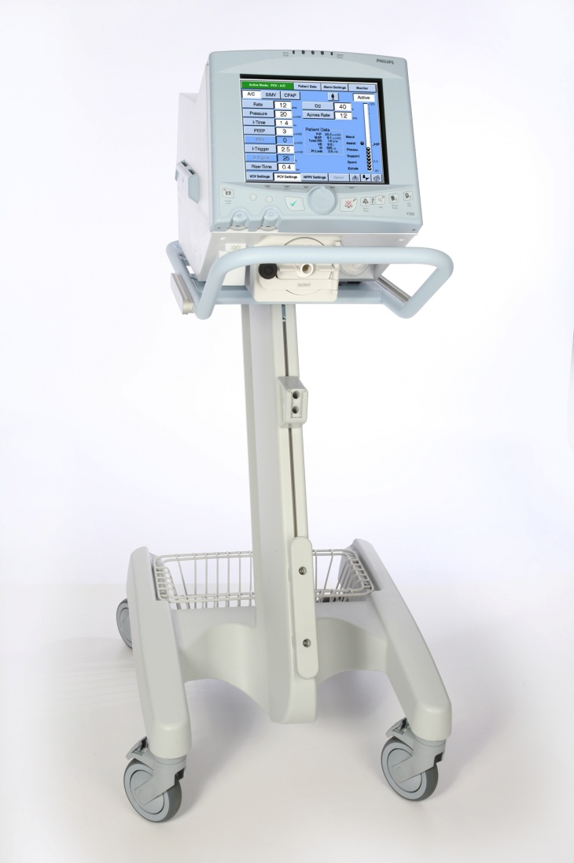
Goals of Mechanical Ventilation
Improve alveolar ventilation
  pH, PaCO₂
Improve oxygenation
  PaO₂, SaO₂
Decrease work of breathing
Notes:
7
The goals of mechanical ventilation include: adjusting alveolar ventilation to bring pH and PaCO₂ within the patient’s normal range, improving oxygenation to acceptable levels given the age of the patient and disease process, and decreasing the work of breathing. Before we move on with our discussion of mechanical ventilation, we should take a look at how spontaneous breathing occurs.

Slide 9
Spontaneous Breathing
Neural stimulation of phrenic nerve
  Diaphragm contracts and intercostals elevate
  Volume of thoracic cage is increased
A intra-thoracic pressure causes an in volume
Pressure gradient causes air to flow into lungs
Negative intra-thoracic pressure aids venous blood return to the right heart
WOB factors:
  Compliance: ΔVolume/ΔPressure (70-100ml/cm H20)
  Resistance: ΔPressure/ΔFlow (1-2cm H20/L/sec)
Notes:
9
The brain provides neural stimulation via the phrenic nerve, which causes the diaphragm to contract and the intercostal muscles to raise the ribs. The downward movement is the most significant cause of thoracic cavity enlargement, and therefore is most responsible for increasing the volume of the thoracic cage. The increased volume causes a decrease in intrathoracic pressure. Only 1.5 cm of downward diaphragmatic movement is responsible for a lung volume increase of over 500 cc. This causes a pressure gradient between the lungs and the atmosphere which causes air to flow into the lungs. The negative intrathoracic pressure during spontaneous breathing aids venous blood return to the right heart. Let’s take a closer look at spontaneous breathing.

Slide 10
Positive Pressure Ventilation
Intra-thoracic pressure remains positive throughout respiration
Gas flow takes path of least resistance
Gas is distributed to non-dependent, less perfused lung regions
Ventilation/perfusion mismatch
Notes:
14
In positive-pressure ventilation, intrathoracic pressure remains positive throughout respiration. Gas flow takes the path of least resistance, and is distributed to the non-dependent, less perfused lung regions. V/Q or ventilation/perfusion mismatch is more likely to occur.

Slide 11
Spontaneous vs Positive-Pressure Breathing
I E I E
I E I E
Pressure
Volume
Spontaneous Positive-Pressure
Notes:
15
Let’s examine the pressure and volume curves typical of a spontaneous and a positive-pressure breath delivered via a mechanical ventilator. On the left, which is the spontaneous breath, we can see the application of information we just discussed. The inspiratory phase has a slight negative pressure; then, on exhalation there is a positive deflection. From our recent discussion of positive-pressure ventilation, notice that the pressure remains positive during the entire inspiratory phase. It is easy to see how spontaneous ventilation, which generates a negative intra-thoracic pressure, aids venous blood flow to the heart. Also, positive-pressure ventilation may decrease venous blood flow, and thus some patients may require intravenous volume.
Now, we'll take a moment to define ventilator parameters and then review some of the basic ventilator settings.

Slide 12
Basic Ventilator Parameters
FiO₂
  Titrate with pulse oximetry
  Goal: < 50%
  SaO2 > 90%
Rate
  10 to 20 bpm
Tidal volume (V_{T})
  6 to 12 ml/kg
Sensitivity
  Pressure or flow triggered, Auto-Trak
Peak flow
  Controls how fast tidal volume is delivered
Inspiratory time (I:E ratio)
  Time spent in the inspiratory phase
Flow pattern
  Square vs. decelerating
Mode of ventilation
  A/C, SIMV, Spont, NIV
Breath types
  Volume or Pressure
Notes:
16
Some of these settings, such as FiO₂, respiratory rate, tidal volume, inspiratory time or I:E ratio, and mode of ventilation, are specified primarily by the physician. Sensitivity, or how easily the patient can trigger the ventilator into the inspiratory phase, and peak flow are usually not physician ordered.
The goal with the FiO₂ is to keep it below 50% if possible. Tidal volume is usually at 6-12 ml/kg, depending on the ventilation management strategy.
In volume-based ventilation, delivery of the set tidal volume is what terminates inspiration. Peak flow determines how fast the tidal volume is delivered. In pressure-based ventilation, reaching the set inspiratory pressure and inspiratory time is what normally terminates inspiration.
Let’s look more closely at the modes of ventilation.

Slide 13
Modes of Ventilation
Assist/Control Ventilation (A/C)
Synchronized Intermittent Mandatory Ventilation (SIMV)
Volume Controlled Ventilation (VCV)
Pressure Controlled Ventilation (PCV)
Spontaneous Modes
  Pressure Support Ventilation (PSV)
  Continuous Positive Airway Pressure (CPAP)
Non-Invasive Ventilation (NIV)
Notes:
17
1
The most widely used and best understood modes of ventilation are Assist Control, SIMV or Synchronized Intermittent Mandatory Ventilation, Pressure Control Ventilation, and Spontaneous. Spontaneous breathing can be pressure supported, and CPAP is often used to support oxygenation. IMV and SIMV are both forms of Intermittent Mandatory Ventilation. The difference between them is that mandatory breaths are synchronized with spontaneous efforts in SIMV. We will start with a discussion of Assist Control.

Slide 14
Assist/Control
Breaths delivered at clinician-set parameters:
  Tidal volume
  Flow rate and pattern
  Back-up respiratory rate
Machine-initiated and/or patient-initiated breaths are all delivered at these set parameters
Pressure
    Time
Notes:
18
2
In Assist/Control ventilation, all breaths are delivered at a clinician-set tidal volume, flow rate and pattern, and respiratory rate. Machine-initiated and patient-initiated breaths are all delivered at these set parameters. That means every time the machine delivers a breath, regardless of whether the machine or the patient triggered the breath, it is exactly the same in every aspect. If you look at the pressure-time waveform shown here, you can see that each breath is the same, whether it is a ventilator-initiated breath as shown on the left, or patient-triggered breath like the one on the right. Each breath has the same tidal volume, same flow rate, and same flow delivery waveform. Like most things, A/C has its advantages and disadvantages.

Slide 15
Assist/Control
Advantages
  Can provide full ventilatory support
  Patient controls rate of breathing
Disadvantages
  Settings may not match patient’s ventilatory demands
  As spontaneous breaths increase, minute ventilation increases proportionately
    can result in hyperventilation
    need to set high respiratory rate and minute
    ventilation alarms
Notes:
19
4
On the advantages side, A/C provides full ventilatory support for patients requiring it. Additionally, patients can control their own rate of breathing. Disadvantages are that the settings may not match the patient’s ventilatory demands; since every breath is the same, this can lead to patient/ventilator dysychrony.
As the patient’s respiratory drive increases and begins to trigger more breaths, minute ventilation increases proportionately. This can result in hyperventilation, because every breath is delivered at the clinician-set tidal volume. CO₂ can drop dramatically. To alert the clinician that the patient has increased his respiratory rate, set the high respiratory rate or high minute ventilation alarm.
When the patient is ready to be weaned off mechanical ventilation, the mode will need to be changed. Why? You can turn the set respiratory rate down, but remember that each time the patient triggers a breath, a machine breath with a set V_{T} is delivered. At this point, the patient needs to be switched to a mode that allows for spontaneous breathing between machine breaths.
That brings us to our discussion of SIMV.

Slide 16
SIMV
Combination of machine and spontaneous breaths
Mandatory breaths typically delivered when patient effort is sensed (synchronized)
Patient determines tidal volume and rate of spontaneous breaths
Synchronized machine breath
Pressure
Time
Patient effort
Notes:
20
6
SIMV, or Synchronized Intermittent Mandatory Ventilation, is a combination of machine and spontaneous breaths. SIMV uses a set mandatory breath rate. These breaths are synchronized with patient effort. The patient is free to breathe spontaneously between machine breaths. For spontaneous breaths, the patient determines the tidal volume and number of spontaneous breaths. In this way, the set respiratory rate can be decreased, and the responsibility for ventilation gradually transferred from ventilator to patient. SIMV is currently one of the more common modes used to wean patients from mechanical ventilation. As you can see on the pressure-time curve at the bottom of the screen, it is a combination of machine and spontaneous breaths. What are the advantages of SIMV?

Slide 17
SIMV
Advantages
  Synchronized breaths may improve patient comfort
  Reduces competition between patient and ventilator
  Hyperventilation less of a concern compared to A/C
Disadvantages
  May not be enough support if set rate or V_{T} too low
  May increase work of breathing (WOB)
    Lag time between patient effort and delivered flow
    Resistance of ET tube and circuit
Notes:
21
8
Synchronized breaths may improve patient comfort and reduce competition between the patient and ventilator. Because the patient is in full control of the spontaneous breaths, patient ventilator synchrony is enhanced. Hyperventilation is less of a concern compared to A/C. Let’s take a look at some concerns with SIMV.

Slide 18
Volume Control Ventilation
Definition
  The application of clinician-set tidal volume and flow delivery rate. Pressure and inspiratory time vary breath to breath.
The clinician sets the inspiratory volume, peak flow-rate, and RR
Peak inspiratory pressure varies with changes in compliance and resistance
Flow delivery is clinician pre-set (square or ramp wave)
Notes:
24

Slide 19
Volume Control Ventilation
May be used in A/C and SIMV modes
In A/C, all breaths (either machine initiated or patient initiated) are flow pre-set, pressure variable, and volume limited
In SIMV, only machine initiated breaths are flow set, pressure variable and volume limited
  Spontaneous breaths can be pressure supported with pre-set time-cycling (I-trigger and E-cycle)
Notes:
25
15

Slide 20
Volume Control Ventilation
VOLUME
Volume constant
Time
Square
Ramp
FLOW
Time
Notes:
26

Slide 21
Volume Control Ventilation
Advantages
  Assures pre-determined tidal volume in spite of changing lung compliance and airway resistance
  Helps to maintain sufficient alveolar ventilation
  Improved gas distribution
Disadvantages
  High pressure may occur causing possible barotrauma (i.e. pneumothorax)
  With pressure increases airway secretions and obstruction should be closely monitored
Notes:
27
17

Slide 22
Indications for VCV
Increased alveolar ventilation
  Pre-determined tidal volumes
Enhanced alveolar recruitment
  Improved VA when VD/VT ratios are high
  Adjusting VT will help with overall ventilation and CO2 elimination
Lung diseases that produce high levels of alveolar deadspace
  Can recruit alveoli with larger tidal volumes
Notes:
28

Slide 23
Pressure Control Ventilation
Definition
  The application of clinician-set inspiratory pressure and inspiratory time. Flow delivery varies according to patient demand.
The clinician sets the inspiratory pressure, I-time or I:E ratio, and RR
Tidal volume varies with changes in compliance and resistance
Flow delivery is decelerating
Notes:
24
Pressure Control Ventilation (PCV) is the application of a clinician-set inspiratory pressure and inspiratory time. Flow delivery varies according to patient demand or inspiratory time. The clinician sets the inspiratory pressure, inspiratory time or I:E ratio, and the respiratory rate. Tidal volume will vary with changes in compliance and resistance. The flow-delivery pattern is decelerating in pressure ventilation.

Slide 24
Pressure Control Ventilation
May be used in A/C and SIMV modes
In A/C, all breaths (either machine initiated or patient initiated) are time cycled and pressure limited
In SIMV, only machine initiated breaths are time cycled and pressure limited
  Spontaneous breaths can be pressure supported with pre-set time cycling (I-trigger, E-cycle)
Notes:
25
15
Pressure Control Ventilation may be used in A/C and SIMV modes. In A/C, all breaths (either machine initiated or patient initiated) are time cycled and pressure limited according to the set inspiratory pressure and inspiratory time or I:E ratio. In SIMV, only machine-initiated breaths are time cycled and pressure limited; all spontaneous breaths are whatever time the patient desires. Spontaneous breaths can be pressure supported, and thus will also be pressure limited.

Slide 25
Pressure Control Ventilation
PRESSURE
Pressure constant
I-time
FLOW
Notes:
26
Here, we can see the pressure-time and flow-time waveforms for different inspiratory time settings. As the inspiratory time increases, the positive pressure is delivered and then held in the patient’s lung for a longer period of time. Next, let’s consider the advantages and disadvantages of pressure-based ventilation.

Slide 26
Pressure Control Ventilation
Advantages
  Limits risk of barotrauma
  May recruit collapsed and flooded alveoli
  Improved gas distribution
Disadvantages
  Tidal volumes vary when patient compliance changes (i.e. ARDS, pulmonary edema)
  With increases in I-time, patient may require sedation and/or chemical paralysis
Notes:
27
17
One advantage of Pressure Control Ventilation is a decreased risk of barotrauma caused by over-distention. Also, longer inspiratory time may recruit collapsed and flooded alveoli, improving gas distribution.
One disadvantage is that tidal volumes vary when patient compliance changes, such as with ARDS or pulmonary edema. Setting a low tidal volume alarm or minute volume alarm alerts the clinician to this changing status so the patient can be re-evaluated.
Another issue with increased inspiratory time is the potential need for heavy sedation or chemical paralysis. Newer ventilators incorporate an active exhalation valve. An active exhalation valve can open during the set inspiratory time in Pressure Control Ventilation, allowing the patient to breathe spontaneously during the inspiratory phase. It remains to be seen whether a decrease in the use of paralytics will result with the active exhalation valve.

Slide 27
Indications for PCV
Enhance patient/ventilatory synchrony
  Patient determines flow
Lung protection strategy
  Lower inspiratory pressure with decelerating flow can improve V/Q matching
  Adjusting I-time can improve oxygenation
  by increasing mean airway pressure (MAP)
Alveolar diseases that produce varying time constants
  Can recruit alveoli by lengthening I-time
Notes:
28
Patient/ventilator synchrony is defined as how closely the mechanical ventilator provides for or supports the patient’s breathing efforts. In Pressure Control Ventilation, the patient can have as much flow from the ventilator as needed, up to the ventilator’s limits. Contrast this to Volume Control Ventilation, where flow is limited to what the clinician sets. Pressure Control Ventilation may improve overall patient/ventilator synchrony since the patient has more control over the breath.
Some research has demonstrated improved patient outcomes using the pressure control mode with lower pressures to ventilate “sick” lungs. Additionally, the decelerating flow pattern inherent in pressure ventilation improves gas distribution as compared to a square wave flow pattern by providing more laminar flow towards the end of the breath.
Remember, in Pressure Control Ventilation the clinician can adjust the inspiratory time. By extending the inspiratory time, the amount of air or tidal volume increases, and the increased inspiratory time allows more air to enter the distant alveoli. You can see the potential advantage this has in patients with lung pathology.
Let’s move on to Pressure Support Ventilation.

Slide 28
Volume vs. Pressure Control Ventilation
Volume Ventilation
Volume delivery constant
Inspiratory pressure varies
Inspiratory flow pre-set
Inspiratory time determined by set flow and V_{T}
Pressure Ventilation
Volume delivery varies
Inspiratory pressure constant
Inspiratory flow varies
Inspiratory time set by clinician
Notes:
23
The delivered volume is constant in volume ventilation; in pressure ventilation, volume varies with changes in resistance and compliance. In volume ventilation, inspiratory pressure varies with changes in compliance and resistance; with pressure ventilation, the inspiratory pressure is set and remains constant. Inspiratory flow is constant in volume ventilation but varies in pressure ventilation. In volume ventilation, inspiratory time is determined by the set flow and tidal volume; in pressure ventilation the inspiratory time is set by the clinician.
Let’s move on to our discussion of Pressure Control Ventilation.

Slide 29
Volume vs. Pressure Control Ventilation
VCV Settings
Mode
Respiratory Rate
Tidal Volume
Peak Flow
PEEP
PSV*
I-Trigger
E-Cycle*
Flow Pattern
FIO₂
PCV Settings
Mode
Respiratory Rate
Inspiratory Pressure
I-Time or I:E
PEEP
PSV*
I-Trigger
E-Cycle*
Rise Time
FIO₂
* Only in modes that permit spontaneous breaths and PSV used

Slide 30
Pressure Support Ventilation
Definition
  The application of a set positive pressure to a spontaneous inspiratory effort. Flow delivery is decelerating, which is inherent to pressure ventilation.
Requires intact respiratory drive
Spontaneous inspiratory effort is assisted to a preset pressure level
Patient determines respiratory rate, inspiratory time, peak flow, and tidal volume
Notes:
29
Pressure Support ventilation is defined as the application of a clinician-set, positive pressure to spontaneous breaths. As with all pressure modes of ventilation, the resulting flow pattern is decelerating; the flow peaks early, then gradually declines throughout the inspiratory cycle. How does this mode differ from Pressure Control Ventilation? In Pressure Support, pressure is added only to spontaneous breaths, and the patient determines respiratory rate and inspiratory time. Remember, with Pressure Control Ventilation the clinician sets the respiratory rate and I-time or I:E ratio in addition to the inspiratory pressure. With Pressure Support, the patient has even more control over their breaths. Since Pressure Support is used to support spontaneous breathing, the patient must have an intact respiratory drive to initiate the breath.

Slide 31
Pressure Support Ventilation
Goals
  Overcome resistive work associated with moving inspiratory flow through the artificial airway and circuit
  Improve patient/ventilator synchrony
  Augment spontaneous tidal volume
10 cm
Pressure
5 cm
Time
Notes:
30
OK, why do we use pressure support? First, when an endotracheal tube is inserted into a patient and a ventilator circuit attached, the patient experiences increased airflow resistance. You can quickly demonstrate this by breathing in and out through a straw. I guarantee you will quickly become tired and short of breath due to the increased resistance of breathing through the narrow-lumen straw. Supporting spontaneous breaths with additional pressure support can help overcome the resistance caused by the ET tube and ventilator circuit.
Similar to the Pressure Control mode, Pressure Support allows the patient to have as much flow as needed (up to the ventilator’s limits), which improves patient/ventilator synchrony. The added pressure actually contributes to an increase in tidal volume.
The pressure-time curve here illustrates Pressure Support of 10 cm H₂O pressure. You can see that every breath is spontaneous by the negative deflection preceding each breath. Notice that the rate is variable, as is the length or duration of inspiration.

Slide 32
Pressure Support Ventilation
Low level PSV
  5 to 10 cm H₂O PSV applied to spontaneous breaths during other ventilator modes (VCV, SIMV, PCV)
  Decreases work required to move air through the ET tube and ventilator circuit
  May be final level of support before extubation
Max PSV
  PSV increased to level that augments spontaneous inspiratory efforts to yield tidal breaths of ~ 10 ml/kg
  Can meet near-total ventilatory needs of patient
Notes:
31
Pressure Support Ventilation can be used in one of two different approaches. Most commonly, you’ll find that physicians will often order Pressure Support Ventilation between 5 to 10 cm H₂O in addition to other mechanical modes. Low levels of Pressure Support, while effective at decreasing resistance to flow, may not be substantial enough to impact tidal volume. During weaning, the number of mechanical breaths may be gradually decreased while spontaneous breaths increase. This process may continue until all mechanical breaths are discontinued and the patient is assisted with low level Pressure Support.
Conversely, if a patient has an intact respiratory drive but can not effectively ventilate due to high respiratory rates and low tidal volumes, pressure support can be incrementally increased to yield tidal volumes of ~10 ml/kg, thus more fully supporting alveolar ventilation.
Knowing that high levels of Pressure Support can meet the ventilatory needs of a spontaneously breathing patient has led to another weaning methodology. Patients with intact ventilatory drives can be switched to high levels of Pressure Support. Then, Pressure Support is gradually weaned to a level of 5 to 10 cm H₂O. If the patient can sustain ventilation, extubation follows.

Slide 33
Pressure Support Ventilation
Advantages
  Patient controls rate, volume and duration of breaths
  Patient comfort
  May overcome WOB
Disadvantages
  May not be enough ventilatory support if patient condition changes
    fatigue or changes in compliance/resistance
  Support level remains constant regardless
  of patient drive
Notes:
32
12
After the preceding discussion, I’m certain you can all list the advantages of Pressure Support Ventilation. First, the patient maintains more control over their breathing, including rate, tidal volume, and inspiratory time. Because of this control, patients often feel more comfortable. Also, Pressure Support Ventilation helps overcome resistive forces, thereby decreasing the work of breathing.
A potential disadvantage you need to be aware of is that Pressure Support may not provide enough assistance to maintain effective alveolar ventilation, especially if the patient’s condition deteriorates. And, as with any other clinician-set parameter, the support level does not change in response to changing patient drive. The patient needs periodic assessment.

Slide 34
Pressure Support Ventilation
Patient assessment
  Monitor exhaled V_{T}
  Maintain system free of air leaks
    Flow termination criteria varies among ventilators
  Monitor for increased RR with decreased V_{T}
Candidates for PSV
  Spontaneously breathing patients with intact respiratory center
Notes:
33
One important assessment parameter is the exhaled tidal volume. Decreases in exhaled tidal volume may indicate changes in resistance or lung compliance, while increases may point to patient improvement.
It is very important to maintain a leak-free ventilator circuit. Different ventilators have varying flow-termination criteria. For example, on the 7200® ventilator flow terminates when flow drops to 5 lpm, if the set pressure level plus PEEP is exceeded by 1.5 cm H₂O pressure, or if inspiration exceeds 5 seconds. In this case, an air leak could prevent the peak flow from decreasing to 5 lpm. Therefore, flow would continue until inspiratory time exceeded 5 seconds or the patient actively exhaled, thus raising the peak inspiratory pressure beyond the set pressure. This could certainly cause patient discomfort and increase the work of breathing.
Another important assessment criteria is spontaneous respiratory rate. If the rate increases, this could indicate the need for additional support to meet the patient’s ventilatory requirements.
Most patients can benefit from Pressure Support, since it can be combined with other modes of ventilation. However, only spontaneously breathing patients with intact respiratory drives are candidates for Pressure Support when used as the only mode of ventilation since no mandatory rate is involved.

Slide 35
PEEP
Definition
  Positive end expiratory pressure
  Application of a constant, positive pressure such that at end exhalation, airway pressure does not return to a “0” baseline
Used with other mechanical ventilation modes such as A/C, SIMV, VCV or PCV
Referred to as CPAP when applied to spontaneous breaths
Notes:
35
Let’s begin with a definition of PEEP or positive end expiratory pressure. PEEP is the application of a clinician-set, positive pressure applied at end exhalation. This prevents pressure from returning to zero, or atmospheric, at the end of the breath. When positive pressure is applied at the end of a mechanical breath, it is referred to as PEEP. When positive pressure is applied throughout the spontaneous breathing cycle, it is referred to as CPAP, or continuous positive airway pressure. Let’s look at a graphic representation of PEEP.

Slide 36
Lung Volumes and Capacities
TLC
IC
IRV
VC
TV
ERV
FRC
RV
RV
Notes:
What is vital capacity? If we take a look at this diagram we can see that Vital Capacity is made up of 3 volumes, Inspiratory Reserve Volume, Tidal Volume, and Expiratory reserve volume. Vital Capacity is an effort-dependent measurement of the greatest volume of gas that a subject can exhale after maximum inspiration. Vital Capacity is normally 65 to 75 ml per kg, and a value of 10 ml per kg or greater is commonly considered a favorable predictor of weaning outcome.

Slide 37
PEEP
Increases functional residual capacity (FRC) and improves oxygenation
  Recruits collapsed alveoli
  Splints and distends patent alveoli
  Redistributes lung fluid from alveoli to intravascular space
  Enhances pressure gradient across A/C membrane
5 cm H₂O PEEP
Notes:
36
On this pressure-time graph, we know that the first breath is mechanically initiated since there is no negative deflection preceding that breath. Note the breath does not begin at the zero base line, but instead begins at 5 cm H₂O pressure. The mechanical breath is delivered, but at end exhalation, pressure remains at 5 cm H₂O. The next breath is spontaneous (note the inspiratory deflection). Here again, pressure throughout the breath cycle is elevated by 5 cm H₂O. The final breath is a patient-initiated, mechanical breath, again showing that at end exhalation, pressure is maintained at 5 cm H₂O.
Why do we add PEEP? Once again, we’ll try to mimic this effect. Take a normal breath in, but do not exhale all the way, thus maintaining some positive pressure in your lungs. What could be the benefit of positive pressure at the end of exhalation? PEEP causes an increase in functional residual capacity or FRC. The FRC is the amount of air left in your lungs at the end of a normal exhalation. This increased volume can improve oxygenation; more air remains available to participate in gas exchange.
In sick lungs, PEEP can also help recruit or open collapsed alveoli. Keep in mind that with many lung pathologies, alveoli have the tendency to collapse. PEEP can be applied at pressures sufficient to overcome this tendency to collapse, keeping the alveoli patent and functional. Finally, in cases of excess pulmonary fluid, PEEP can cause this unwanted lung fluid to move from the alveoli into the perivascular space.

Slide 38
Fick’s Law of Diffusion
V = A x ά x (P1 – P2)
T
V = flow of gas
A = surface area
ά = diffusion constant
P = pressure
.
.

Slide 39
CPAP
Definition
  Continuous positive airway pressure
  Application of constant positive pressure throughout the spontaneous ventilatory cycle
No mechanical inspiratory assistance is provided
  Requires active spontaneous respiratory drive
Same physiologic effects as PEEP
Notes:
37
Now that you understand the physiologic effects of PEEP, you can apply the same knowledge to CPAP. The only difference is that CPAP is the application of positive pressure throughout the spontaneous ventilatory cycle. Since this is a totally spontaneous mode, the patient must have an intact respiratory center.

Slide 40
CPAP
May decrease WOB
Tidal volume and rate determined by patient
Often final form of support before extubation
10 cm H₂O PEEP
Time
Notes:
38
This graphic depicts the CPAP mode set at 10 cm H₂O. Similar to Pressure Support, the patient determines the respiratory rate and tidal volume. Keep in mind that CPAP and PSV are often used in conjunction. CPAP can prevent or minimize alveolar collapse, while Pressure Support helps overcome resistance and augments tidal volume. CPAP, either alone or in combination with Pressure Support, is often the final form of support prior to extubation.

Slide 41
PEEP/CPAP
Indications
  Prevent and/or reverse atelectasis
  Improve oxygenation
Potential adverse effects
  Decrease in cardiac output due to increase in positive intra-thoracic pressure
  Barotrauma
  Increased intracranial pressure
Notes:
39
Although the primary indication for PEEP and CPAP should now be readily clear, you need to be aware of the potential adverse effects. Positive pressure applied at end exhalation is transmitted throughout the lungs. Positive intrathoracic pressure can decrease venous return and, consequently, cardiac output. Be prepared to volume support sick patients who require incremental increases in PEEP.
Increased intrathoracic pressure can also result in lung rupture or barotrauma, an adverse effect that may require immediate clinical intervention. Lastly, PEEP and CPAP can increase intracranial pressure, a potentially devastating side effect if the patient is suffering from a head injury.

Slide 42
Sensitivity
Sensitivity setting establishes the trigger variable
The trigger variable determines when the ventilator recognizes a patient’s inspiratory effort
When patient effort is recognized, the ventilator is triggered to deliver a breath
The trigger can be a change in pressure or a change in flow
Notes:
40
Many non-respiratory clinicians are often uncertain of what sensitivity is. It is another clinician-set variable. Sensitivity, often referred to as trigger, determines when the ventilator recognizes a patient’s spontaneous inspiratory effort. When patient effort is recognized, the machine triggers a response, either to give a mechanical breath or support the spontaneous effort. The trigger can be a change in pressure or a change in flow. Let’s take a closer look at sensitivity.

Slide 43
Ventilator Alarms
High airway pressure
Low airway pressure
High respiratory rate
Low respiratory rate
High minute volume
Low minute volume
Low exhaled tidal volume
Apnea
Notes:
47
5
Let’s turn our focus to ventilator alarm management, including high and low airway pressure alarms, rate alarms, and volume alarms. Alarms warn the clinician about technical and patient conditions that can negatively impact the ventilator’s ability to provide support. Alarms can be audible and/or visual, depending on the severity of the alarm condition. Alarms can only provide warning if set appropriately. When a ventilator alarm is activated, the clinician needs to respond, identify the alarm parameter that has been violated, and institute corrective action. Since many different situations can cause an alarm condition, the clinician should employ a systematic approach to troubleshoot the problem.
All clinicians need to be familiar with ventilator messages and alarms, and must be able to troubleshoot. If you can not readily identify the problem and the patient is in distress, disconnect the patient from the ventilator and provide manual ventilation.

Slide 44
Ventilator Management Summary
Airway Management
Ventilator Settings (Ventilation and Oxygenation)
Managing the Work of Breathing
Mode Selection
  AC, SIMV, PS
Breath Type
  Volume vs Pressure
Maximizing Ventilator Performance
  VT RR, FiO2, PEEP, Vital Signs
Monitoring the Ventilator
  Alarms, Synchrony, Patient Improvement

Slide 45
Ventilator Graphics
Flow-Time Curve
Pressure-Time Curve
Volume-Time Curve
Pressure-Volume Loop
Flow-Volume Loop
Notes:
Ventilator graphics plot four main parameters: pressure, volume, flow and time. The scalar waveforms are graphic displays of pressure, volume and flow in relation to time. On the graphics, the horizontal axis plots time, and the vertical axis represents the respiratory parameter. Loops are a graphic display of two parameters, either pressure and volume or flow and volume. Time is not indicated on loops.
The following slides review the normal configuration of flow, pressure and volume time curves, then the pressure-volume and flow-volume loops. The object is not to memorize waveform patterns, but to understand the cause and implication of unfamiliar tracings. The gradual changes in flow, pressure and volume depicted by the waveforms are dependent on the ventilator, ventilator settings, compliance and resistance of the circuit and artificial airway, and physiological properties of the lungs and chest wall.

Slide 46
Flow-Time Curves (VCV mode)
- Square vs Decelerating
LPM
Flow
Pressure
Volume
90
50
Inspiration
0.0
-50
-100
Expiration
-140
0
1
2
3
4
5
6
7
Notes:
In a volume-oriented mode of ventilation, there are two widely used flow patterns, square and decelerating. The square or constant flow pattern is displayed here. During the inspiratory phase (shown in blue), flow rises very rapidly to the peak flow value set on the ventilator and then remains constant until the set tidal volume is delivered. Shown in red is the expiratory phase of the flow-time curve. Expiratory flow is passive and should return to baseline. Expiratory flow is dependent on resistance of the ventilation system, and on the physical properties of the airways and lungs.
Some ventilators like the Esprit™ Critical Care Ventilator allow the clinician to choose between a square or decelerating flow pattern in volume-based ventilation. The decelerating flow pattern is inherent to the pressure-oriented breath type and is not user selectable. The second curve, on the right, illustrates the inspiratory phase of decelerating or ramp flow pattern. Under normal conditions, the decelerating flow pattern falls during inspiration after having reached the initially high value and gradually returns to baseline.
Changing from a square to a decelerating ramp flow pattern will increase the inspiratory time, if other parameters remain constant. The light blue dotted waveform shows the square superimposed on the decelerating flow pattern. Notice the inspiratory time is almost twice as long with the decelerating ramp as with the square flow pattern. What effect could this have on the patient?
An increase in inspiratory time would decrease expiratory time. If the patient does not have enough time to completely exhale, the shorten expiratory time could cause air-trapping and lead to Auto-PEEP and patient-ventilator asynchrony. Increasing the peak flow rate would decrease the inspiratory time.

Slide 47
2. Pressure-Time Curve (VCV mode)
cm H₂O
Flow
Pressure
Volume
40
35
Square
Flow Pattern
Decelerating
Flow Pattern
30
25
20
Inspiration
15
Expiration
10
5.0
0
1
2
3
4
5
6
7
Notes:
As we mentioned earlier, In volume controlled ventilation two flow patterns are available. The square and decelerating flow patterns create a unique shaped pressure curve. In volume controlled ventilation, the pressure achieved will vary depending on the patient’s lung compliance and resistance. On the left is a pressure curve created by a square flow pattern, inspiratory pressure increases in a linear fashion until the set tidal volume is delivered or high pressure limit is reached. When flow ceases, exhalation occurs and pressures drops to baseline or set PEEP. Under normal conditions, this is a passive process caused by the elastic recoil of the lung.
The waveform on the right is the result of a volume controlled breath with a decelerating flow pattern. This pressure curve is different. This pressure curve is similar to the waveforms created in pressure control ventilation (PCV). Do you know why? Because decelerating flow patterns are inherent to pressure control ventilation.

Slide 48
Pressure-Time Curve (VCV vs PCV)
cm H₂O
Flow
Pressure
Volume
40
35
30
VCV with Decelerating
Flow Pattern
Pressure Control
Ventilation
25
Rise Time
20
Inspiration
15
10
I-Time
Expiration
5.0
0
1
2
3
4
5
6
7
A
Notes:
This slide illustrates the similarities between the pressure curve associated with pressure control ventilation and volume control ventilation with a decelerating flow pattern.
In pressure control ventilation, the pressure rapidly rises to the set peak inspiratory pressure and expiration begins after the set inspiratory time has lapsed. The negative deflection at the beginning of the cycle, indicated by the circle, indicates the patient has triggered the breath. The volume delivered will vary with changes in the patient’s compliance and resistance.
What is the set PEEP and set inspiratory pressure indicated by this graph? Note inspiratory pressure of 15 cmH₂O is above the set PEEP of 5 cmH₂O to create a peak inspiratory pressure of 20 cmH₂O.

Slide 49
3. Volume-Time Curve
mL
Flow
Pressure
Volume
450
400
350
Inspiration (set Flow rate)
300
250
Expiration (passive recoil)
200
150
100
0
0
0
1
2
3
4
5
6
7
Notes:
The volume-time curve shows the volume delivered during inspiration and the exhaled volume measured by the expiratory flow sensor. In volume-orientated breaths, volume increases until the set tidal volume is delivered or the high pressure alarm limit is triggered. In pressure-orientated breaths, volume increases until the set peak inspiratory pressure is met and the inspiratory time has lapsed. During exhalation the transferred volume decreases due to the passive recoil of the lung. Generally what goes in comes out, unless a leak is present or gas is trapped in the lung. This concludes the review of normal flow, pressure and volume scalar waveforms.

Slide 50
4. Pressure-Volume Loop
ml
800
700
600
500
Volume
400
300
200
100
Pressure
0
cm H₂O
-5.0
10
20
30
40
Notes:
Instead of plotting one parameter against time, loops plot two parameters on the same graph. The pressure-volume loop plots the interaction between pressure, on the horizontal axis, and volume, on the vertical axis. The highest point on the loop corresponds to the tidal volume, which is read off the vertical axis.

Slide 51
- Pressure-Volume Loop
- ventilator initiated breath
ml
800
700
600
500
500
  Expiration
400
300
200
100
Inspiration
0
cm H₂O
-5.0
10
20
30
40
Notes:
On a ventilator-initiated mandatory breath the movement of the pressure-volume loop is counterclockwise, starting in the lower left corner. During inspiration, as the lung begins to fill and there is a simultaneous increase in both pressure and volume. Once the inspiration criteria are met, exhalation begins at the highest point on the loop returns to baseline. In patients with normal lungs, this curve resembles football shape and is centered in the middle of the graph. The highest point on the loop corresponds to the tidal volume, which is read off the vertical axis.

Slide 52
- Pressure-Volume Loop
- spontaneous, non-P/S breath
ml
800
700
600
Inspiration
500
400
300
Expiration
200
100
0
cm H₂O
-5.0
10
20
30
40
Notes:
During a spontaneous, non-pressure-supported breath, the rotation is clockwise; inspiration and then expiration.

Slide 53
5. Flow-Volume Loop
L/min
70
50
Flow
0
Volume
-50
-70
0
300
400
500
ml
Notes:
The flow-volume loop plots the interaction between volume on the horizontal axis and flow on the vertical axis. This waveform is used to analyze patient’s response to bronchodilator therapy, identify leaks and auto-PEEP. The clinician can also monitor changes in patient airway resistance.

Slide 54
- Flow-Volume Loop
L/min
70
50
Inspiration
PIFR
VT
0
-50
Expiration
-70
PEFR
0
300
400
500
ml
Notes:
The flow-volume loop plots the interaction between volume on the horizontal axis and flow on the vertical axis. This waveform is used to analyze patient’s response to bronchodilator therapy, identify leaks and auto-PEEP. The clinician can also monitor changes in patient airway resistance.

Slide 55
Scaling
LPM
Flow
Pressure
Volume
200
100
0.0
-100
-200
-300
0
2
4
6
8
10
12
14
LPM
Flow
Pressure
Volume
90
50
0.0
-50
-100
-140
0
1
2
3
4
5
6
7
Notes:
This slide illustrates a graphic scale set inappropriately. The range for the flow scale is too wide, and the time scale is too long. This results in a small waveform which is difficult to evaluate. Auto-PEEP is present, but due to the inappropriate scaling it is difficult to detect.

Slide 56
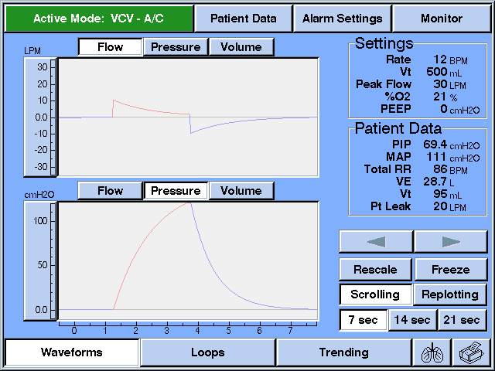
Rescaling
Notes:
Most mechanical ventilators allow clinicians to adjust the graphic scale. For example on the Esprit™ ventilator, scaling is easy to accomplish by simply pressing the Rescale button. If the Rescale button is pressed, scaling will be automatically adjusted for maximum viewing. The scales may also be adjusted manually by clicking on the top or bottom part of the scale and turning the control knob.

Slide 57
Normal Flow-Time Curve
LPM
Flow
Pressure
Volume
90
50
Inspiration
0.0
-50
Expiration
-100
Zero flow = equilibration of lung and circuit pressure
-140
0
1
2
3
4
5
6
7
Note: There can still be pressure behind
airways that are completely blocked
Notes:
Expiratory flow depends on resistance in the ventilation system, resistance of the endotracheal tube, and on the physical properties of the airways and lungs. Zero flow at the end of exhalation is indicative of an equilibration between the lung and circuit pressure. Notice how the expiratory flow curve returns to the baseline between each breath.

Slide 58
Flow-Time Curve with Auto-PEEP
LPM
Flow
Pressure
Volume
90
50
0.0
-50
Auto-PEEP
-100
Transition from expiration to inspiration occurs before expiratory flow returns to zero
-140
0
1
2
3
4
5
6
7
Notes:
However if the transition from exhalation to inspiration occurs without the expiratory flow returning to zero, Auto-PEEP is present. Auto-PEEP is caused by insufficient expiratory time, increased expiratory resistance and early collapse of alveoli resulting in air trapping. The farther below baseline the waveform changes from red to blue, the greater the air-trapping. The values on the vertical scale represent flow not pressure. The clinician can only identify that Auto-PEEP is present, not measure how much. An expiratory hold maneuver can be used to determine how much Auto-PEEP is present.

Slide 59
Patient effort with Auto-PEEP
LPM
Flow
Pressure
Volume
90
50
0.0
-50
-100
-140
0
1
2
3
4
5
6
7
Notes:
When Auto-PEEP is present, the patient has to pull through the Auto-PEEP to trigger a breath. For example, if the patient has 7 cm H₂O of Auto-PEEP and the pressure sensitivity is set at 2 cm H₂O. The patient would have to pull a negative 9 cm H₂O in order to trigger a ventilator breath. In flow triggering, flow is not initiated until the patient pulls through the Auto-PEEP, creates a negative pressure in the lungs, and then meets the flow trigger sensitivity. Undetected Auto-PEEP can cause increased work of breathing for the patient.

Slide 60
Changes in Resistance
- airway obstruction (bronchospasm, secretions)
LPM
Flow
Pressure
Volume
90
50
0.0
-50
-100
Initial flow is limited
exhalation is prolonged
Flow is improved
exhalation is shorter
-140
0
1
2
3
4
5
6
7
Notes:
On this flow curve expiratory flow is blunted and the expiratory phase is drawn out. (Push down arrow) In comparison, this curve has a higher expiratory flow rate and a decreased expiratory time which denotes a lower expiratory resistance. This decrease in expiratory resistance may be observed after the patient receives a bronchodilator (e.g. MDI or aerosolized bronchodilator treatment). Monitoring how long the resistance is reduced can help determine the frequency and effectiveness of bronchodilator therapy.

Slide 61
PCV- Inspiratory Time
- I-time and VT
LPM
Flow
Pressure
Volume
90
Lost VT
50
0.0
-50
I-Time
0.7 seconds
I-Time
1.2 seconds
-100
-140
0
1
2
3
4
5
6
7
Notes:
Observing the flow-time curve provides insight to setting appropriate peak inspiratory pressure and inspiratory time in pressure control ventilation. For example, the physician orders PCV with a target tidal volume of 500 ml. Pressure control ventilation is initiated with a PIP of 20 cm, resulting in a VT of 450 cc.
What ventilator setting change would you recommend to improve tidal volume delivery? How can the flow-time waveform help you?
Before increasing the inspiratory pressure to obtain additional VT, the clinician should consider increasing the inspiratory time. As illustrated here, inspiratory flow does not return to zero before cycling into expiration. This could result in a lesser delivered volume as indicated by the arrow. Increasing inspiratory time allows the flow to return to baseline and increase VT without increasing target pressure. By increasing I-Time to 1.2 seconds, inspiratory flow returns to baseline and the 500 ml VT is achieved.

Slide 62
Flow Asynchrony (Flow-Trak option)
- Flow demand > peak flow
cm H₂O
Flow
Pressure
Volume
40
35
30
25
20
15
Flow Starvation
10
5.0
0
1
2
3
4
5
6
7
Notes:
The pressure-time curve can be utilized to improve patient-ventilator synchrony. If the patient has an explosive inspiratory flow demand greater than the peak flow setting on the ventilator during volume control ventilation, the inspiratory phase of the pressure curve will be concave with a negative deflection point. This is often referred to as flow starvation. Either increasing the flow rate or switching the patient to pressure control ventilation, can improve patient comfort and help to meet their flow demands.
On the Esprit™ Critical Care Ventilator, if the set peak flow or tidal volume does meet patient demand, the Flow-Trak™ option will give additional flow to satisfy patient need. Flow-Trak allows unrestricted access to additional flow or volume within a standard volume controlled ventilation breath without increasing driving pressure, thus enhancing patient-to-ventilator synchrony.

Slide 63
PCV mode
- E-cycle and I-time not in synch
cm H₂O
Flow
Pressure
Volume
40
35
30
25
Pressure higher than set
(I-time too long)
20
15
10
5.0
0
1
2
3
4
5
6
7
Notes:
Here we see that the peak pressure is higher than what is set. What could cause the pressure curve to spike at the end of the inspiratory phase?
In pressure control ventilation if the patient wants to end inspiration before the end of the set inspiratory time, pressure will go up as the patient pushes against the exhalation valve.

Slide 64
PCV- Inspiratory Time
cm H₂O
Flow
Pressure
Volume
40
35
30
25
20
15
Optimal
10
5.0
Too Long
0
1
2
3
4
5
6
7
Notes:
For patients in pressure control you can use the pressure-time curve to set an appropriate inspiratory time. If inspiratory time is set too long, the patient is attempting to exhale while the ventilator is still delivering flow. Decreasing the I-Time as shown by the optimal arrow, can increase the patient’s comfort and synchrony with the ventilator.

Slide 65
PCV - Rise Time
cm H₂O
Flow
Pressure
Volume
40
35
0.1 second Rise Time
0.3 second Rise Time
30
25
Pressure overshoot
20
15
10
5.0
0
1
2
3
4
5
6
7
5 mm ET Tube
Notes:
If the Rise Time setting is too fast, a small transient pressure overshoot can occur. This pressure waveform shows a pressure overshoot associated with 0.1 second Rise Time. This can be caused by small endotracheal tubes and high resistance to inspired flow. By increasing the rise time to 0.3 seconds, the resistance is decreased eliminating the pressure overshoot. Although this transient pressure overshoot is not transmitted to the lungs it may be uncomfortable for the patient.

Slide 66
Expiratory Leak or Air-trapping
mL
Flow
Pressure
Volume
450
400
350
300
Inspiration
Expiration
What’s This?
250
200
150
100
Lost Volume
0
0
1
2
3
4
5
6
7
Notes:
What is happing here?
The patient has an expiratory leak or is air trapping. The tidal volume is delivered, but due to the leak the expiratory volume curve does not return to baseline.

Slide 67
Active Expiration
- Exhaling below FRC
mL
Flow
Pressure
Volume
450
400
Inspiration
Expiration
350
300
250
200
Active Expiration
150
100
0
0
0
1
2
3
4
5
6
7
Notes:
In this volume-time curve the patient is actively exhaling below their FRC. In the clinical setting, this can occur it the patient changes position or in response to pain. Patients who are air-trapping will periodically exhale larger volumes to help eliminate the trapped air.

Slide 68
Compliance (ΔVolume/ΔPressure)
- Normal: (70 – 100 ml/cm H20 - static)
(40 – 70 ml/cm H20 – dynamic)
ml
800
700
Indicates a drop in compliance (less volume for the same pressure)
600
500
↑ Compliance
- shift to vertical axis
↓ Compliance
- shift to horizontal axis
400
300
200
100
0
cm H₂O
0
10
20
30
40
Notes:
In normal compliance, the slope of the pressure-volume loop is approximately a 45 degree angle to the horizontal axis. In patients with increase compliance, e.g. emphysema, the loop will shift left toward the vertical axis.
In patients with decreased compliance, as illustrated in this slide, the slope of the loop will shift right toward the horizontal axis, indicating a higher pressure required to deliver volume. The difference between the green arrow and the purple arrow represents a change in compliance in pressure control ventilation, as indicated by an increase in pressure without a corresponding increase in tidal volume
What factors can cause a decrease in compliance? How about ARDS, air embolism, curvature of the spine, lung tumor, endotracheal tube, pneumothorax, mucus plug, change in position (Trendelenberg, lateral) or obesity.
.
In this slide, we see that the solid line P-V loop flattens and shifts to the right. What could cause this to happen?

Slide 69
Resistance (ΔPressure/ΔFlow)
- Normal (0.5 – 2.5 cm H20/L/sec @ 0.5L/sec)
ml
800
700
Bowing of waveform = increased inspiratory resistance
600
500
400
300
200
100
0
cm H₂O
0
10
20
30
40
Notes:
The solid line on the graph depicts high inspiratory airway resistance causing the inspiratory portion of the Pressure-Volume loop to bow out.

Slide 70
- Pressure-Volume Loop
- Compliance, Resistance, Time Constant
(Time Constant: Filling or emptying time of lung)
ml
800
700
600
500
500
Airway Resistance
  Expiration
400
Dynamic Compliance
300
200
Static Compliance
100
Inspiration
0
cm H₂O
-5.0
10
20
30
40

Slide 71
Time Constant
-Filling or emptying time of the lung
  Time Constant = Cstat x Raw
  TC = C (∆Volume/∆Pressure) x R (∆Pressure/Flow)
  Normal Lung: 0.2 sec (per 100 ml)
  Asthmatic Lung (↑R or ↑C: 0.4 sec (per 100 ml)
  Fibrotic Lung: (↓C or ↓R: 0.1 sec (per 100 ml)
  Note: Ventilator breathing utilizes system pressure
  Spontaneous breathing utilizes trans-pulmonary pressure

Slide 72
Over Distension (↑ PEEP, VT or Pressure)
ml
800
700
A = Inspiratory pressure
B = Volume
600
500
A
400
+
300
200
B
100
0
cm H₂O
0
10
20
30
40
Notes:
Over-distention may be caused by a combination of PEEP and too much volume or pressure. Peak inspiratory pressure is A and B is delivered volume. The lower inflection point on a ventilated patient is mostly caused by the resistance of the ET tube, unless the peak inspiratory flow is under 10 LPM. The upper inflection point indicates where the lung becomes less compliant and illustrates where over-distension starts to occur. Decreasing the volume or pressure may help avoid barotrauma or volu-trauma in this situation.

Slide 73
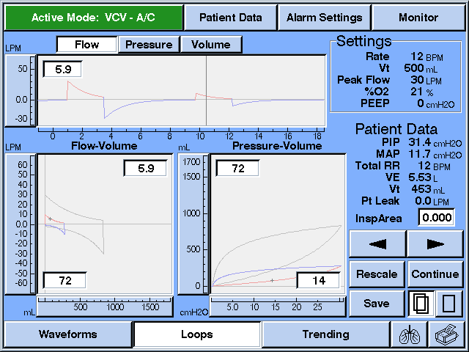
Freeze To Use Cursor
Notes:
Some ventilator graphics give the clinician an option to freeze or save a waveform. This provides an opportunity to analyze the waveform more closely. For example, evaluating the difference in peak expiratory flow pre and post bronchodilator is made easy by the V200™ Critical Care Ventilator. The clinician would first freeze the graphics display and then use the arrows to move the curser to the appropriate point. The value coinciding with the curser position is displayed in the window. The clinician could also save a waveform and later superimpose a new waveform over the save graphic. Pressing the overlay button will in order to monitor responses to changes in parameter or bronchodilator therapy.

Slide 74
Resistance (Test of bronchodilator responsiveness)
LPM
70
50
Flow
“Scooped out”
pattern
0
Decreased PEFR
-50
-70
0
200
400
VT
ml
0
Notes:
The abnormal flow-volume loop is shown in a wine color. Expiratory resistance will cause the a scooped out appearance on the expiratory curve and a decrease in peak expiratory flow rate (PEFR).
Clinicians utilize this waveform to evaluate the effectiveness of bronchodilator therapy. As the medium and small airways open, the PEFR will increase and the expiratory flow pattern will return to normal (as depicted by the broken red line).

Slide 75
Leaks
LPM
70
50
Inspiration
0
Leak (lost VT)
-50
Exhalation
-70
0
300
400
500
ml
Notes:
Leaks are easily detected on the flow-volume loop, expiratory flow does not return to baseline. The amount of lost exhaled VT is indicated by the blue arrow.

Slide 76
Flow Volume Loop (i.e. secretions)
LPM
70
50
Inspiration
Secretions, or
water in the
circuit
0
-100
Exhalation
-150
ml
0
300
400
500
Notes:
What could cause a scalloped or “saw tooth” tracing on the expiratory portion of the flow-volume loop? The expiratory portion of the Flow-Volume, shown here in red, has a scalloped look. The expiratory part of a normal loop is depicted by the dotted red line. Patients who have secretions in their airways, or a circuit with water in a dependent loop, often display this type of graphic.

Slide 77
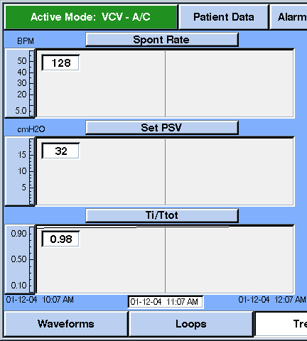
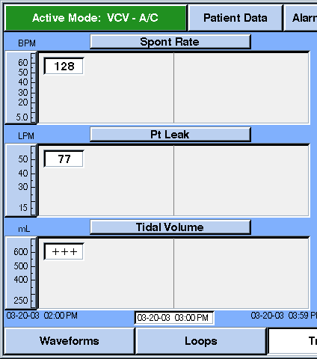
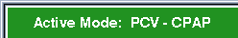
Trending
41
31
5
30
44
325
Notes:
This view compares a patient’s spontaneous rate, set pressure support (PSV) and Ti/Ttot. These parameters can be useful when weaning a patient from ventilator support. Notice as the PSV was decrease from 10 cmH₂O to 5 cm H₂O, the patient begins to fatigue and their respiratory rate and Ti/Ttot significantly increase. When the pressure support was increased back to 10 cm H₂O, the patient’s work of breathing decreased.
From the trended data shown here, the clinician can evaluate the effect a leak had on the patient’s respiratory rate and tidal volume.
How else could the clinician use trending to help at the patient’s bedside?

Slide 78
What Are Respiratory Mechanics Measurements?
Respiratory Mechanics is a general term for measurements of:
  Patient lung condition
    Compliance (stiffness)
    Airway Resistance (resistance to flow)
  Lung capacity
  Or patient drive to breathe
Notes:
Now that we’ve discussed our objectives let’s move our discussion to answering the question; What are respiratory mechanics measurements? Respiratory Mechanics is a general term for measurements of: Patient lung condition, which has two components, lung compliance a measure of lung and chest wall stiffness, and airway resistance to flow. We also measure lung capacity and patient drive to breathe.

Slide 79
Why Measure Respiratory Mechanics?
Peak pressure in the patient circuit due to resistance of ET-Tubes, airway resistance and compliance.
Patients are often thought to be either restrictive or obstructive based on the admitting diagnosis.
  Restrictive patients (stiff lungs): ARDS, Pneumonia, Pulmonary Edema, etc.
  Obstructive patients (high airway resistance, air trapping and ↑FRC): COPD, Asthma, etc.
High pressures in ARDS patients are often assumed to be due to low compliance.
  ARDS patients may have broncho-constriction or narrowing of ET-Tubes from secretions.
COPD patients often have congestive heart failure and pulmonary edema causing decreased compliance.

Slide 80
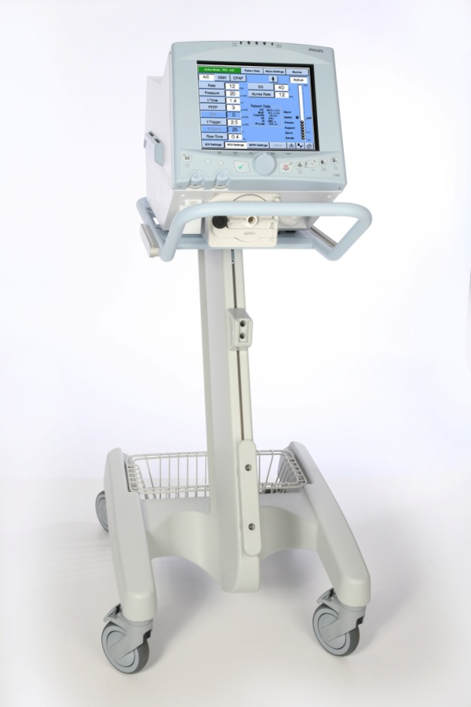
Maneuvers vs.Calculated Values
The Respironics ventilator measures respiratory mechanics by either implementing a maneuver or by continuously calculating values without interruption to ventilation.
Respiratory Mechanics Maneuvers
  Ventilation is modified in some way to enable direct measurements of patient condition.
Notes:
The ventilator measures respiratory mechanics by either implementing a maneuver or by continuously calculating values without interruption to ventilation. When a respiratory mechanics maneuver is performed, ventilation is modified in some way to enable direct measurements of patient condition.

Slide 81
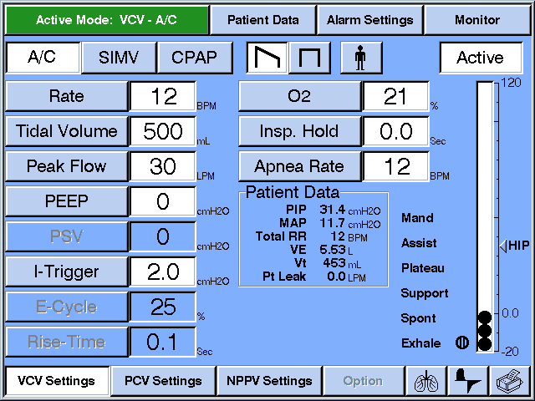
Respiratory Mechanics
Notes:
The enter the Respiratory Mechanics Option by pressing the lung icon located on the bottom right of the screen.

Slide 82
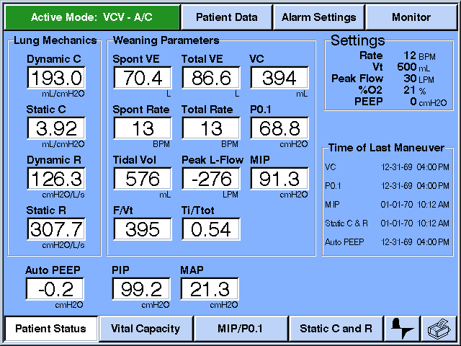
Patient Status Screen
34
1.2
7.0
1050
30.2
24
2.3
0.45
Date
and time
of last
maneuver
23
500
7.0
29.3
2.3
---
0.38
1.3
28
2.3
Notes:
After pressing the lung icon to enter the Respiratory Mechanics option, the Patient Status screen appears. On the Patient Status screen you can always view the date and time of the last maneuver. This can be particularly helpful in determining how old the data is on the display. The displayed data is divided in Lung Mechanics and Weaning Parameters for easy reference.

Slide 83
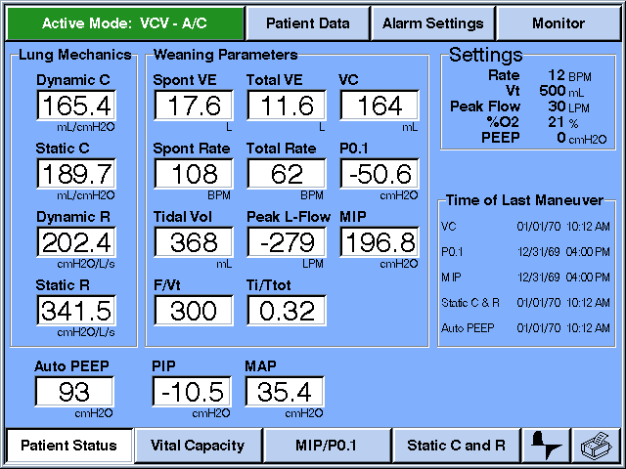
Respiratory Mechanics Maneuvers
Information at
the touch of a button
Vital Capacity
MIP/P0.1
Static C and R

Slide 84
Respironics Ventilator Maneuvers
Vital Capacity
Maximum Inspiratory Pressure (MIP)
Occlusion Pressure at 100 ms (P0.1)
Static Compliance and Resistance
27.7
0.0
8.26
852
26.8
0.0
14
-2.5
12.5
556
64
-13.5
13.9
----
----
3.7
33.4
10.2
Notes:
Today we’ll discuss the following maneuvers, Vital Capacity, Maximum Inspiratory Pressure (MIP), Occlusion Pressure At 100 ms (P0.1) and Static Compliance and Resistance. Lets start with Vital Capacity.

Slide 85
Vital Capacity
Normal VC is usually between 65 and 75 ml/kg.
A value of 10 ml/kg or more has been suggested to predict weaning outcome.
A VC while on a ventilator is typically used to determine readiness to wean or to evaluate ALS or other neuro-muscular diseases.
Notes:
Under normal conditions a predicted Vital Capacity is usually between 65 and 75 ml/kg. However a value of 10 ml/kg or more has been suggested to predict weaning outcome. Obtaining a VC while on a ventilator is typically used to determine readiness to wean or to evaluate ALS or other muscular disease states.

Slide 86
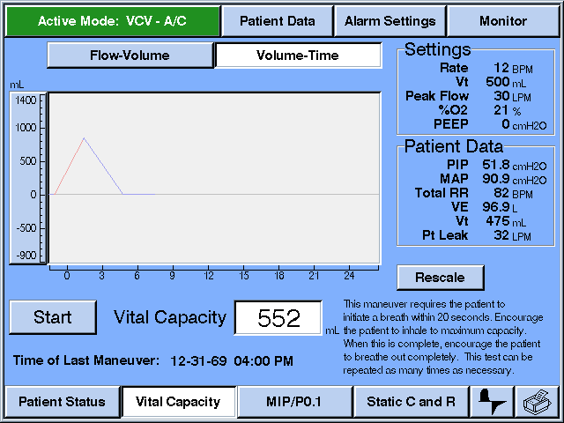
Vital Capacity
Stop
---
Notes:
This is an example of a VC maneuver. The maneuver will automatically end at the start of the next inspiration or if 20 seconds elapses which ever comes first. The Stop button also allows you to cancel the maneuver at any time. Now lets move on to Maximum Inspiratory Force. The vital capacity screen allows the user to determine that maneuver is greater than the patients normal breath. As we can see above, two normal breaths followed by the vital capacity maneuver.

Slide 87
Maximum Inspiratory Pressure (MIP)
Assessment of respiratory muscle function needs to be considered in terms of both strength and endurance.
The muscular strength of the diaphragm and accessory muscles, and to a lesser degree endurance is measured by performing a MIP.
  Sometimes referred to as Negative Inspiratory Force (NIF).
Notes:
Respiratory muscle function is one of the most important factors in determining weaning outcome. Assessment of respiratory muscle function needs to be considered in terms of both strength and endurance. The muscular strength of the diaphragm and accessory muscles, and to a lesser degree endurance is measured by performing MIP. Sometimes MIP is referred to as a Negative Inspiratory Force or NIF.

Slide 88
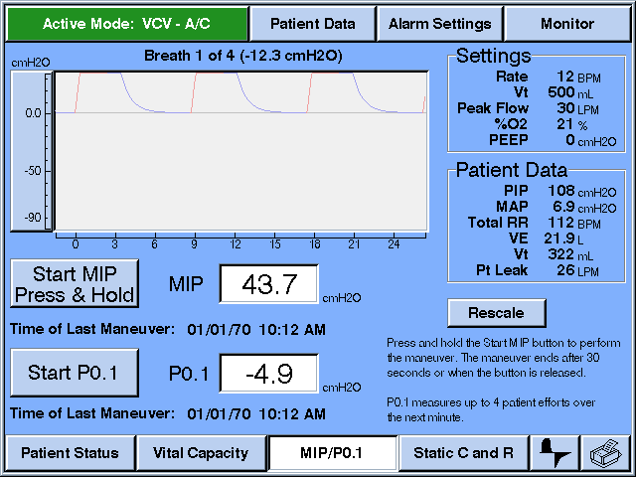
MIP Evaluation – good performance
51.5
- 3
Efforts should increase or at least stay the same
Decreasing efforts = muscle weakness
Notes:
Here we see a MIP with a patient that exhibits strength and endurance. As the MIP is performed efforts should increase or at least stay the same. Decreasing efforts may equal muscle weakness.

Slide 89
MIP Evaluation – poor performance
41.1
Value reported
is the one most
negative
MIP may look OK, but effort is not sustained
This patient may not be a candidate for weaning
Notes:
The MIP reported by the ventilator is the most negative attempt during the maneuver. Here the MIP numerical value is good, but the patient can only sustain that negative value for one breath. This patient does not appear to have any endurance. When the maneuver is completed, a dialog window appears with the results of the maneuver and a prompt to Accept or Reject the maneuver. If you accept the maneuver, the value will be displayed along with the date and time on the Patient Status screen and in the patients trended data. Now lets move on to P0.1.

Slide 90
Occlusion Pressure at 0.1 sec
Index of respiratory drive, also known as P100
  Correlates with the respiratory center’s neural output
  Clinically opposite to MIP
    As the value becomes more negative it
    indicates a worsening condition.
The opening of the inspiratory valve is delayed
by 100 ms during patient triggered ventilation.
  This is not a coached maneuver, the patient is unaware of the occlusion, maneuver requires
  active breathing.
Notes:
Occlusion pressure at 0.1 seconds is an index of respiratory drive, it is also known as P₁₀₀. It is said to correlate with the respiratory center’s neural output. P₁₀₀ is clinically opposite to MIP. With MIP the lower the negative value the stronger the patient. With P₁₀₀ as the value becomes more negative it indicates a worsening condition or fatigue. The maneuver is accomplished by delaying the opening of the inspiratory valve by 100 ms on a patient triggered breath. Although this is not a coached maneuver, and the patient is unaware of the occlusion, it does require a patient triggered breaths.

Slide 91
Occlusion Pressure at 0.1 second (P 0.1)
As a predictor of weaning
  Patients with healthy lungs and regular breathing, will have values that are no lower than - 2 cm H2O to - 4 cm H2O.
  Values more negative than - 6 cm H2O predict pending respiratory muscle fatigue.
  The greater the patient distress, the more negative the value.
Notes:
The occlusion pressure at 0.1 seconds is a predictor of weaning. Patients with healthy lungs and regular breathing, will have values that are no lower than - 2 cm H₂O to - 4 cm H₂O. Values more negative than - 6 cm H₂O predict pending respiratory muscle fatigue. The greater the patient distress, the more negative the value.

Slide 92
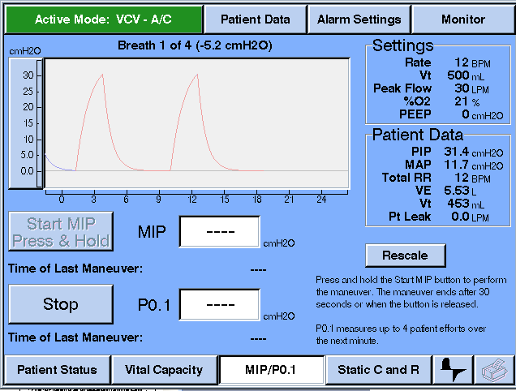
P0.1 Evaluation
The maneuver automatically ends after 1 minute or 4 patient triggered breaths have occurred.
Notes:
Press Start P0.1 to begin the maneuver. Each The maneuver automatically ends after one minute or after the 4 selected breaths have occurred. Observe the text that tells the clinician how many breaths have been completed.

Slide 93
Static C and R
Static Compliance and Resistance maneuver can only be performed in VCV
If the flow pattern is set on descending ramp the ventilator™:
  Automatically changes to a square flow pattern for the maneuver
  At the end of the maneuver, it will change it back.
A constant flow pattern is required for calculating resistance
Notes:
The static Compliance and Resistance maneuver can only be performed in volume control ventilation. In order to measure Resistance, a square flow pattern is required. If the ventilator is set on the descending ramp flow pattern the ventilator™ ventilator will: Automatically change to a square flow pattern for the maneuver, and at the end of the maneuver, the ventilator will change the flow pattern back to descending ramp. A constant flow pattern is not required for compliance measurements but is required for measuring resistance.

Slide 94
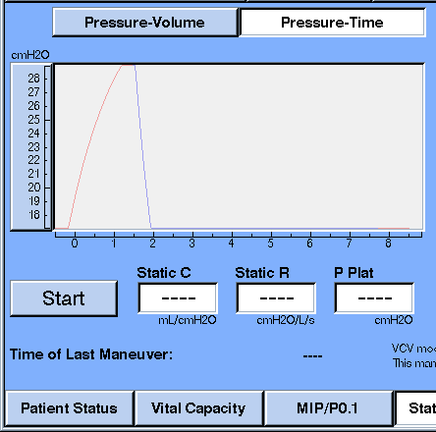
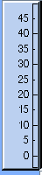
Static C & R Maneuver
Peak pressure reflects both resistance and compliance
Flow is stopped at end inspiration (plateau) which allows the lung and alveolar pressure to equilibrate
  The pressure above plateau pressure equals resistance
  The difference between PEEP and Plateau pressure represents compliance
Peak Pressure
Resistance
Plateau Pressure
Compliance
PEEP
R = (PIP-Pplat)/ Flow
C = Volume / Pplat-PEEP
Notes:
The peak pressure reflects components of both resistance and compliance (press down arrow). At end inspiration flow stops and a pause is instituted, which allows the lung and alveolar pressure to equilibrate and establishes the plateau pressure (press down arrow). The pressure between peak and plateau pressure equals resistance. The difference between the Plateau and pressure represents compliance. Observe the graphic to determine is pressure stabilization occurred. If you do not have a stable plateau, compliance and resistance value is not accurate. After the maneuver Static C, Static R and PPlat are displayed. If you accept the maneuver, these parameters are transferred to the Patient Status Screen with a date and time stamp.

Slide 95
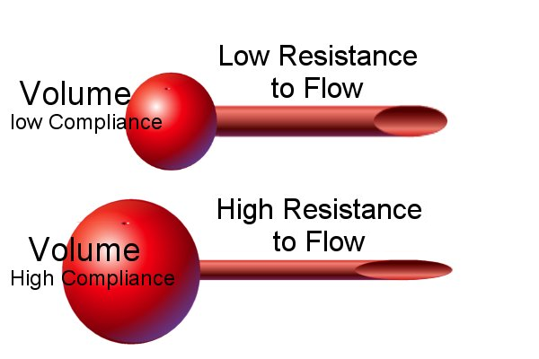
Comparing C & R (Equal Driving Pressure)
.
Poiseuille’s Law: V = ΔP x R⁴
Pressure
Change in Volume
Change in Pressure
Change in Pressure
Change in Flow
C =
R =
Pressure
But takes longer to fill
Notes:
Lets take a second here to apply what we just learned. The illustration on the top represents low compliance and low resistance to flow. In this example most of the pressure is used to expand the lungs and very little is needed to overcome the resistance to flow. In this care the drop in pressure from PIP to Plateau pressure is small, and the drop from plateau pressure to base line very large. On the illustration on the bottom, the lungs are very compliant, but resistance to flow is high. Here you would see a large drop in pressure between PIP and Plateau pressure and a small drop in pressure between Plateau pressure and base line pressure. Now lets take a look at a pressure time curve reflecting these concepts.

Slide 96
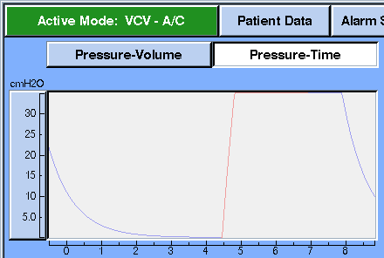
Low C With Low R
Low compliance
& low resistance
=
Small drop in
pressure between
PIP and P_{PLAT}
Notes:
This is a representation of a pressure time curve from a Static Compliance maneuver from a patient with low compliance and low resistance. As you can see the pressure drop from PIP to P_{PLAT} is small, and the drop from P_{PLAT} to PEEP or baseline is large.

Slide 97
High C and High R
Normal to high
compliance
& high resistance
=
Large change in
pressure between
PIP and P_{PLAT}
Notes:
On the other hand, here we have a patient with normal to high Compliance and high resistance. Here we see the pressure drop from PIP to P_{PLAT} is large and the drop from P_{PLAT} to PEEP or baseline is small.

Slide 98
Calculated Values
F/VT Rapid Shallow Breathing Index
Ti/ TTOT Factional Inspiratory Time
Peak Lung Flow
Dynamic estimates of Compliance and Resistance
Notes:
Calculated data the ventilator™ ventilator provides includes: F over VT also referred to as the Rapid Shallow Breathing Index. T_{i}/ T_{TOT} or Factional Inspiratory Time, Peak Lung Flow and the measurement of Dynamic estimates of Compliance and Resistance. We’ll discuss each one of these individually. Lets start with the Rapid Shallow Breathing Index.

Slide 99
F/VT – Rapid Shallow Breathing Index
A calculation of Frequency divided by tidal volume for spontaneous breaths only in CPAP with 0 cm H2O PS
Patients often breath fast and shallow to spare the diaphragm when faced with fatiguing Work of Breathing
Studies have shown that patients with ratios of frequency to tidal volume in excess of 105 may fail extubation workloads
  Spontaneous breathing without positive pressure support
Notes:
The Rapid Shallow Breathing Index is a weaning parameter developed by Dr. Martin Tobin. It is a calculation of total frequency in one minute divided by the accumulated tidal volume, or in other words minute volume, for spontaneous breaths. According to Dr. Tobin’s protocol F/VT can only be calculated in CPAP with 0 cm H₂O pressure support. Patients often breath fast and shallow to spare the diaphragm when faced with fatiguing Work of Breathing. Numerous studies have shown that patients with ratios of frequency to tidal volume in excess of 105 may fail extubation workloads.

Slide 100
Ti/ TTOT
A calculation of how much of the spontaneous breathing cycle is spent in inspiration, also known as the Duty Cycle
Normal values are 0.3 to 0.4
Values of 0.5 or greater suggest impending fatigue
When the respiratory system cannot maintain patient demands, Ti/ TTOT will eventually increase
Notes:
Ti/T_{TOT} is a calculation of how much of the spontaneous breathing cycle is spent in inspiration, also known as the Duty Cycle. As the diaphragm begins to fatigue the fraction of the breathing cycle spent in inspiration tends to increase. Normal Values are 0.3 to 0.4, and values of 0.5 or greater suggest impending fatigue. When the respiratory system cannot maintain patient demands, T_{i}/ T_{TOT} will eventually increase.
This variable may prove useful during weaning trails or titration of PSV.

Slide 101
Dynamic Mechanics
Provides a good estimate of Static C and R without the need for a maneuver or interrupting ventilation.
C and R are estimated by looking at the relationship of flow, volume, and pressure to compliance and resistance throughout a mandatory breath
Useful when patient cooperation is not attainable.
Notes:
If you remember from our discussion of Static Compliance and Resistance, the patient needs to cooperate with the clinician to achieve a stable plateau. If the patient triggers a breath, the maneuver is aborted. Dynamic mechanics provides a good estimate of static compliance and resistance without the need for a maneuver or interrupting ventilation. C and R are estimated by looking at the relationship of flow, volume, and pressure to compliance and resistance throughout a mandatory breath. Dynamic mechanics may be useful when patient cooperation is not attainable.

Slide 102
Dynamic vs. Static C & R
Dynamic measurements can be made during any VCV, PCV, and A/C, does not require an inspiratory pause.
  Dynamic C and R are measured every breath
    May not be quite the same as static measurements.
Notes:
Dynamic measurements can be made during A/C with either VCV or PCV, and does not require an inspiratory pause. The Dynamic C and R measures every breath. Because the dynamic measurement does not involve a pause, it may not be quite the same as static measurements. However, keep in mind that if you cannot get the patient to cooperate for a static maneuver, the trending of Dynamic C and R can be very useful.

Slide 103
Respiratory Mechanics Summary
Respiratory Mechanics can optimize ventilator management by:
  Providing clinicians feedback on effectiveness of treatment or a ventilator setting change
Assessing weaning ability
Guiding the weaning process
  Early warning allows clinicians to change course before patients fatigue or fail extubation
Notes:
In summary, Respiratory Mechanics can optimizing ventilator management by:
Providing clinicians feedback on effectiveness of ventilator treatment or ventilator a setting change, assessing the patients weaning ability, and guiding the weaning process. They provide an early warning to allow clinicians to change course before patients fatigue and fail weaning, or fail extubation.

