Slide 1
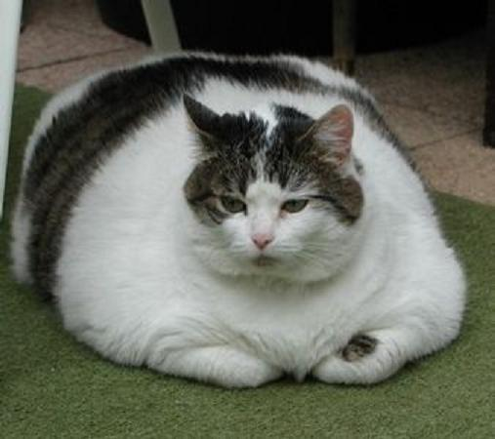
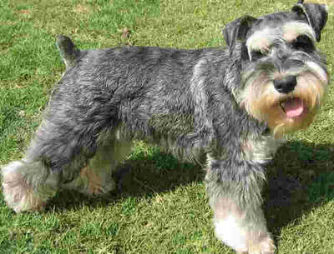
Diabetes
Jenefer Stillion, DVM
Resident Board Review

Slide 2
Diabetes Mellitus
Endocrine pancreas
Insulin synthesis and secretion
DM in humans
Canine diabetes
Feline diabetes

Slide 3
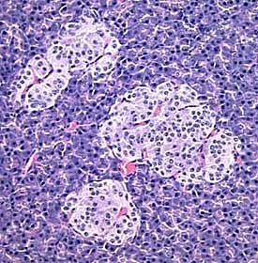
Endocrine Pancreas
Islets of Langerhans
Comprise only 1-2% of the mass of the pancreas
Receive about 10 to 15% of the pancreatic blood flow
Innervated by parasympathetic and sympathetic neurons
Notes:
allowing their secreted hormones ready access to the circulation
Nervous system modulates secretion of insulin and glucagon

Slide 4
Endocrine Pancreas
Pancreatic islets house four major cell types, each of which produces a different endocrine product:
Alpha cells (A cells) secrete glucagon
Beta cells (B cells) produce insulin
Delta cells (D cells) secrete somatostatin
F cells/PP cells secrete pancreatic polypeptide
Notes:
Beta cells: most abundant of the islet cells, occupy the central portion of the islet and are surrounded by a "rind" of alpha and delta cells.
Somatostatin: which is also produced by a number of other endocrine cells in the body, Somatostatin (also known as growth hormone-inhibiting hormone (GHIH) or somatotropin release-inhibiting factor (SRIF)) is a peptide hormone that regulates the endocrine system and affects neurotransmission and cell proliferation via interaction with G-protein-coupled somatostatin receptors and inhibition of the release of numerous secondary hormones.
Pancreatic polypeptide: The function of PP is to self regulate the pancreas secretion activities (endocrine and exocrine), it also has effects on hepatic glycogen levels and gastrointestinal secretions.
Its secretion in humans is increased after a protein meal, fasting, exercise, and acute hypoglycemia and is decreased by somatostatin and intravenous glucose.
The paracrine feedback system of the islets of Langerhans has the following structure:^{[6]}
Insulin: activates beta cells and inhibits alpha cells
Glucagon: activates alpha cells which activates beta cells and delta cells
Somatostatin: inhibits alpha cells and beta cells

Slide 5
Biosynthesis of Insulin
Insulin mRNA is translated as a single chain precursor called preproinsulin
Removal of a signal peptide during insertion into the endoplasmic reticulum generates proinsulin
Proteolytic cleavage of proinsulin forms equimolar concentrations of C peptide and insulin, which are stored in secretory granules of beta cells

Slide 6
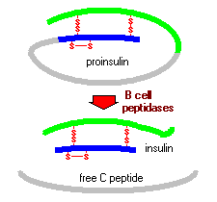
Biosynthesis of Insulin
Preproinsulin

Slide 7
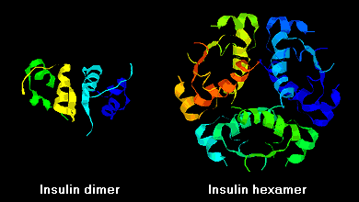
Insulin
Insulin molecules form dimers in solution
  hydrogen-bonding between B chains
In the presence of zinc ions, insulin dimers associate into hexamers

Slide 8
Insulin
Clinical ramifications:
Monomers and dimers readily diffuse into blood, whereas hexamers diffuse poorly
Absorption of insulin preparations containing a high proportion of hexamers is delayed and somewhat slow

Slide 9
Insulin Secretion
Glucose is transported into beta cell by type 2 glucose transporters (GLUT2)
Phosphorylation of glucose to produce glucose-6-phosphate
  catalyzed by glucokinase
  rate-limiting step in glycolysis
  effectively traps glucose inside the cell
As glucose metabolism proceeds, ATP is produced in the mitochondria
Notes:
Secreted in response to increased blood concentration of glucose
Each molecule of glucose yields two molecules of pyruvate which enter the citric acid cycle to make ATP

Slide 10
Insulin Secretion
↑ ATP:ADP ratio closes ATP-gated potassium channels in the beta cell membrane
  Potassium ions (K⁺) are prevented from leaving the beta cell
The rise in positive charge inside the beta cell causes depolarization
Voltage-gated calcium channels open, allowing calcium ions (Ca²⁺) to flood into the cell
↑ in intracellular calcium concentration triggers the secretion of insulin via exocytosis

Slide 11
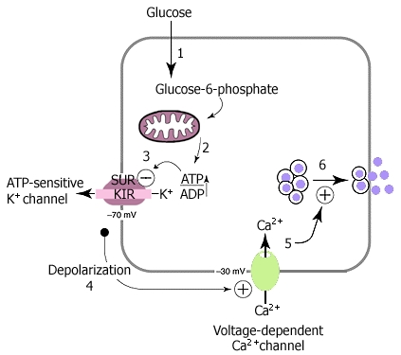
Insulin Secretion

Slide 12
Insulin
Two phases of insulin release in response to a rise in glucose:
  First is an immediate release of preformed insulin stored in secretory granules
  Second is a more prolonged release of newly synthesized insulin
Once released, insulin is only active for a brief time
Degraded by enzymes → insulinase found in the liver and kidneys
Half-life of only about 6 minutes

Slide 13
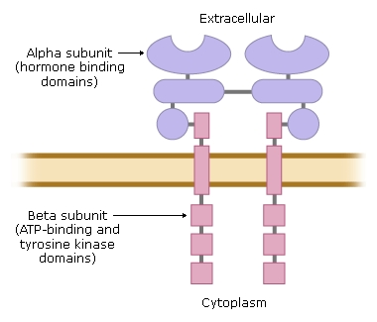
Insulin Receptor
Tyrosine kinase
Two alpha subunits
  Extracellular
  House insulin binding domains
Two beta subunits
Notes:
Insulin binds to the alpha subunits, induces a conformational change, beta subunits autophosphorylate , initiate a cascade of phosphorylation and dephosphorylation reactions

Slide 14
Insulin Effects
Facilitates entry of glucose into muscle, adipose and several other tissues
Stimulates the liver to store glucose in the form of glycogen
Promotes synthesis of fatty acids in the liver
Inhibits breakdown of fat in adipose tissue
Stimulates the uptake of amino acids
Increases the permeability of many cells to potassium, magnesium and phosphate ions

Slide 15
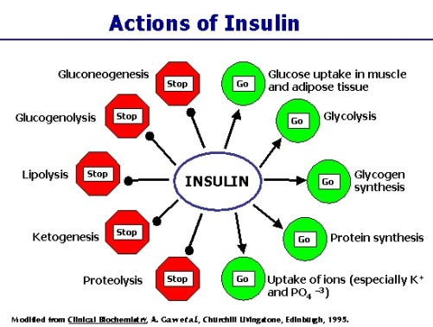
Insulin Effects

Slide 16
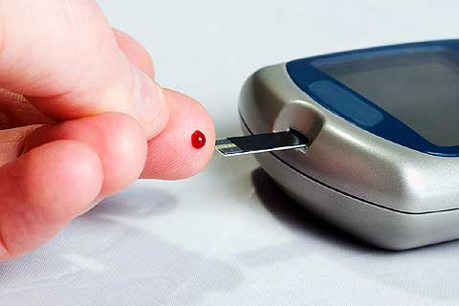

Diabetes in Humans
Type 1
Type 2
Notes:
based on the pathophysiologic mechanisms and pathogenic alterations affecting the beta cells

Slide 17

Type 1 DM
Characterized by a combination of genetic susceptibility and immunologic destruction of beta cells
Progressive and eventually complete insulin insufficiency
10% of human diabetic patients
Notes:
Also known as insulin dependent DM

Slide 18
Type 1 DM
Autoantibodies
Anti-insulin
Anti-beta cells
Anti-glutamic acid decarboxylase (GAD)
Notes:
Detection of anti-GAD autoantibodies is used to screen for development of type 1 diabetes

Slide 19
Type 1 DM
Immune-mediated destruction of islets is divided into six stages
STAGE
Stage 1 | Genetic susceptibility
Stage 2 | Triggering event
Stage 3 | Active autoimmunity and normal insulin secretion
Stage 4 | Active autoimmunity and impaired insulin secretion
Stage 5 | Overt diabetes with residual insulin secretion
Stage 6 | Overt diabetes with complete beta-cell destruction
Notes:
Likely DM in dogs progresses through similar stages. Don’t usually identify them until stage 5 or 6.

Slide 20

Type 2 DM
Characterized by insulin resistance and dysfunctional beta-cells
90% of human diabetic patients

Slide 21
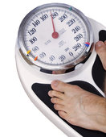
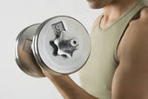
Type 2 DM
Typically non-insulin-dependent
Control usually possible through diet, exercise and oral hypoglycemic drugs

Slide 22
Canine Diabetes Mellitus
Non-insulin dependent diabetes mellitus (NIDDM)
Uncommon to rare
Associated with insulin antagonistic disease or drugs
  Glucocorticoids
  Hyperadrenocorticism

Slide 23
Canine Diabetes Mellitus
Insulin-dependent diabetes mellitus (IDDM)
Permanent hypoinsulinemia
Absolute necessity for exogenous insulin to maintain glycemic control
Incidence 1/100 dogs reaching age 12
Fall et al. JVIM 2007
Notes:
Dogs with IDDM have a reduced but adequate mass of functional beta cells to maintain carbohydrate tolerance when insulin resistance is not present but are unable to secrete enough insulin to maintain euglycemia in the presence of insulin antagonism.
Defect of carbohydrate metabolism associated with an absolute deficiency of insulin

Slide 24
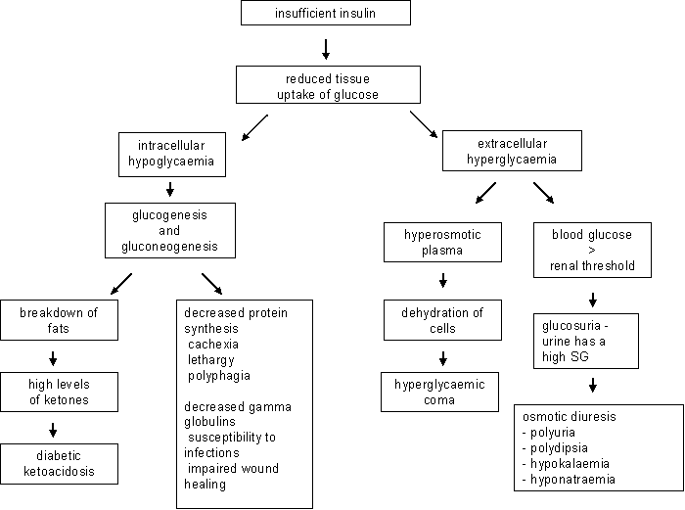
Pathophysiology

Slide 25
Etiology
Genetics
Immune-mediated insulitis
Pancreatitis
Obesity
Concurrent hormonal disease
Hyperadrenocorticism
Excess growth hormone during diestrus
Hypothyroidism
Drugs
Glucocorticoids
Progestagens
Infection
Concurrent illness
Renal insufficiency
Cardiac disease
Hyperlipidemia
Notes:
Multifactorial

Slide 26
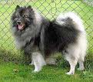
Breed Risks
Australian terrier
Schnauzer
Bichon Frise
Spitz
Fox Terrier
Miniature Poodle
Samoyed
Cairn Terrier
Keeshond
Maltese
Toy Poodle
Lhasa Apso
Yorkshire terrier
Guptil et al. 1999

Slide 27
Signalment
Typically occurs in older dogs
  5 to 15 years of age
Juvenile-onset (< 1 year-old) diabetes is uncommon
Female dogs affected twice as frequently as males
Genetic predisposition suggested by familial associations in dogs
Guptill L et al. Vet J 2003
Notes:
Nelson: peak incidence at 7 to 9 years of age
Guptill Vet J: highest incidence was in dogs age 10-15, females at risk, Keeshonds “Spitz type” dogs
Fall T et al JVIM 2007: 5 to 12 years of age
Davison LJ Vet Rec 2005: 80% between 5 and 12 years of age, also, did not find females to be at increased risk

Slide 28
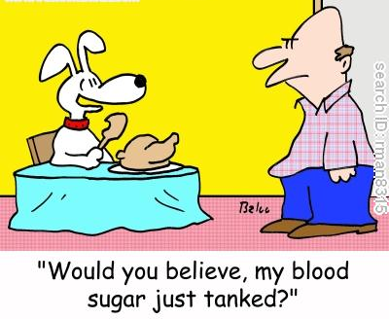
Clinical Signs
Polyuria
Polydipsia
Weight loss
Polyphagia
Sudden blindness
Notes:
4 most common clinical signs. May not be noticed or tolerated until dog goes blind form cataracts.

Slide 29
Physical Exam
Depends on:
Whether DKA is present and it’s severity
Duration of diabetes prior to diagnosis
Nature of concurrent disease(s)
Nonketotic diabetic dog has no typical physical exam findings

Slide 30

Physical Exam
Obese
Rarely emaciated
Sparse, dry, brittle, lusterless hair coat
Hyperkeratosis
Hepatomegally
Cataracts
Anterior uveitis
KCS

Slide 31
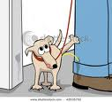
Diagnosis
Clinical signs
Persistent fasting hyperglycemia
Glucosuria
  Renal threshold for glucose 180-220 mg/dL
Notes:
Important to document both persistent hyperglycemia and glucosuria to establish a diagnosis of DM. Hyperglycemia differentiates DM from primary renal glycosuria and glucosuria differentiates DM from other causes of hyperglycemia

Slide 32
Causes of Hyperglycemia
Diabetes mellitus
“Stress”
Postprandial
Hyperadrenocorticism
Diestrus
Pheochromocytoma
Exocrine pancreatic neoplasia
Renal insufficiency
Drug therapy
  Glucocorticoids
  Progestagens
  Thiazide diuretics
  Dextrose-containing fluids
  Parenteral nurtrition
Head trauma
Notes:
Mild hyperglycemia: 130-180 mg/dL
Insulin resistance: Cushing’s, diestrus, corticosteroids

Slide 33
Diagnostics
Complete blood count
Serum biochemistry panel
Urinalysis
Urine culture
Abdominal ultrasound

Slide 34
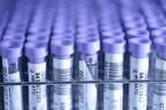
Hematology
Typically normal
Neutrophilic leukocytosis
Polycythemia
Notes:
Elevated neutrophils with inflammation or infection: toxic changes, bands may be present with pancreatitis
Polycythemia with dehydration

Slide 35
Serum Biochemistry
Hyperglycemia
Hypercholesterolemia (33%)
Hyperlipidemia (42%)
Hypochloremia (60%)
↑ALT (78%)
↑ AST (71%)
↑ ALP (90%)
Hess RS JAVMA 2000
Notes:
Depend on the duration of untreated DM and presence of concurrent conditions
Increase in liver enzymes is usually mild and is due to hepatic lipidosis
Serum ALP > 500 IU/L should raise suspicion of hepatopathy other than hepatic lipidosis
Elevated total bilirubin: think extrahepatic biliary obstruction secondary to pancreatitis
Liver biopsy and AUS to differentiate
BUN and Cr usually normal in uncomplicated diabetic: if elevated, prerenal versus renal
Do NOT have ionized hypomagnesemia on presentation like humans and cats (Fincham SC 2004 JVIM)
Hyperlipidemia and lipemia are common in untreated diabetic: increase in the blood concentrations of triglycerides, cholesterol, lipoproteins, chylomicrons and FFA (DeBowes, 1987)

Slide 36

Urinalysis
Urine specific gravity usually > 1.025
Depends on severity of glucosuria
2% or 4+ glucosuria will increase the USG by 0.008 to 0.010 on refractometer
Notes:
USG < 1.020 and glucosuria < 2% - look for other cause of PU/PD like Cushing’s or renal insufficiency

Slide 37

Urinalysis
Glucosuria
Proteinuria
Bacteriuria
+/- Pyuria and Hematuria
+/- trace Ketones
Notes:
Proteinuria due to infection or glomerular damage secondary to disruption of basement membrane (Struble et al. 1998)
Healthy diabetics can sometimes have trace to mild ketones in urine

Slide 38
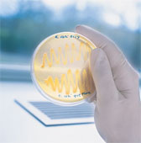
Urine Culture
Urinary tract infection
Absence of pyuria and hematuria does not rule it out
Prevalence of 21% in dogs with diabetes mellitus
  Aerobic culture
  Escherichia coli
Hess RS JAVMA 2000

Slide 39
Abdominal Ultrasound
Performed in 127/221 dogs
Results were abnormal in 124/127 dogs (97%)
Hyperechoic liver 104/127 (82%)
Hyperechoic renal cortices 48/127 (38%)
Hypoechoic pancreas with hyperechoic
mesentery (acute pancreatitis) 27/127 (21%)
Peritoneal effusion 23/127 (18%)
Duodenal wall thickening 11/127 (8%)
Hess RS JAVMA 2000
Notes:
Abnormal in 56% of their population of dogs – Was it only done in dogs that were more sick or where disease suspected?
Most of these dogs with peritoneal fluid and duodenal wall thickening (19 and 11, respectively) also had ultrasonographic changes
consistent with a diagnosis of acute pancreatitis.

Slide 40
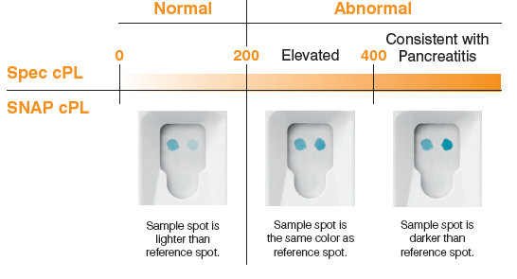
Ancillary Tests
Thoracic radiographs
Coagulation testing
Pancreatic enzymes
  TLI
  cPLI
Serum insulin concentration
Progesterone levels, LDDS, ACTH stim

Slide 41
Pancreatic Enzymes
Serum trypsinlike immunoreactivity (TLI)
Usually normal
High with acute pancreatitis
Low with EPI
Pancreatic lipase immunoreactivity (cPLI)
Usually normal
High with acute pancreatitis
Normal to high with chronic pancreatitis
Notes:
Consider if AUS is not available.
Serum lipase/amylase and TLI do not always correlate with presence or absence of pancreatitis. Pancreatic enzyme concentrations can be increased in dogs with a histologically confirmed normal pancreas and normal in dogs with histologically confirmed inflammation of the pancreas, especially if inflammation is chronic or mild.
TLI: Trypsinogen is a proenzyme (a non-activated enzyme) that is secreted into the small intestine by the pancreas, along with other pancreatic digestive enzymes. When it reaches the small intestine, trypsinogen is converted to trypsin, an enzyme that is involved in the digestion of proteins. In healthy animals, a small amount of trypsinogen escapes from the pancreas into the blood circulation, and can be measured in a blood sample by a test called trypsin-like immunoreactivity.
cPLI:Canine pancreatic lipase is an enzyme that is synthesized and released only by pancreatic acinar cells.
Increased serum concentrations of canine pancreatic lipase suggest an increased release from pancreatic acinar cells. The increased release of pancreatic lipase is classically associated with pancreatic inflammation, ie acute or chronic pancreatitis.

Slide 42
Serum Insulin Concentration
Routine measurement is not recommended
IDDM: low, normal
Increased serum insulin
Suggests presence of functional beta cells
Low serum insulin
Does not rule out the existence of functioning beta cells
Hyperglycemia suppresses beta cell function
Notes:
Measured in the face of hyperglycemia.

Slide 43
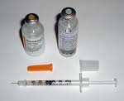
Treatment
Goals
Insulin therapy
Dietary therapy
Exercise

Slide 44
Goals of Therapy
Primary goal is the elimination of owner-observed clinical signs
Balance tight glucose control with risk of hypoglycemia

Slide 45

Insulin Therapy
Initial control with an intermediate-acting insulin (NPH, Lente)
Recombinant human or pork source
Dose: 0.25 U/kg BID
Notes:
Human or pork source minimizes the development of antiinsulin antibodies

Slide 46
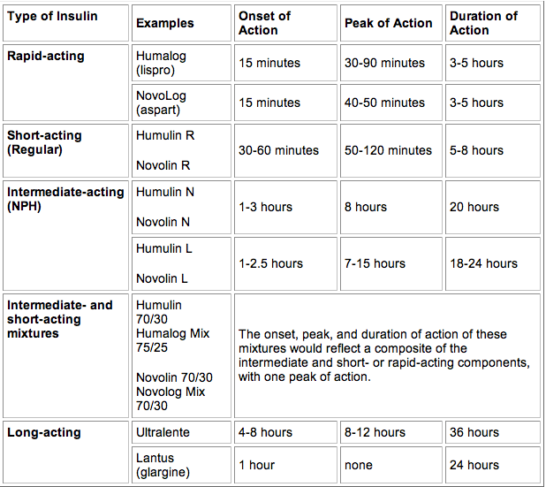
Insulin
Less potent
(Lente)
(PZI)
More potent

Slide 47
Initial Adjustments in Insulin Therapy
Hospitalize no longer than 24 to 48 hours to complete diagnostics and to start insulin
Measure BG at time of insulin administration
Blood glucose curve to identify hypoglycemia
  Decrease insulin dose prior to discharge
Initial goal is NOT to achieve glycemic control
Notes:
Usually recheck in one week and adjust insulin levels then

Slide 48
Dietary Therapy
Correct or prevent obesity
Maintain consistency in timing and caloric content of meals
Diet that minimizes postprandial increases in BG concentration

Slide 49
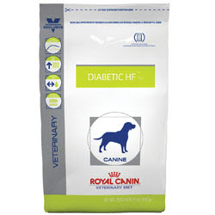


Dietary Therapy
It’s all about fiber….
Royal Canin Diabetic HF
Purina DCO
Hill’s W/D

Slide 50

Exercise
Promotes weight loss
Reduces obesity-related insulin resistance
Glucose-lowering effect
  Increases absorption of insulin from injection site
  Increases blood flow to muscle
  Stimulates translocation of glucose transporters in muscle cells
  Increases glucose effectiveness

Slide 51
Monitoring Diabetic Control
History and physical exam
Serum fructosamine
Urine glucose/ketones
Blood glucose curve

Slide 52
Serum Fructosamine
Proteins synthesized from the irreversible non-enzymatic, insulin-independent binding of glucose to serum proteins
Correlated to average glucose concentration over previous 1 - 2 weeks

Slide 53
Serum Fructosamine
Normal range: 225-365 µmol/L
Factors affecting results (falsely decrease):
  Hypoproteinemia
  Hyperlipidemia
  Azotemia
  Storage of sample at room temperature
Notes:
Can be high with insulin under or overdosage

Slide 54
Serum Fructosamine
Interpretation in Diabetic Dogs
Excellent control | 350-400 µmol/L
Good control | 400-450 µmol/L
Fair control | 450-500 µmol/L
Poor control | > 500 µmol/L
Prolonged hypoglycemia | < 300 µmol/L
Nelson RW. Canine Diabetes Mellitus in Textbook of Veterinary Internal Medicine 7th Ed.

Slide 55
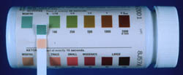
Urine Monitoring
Monitor urine glucose and ketones at home
Do NOT adjust daily insulin dose based on morning urine glucose measurement
Persistent glucosuria and/or ketonuria warrant evaluation by a veterinarian

Slide 56
Blood Glucose Curve
Provide guidelines for making adjustments in insulin therapy
Use history, PE, body weight and fructosamine level to determine when a glucose curve is necessary
May not be meaningful in stressed, excited or aggressive dog

Slide 57
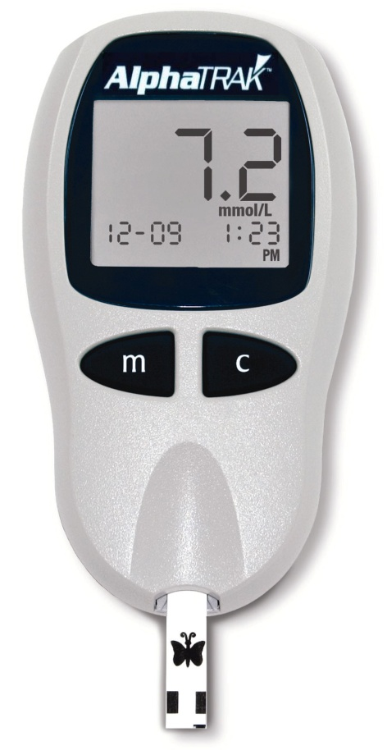
Blood Glucose Curve
Maintain feeding and insulin schedule used by owner
Obtain BG every 1-2 hours
Use to determine:
Glucose nadir
Time of peak insulin effect
Duration of insulin effect
Severity of BG fluctuations
Notes:
Remember hand-held portable glucose meters may differ from point-of-care analyzers: tends to be lower on hand-held meter
AlphaTRAK has been validated in dogs and results are significantly closer to reference values compared to other hand-held analyzers (Wess G et al JAVMA 2000)

Slide 58
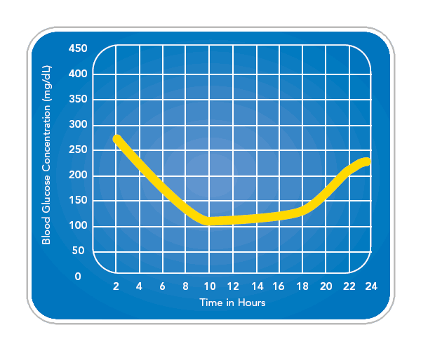
Blood Glucose Curve
Notes:
Want BG between 100 and 250 mg/dL
Nadir is the lowest glucose measurement and should ideally fall between 100 and 125 mg/dL
To determine if insulin is effective, need to look insulin dosage, highest BG and difference between highest and lowest BG

Slide 59
Complications of Insulin Therapy
Hypoglycemia
Stress hyperglycemia
Recurrence or persistence of clinical signs
Insulin underdosage
Insulin overdosage (Somogyi response)
Short duration of insulin effect
Prolonged duration of insulin effect
Inadequate or impaired insulin absorption
Circulating antiinsulin antibodies
Insulin resistance
Notes:
Duration: Lente and NPH usually last 10 to 14 hours and need to be administered BID. Persistent clinical signs and morning glucosuria. Need to switch to a longer lasting insulin or dose TID

Slide 60
Hypoglycemia
Causes:
Sudden large increase in insulin dosage
Excessive overlap of BID dosing
Strenuous exercise
Prolonged inappetance/anorexia
Sudden improvement in insulin resistance

Slide 61
Hypoglycemia
Clinical signs depend on rate and severity of blood glucose decline
Lethargy
Weakness
Ataxia
Seizures
Coma

Slide 62
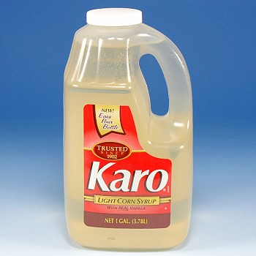
Hypoglycemia
Treat with oral or IV dextrose
Stop insulin until glucosuria recurs
Initially decrease insulin dose by 25 to 50%

Slide 63
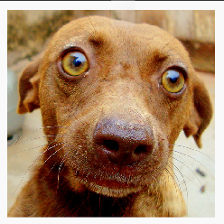
Stress Hyperglycemia
Result of increased catecholamine and glucocorticoid secretion and increased hepatic glucose production
Can significantly increase BG in the face of insulin therapy
Suspect if disparity between
clinical assessment of glycemic
control and results of BG

Slide 64
Insulin Underdose
Inadequate dose associated with persistent clinical signs
Once daily versus twice daily dosing
< 1.0 U/kg BID
Rule-out other causes for insulin ineffectiveness
  Watch the owner administer insulin

Slide 65
Insulin Overdose
Somogyi response
Insulin-induced hypoglycemia
Leads to counter-regulation and severe hyperglycemia
Stimulates hepatic glycogenolysis
Secretion of glucagon and epinephrine
Inability to secrete endogenous insulin to dampen rising BG

Slide 66
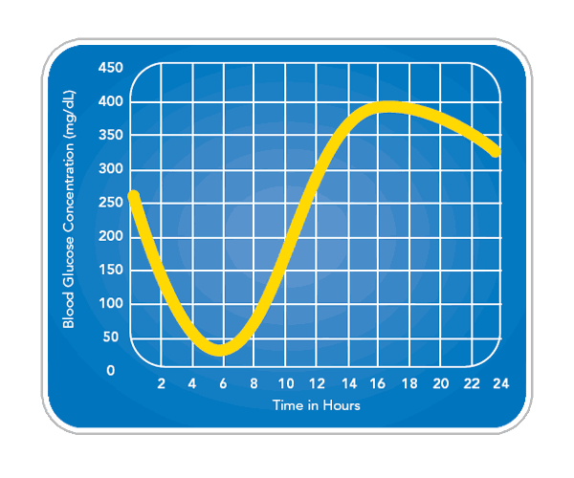
Somogyi Response

Slide 67
Insulin Antibodies
Result from repeated injections of a foreign protein (insulin)
The more divergent the insulin molecule being delivered from the species being treated, the greater the likelihood of antibody formation
Canine, porcine, recombinant human: GOOD
Beef, beef/pork combo: BAD
Notes:
Insulin antibodies have been identified in approximately 40-50% of dogs treated with pork/beef insulin and 65% of dogs treated with bovine insulin (Harb-Hauser 1998, Davison 2003).
Species of origin, insulin formation, impurities in preparation and method of injection influence development of antibodies

Slide 68
Insulin Antibodies
Associated with:
Erratic and poor glycemic control
Frequent insulin adjustments
Insulin resistance

Slide 69
Insulin Resistance
The presence of BG concentrations that are persistently > 200 mg/dL when measured every 2 hours over a 10-12 hour period in a diabetic dog receiving an insulin dose > 1.0 U/kg
Hess RS Vet Clin Small Anim, 2010

Slide 70
Insulin Resistance
Rule out causes of perceived resistance:
Improper handling of insulin
Improper administration of insulin
Use of the wrong insulin syringe
Outdated insulin
Somogyi effect

Slide 71
Insulin Resistance
True resistance to exogenous insulin caused by conditions that trigger the secretion of stress-related, counter-regulatory, diabetogenic hormones:
Glucagon
Glucocorticoids
Catecholamines
Growth hormone
Notes:
Glucocorticoids: HAC
Catecholamine: pheochromocytoma
GH: acromegally

Slide 72
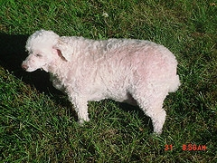
Common Concurrent Conditions
Hyperadrenocorticism 23%
Urinary tract infection 21%
Acute pancreatitis 13%
Neoplasia 5%
Hypothyroidism 4%
Hess RS JAVMA, 2000
Notes:
221 diabetic dogs, well-regulated and poorly regulated

Slide 73
Complications of Diabetes Mellitus
COMMON
UNCOMMON
Hypoglycemia
Persistent PU/PD, weight loss
Cataracts
Anterior uveitis
Bacterial infections
Pancreatitis
Ketoacidosis
Hepatic lipidosis
Peripheral neuropathy
Glomerulonephritis
Retinopathy
EPI
Gastric paresis
Diabetic diarrhea
Diabetic dermatopathy
Nelson RW in Textbook of Veterinary Internal Medicine 7th ed.

Slide 74
Prognosis
Mean survival: 2 to 3 years from diagnosis
High mortality during first 6 months of therapy
  Ketoacidosis, concurrent illness
Long-term survival depends on:
  Owner commitment
  Ease of glycemic regulation
  Presence and reversibility of concurrent disease
  Avoidance of chronic complications

Slide 75
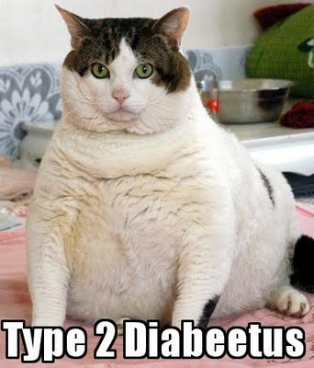
Diabetes Mellitus in the Cat
IDDM
Most common clinically recognized form of DM in cat
70% of cats have IDDM at time of diagnosis

Slide 76
Diabetes Mellitus in the Cat
NIDDM
More frequent in the cat than the dog
30% of diabetic cats

Slide 77
Etiology
Combination of insulin resistance and beta cell dysfunction
IDDM vs. NIDDM: depends on the severity of loss of beta cells and the severity and reversibility of concurrent insulin resistance
Immune-mediated destruction of islets does NOT play a significant role

Slide 78
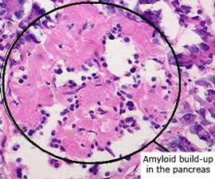
Histologic Abnormalities
Islet amyloidosis
Vacuolar degeneration of beta cells
Islet hypoplasia
Chronic pancreatitis

Slide 79
Amyloid
Islet amyloid is derived from amylin (IAPP)
Hormone co-secreted with insulin from β cells
In cats and humans, amylin is predisposed to folding into β-pleated sheets which are deposited as amyloid in the islets
Amyloid deposition found in 65 to 90% of cats with DM
Notes:
IAPP: islet amyloid polypeptide
Severity of amyloid deposition increases with age but cats with DM have more than non diabetic cats

Slide 80
Amyloid
Insulin resistance
(obesity, prednisone)
Increased insulin secretion
Increased amylin secretion
Progressive amyloid deposition in islets
Islet destruction

Slide 81
Transient Diabetes
Approximately 20% of diabetic cats
Usually occurs 4 to 6 weeks after initiation of treatment
Hyperglycemia, glycosuria and clinical signs resolve
Future requirement for insulin depends on underlying islet cell abnormalities
Notes:
If islet pathology is progressive (amyloidosis) eventually enough beta cells are destroyed and permanent IDDM occurs.
Cats with transient diabetes are in a subclinical diabetic state that become clinical when the pancreas is stressed by exposure to an insulin antagonistic drug or disease (pancreatitis)

Slide 82

Risk Factors
Genetic
Unknown
Environment
Increasing age
Male gender
+/- being neutered
Obesity
Inactivity
Drugs
  Glucocorticoids
  Progestin
Notes:
Studies in Australia and UK: frequency of DM is 4 times higher in Burmese versus domestic cats
Prahl et al J Fel Med Surg 2007: did not find being neutered was a risk factor

Slide 83
Signalment
95% of cats are > 5 years-old at time of diagnosis
70 to 80% are male (usually neutered)
Reusch C. Feline Diabetes Mellitus in Textbook of Veterinary Internal Medicine 7th Ed.
Notes:
Maybe a higher risk in Burmese cats (not in US study; study by Panciera et al 1990, Rand et al 1997)
Prahl A et al J Fel Med Surg 2007: 87% of cats were > 7 years of age, 62.5% were male, 85% mixed breed

Slide 84
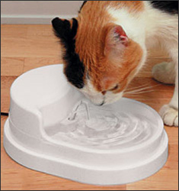
Clinical Signs
Polyuria
Polydipsia
Polyphagia
Weight loss
Lethargy

Slide 85
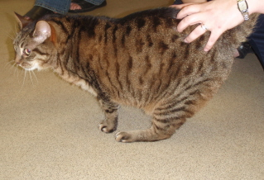
Physical Exam
Dry, lusterless, unkempt hair coat
Obese
Hind limb weakness
Plantigrade posture
Hepatomegally
Nonketotic diabetic cat has no classic physical exam finding
Notes:
10% have signs of diabetic neuropathy

Slide 86
Diagnosis
Clinical signs
Persistent fasting hyperglycemia
Glucosuria
  Renal threshold for glucose 200-280 mg/dL

Slide 87
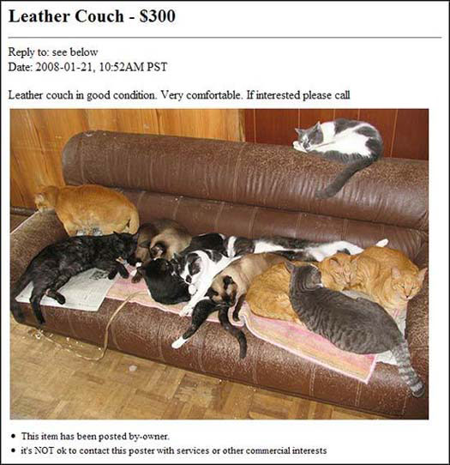
Diagnostics
Complete blood count
Serum biochemistry panel
Urinalysis
Urine culture
Abdominal ultrasound

Slide 88
Specific to the Cat
Serum thyroxine concentration
Feline trypsin-like immunoreactivity (fTLI)
Notes:
Hyperthyroidism can cause insulin resistance, may have falsely lowered T4 levels if also euthyroid sick
Remember: AUS is the single best diagnostic test for identifying pancreatitis in the cat.

Slide 89
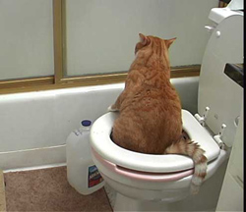
Urinary Tract Infection
Overall incidence of 13%
  11% of newly diagnosed cats
Escherichia coli most common isolate
Females > males
Bailiff NL JVIM 2006

Slide 90
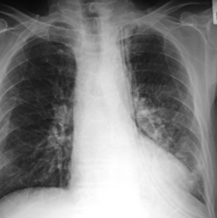
Pulmonary Complications
Diabetes mellitus in humans
Associated with pulmonary fibrosis
Increases incidence of respiratory infection
Negatively effects pulmonary function
Notes:
Effects on pulmonary function include decreases in lung capacity, impairment of gas exchange, increased susceptibility to infection

Slide 91
Pulmonary Complications
Cats with diabetes mellitus
Do not exhibit clinical signs of respiratory disease more than healthy cats
3 times more likely than control cats to have abnormal pulmonary histopathology
Types of lesions found varied and nonspecific
Mexas, AM JVIM 2006
Notes:
Retrospective study. U Penn and NCSU, 42 cats with DM, 45 without – all had necropsy done
Independent of the presence of clinical evidence of respiratory disease
Lesions found: congestion, edema, histiocytosis, pneumonia, NO thrombosis or infarction (microangiopathy)

Slide 92
Treatment
Goals
Insulin therapy
Oral hypoglycemic agents
Dietary therapy
Exercise
Notes:
Goal is similar to dogs: eliminate owner observed clinical signs associated with hyperglycemia and glucosuria

Slide 93
Insulin Therapy
Cats are unpredictable in their response to exogenous insulin
Initial insulin choice depends on personal preference and availability
Twice daily dosing
Start at 1 U/cat

Slide 94
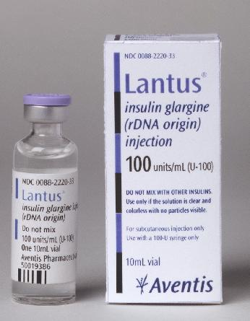
Glargine (Lantus)
Long-acting insulin analog (up to 24 hours)
Exists in solution at acidic pH
After injection, forms microprecipitates
Sustained release
Notes:
Used as once daily insulin in humans
Cannot dilute: changes pharmacokinetic profile
Conflicting studies: may or may not be better than PZI and Lente with regard to remission rate

Slide 95
Initial Insulin Therapy
Hospitalize no longer than 24 to 48 hours to complete diagnostics and to start insulin
Measure BG at time of insulin administration
Blood glucose curve to identify hypoglycemia
  Decrease insulin dose prior to discharge
Initial goal is NOT to achieve glycemic control

Slide 96
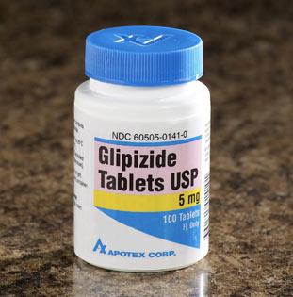
Oral Hypoglycemic Agents
Five classes of oral agents approved for use in humans:
Sulfonlureas
Meglitinides
Biguanides
Thiazolidinediones
α-Glucosidase

Slide 97
Sulfonylureas
Glipizide, Glyburide
Treatment of NIDDM in cats
Direct stimulation of insulin secretion by beta cells
Need some endogenous pancreatic insulin secretory ability for them to work
Initial dose 2.5 mg PO BID

Slide 98
Glipizide
Adverse Reactions:
Vomiting within 1 hour of administration
Increased serum hepatic enzyme activity
Icterus
Hypoglycemia
Accelerated loss of beta cell function?
Notes:
Caused by glipizide induced stimulation of amylin secretion and worsening islet amyloidosis

Slide 99
Dietary Therapy
Restriction of carbohydrate absorption
Option 1: moderate carbs and fat, high fiber
  Hill’s w/d
Option 2: high protein, low carb, low fiber
  Purina DM
Option 3: high fat, low carb, low fiber
  Science Diet Feline Growth

Slide 100
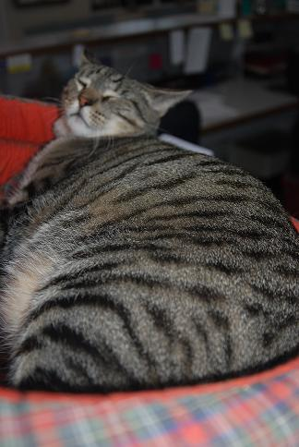
Obesity
Causes reversible insulin resistance
Down regulates insulin receptors
Impaired insulin receptor binding
Defects in insulin action

Slide 101
Monitoring Diabetic Control
History and physical exam
Serum fructosamine
Urine glucose/ketones
Blood glucose curve

Slide 102
Insulin Resistance
Most diabetic cats can be controlled on 1 to 3 units insulin per dose (<1 U/kg)
Severity of insulin resistance varies with the underlying disease
Notes:
There are currently no published prospective or retrospective studies evaluating the causes of insulin resistance in cats

Slide 103
Causes of Insulin Resistance
Drug administration (progestagens, corticosteroids)
Infection
Hyperthyroidism
Acromegaly
Pancreatitis
Renal disease
Hepatic disease
Cardiac insufficiency
Hyperlipidemia
Neoplasia
Severe obesity
EPI
Hyperadrenocorticism
Pheochromocytoma
Notes:
Glycemic control worse in cats with concurrent disease

Slide 104
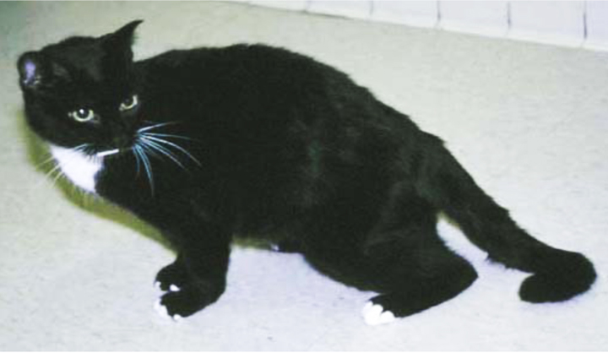
Diabetic Neuropathy
Prevalence of 10% in cats with IDDM
Clinical signs:
Hindlimb weakness
Impaired ability to jump
Plantigrade posture
Muscle atrophy
Depressed limb reflexes
Postural reaction deficits

Slide 105
Diabetic Neuropathy
Exact mechanism unkown
  Vascular, axonal and metabolic hypothesis
No specific therapy
Longer the neuropathy and the more severe, less likely it is to reverse with glycemic control

Slide 106
Prognosis
Depends on:
Owner compliance
Ease of glycemic control
Presence/nature of concurrent disorders
Avoidance of chronic complication
If survive first 6 months, can maintain quality of life for > 5 years

Slide 107
Predictors of Clinical Remission
Remission: normoglycemia without insulin for ≥ 4 weeks
90 cats with newly diagnosed diabetes mellitus
50% achieved remission
Remission:
More likely with higher age
Less likely with high cholesterol
Longer with higher body weight
Shorter with higher blood glucose
Zini E et al. JVIM 2010
Notes:
Included cats with DKA and concurrent diseases
Blood work and body weight was on admission.

Slide 108
References
Bailiff NL, Nelson EC, Feldman JL et al. Frequency and risk factors associated with urinary tract infection in cats with diabetes mellitus. J Vet Intern Med 2006;20:850-855.
Canine diabetes mellitus In: Feldman EC, Nelson RW eds. Canine and feline endocrinology and reproduction 3rd ed. 2004 St. Louis, Saunders.
Davidson LJ, Walding B, Herrtage ME et al. Anti-insulin antibodies in diabetic dogs before and after treatment with different insulin preparations. J Vet Intern Med 2008;22:1317-1325.
Durocher LL, Hinchcliff KW, DiBartola SP et al. Acid-base and hormonal abnormalities in dogs with naturally occurring diabetes mellitus. J Am Vet Med Assoc 2008;232:1310-1320.
Fall T et al. Diabetes mellitus in a population of 180,000 insured dogs: incidence, survival and breed distribution. J Vet Intern Med 2007;21:1209-1216
Feline diabetes mellitus In: Feldman EC, Nelson RW eds. Canine and feline endocrinology and reproduction 3rd ed. 2004 St. Louis, Saunders.
Hess RS, Saunders M, Van Winkle TJ et al. Concurrent disorders in dogs with diabetes mellitus: 221 cases (1993-1998). J Am Vet Med Assoc 2000;217(8):1166-1173.
Hess RS. Insulin resistance in dogs. Vet Clin Small Anim 2010;309-316.

Slide 109
References
Mexas AM, Hess RS, Hawkins EC et al. Pulmonary lesions in cats with diabetes melliltus. J Vet Intern Med 2006;20:47-51.
Morgan MJ, Vite CH, et al. Clinical peripheral meuropathy associated with diabetes mellitus in 3 dogs. Can Vet J 2008;49:583-586.
Nelson RW. Canine diabetes mellitus. In: Ettinger SJ, Feldman EC eds. Textbook of veterinary internal medicine7th ed. 2010 St. Louis, Saunders.
Reusch C. Feline diabetes mellitus. In: Ettinger SJ, Feldman EC eds. Textbook of veterinary internal medicine7th ed. 2010 St. Louis, Saunders.
Rios L, Ward C. Feline diabetic mellitus: diagnosis, treatment and monitoring. Comp endium 2008;626-637.
Scott-Moncrieff JC. Insulin resistance in cats. Vet Clin Small Anim 2010:241-257.
Zini E, Hafner M, Osto M et al. Predictors or clinical remission in cats with diabetes mellitus. J Vet Intern Med 2010;24:1314-1321.

Slide 110
Diabetes Insipidus
Central DI → deficiency of arginine vasopressin (AVP)
Nephrogenic DI → renal tubules are insensitive to actions of AVP
  Huskies
  Mutation in V2 receptor

Slide 111
Diabetes Insipidus
Clinical signs
Polyuria
Polydipsia
Urinary incontinence
CNS: stupor, ataxia, seizures, tremors
Notes:
If water is with held can develop life-threatening hypertonic encephalopathy – ataxia and stupor

Slide 112
Diabetes Insipidus
Characterized by three primary findings:
Dilute urine
Absence of renal disease
Rise in urine osmolality following administration of vasopressin

Slide 113
Vasopressin
Released by the posterior lobe of hypothalmus in response to hypovolemia and hypertonicity
Also called arginine-vasopressin (AVP) or anti-diuretic hormone (ADH)

Slide 114
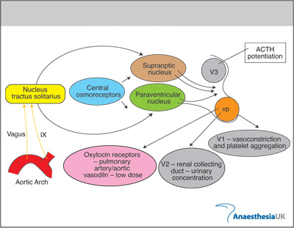
Vasopressin
Notes:
Vasopressin is an endogenous nonapeptide hormone released by the posterior pituitary in response to hypovolaemia and hypertonicity. It is also commonly know as antidiuretic hormone (ADH) and DDAVP. Its release is regulated by a combination of arterial baroreceptors in the carotid sinus and aortic arch, and osmoreceptors located near to the supraoptic nucleus (Figure 1). Release is normally constantly inhibited by volume receptors in the cardiac cavities.
Normal levels of plasma vasopressin are 0-4 pg/ml. Levels of 5-7 pg/ml cause maximum urinary concentration. Vasopressin at higher concentrations causes vasoconstriction via V1 receptors, and potentiates cortisol release via V3 receptors. It is metabolised by aminopeptidases throughout the body, and has a half-life of about 10 minutes.

Slide 115
Central Diabetes Insipidus
Two forms in dogs and cats
Complete DI → little or no increase in urine osmolality in response to increases in serum osmolality (no AVP)
Partial DI → AVP released with increasing plasma osmolality but is subnormal in amount

Slide 116
Serum Osmolality
Osmolality = 2(Na + K) + (BUN/2.8) + (GLU/18)

Slide 117
Central DI - Causes
Intracranial tumor
  Primary pituitary tumor, meningioma, metastatic
Inflammatory
Parasitic
Severe head trauma
Pituitary surgery
Idiopathic

Slide 118
Laboratory Findings
Isosthenuria (usg < 1.010)
Urine osmolality < 290 mosmol/kg
Hypernatremia
Low BUN
+/- Azotemia

Slide 119
Differential Diagnosis
Primary polydipsia
Nephrogenic diabetes insipidus

Slide 120
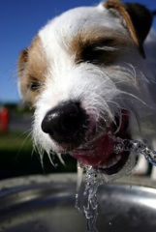
Primary Polydipsia
Hyperactive young dogs
Behavioral
Urine osmolality > 1000 mosmol/kg diagnostic
Water deprivation test

Slide 121
Diagnosis
Water deprivation test
In both nephrogenic and central diabetes insipidus urine osmololality will remain low during water deprivation
Vasopressin administration
Central diabetes insipidus urine osmolality with increase by 50%
Nephrogenic diabetes insipidus no rise in urine osmolality
Notes:
Fast animal for 12 hours then withhold water. Collect plasma and urine every 2 hours and measure osmolality in both. Weigh animal at each collection and stop when 3-5% body weight loss.

Slide 122
Diagnosis
Measurement of plasma vasopressin
Administer hypertonic saline
  0.03 ml/kg/min for 2 hours
Risk of critical hypertonicity
CT/MRI
Patients with head trauma
Suspicion of pituitary lesion/tumor

Slide 123
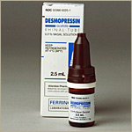
Treatment
DDAVP (Desmopressin)
AVP analogue
Provides antidiuretic activity for about 8 hours
One drop in conjunctiva BID

Slide 124
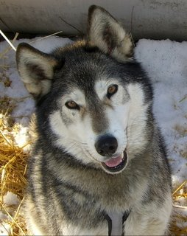
Prognosis
Good in the absence of neoplastic lesion

