Slide 1
ALBUMIN
KELLY BLACKSTOCK, DVM
BOARD REVIEW
MAY 10, 2011

Slide 2
STRUCTURE of ALBUMIN
Three domains linked by S-S bonds b/n cysteine residues
Spatial arrangement results in:
  Hydrophobic pockets with exposure of amino acid residues
  Exposed thiol group
  Domains (I and II)
Size and negative charge favor retention with the vascular space
High water solubility
Human albumin is 79.3% homologous with the canine albumin molecule
Notes:
Albumin is Three dimensional, highly flexible, symmetrical protein
effect non-oncotic properties (hydrophilic)
Exposed –SH (thiol) group provides extracellular antioxidant activity, NO binding, and S-nitrosothiols formation
Domains I and II transport molecules
Gives high water solubility

Slide 3
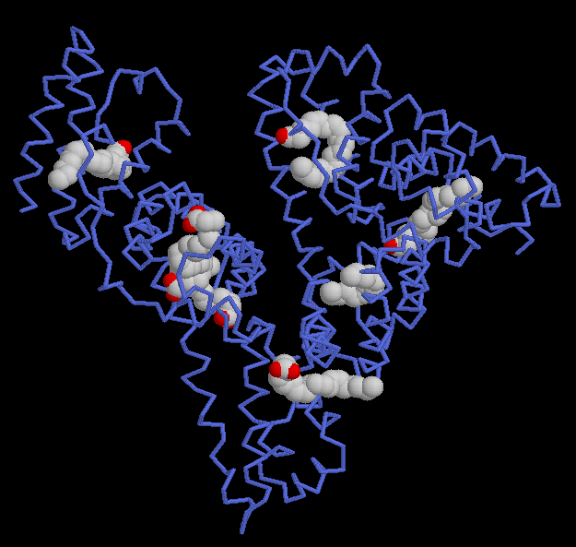

Slide 4
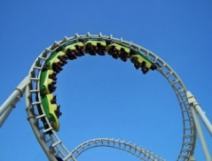
FUN FACTS
Largest concentration in the blood, accounting for roughly 55% of total serum protein content
Single polypeptide chain of 585 amino acids with a molecular weight of 66,500 Da
Synthesized in the liver at a rate of 12-25g/day
Travels through the circulation over 15,000x in its lifespan

Slide 5
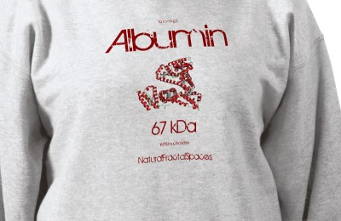
Concentration of Albumin
Synthesis
Degredation
Distribution

Slide 6
SYNTHESIS
Synthesis only takes place in the liver
No storage, immediately secreted by the cell
Process takes 30min
In healthy people rate of synthesis is about 13G/day
Liver can increase synthesis to only 2x normal
Nutrition and adequate nitrogen intake are essential for normal synthesis
Notes:
Liver increase to only 2x normal is because 50% of hepatocy activity is already devoted to albumin secretion

Slide 7
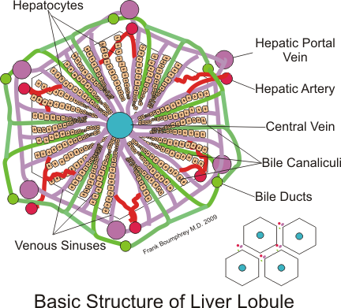
SYNTHESIS
Most important trigger is colloid osmotic pressure
Mechanism unclear
Osmoreceptors within the hepatic interstitial matrix
Hepatic vascular beds are different
  Larger capillary pore sizes
  Protein reflection coefficient of zero
Notes:
The combination of these two factors make the vascular beds permeable to molecules less than 620,00 Daltons

Slide 8
DEGREDATION
Degredation occurs in most organs
Mechanism even less understood than synthesis
Half-life 19 days (humans), 8.2 days (dogs)
Approximately 4% of total body albumin is degraded daily , but rate dependent on ALB concentration

Slide 9
DISTRIBUTION
Serum concentration is also affected by loss and exchange
Serum 30-40% of total body albumin, 60-70% is within interstitial space
Extravascular albumin can act as a reservoir
There is continuous exchange of albumin between the intracellular and extracellular spaces
  albondin receptors
Notes:
Major interstitial reserves located within the skin, muscle, liver, lung, heart, kidneys and spleen
Extravascular reservoir can replenish the intravascular pool during times of stress and acute loss
Receptors are both passive and active

Slide 10
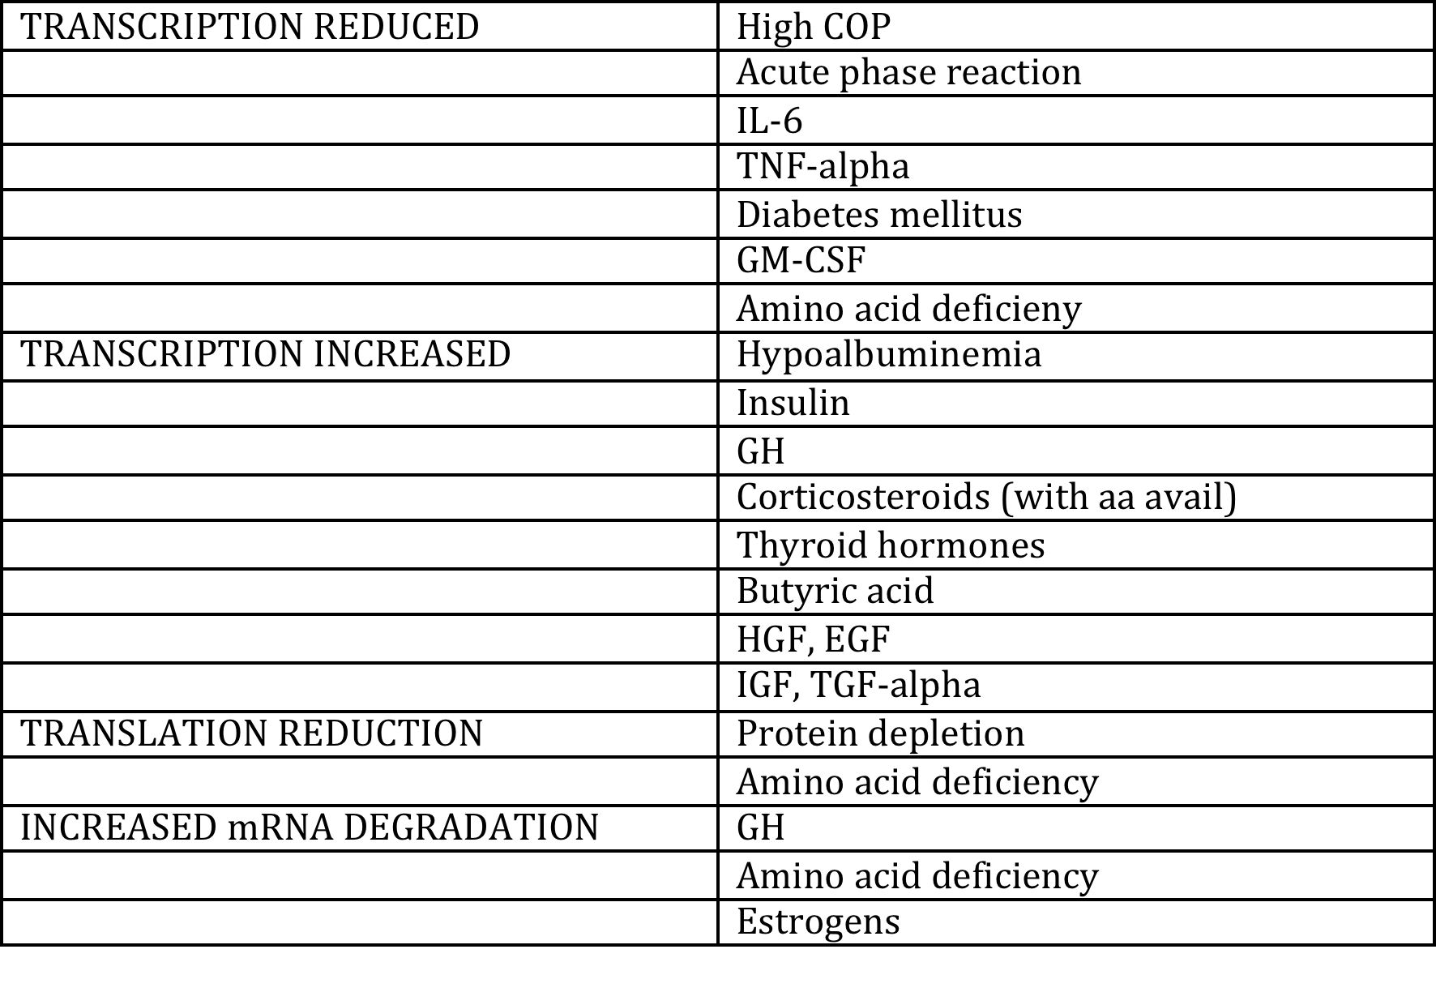
Regulation of Albumin

Slide 11
ROLES OF ALBUMIN
Maintenance of plasma oncotic pressure
Binding/transport of endogenous and metabolic compounds and drugs
Protection against exogenous toxins
Regulation of acid-base balance
Effects on blood coagulation
Maintenance of microvascular integrity and capillary permeability
Antioxidant effects
Wound healing

Slide 12
ONCOTIC PRESSURE
Pivotal role in fluid balance as it contributes up to 80% of the normal plasma oncotic pressure
2/3 results from a direct osmotic effect
1/3 results from the Gibbs-Donnan Effect
Each gram of albumin is capable of holding 18ml of water within the intravascular space
In critical illness relationship b/n albumin concentration and COP is less predictable

Slide 13
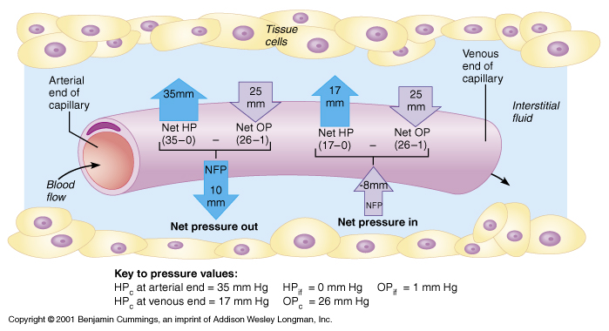
STARLING’S LAW
Fluid distribution is determined by a balance of forces
Starling developed an equation to describe this:
Net flow = [kf (P_{C} –P_{IF}) – σ(π_{C} – π_{IF})] –Q_{lymph}
Predicts that the amount of extravascular fluid flux will be inversely related to oncotic pressure
Notes:
Where kf = filtration coefficient, P is hydrostatic pressure, σ is pore size of the capillary membrane, and π is the colloid effect. Q is rate of lymph flow

Slide 14
GIBBS-DONNAN EFFECT
Large number of albumin molecules in circulation
Large net negative charge attracts cations (Na⁺)
Accumulation of ions draws water across semipermeable membrane
Effect contributes to water-holding property

Slide 15
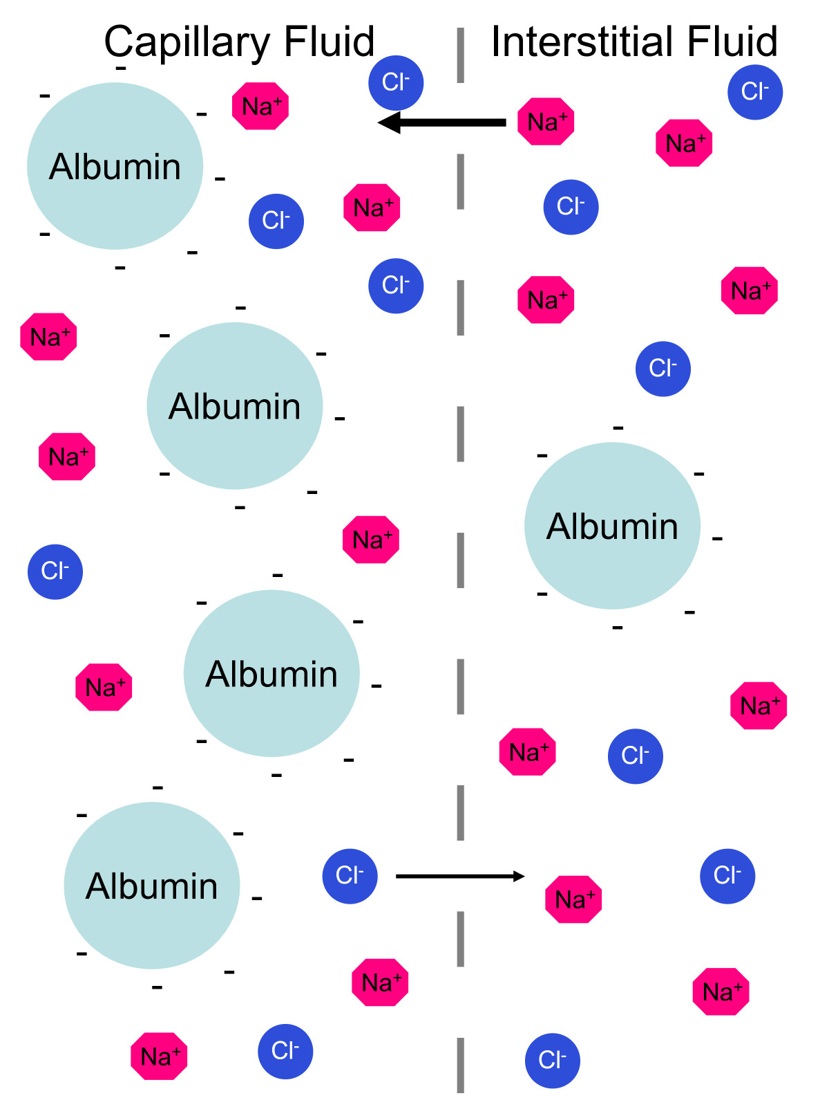
GIBBS-DONNAN EFFECT

Slide 16

CARRIER FUNCTION
Important carrier for many endogenous and exogenous substances
Most strongly bound compounds are hydrophobic organic anions: bilirubin, long chain FAs and hematin
Can also bind bile acids, eicosanoids, copper, zinc, folate, and NO
Role in transport for metabolism or elimination, storage reserve and regulation of the active concentration
Important transport functions in critically ill patients
Notes:
Transport of bilirubin, drugs and long-chain fatty acid anions are most clinically

Slide 17
BILIRUBIN
Bilirubin bound at the degradation sites of hemoglobin and then transported to the liver for hepatic conjugation prior to biliary excretion
Normally bilirubin binds exclusively to albumin
Loss of toxicity when bound
Competitive inhibition with drugs
Notes:
Loss of toxicicty:
increased circulating bilirubin levels and hypoalbuminemia potentiate toxic effects, including neurologic dysfunction, peracute encephalopathy, renal failure and death
no vet studies, newborns
Competitive inhibition:
hyperbilirubinemia, competition b/n drug and bili for same binding site can potentially increase free bilirubin concentration or displace the drug=side effects from each
drugs that compete NSAIDS, and warfarin

Slide 18
BINDING DRUGS
Secondary or tertiary carrier for hormones and vitamins
Multiplicity of binding sites, carries a variety of drugs
  Domain I: warfarin, salicylates, phenytoin, chlorpropamide, some penicillins
  Domain II: thyroxine, benzodiazepines, ibuprofen and ketoprofen
Controls the free fraction of drugs and may alter drug distribution, excretion, pharmacodynamics, and toxicity
Notes:
Hormones and vitamins: thyroxine and vitamin D
When albumin binding is subnormal, a reduced dose of drug should be utilized, not predictable however

Slide 19

Ikenoue N, Saitsu Y, et al. “Disease induced alterations in plasma drug-binding proteins and their influence on drug binding percentages in dogs.” Vet Q 2000; 22(1): 43-49
Investigated changes in ALB and α-1-acid glycoprotein levels in different disease states
% of drug bound decreased with decreases in albumin
This effect was seen with various NSAIDS, diazepam, and warfarin
Notes:
Higher circulating levels of drug, especially NSAIDS, up to 13fold increase

Slide 20
Drugs that bind Albumin
Cardiovascular
  Digitoxin
  Furosemide
  Hydralazine
  Propranolol
CNS Active
  Amitryptiline
  Chlorpromazine
  Thiopental
Antiseizure
  Phenobarbital
  Phenytoin
Anticoagulants
  Warfarin
Antibiotics
  Cephalosporins
  Penicillins
  Sulfonamides
  Tetracyclines
Anti-inflammatory
  Ibuprofen
  Phenylbutazone
  Salicylic Acid
Benzodiazepines
  Diazapam
Hypoglycemic agents
  Glipizide

Slide 21
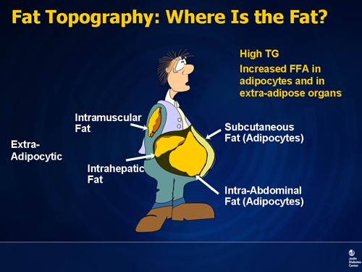
BINDING FFA
FFA bind to multiple sites on albumin
Binding makes FFAs less toxic
Lipemia and hyperlipidemia are common in patients with hypoalbuminemia
Hyperlipidemia has been implicated in pathology of ARDS
Notes:
Pathology of ARDS:
May injure the pulmonary endothelium alon with leukotriene and inflammatory cytokines

Slide 22
ACID-BASE EFFECTS
Contains histidine residues with an acid dissociation constant of 7.4 pKa
Allows albumin to act as an effective plasma buffer
Exhibits a positive charge during alkalosis or a negative charge during acidosis
On average, a decrease in albumin concentration of 1 g/dL may reduce the AG by 3 mEq/L and may increase plasma bicarbonate by 3.5 mM/dL

Slide 23

COAGULATION EFFECTS
Not fully defined, several theories
Antithrombotic:
  Related to NO binding inhibiting its inactivation and prolongation of platelet aggregation
  Binds aracidonic acid, limiting creation PGs
Anticoagulants effects:
  Heparin-like activity due to similarity in structure
  Has been found to enhance AT-III activity in vitro
Notes:
Remember PG cause latelet aggregation and thrombosis

Slide 24
MICROVASULAR INTEGRITY
Exact mechanisms not clear
May modulate the increase in capillary permeability during acute inflammation
Strong negative charge may succeed in repelling other negatively charged molecules
May have a space-occupying function that reduces the size of the endothelial channels
Experimentally shown to reduce microvascular permeability and inhibit endothelial cell apoptosis
Notes:
Experimental evidence: rat model of rat hemorrhagic shock and lung apoptosis (J trauma 2000), microvascular apoptosis inhibition by explants of albumin (Microvasc Res 1999)

Slide 25
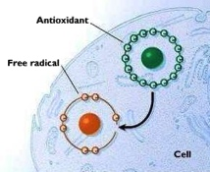
ANTIOXIDANT EFFECTS
Major extracellular source of sulfhydryl groups
Indirectly inhibits the production of oxygen free radicals
NO neutralization
In vitro studies:
  Reducing the oxidative burst and
  Reducing endothelial permeability
  Prevented reperfusion damage, ARDS
Direct scavenger of ROS, “sacrificial antioxidant”
Can bind iron
Notes:
Sulfhydryl groups: these possess potent fre radical scavenging activity and may also modulate the translational antioxidant response
Indirect inhibition: related to its binding capacity with either free copper or bilirubin, which takes out vitamin E
NO neutralization: vasodilation and increased production of ROS
CCM 2002: Horstick et al, albumin in hemorrhagic shock, statement 4
Scaventer: ROS and bacerial toxins resluting in the function destruction of the molecule
Iron: preventing iron dependant oxidizing events such as lipid peroxidation

Slide 26
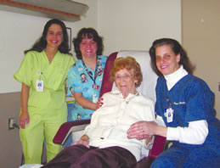
WOUND HEALING
Predominately thru carrier transport
  Zinc
  Amino acids
  Fatty acids
  Drugs
These substrates are needed for collagen cross-linking and membrane synthesis

Slide 27
HYPOALBUMINEMIA IN DISEASE
Decreased synthesis
Acute phase reaction
Leakage from the vasculature
Denaturation at sites of inflammation
Degradation due to toxin binding
Dilution secondary to fluid therapy
Notes:
Decreased synthesis: inadequate nutrition, inadequate intracellular K, exposure to toxins, declining liver function, Gi malabsorption or secretory diarrhea
Acute phase: preferential synthesis of acute phase proteins ie C-reactive protein, Mannose-binding protein, complement factors, ferritin, ceruloplasmin, Serum amyloid A and haptoglobin
Leakage: inflammation leads to change in vascular permeability

Slide 28
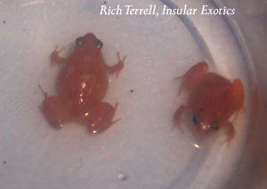
DISEASES KNOWN TO
DECREASE ALBUMIN
Sepsis, SIRS
Burns
End-stage hepatic failure
PLE/PLN
Nephrotic syndrome
Gastroenteritis
Pancreatitis
Pyometra
Peritonitis
Pleuritis

Slide 29

CONSEQUENCES
Decreased COP
Edema
Poor wound healing
Gastrointestinal
Hypercoaguability
Systemic organ dysfunction
Notes:
Gastrointestinal, delayed gastric empting, ileus, delayed healing
Extravascular lung water has been correlated directly with survival with increased volumes being an independent predictor of mortality in human patients across all diagnostic groups!!!

Slide 30
ALBUMIN AND PROGNOSIS
A clear and direct dose-dependent association b/n hypoalbuminemia and mortality has been shown in diverse clinical situations
Serum levels < 2.0 g/dL positively correlated with increased morbidity and mortality
Critically ill patients has a strong prognostic value for mortality:
  Each 10g/L decline in serum albumin concentration raises the risk of morality by 137%, morbidity by 89%
  Vincent et al (Ann Surg 2003; 237:319-34)
Notes:
In addition it prolonged intensive care and hospital stay by 28% and 71%. This was independent of nutritional status and inflammation
Meta-analysis of 90 cohort studies with 291, 433 patients documented above

Slide 31
ALBUMIN USE IN HUMANS

Slide 32
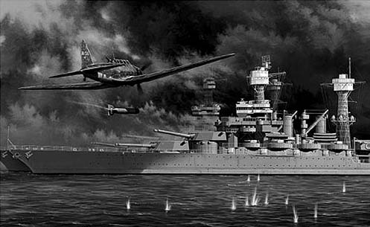
HISTORICAL USE
First used in 1941 in 7 patients who had been severely burned during the Japanese attack on Pearl Harbour
After WWII it became the main therapeutic modality for curing hemorrhage and trauma injuries

Slide 33
RESUSCITATION?
Cochrane report 1998: meta-analysis of 32 randomized trials, revealed that treatment with albumin was associated with a higher risk of mortality in critically ill patients
Second meta-analysis 2001: 55 trials, 3504 patients, showed that albumin was safe but did not affect overall mortality
Meta-analysis 2003: demonstrated a trend towards reduced morbidity. Significant inverse relation b/n complication rates and albumin levels
Notes:
Meta 2003, if a level of 30G/l was achieved there were significantly less complications

Slide 34

SAFE STUDY
The Saline versus Albumin Fluid Evaluation Study
Prospective randomized double blind clinical trial, 7000 patients
No significant differences between groups were found in terms of mortality,
Patients with severe sepsis showed a trend toward prolonged survival,
Patients with brain injury showed a trend toward increased morality
Clinical conditions likely to play a relevant role in the choice of fluid for resuscitation
N Eng J Med 2004; 350: 2247-56

Slide 35
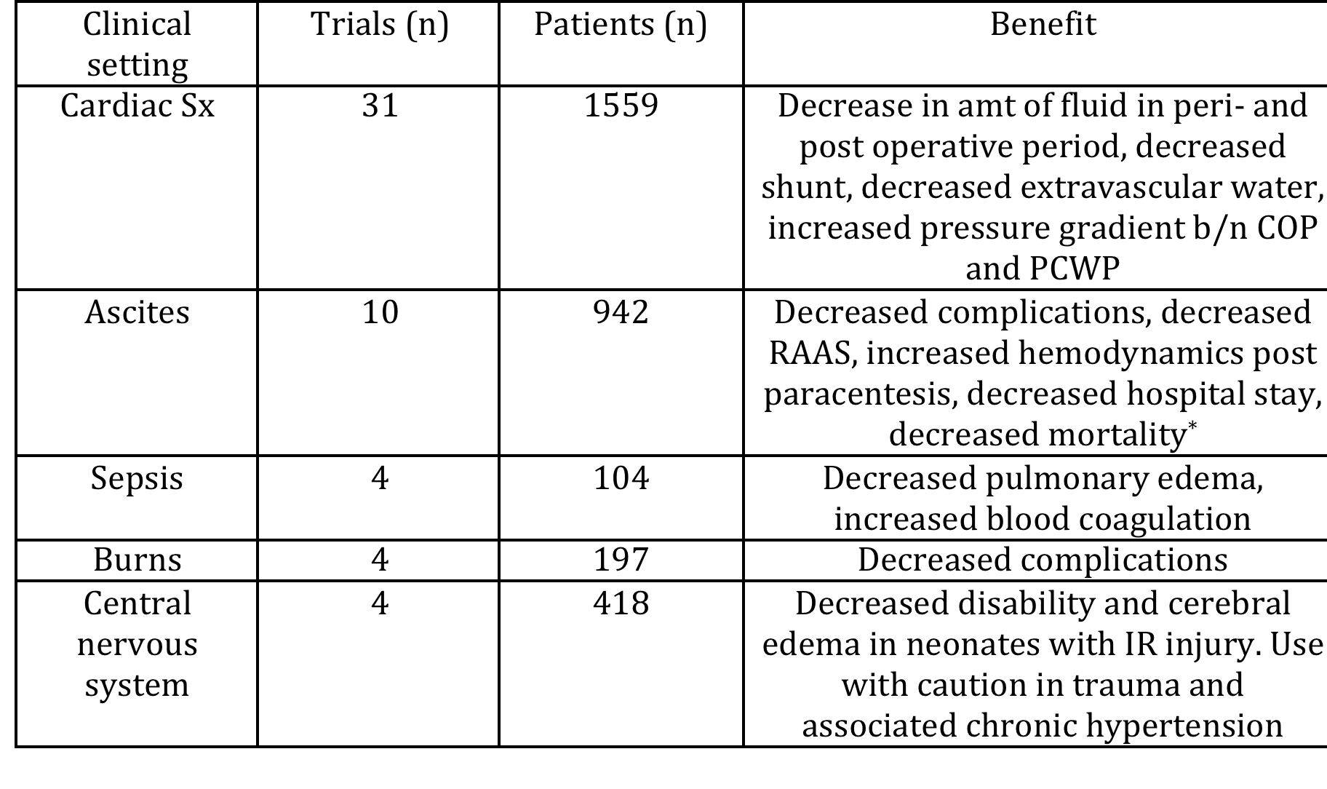
OTHER INVESTIGATION
Gattinoni et al, AIM publishing 2010

Slide 36

ALBUMIN AND ALI
Martin et al. “Albumin and furosemide therapy in hypoproteinemic patients with acute lung injury.” Crit Care Med. 2002; 30: 2175-2182
Martin et al. “A randomized, controlled trial of furosemide with or without albumin in hypoproteinemic patients with acute lung injury.” Crit Care Med. 2005; 33(8):1681-1687
Notes:
Trial 1: administration of 25% HSA and furosemide significantly reduced pulmonary edema and improved outcome in SIRS patients
Trial 2: Albumin treated patients had greater increased in oxygenation, serum total protein and net fluid loss throughout the study period. Fluid bolus administration to control patients reduced net negative fluid balance, control patients more frequently developed hypotension and had fewer shock-free days, which translated to differences in organ failure at the end of the study

Slide 37

ALBUMIN USE IN SMALL ANIMALS

Slide 38

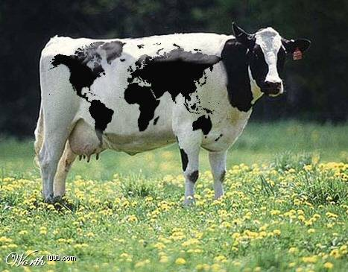

PRODUCTS AVAILABLE
Plasma
Human
Bovine
Canine

Slide 39
PLASMA
Canine plasma on average contains 25-30 g/L albumin, requiring large volumes to supply a conservative amount
Approximately 22.5ml/kg of plasma is required to increase plasma albumin 0.5g/dL
Formula:
ml of plasma needed = desired TS - measured TS (g/dL)x WT (kg)x 50/donor TS (g/dL)
(assumes that albumin is roughly equal to ½ of plama TS)

Slide 40
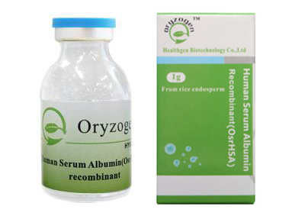
HSA
Bottled 25% HSA, stored at room temperature, long shelf-life
Vented delivery set is required
Contains no preservatives, manufacturer warns against administration of the solution for up to >4hrs b/c of potential for bacterial contamination
Goal of administration:
  Increase albumin to 2.0-2.5 g/dL
  Increase COP to 14-20 mmHg

Slide 41
HSA
Protocol for calculating dosage to administer:
ALB deficit=10 x (ALB_{desired} - ALB_{patient}) x Wt (kg) x 0.3
Recommendation for a 10% solution, diluted with saline
Monitor closely for signs of a reaction
Additional dosage of HSA after 7 days is contraindicated

Slide 42
Mathews et al. JVECC 2005, 15(2);110-18
Retrospective, 66 animals, Ontario Vet College, June 1997-2001
25% albumin administers as bolus, slow push or CRI
Indications generally included no response to other colloidal products, further improvement needed for BP, or oncotic support
14 dogs with PLE received perioperatively
Notes:
Maximum volume delivered was 25ml/kg, mean was 5ml/kg
-Max vol as slow push or bolus was 4ml/kg, mean was 2ml/kg
-Range for CRI was 0.1-1.7ml/kg/hr over a range of 4-72hrs

Slide 43
Mathews et al. JVECC 2005, 15(2);110-18
71% of animals survived until discharge, after an average 5d after transfusion
5 animals died during or within 18hrs after transfusion
Significant increase in serum albumin, total solids and BP in all groups
pleural and abdominal fluid accumulations, pulmonary and SQ edema were noted to improve following HSA
Notes:
All animals that died close to the transfusion had conditions that were deteriorating including severe sepsis, DIC

Slide 44
Trow et al. JAVMA Aug 2008, 233(4); 607-12
Retrospective case series, 73 client owned dogs, Jan 03-June 06
HSA dilute from 25% to 10%,
Dosage based on calculated deficit or 2-5ml/kg
Septic peritonitis, most common diagnosis
64% also received blood products

Slide 45
Trow et al. JAVMA Aug 2008, 233(4); 607-12
Albumin concentration, TS and COP were all significantly higher following treatment
49.3% of patients did not survive
Compared with non-survivors, serum albumin and TS in survivors were significantly higher after administration of HSA
Magnitude of improvement after HSA for albumin, COP and TS was also significantly higher in survivors
Median dosage administered was higher in survivors

Slide 46
Trow et al. JAVMA Aug 2008, 233(4); 607-12
Variables associated with survival
dosage
post-HSA administration albumin concentration
magnitude of serum albumin increase
post-HSA administration total solids
magnitude of increase in total solids
magnitude of increase in COP

Slide 47
ADVERSE EFFECTS
human safety: spontaneous reported serious adverse events, only 123 serious adverse events occurred in 95 million 40G doses administered
2 reports of adverse effects with healthy dogs received HSA infusions
  Francis et al. “Adverse reactions suggestive of type III hypersensitivity in 6 healthy dogs given human albumin.” JAVMA 2007, 230(6); 873-79.
  Cohn et al. “Response of healthy dogs to infusions of human serum albumin” AJVR June 2007, 68(6); 657-663

Slide 48
Francis et al. JAVMA April 2007
Investigative clinical trial, 6 dogs, Washington State University
Single dose (2ml/kg) of 25% HSA administered over 1 hr
1 dogs developed immediate hypersensitivity reaction: vomiting and facial edema, stopped immediately, only received .5ml/kg over 15min
All 6 dogs had signs of delayed adverse reaction 5-13 days later. Signs: lameness, edema, cutaneous lesions indicative of vasculitis, vomiting, inappetance, ecchymoses, depression, lymphadenopathy, diarrhea, hematemesis, pruritus, temporalis and masseter muscle atrophy.

Slide 49
Francis et al. JAVMA April 2007
4/6 dogs did not require hospitalization and responded to treatment with steroids and benedryl, GI protectants and pain meds
2 dogs that died, diagnostics consistent with AG-Ab deposition.
Anti-human albumin antibodies were confirmed in all 6 dogs with ELISA, peaked 2-4 weeks post administration
Reviewed hospital records (2001 -2005), 92 patients that had received HSA, 5.7% developed acute hypersensitivity, one developed delayed hypersensitivity
Notes:
histopathology showed fibrinoid degeneration and necrosis of many vessels. Electron microscopy of glomeruli were consistent
No solution contaminants, cultured negative, no reported reactions in people, also evaluated for contaminants-only found lactoferrin in trace amts

Slide 50
Cohn et al. AJVR June 2007
25% HSA given to 9 healthy dogs, 1-2 times
3/9 acute reaction, including hypertension, facial edema, urticarial, distal limb edema, pruritis, vomiting and diarrhea.
2/9 delayed reaction, 6-7 days post infusion
Anaphylactic reaction in 1/9 acute reactions and 2/2 with 2nd infusion

Slide 51
Cohn et al. AJVR June 2007
Biochem showed decreased platelets, globulins and cholesterol, increased TS/ALB/COP, T-bili, and calcium
All dogs developed anti-HSA antibodies, none present before transfusion
Conclusion: risk of life-threatening adverse reactions to HSA infusion in healthy dogs

Slide 52
ADVERSE EFFECTS IN CLINICAL TRIALS?
MATHEWS et al:
Facial edema was observed during 2 dog transfusions
2 animals had repeated transfusions several months apart, no adverse reactions noted during transfusion. However, delayed effects could not be assessed as both dogs were euthanized within 2 days
TROW et al:
27% of dogs had at least 1 complication that could potentially be related HSA infusion (3 delayed, 17 acute)
Fulminant anaphylaxis was not recorded.
Development of a complication was not associated with outcome or length of hospitalization.
Dogs that developed complications has lower PCVs and had received a lower amount of crystalloids

Slide 53
BOVINE
Closer in structure to the canine molecule
Readily available and more cost effective
Mosley et al. Vet Anaesth Analg. 2005; 32: 14-15
  1/10 acute reaction
  2/2 administered second dose, no acute reaction, 14d later had delayed reaction (1 severe anaphylactic)
  6/10 had delayed type III reaction roughly 15days after, although all recovered.
  Researchers concluded must have had previous exposure, not suitable therapeutic option for use in dogs

Slide 54
POSSIBLE MECHANISM FOR BOVINE REACTION
Fetal bovine serum is used as a nutrient source for cell cultures used in manufacture of canine vaccines, and large amounts of BA and bovine IgG have been shown to be included in monovalent and multivalent vaccines for dogs (may also explain reaction to HSA)
Atopic dogs and dogs with GI disease found to have significantly higher concentrations of IgG against various food antigens, including beef

Slide 55

CANINE
Lyophilized 5 G bottle, no preservatives
Should be refrigerated until time of use
Should be diluted with 0.9%NaCl, Norm-R or D5W
Do not dilute with sterile water
Once rehydrated, must be used within 24hrs
Contraindicated in patients predisposed to volume overload, severe anemia, severe dehydration, and those who have had reaction to administration

Slide 56
CANINE ALBUMIN DOSING
5-6 ml/kg (16% dilution)
Maximum to be administered is 2 G/day
Isotonic dilution is recommended, 4:1 dilution
Concentration | Amount of Diluent
5% | 100ml
10% | 49ml
16% | 30ml

Slide 57

SAFETY
Safety trial conducted by drug company
Normovolemic, healthy beagles
Administered albumin once a week for 4 weeks
No acute or delayed reactions were seen
Dogs were evaluated for 5 weeks

Slide 58
CANINE ABSTRACTS
Craft et al: “The effect of transfusion with canine specific albumin in dogs with septic peritonitis”
  CSA given to dogs with septic peritonitis at 800-884mg/kg over 6hrs
  6 dogs enrolled
  A significant difference was noted between pre and 2hr post transfusion albumin concentrations, pre and 2hr post transfusion COP and 24 hr measures of both albumin and COP.
  No immediate hypersensitivity reactions were noted
  2 dogs survived until discharge, no delayed hypersensitivity in those dogs at 6 weeks

Slide 59
CANINE ABSTRACTS
Craft et al: “Evaluation of the use of lyophilized canine specific albumin in dogs with septic peritonitis”
  Prospective, randomized non-blinded clinical trial
  8 patients with both septic peritonitis and hypoalbuminemia
  serum albumin and systolic blood pressure increased significantly in the transfused group, but no difference in albumin or COP measurements was noted between groups
  6 patients survived until discharge, no hypersensitivity was noted

Slide 60
CONCLUSIONS
Main secretory protein synthesized by the liver, but has many other important functions besides maintaining oncotic pressure
Hypoalbuminemia is associated with higher mortality in a dose-dependent manner
No definite conclusions can be drawn about the use of albumin in critically ill patients
HSA appears to be relatively safe in critically ill patients, but can cause life-threatening effects in healthy animals
CSA may be a safe alternative, but more research is needed

Slide 61
QUESTIONS?

