Slide 1

Demonstration Plant
Spring, 2012
Muhammed Abdul-Shakoor, Thalia Aoki, Sahana Balaji, Miree Eun, Tim Hui, Diana Kelterborn, Meena Selvanathan

Slide 2
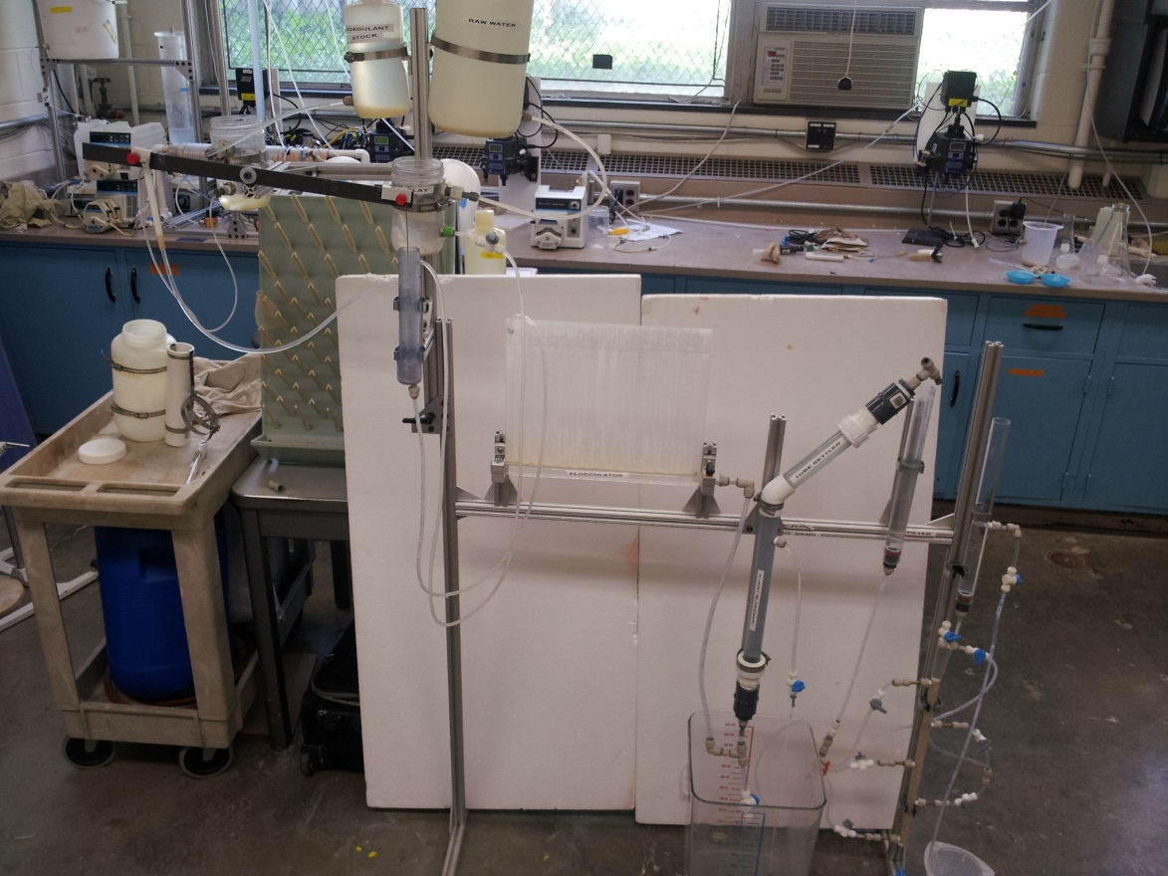

Introduction
Simple hands on demonstration
Educational tool
Vital role in contributing to the growth of the AguaClara technologies

Slide 3
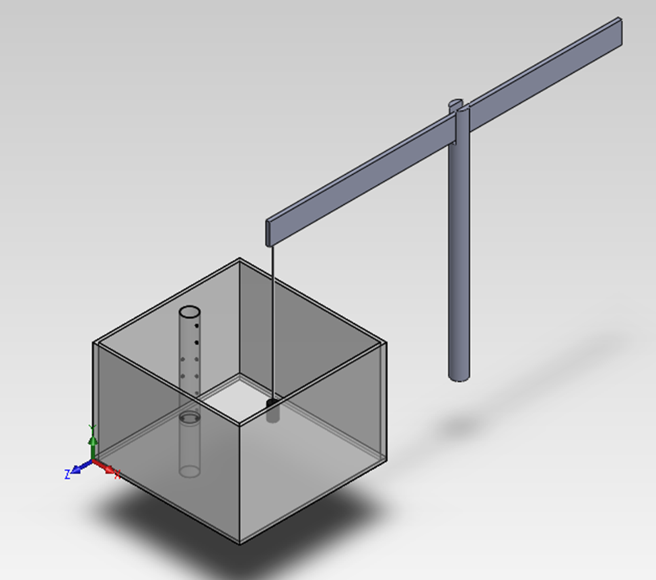
Dose Controller: Previous Designs
Specification
  Linear relationship between the water height and the dose rate
Fabrication
  Surface Tension, hole sizes, applicability at DP scale
Notes:
Update the information on this slide based on the DemoPlant description paper.

Slide 4
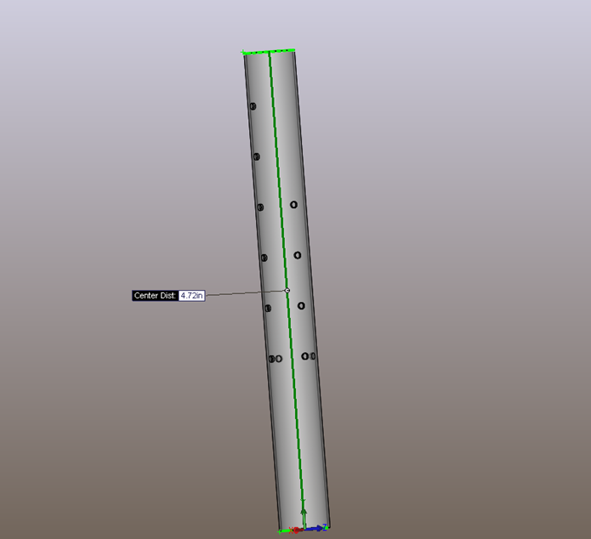
LFOM
  Mimic the Sutro weir using a pattern of holes that are easily machined
  Achieve a linear relationship between water depth and flow rate
MathCad Design
  Inputs (Flow rate, Height, Number of Rows)
  Outputs(Number of holes per row, orifice diameters, pipe diameters.

Slide 5
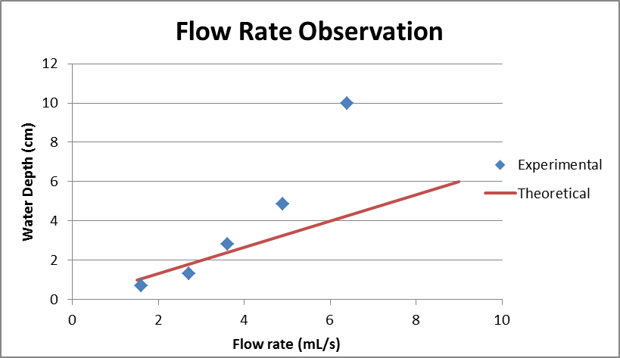
LFOM vs Lam Flow Pipes
Educational use
Measures flow rate
More approximate for lower flow ranges
Actual calculated flow rate: 48 mL/min
Ultimately failed at DP scale

Slide 6
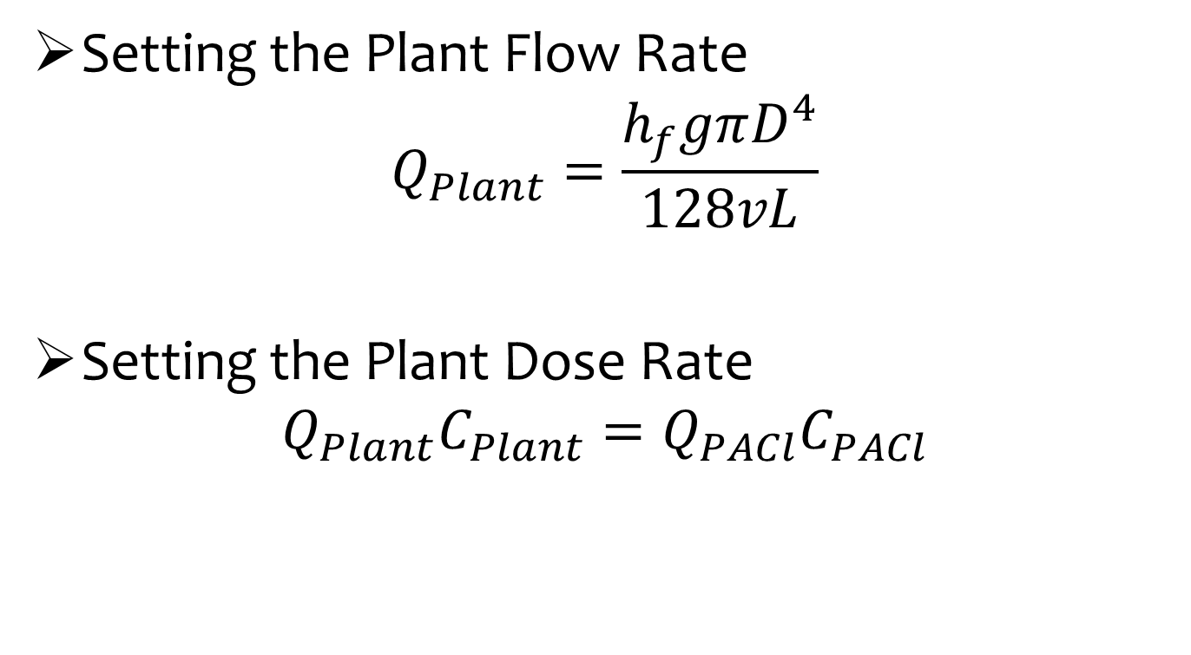
Dose Control Calculations
Setting the Plant Flow Rate
$$Q_{Plant}=\frac{h_{f}gπD^{4}}{128vL}$$
Setting the Plant Dose Rate
$$Q_{Plant}C_{Plant}=Q_{PACl}C_{PACl}$$

Slide 7
Flow Rate/Dose Control System
Constant Head Tank
(Raw Water)
Constant Head Tank
(Alum)
Δh₂
Δh₁
No Flow

Slide 8
Flow Rate/Dose Control System
Constant Head Tank
(Raw Water)
Constant Head Tank
(Alum)
Δh₁
Δh₂
Full Flow

Slide 9
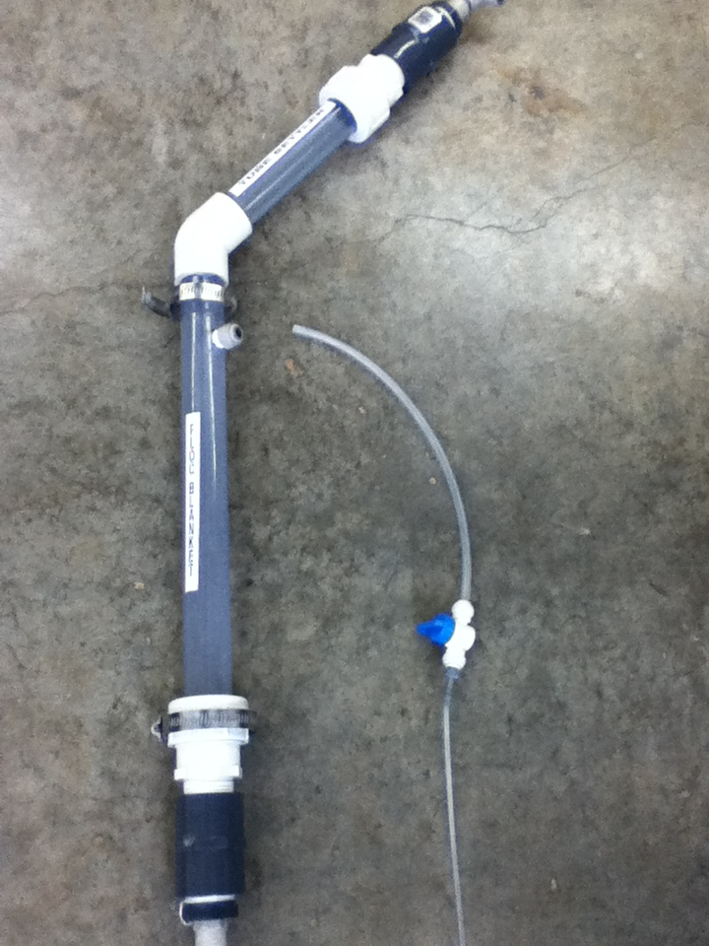
Sedimentation Tank
Create a new sedimentation tank
  Floc blanket
  Tube settler

Slide 10
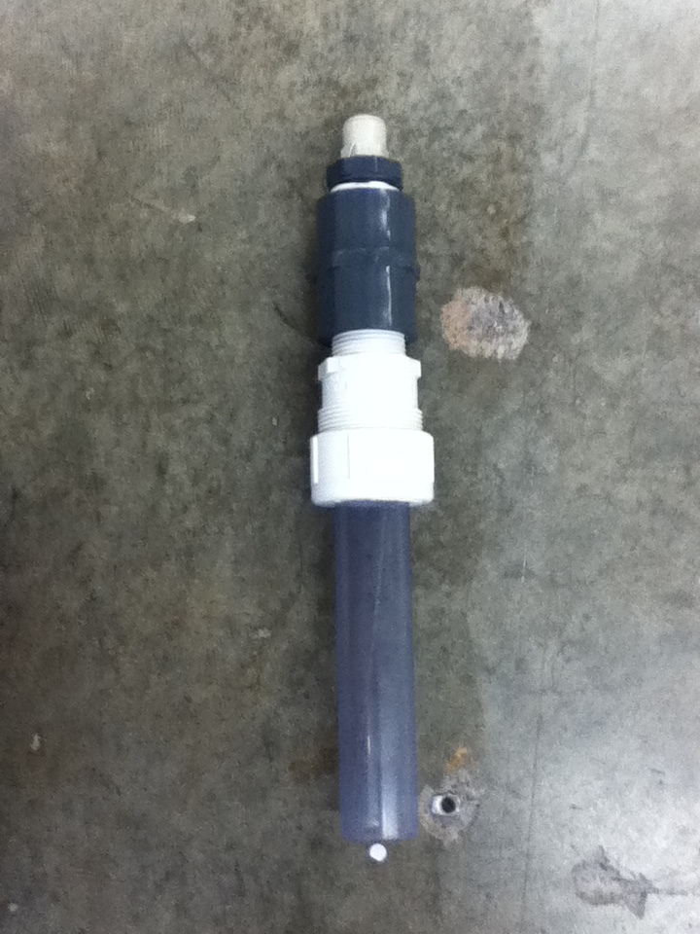
Design
Based on 1131, simple design approach

Slide 11
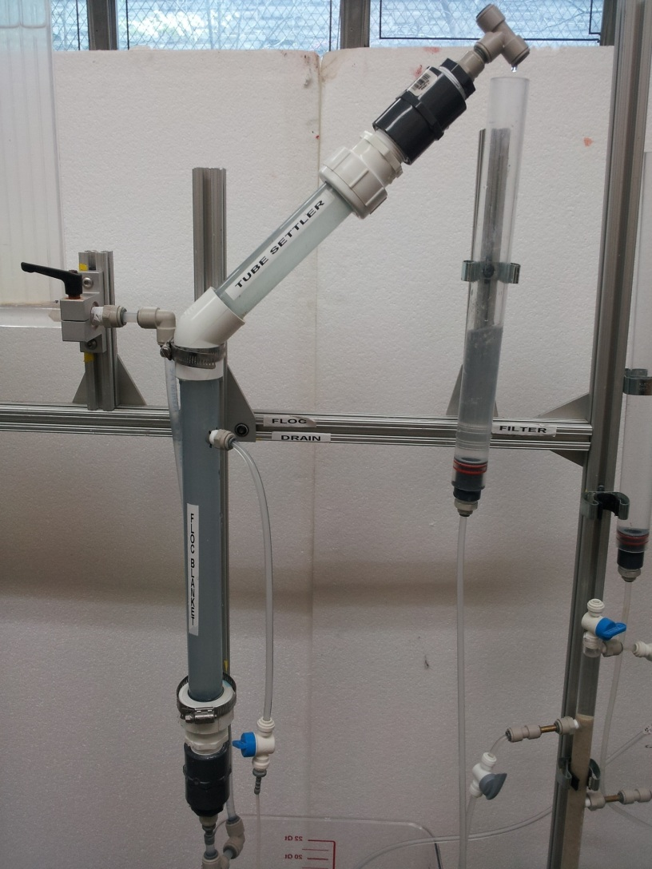
Final Sedimentation Tank

Slide 12
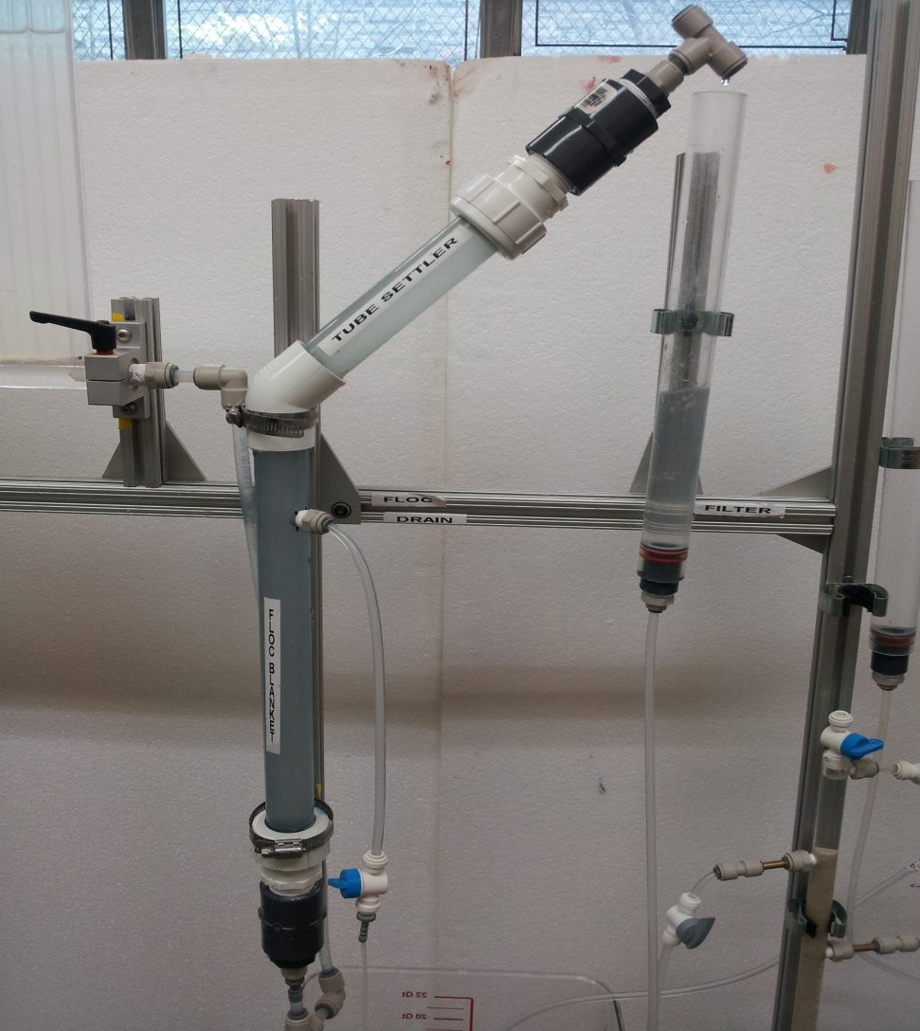
Sedimentation Tank Features
Column builds floc blanket

Slide 13
Sedimentation Tank Features
Column builds floc blanket
Funnel-shaped fitting collects settled flocs

Slide 14
Sedimentation Tank Features
Column builds floc blanket
Funnel-shaped fitting collects settled flocs
Floc drain siphons off large flocs

Slide 15
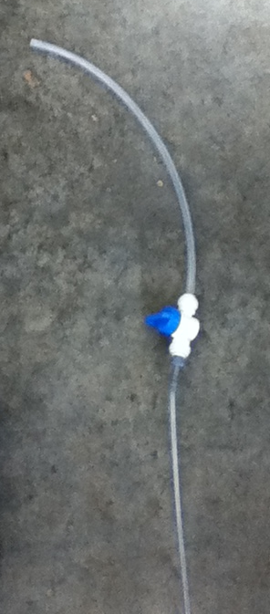
Sedimentation Tank Features
Column builds floc blanket
Funnel-shaped fitting collects settled flocs
Floc drain siphons off large flocs

Slide 16
Sedimentation Tank Features
Column builds floc blanket
Funnel-shaped fitting collects settled flocs
Floc drain siphons off large flocs
Tube settler captures small particles

Slide 17
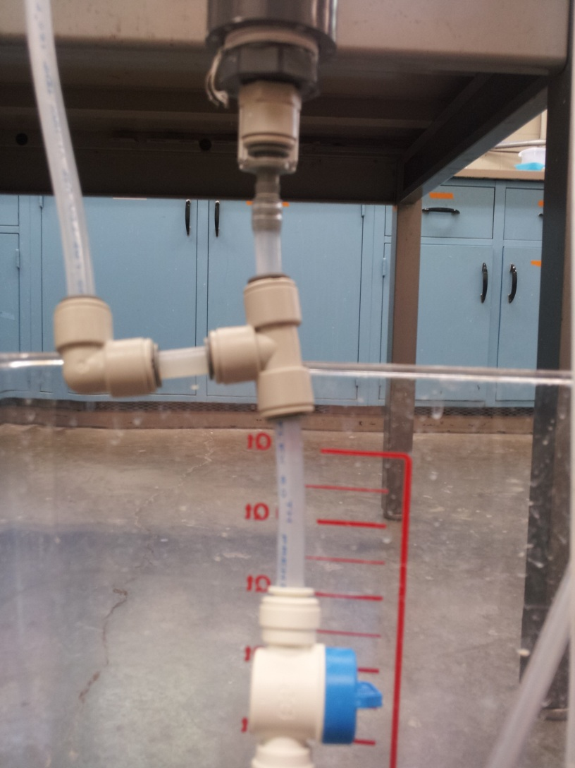
Sedimentation Tank Features
Column builds floc blanket
Funnel-shaped fitting collects settled flocs
Floc drain siphons off large flocs
Tube settler captures small particles
Emergency floc drain sends excess flocs to waste

Slide 18
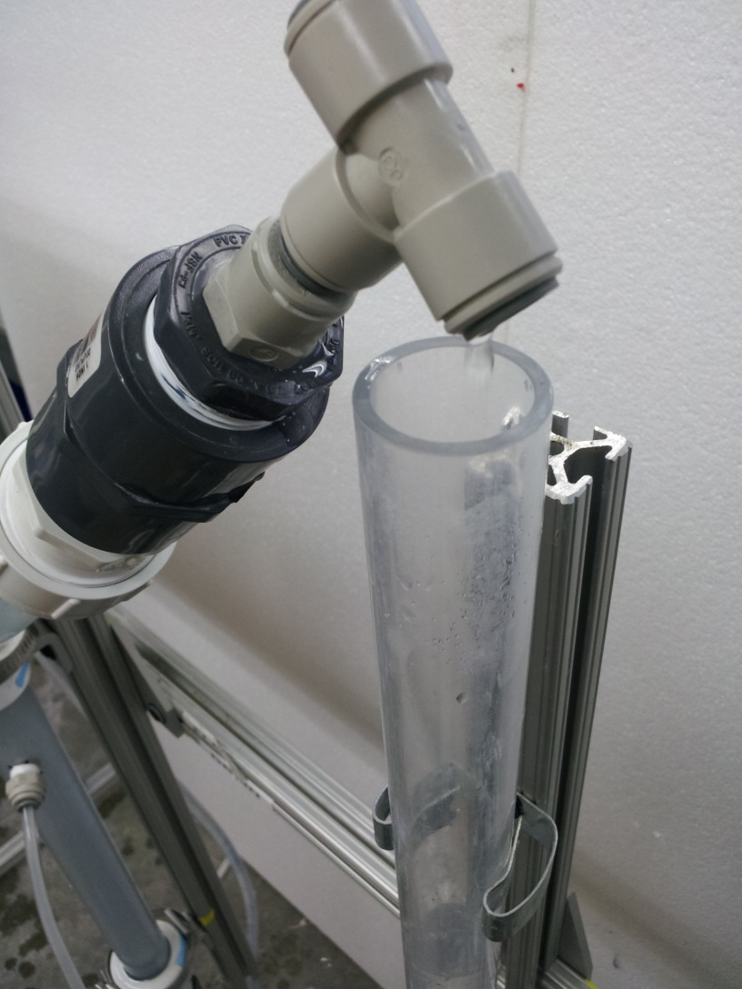
Sedimentation Tank Features
Column builds floc blanket
Funnel-shaped fitting collects settled flocs
Floc drain siphons off large flocs
Tube settler captures small particles
Emergency floc drain sends excess flocs to waste
Drop tube creates new free surface

Slide 19
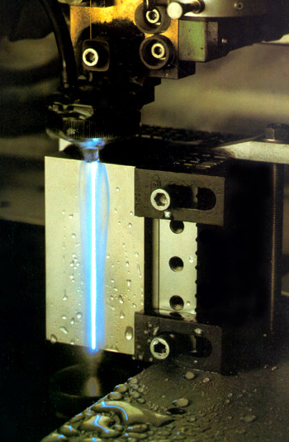
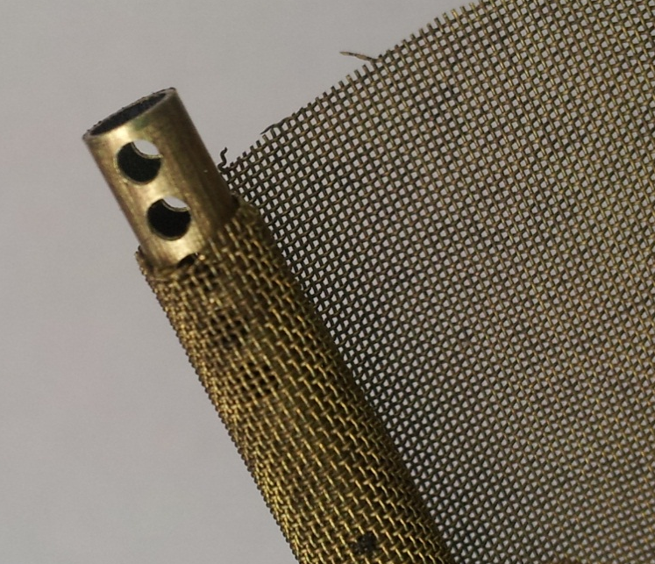
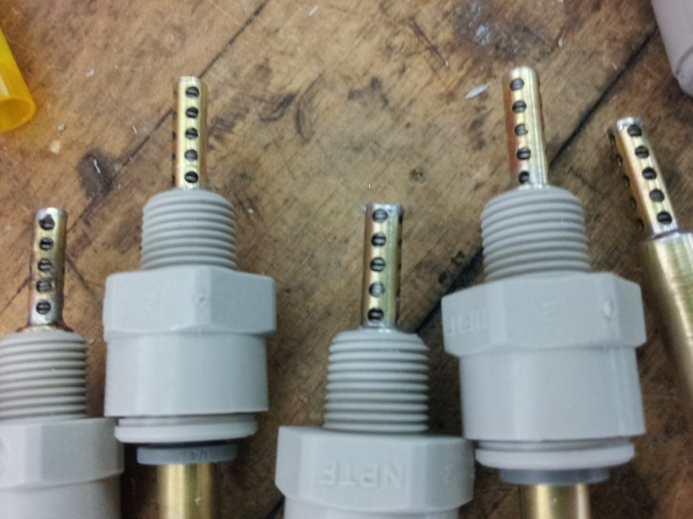
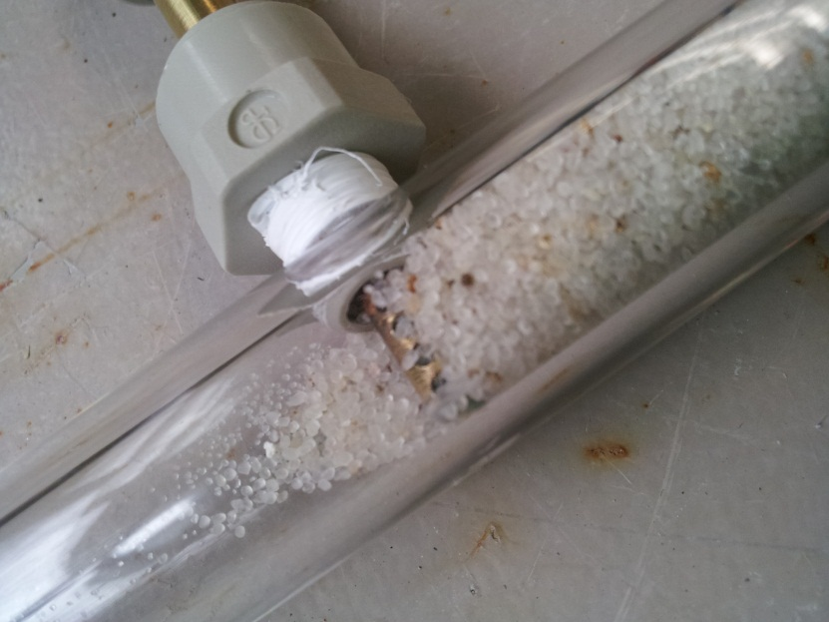
SRSF Fabrication Challenges
Acrylic vs. PVC pipes
  Higher transparency and more accurate ID size of acrylic pipes are advantageous for DP
  Acrylic pipes are more brittle → more difficult to drill holes for distribution pipes
Fabrication of “Slotted” pipes
  1/2” long portion of 3/16” ID pipes
  Minimum width of 0.2 mm (0.0079”)
  Watertight connections required
  Proposed Solutions?
    WireEDM machine in Clarks Hall
    Wire mesh wrapped pipes
    Pipes with compressed springs in them!!

Slide 20
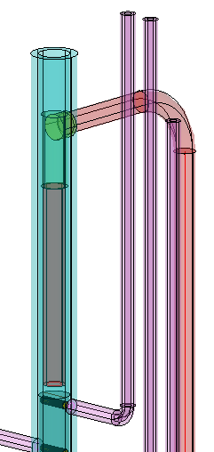
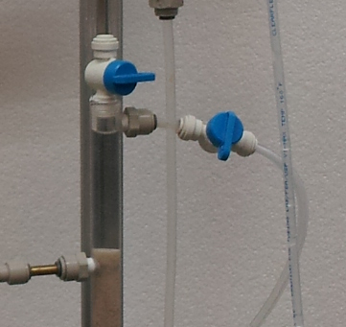
Adjustments Made
Replaced backwash siphon with manual valves and eliminated the inlet box

Slide 21
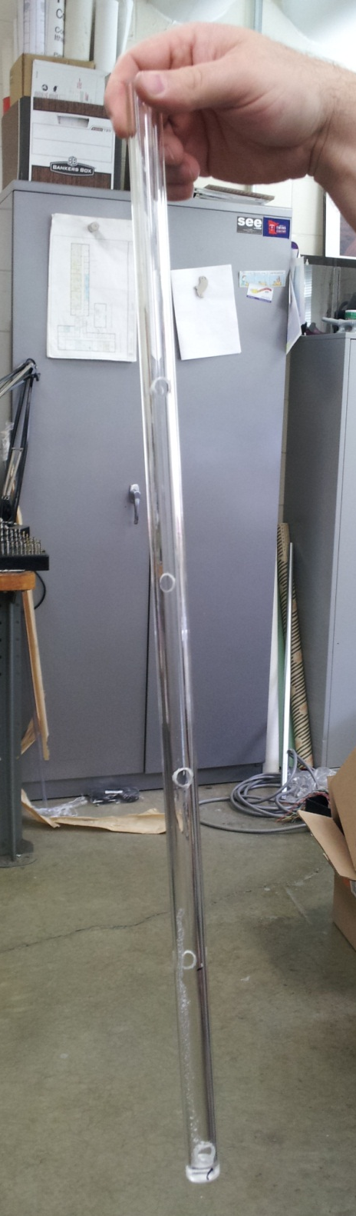
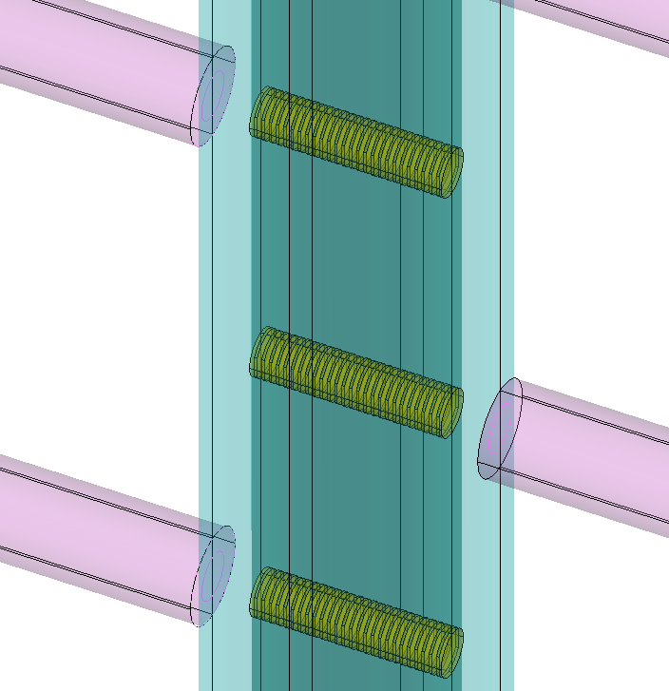
Adjustments Made
Sand layer thickness changed from 2 cm to 10 cm
10 cm

Slide 22
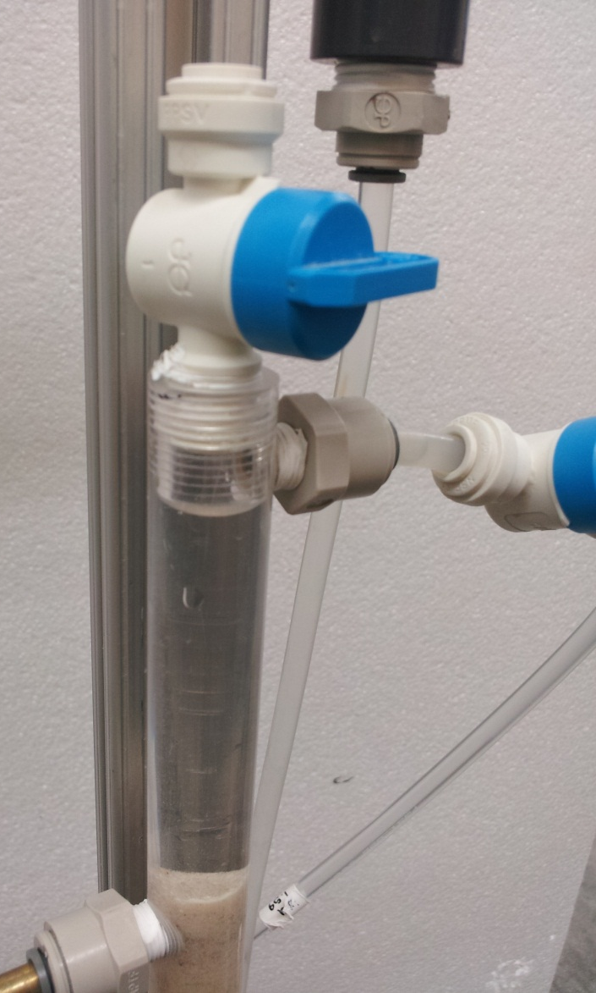
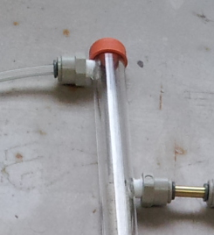
Adjustments Made
Replaced rubber stopper with manual threaded valve

Slide 23
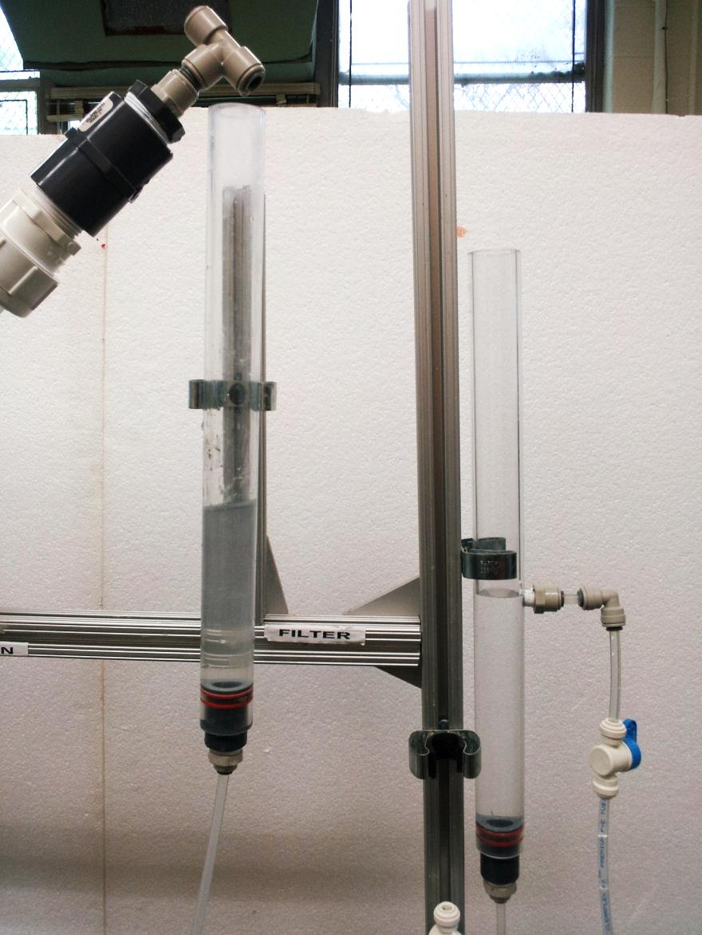
Adjustments Made
Added drop tube before the filter and clear well after it

Slide 24
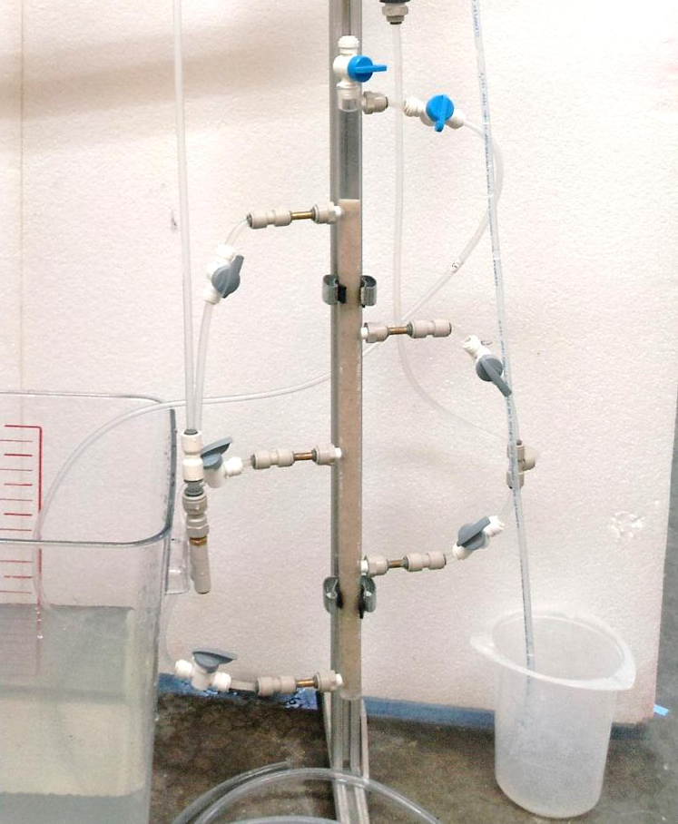
SRSF Results (1)
Valve for air bubbles
Backwash valve
3/4” OD
1/2” ID clear acrylic pipe
Sealant
(Teflon tapes)
1/4” Flexible
3 Inlet tubing
1/4” Flexible
2 Outlet tubing
1/4” to 1/4”
3-way connectors
Effluent water
3/16” Brass pipes
with compressed
springs

Slide 25

SRSF Demonstration
Filtration mode to Backwash - Fluidization

Slide 26
SRSF Demonstration
Filtration mode to Backwash - Watergap

Slide 27
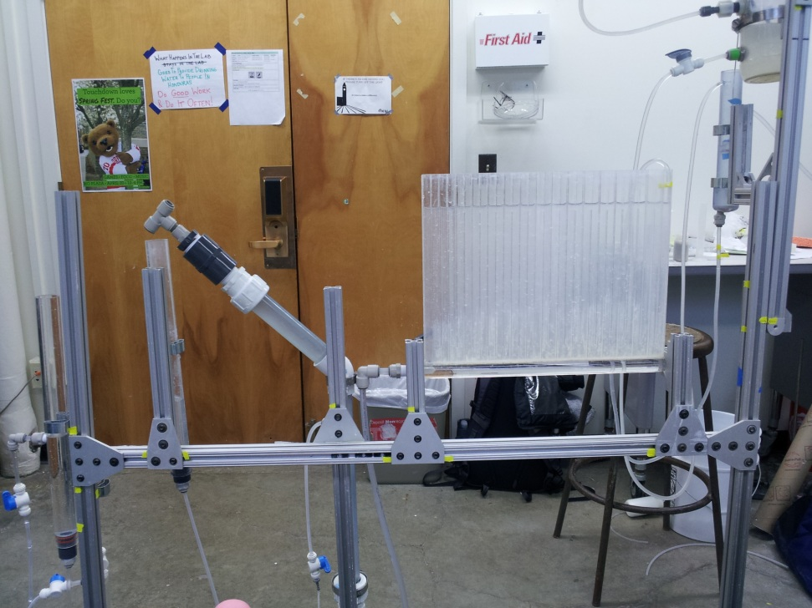
80/20 Aluminum Frame
Water flow rates and heights
Visibility of processes
Clarity to lay-person
Compactness
Ease of construction and operation
Ease of modification

Slide 28
Documentation
Consolidated MathCAD file
  Design calculations
  Headloss calculations
User’s Manual
  Catalogue of different parts
  Construction and operation instructions

Slide 29
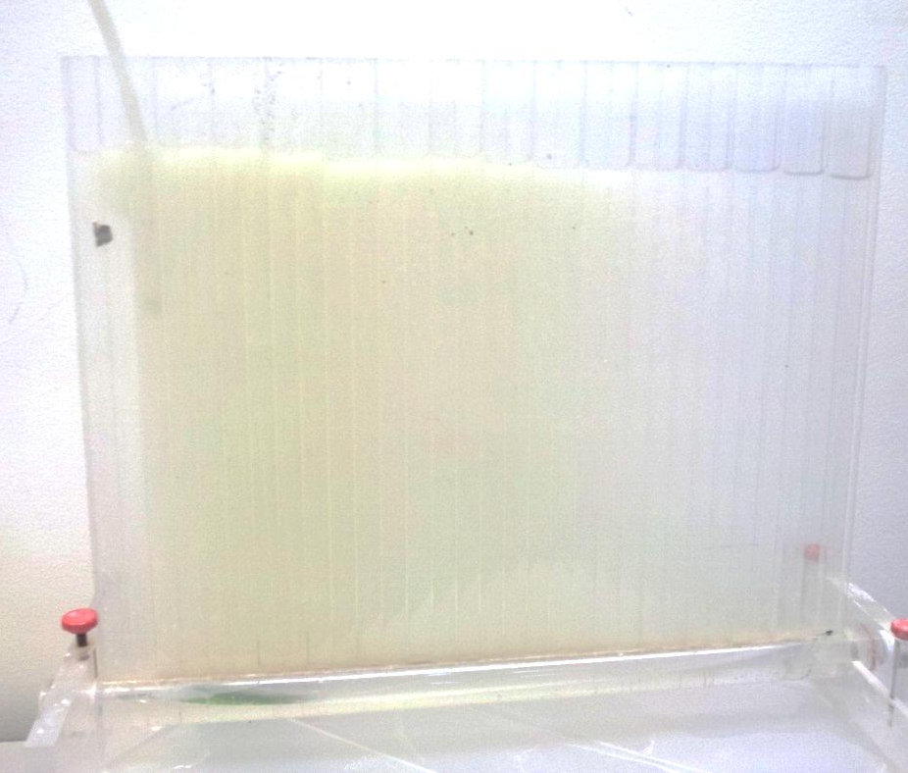
Future Work
80/20 Frame
  Improved buckets, labels
  More compact frame
  Smaller pieces, hinges, wheels
  Duplication
Flocculator
  Floc drainage pipe for flocculator OR Redesigning flocculator with U-shape bottom

Slide 30
Future Work
Sedimentation Tank
  Modify sedimentation tank geometry to eliminate emergency floc drain (influent jet)
  Adjust floc weir for better drainage and simpler operation
SRSF
  Improvement on fluidization of SRSF bottom sand layer
  Replacement of SRSF acrylic column with PVC pipe or fabrication of SRSF protective case for easy mobilization
  Fabrication of an extra “slotted” pipe
  Repositioning of SRSF column

Slide 31
Thank you!

