Slide 1

Demo Plant Team
Susan Chen, Owen Guldner, and Diana Kelterborn

Slide 2

Introduction
Important educational tool
Used at Cornell for outreach
Used in Honduras to teach operators
Last semester:
  A sedimentation tank and a SRSF were added
  Plant was put on an 80/20 frame

Slide 3
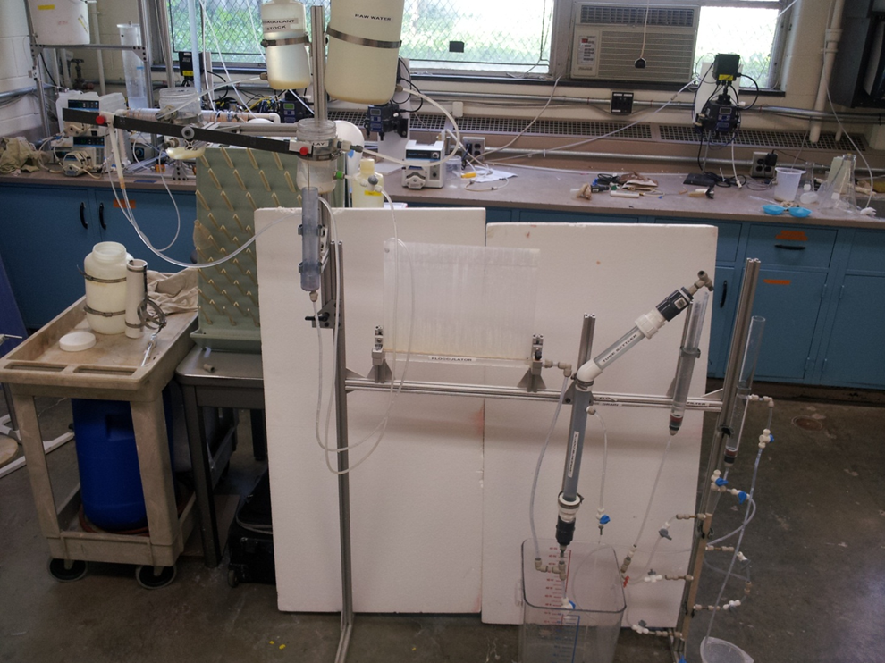
Objectives
Improve the chemical doser so it works without having to move counterweight
Adjust the filter so all the layers reliably backwash
Improve overall plant layout

Slide 4
Plant Layout
Constraints
  Sit on a table
  Easily assembled and disassembled
  Professional and neat appearance
  Displayed in order to be easily seen and understood
  Less than six feet tall
  Still many ways to organize the plant…

Slide 5
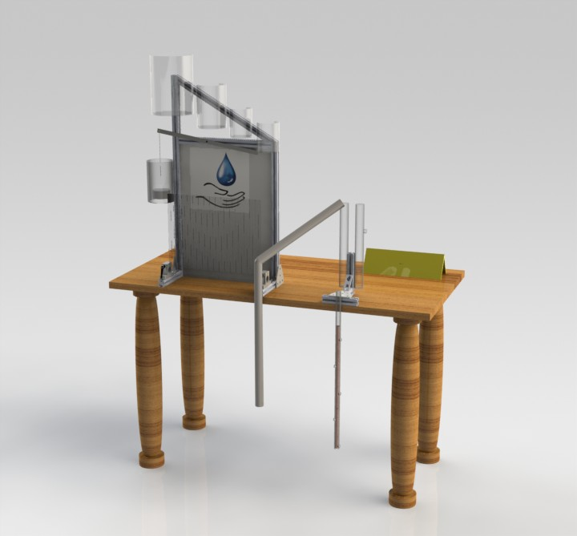
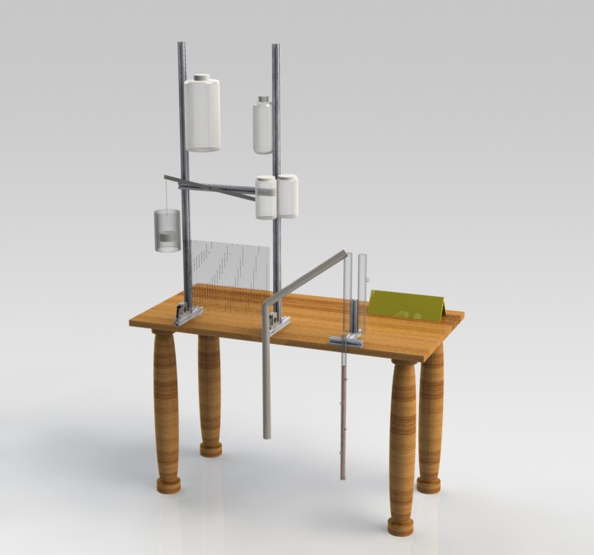
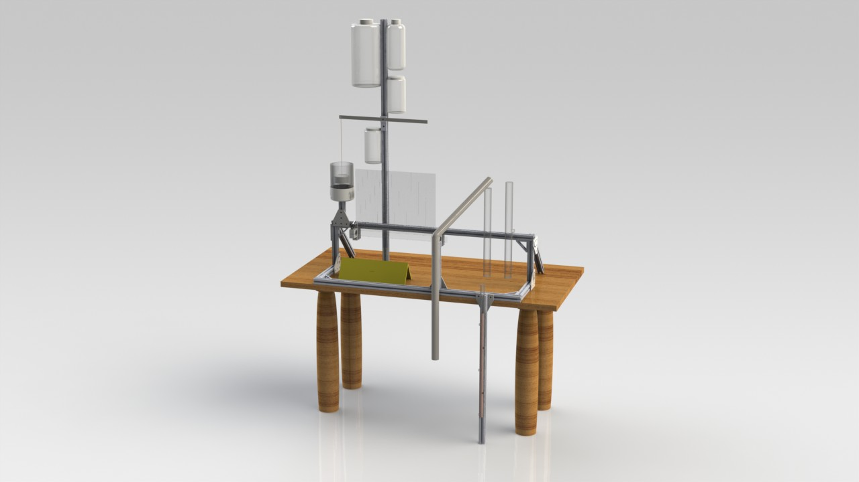
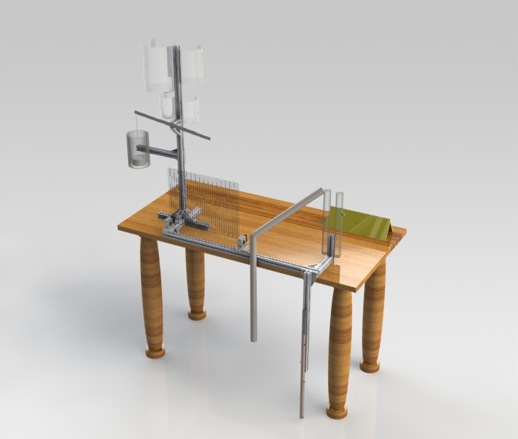
Designs

Slide 6
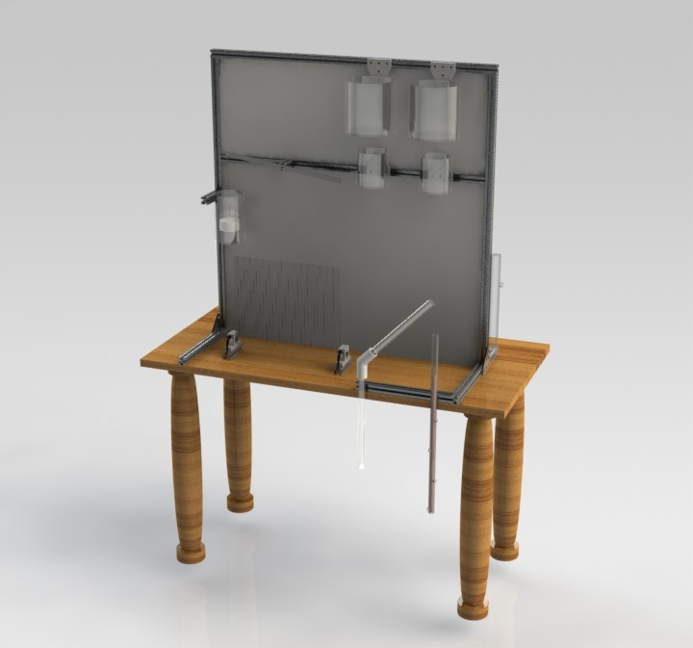
Current Design

Slide 7
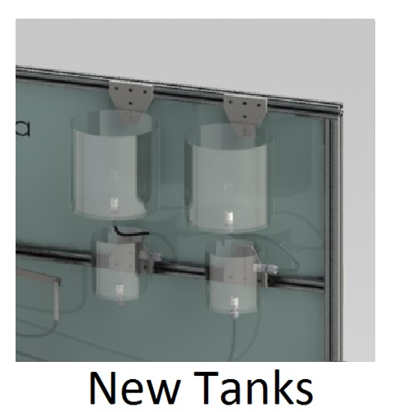
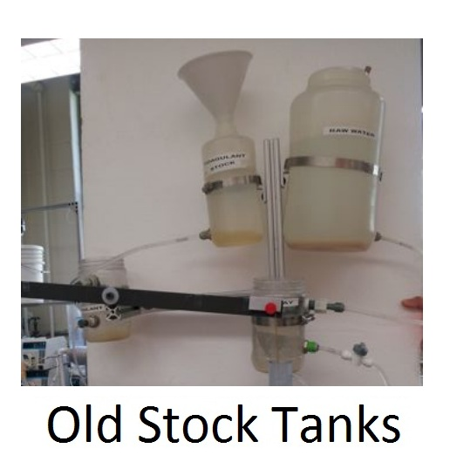
Stock Tanks and Constant Head Tanks
Clear
Wide-mouth for filling and for stacking
Just large enough
Match each other
Straight sides
Durable

Slide 8

Paneling
Ensures focus stays on the plant, not on what’s behind the plant

Slide 9
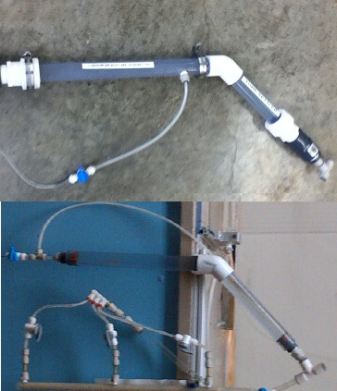
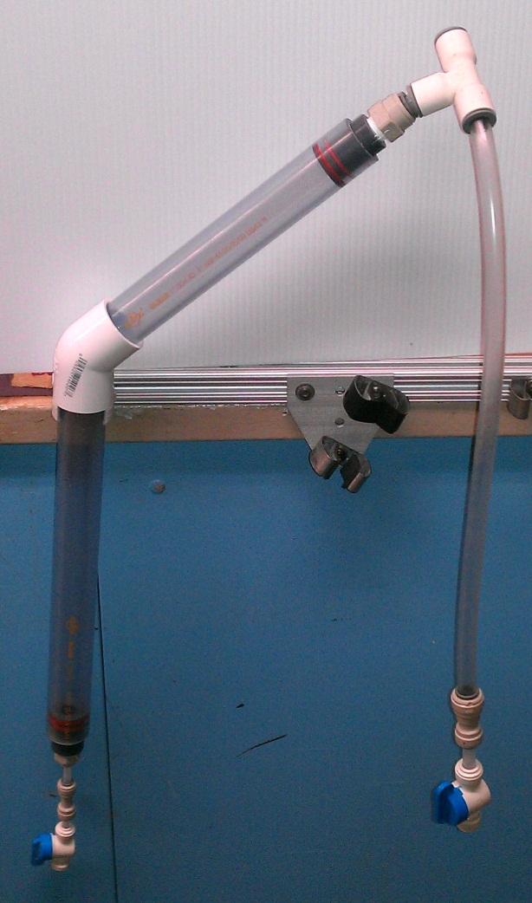
Sed Tank
Shorter, thinner tubes and smaller fittings
Changed clear well to ½ inch tubing to save room

Slide 10
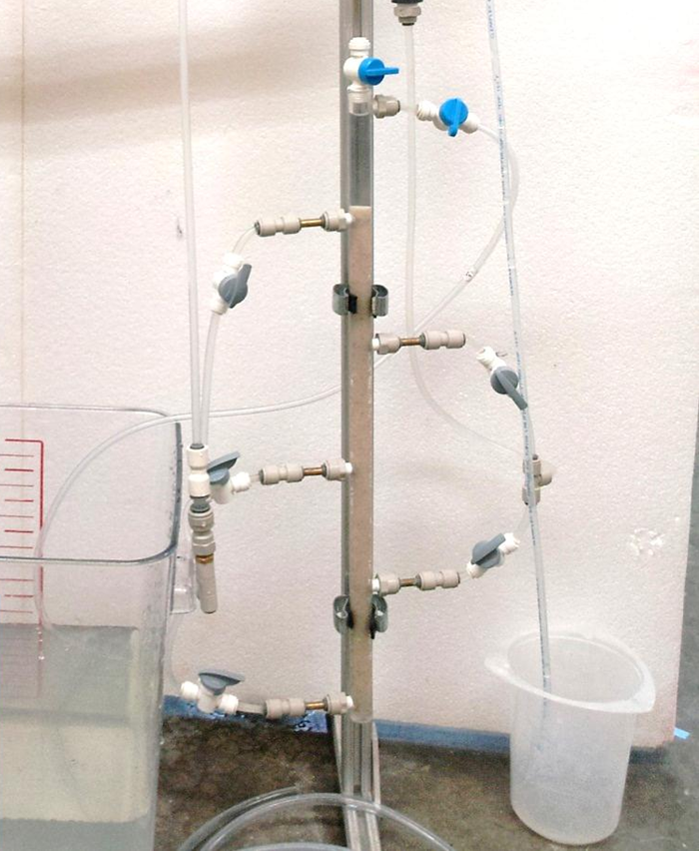
Stacked Rapid Sand Filter
Filter didn’t properly backwash
Bottom two layers never fluidized
‘Water gaps’ formed pushing the sand up and out the backwash valve

Slide 11
Stacked Rapid Sand Filter
We’ve experimented with finer and coarser sand grains.
Finer sand grains formed fewer ‘water gaps’
Tilting the filter column eliminates ‘water gaps’
We will build a taller filter to allow more room for the sand to expand

Slide 12
Future Work
Build tanks
Make the frame easier to assemble by adding hinges and/or pins
Paint and add the panels
Determine exact flow rates and their corresponding dosages
Finalize the heights of all the processes
Revise the user manual to reflect all of our changes

Slide 13
