Slide 1
Tube Flocculator
Patience Ruijia Li
Margaret Fleming

Slide 2
Outline
Introduction
Previous work
Apparatus & Experiment
Tasks

Slide 3

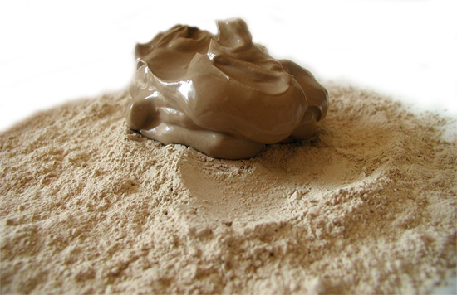
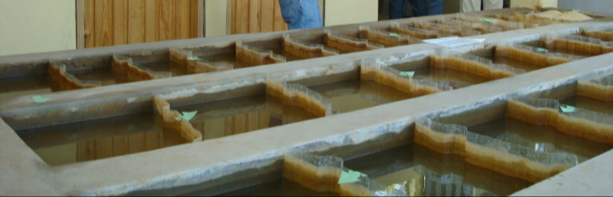
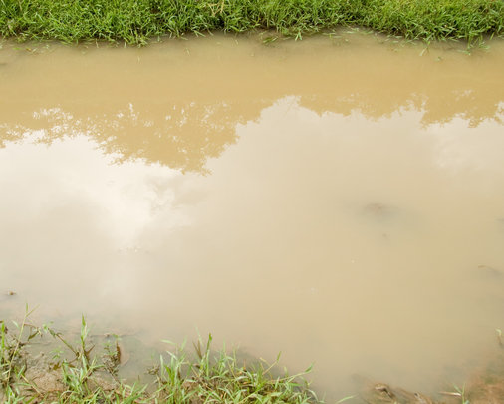
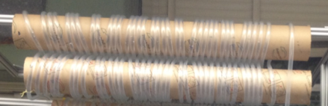

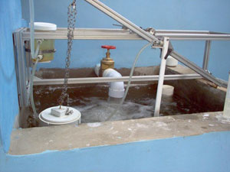

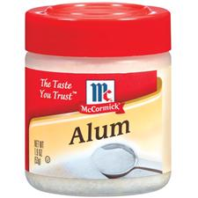
Introduction
Floc formation for removal in sed tank

Slide 4
Previous work
2 experiments:
measure residual turbidity under the same experimental conditions
– one with floc breakup device and one without.

Slide 5
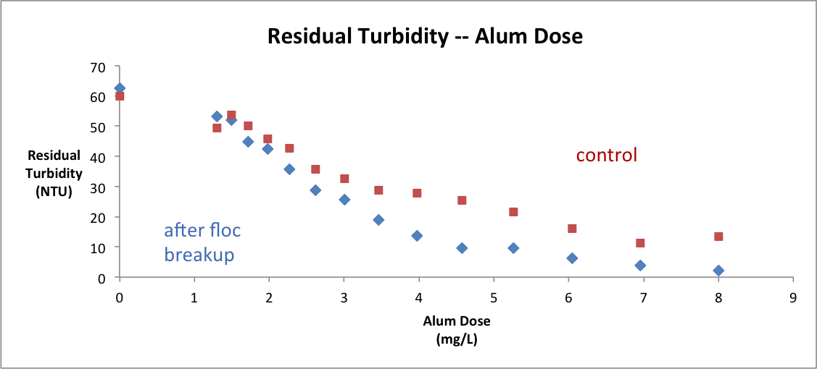
Previous results

Slide 6
Apparatus
Synthetic raw water (SRW) and coagulant metering system
Rapid mix
Tube flocculator
Flocculation residual turbidity analyzer (FReTA)
All Managed by
Process Controller

Slide 7
Experiments
1. Backwash entire
2. Loading
3. Pump ramp down
4. Closing of ball valve
5. Settling
6. Reopening of ball valve
Operational States

Slide 8
Tasks
Test the discrepancy between the influent and effluent turbidimeters
Results show that the 2 turbidimeters are reading similar numbers for the same water.
Experiment # | Influent turbidity | Effluent turbidity
1 | 104 | 112
2 | 106 | 116

Slide 9
Tasks
New silicone tube test: (28m tube)
Target influent turbidity = 100NTU
Raw water flow rate = 5.5 mL/s
Length of tube = 28m
Alum base=1.3
Alum coefficient=1.15
Max reps = 15
Alum dose = (coefficient)(base^{Maxreps})

Slide 10
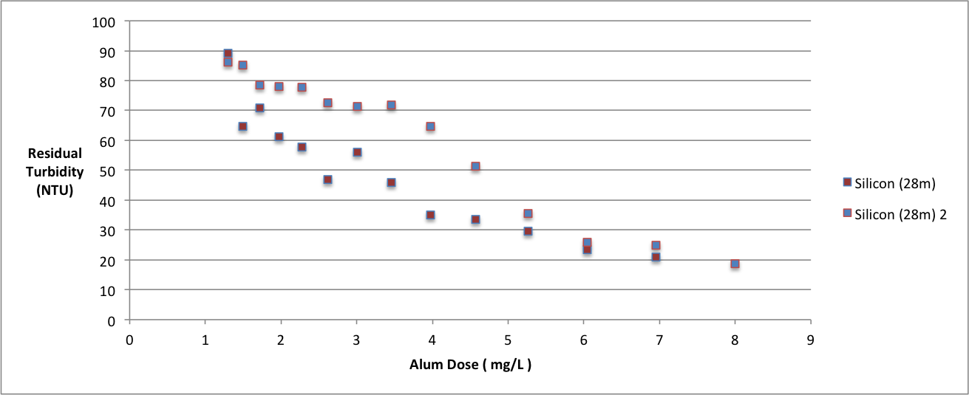
New silicone tube test result

Slide 11
Tasks
New silicone tube test: (0.74m tube)
Target influent turbidity = 100NTU
Raw water flow rate = 5.5 mL/s
Length of tube = 0.74m
Alum base=1.3
Alum coefficient=1.15
Max reps = 15

Slide 12
Tasks: Floc breakup
How to break large flocs?
-- Floc size?
Based on energy dissipation rate:
D_{orifice} = 6.093 mm
D_{tubeflocculator} = 9.525 mm

Slide 13
Tasks: tapered flocculation
Decrease energy dissipation rate gradually so flocs can continue to grow
Maintain the head loss and residence time

