Slide 1

Tube Flocculator
Spring 2013
Patience Li
Margaret Fleming

Slide 2

OUTLINE
Introduction
Experiments
Conclusion
Future Work

Slide 3
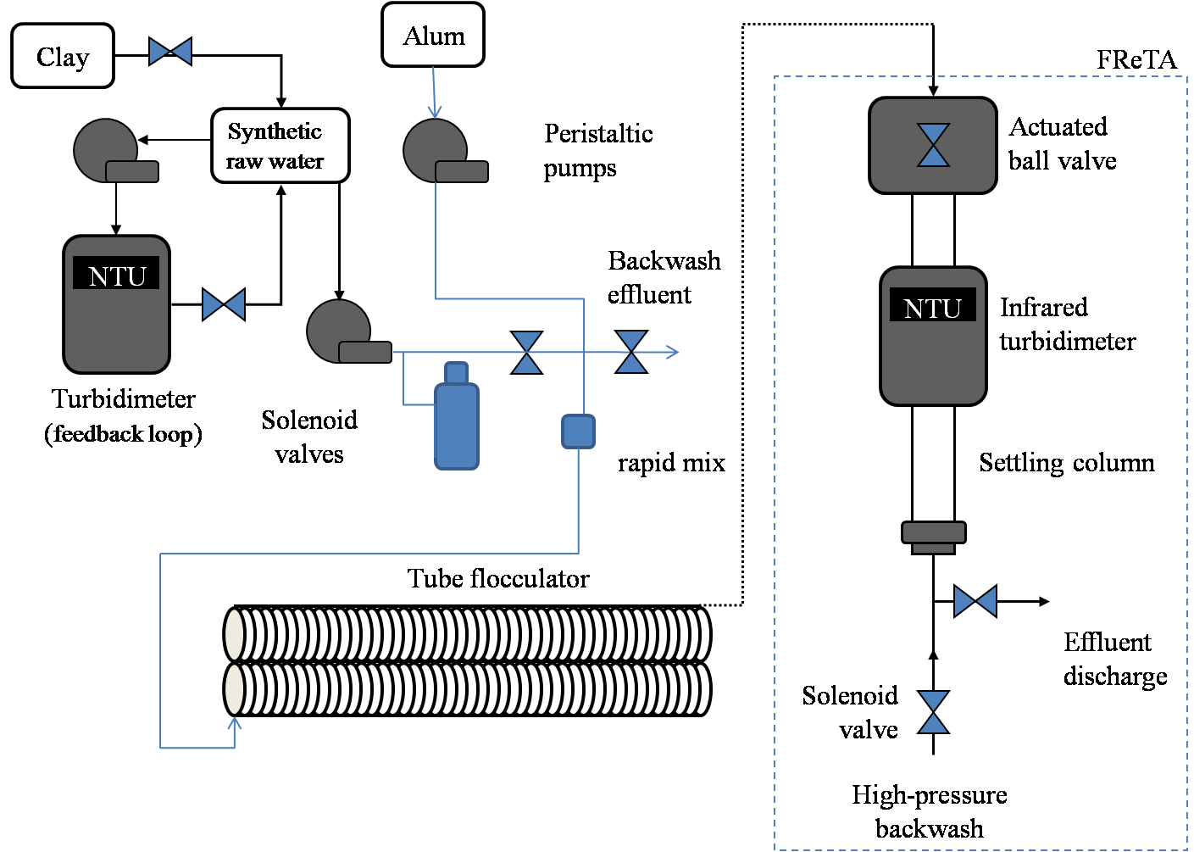
Introduction -- Apparatus

Slide 4
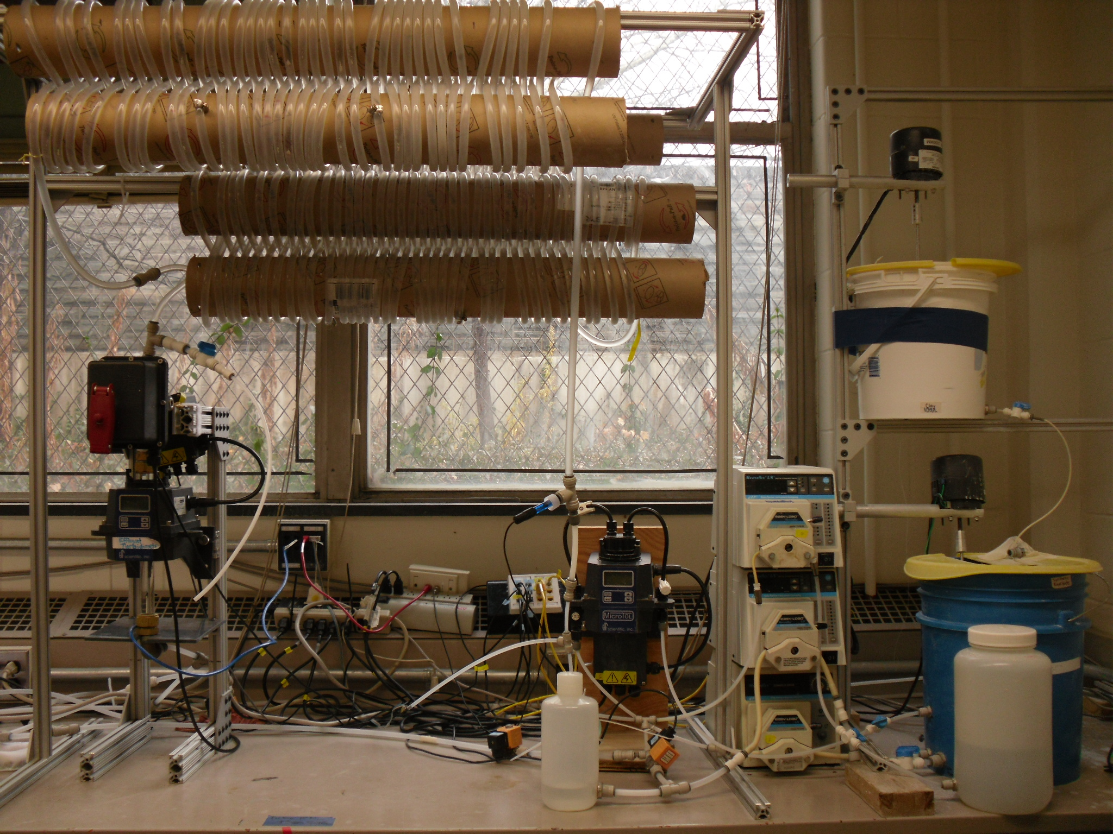

Slide 5
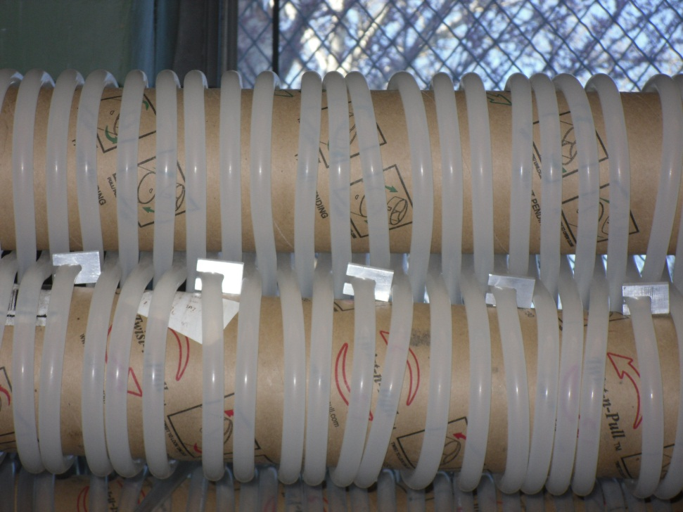
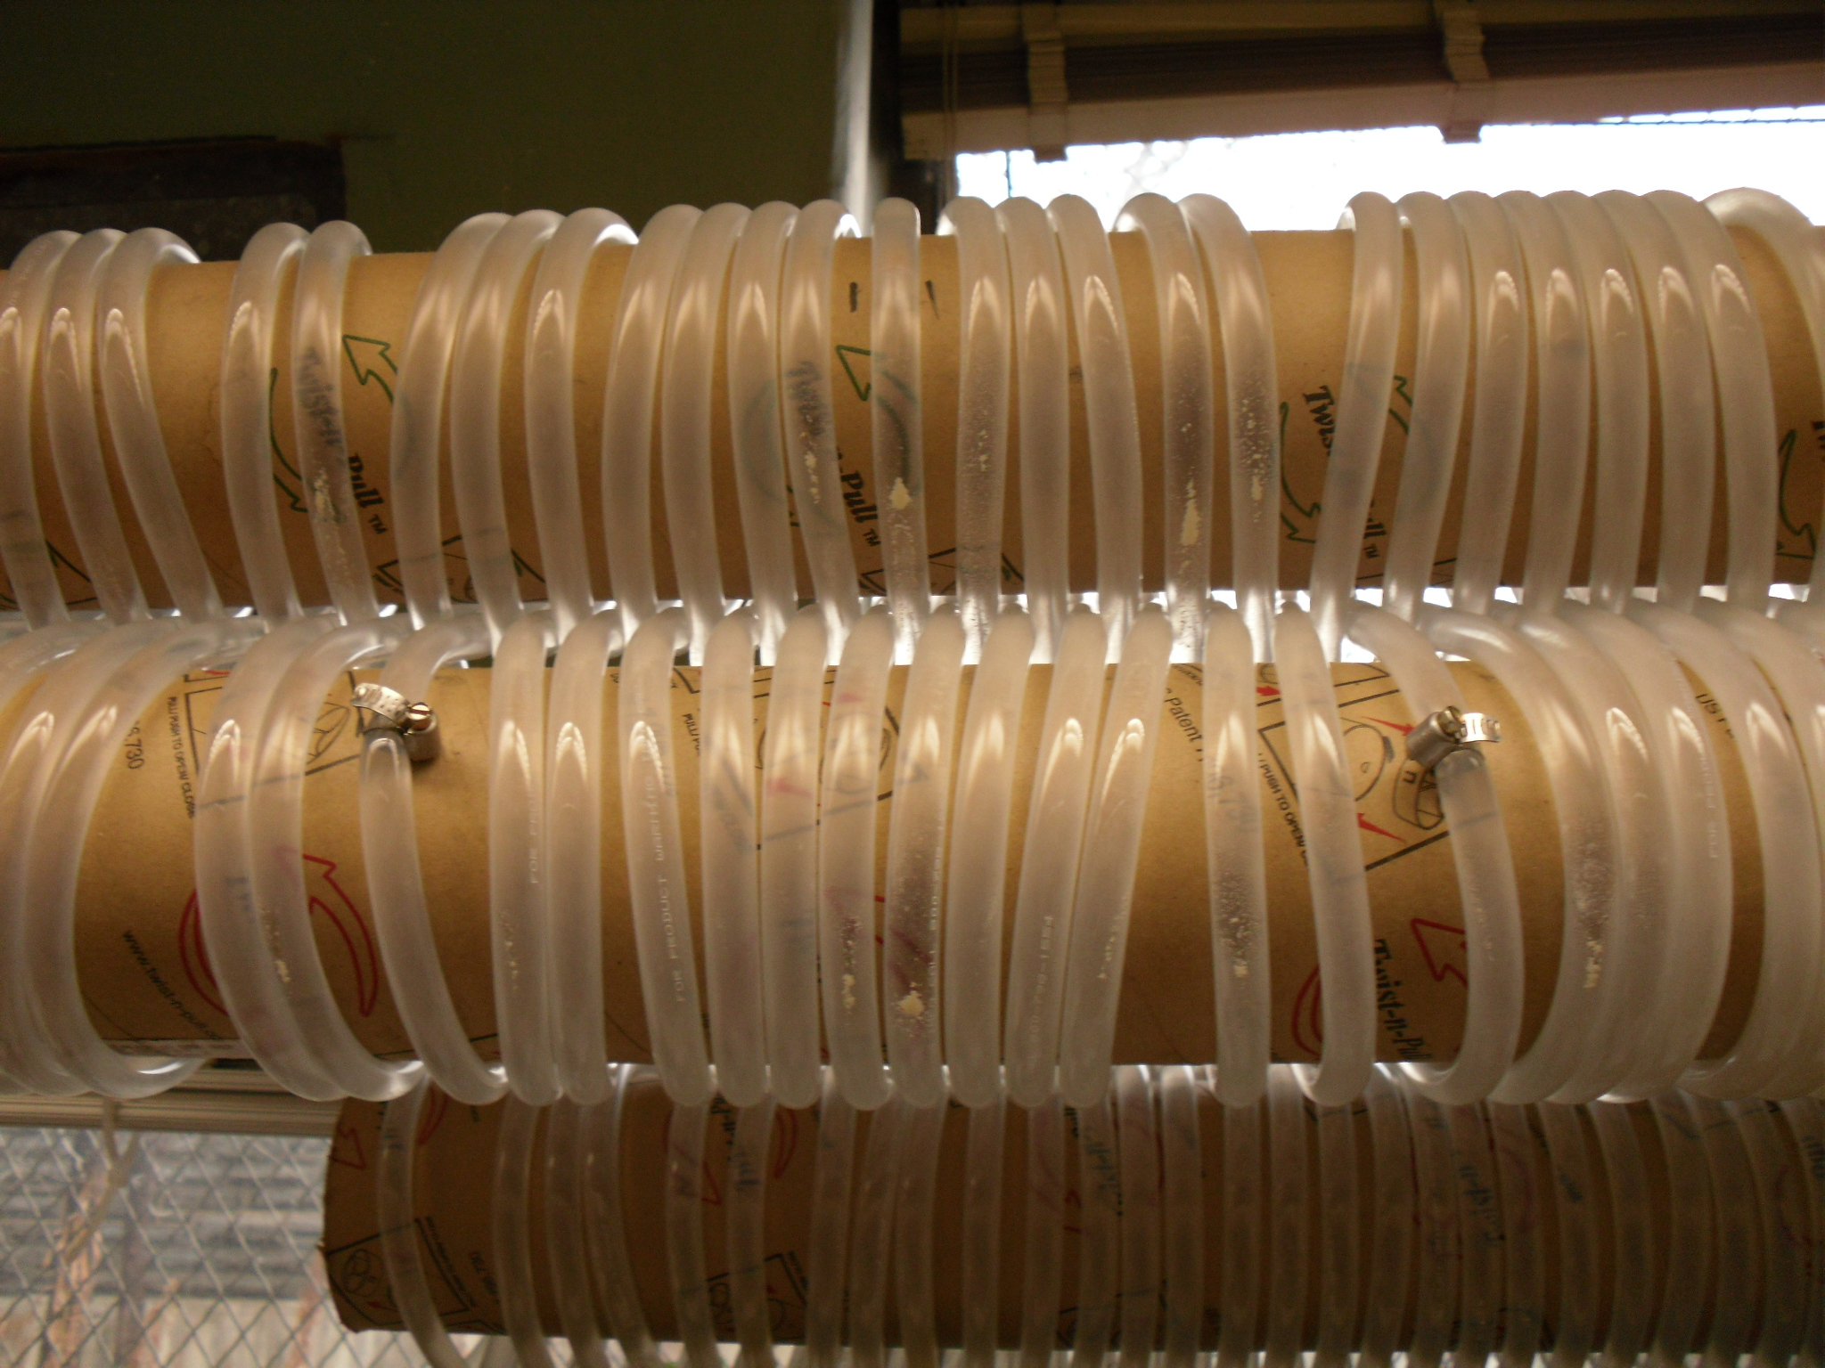
Experiments: Silicone vs. Tygon
Goals– Reduce coagulant and clay attachment
Silicone
Tygon

Slide 6

Experiment: Silicone vs. Tygon
Process Controller Method
Set Point | Value
Target influent turbidity | 100 NTU
Raw water flow rate | 5.5 mL/s
Length of tube flocculator (1 unit) | 28 m
PACl base | 1.1
PACl coefficient | 0.9
Max reps | 15
$$Dose=Coefficient∗{Base}^{rep \#}$$

Slide 7
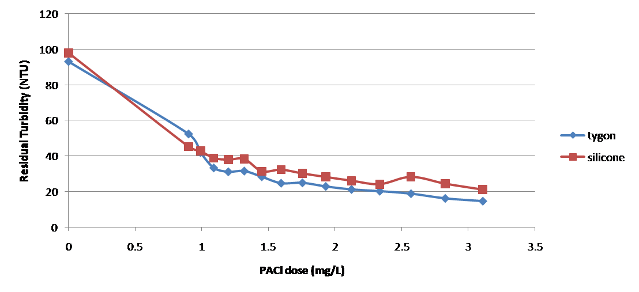
Experiments: Silicone vs. Tygon
Results
Silicone tube is better!

Slide 8
Floc Break up Goals
Floc Break up
Orifice size = f (ε)
Positioning of break up points
Capture velocity (constraint)
No. of break up positions
Improve Flocculation Performance

Slide 9
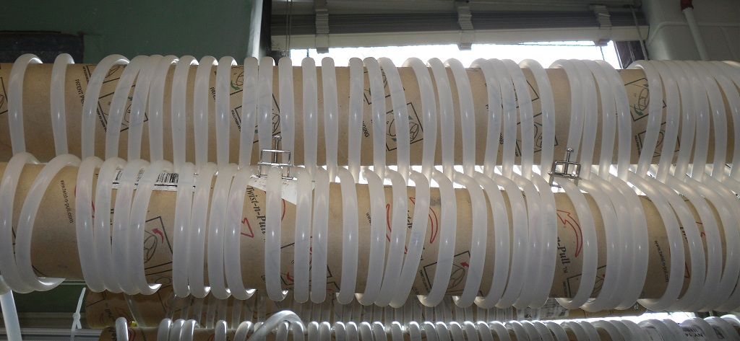
Experiment: Floc Break up

Slide 10
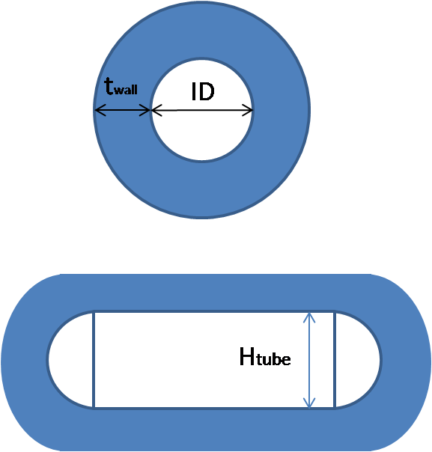
Experiment: energy dissipation rate clamp size
Assumptions
1) No vena contracta
2) ID conserved
3) Rectangle + 2 half circles
4) Wall thickness conserved

Slide 11
Experiment: energy dissipation rate clamp size

Slide 12
Experiment: energy dissipation rate clamp size

Slide 13
Experiments: Floc Breakup at Low Coagulant Dose
Results – low PACl dose is not beneficial

Slide 14
Experiments: Optimal Coagulant Dose
Ideal situation for floc breakup is what achieves a residual turbidity below 5 NTU Dose = 10 mg/L PACl dose

Slide 15
Experiments: Optimal Orifice Size for Floc Break Up Device
PACl dose: 10 mg/L
Orifice sizes (H_{tube}): 0.4 cm, 0.5 cm, 0.6 cm, 1.3 cm (no clamps)
Associated additional energy dissipation rates: >1000 mW/kg, 300 mW/kg, 90 mW/kg, 0 mW/kg

Slide 16
Optimal Orifice Size for 2 clamp set up
Results: best performance from 5 mm orifice size
orifice size without clamps
orifice size with optimal floc break up
(cm)

Slide 17
Optimal Number of Clamps
PACl dose: 10 mg/L
Orifice size: 5mm
Results:
  Floc Breakup points improve flocculator performance
  Adding more than two clamps at a 5 mm orifice size does not improve flocculator performance

Slide 18
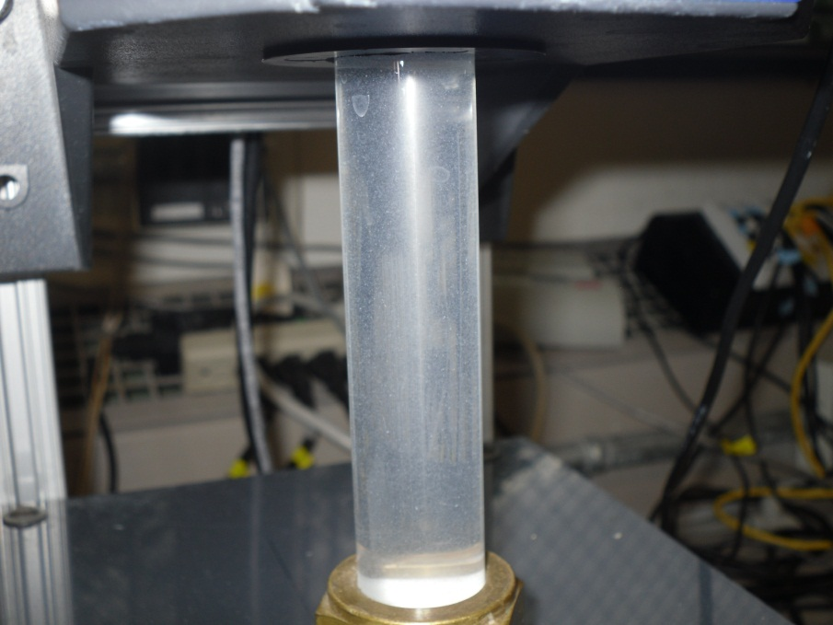
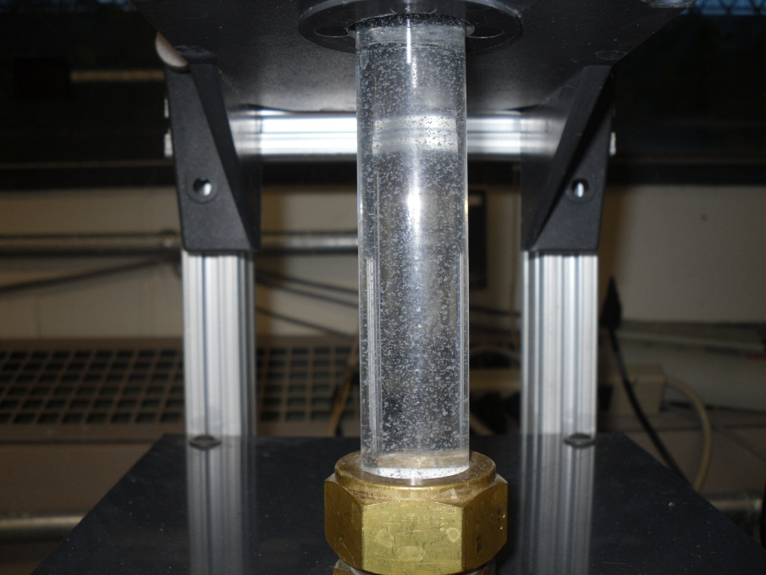
Conclusions
Silicone tube provides a more accurate environment for measuring effluent turbidities than tygon
Floc break up is only beneficial at higher coagulant dose.
PACl dose 5 mg/L
PACl dose 10 mg/L

Slide 19
Conclusions
At a coagulant dose of 10 mg/L, adding clamps improves flocculator performance.
For a two clamp floc break up system, the optimal clamp size is approximately 5 mm.
  When more clamps are added at this orifice size, flocculator performance does not improve.
  It should not be assumed that a 5 mm clamp size remains optimal when clamp number is increased.

Slide 20
Future Work
Floc Break up:
Optimal orifice size for 2, 4, 8, and 16 clamp system
Optimal break up device positioning
Tapered Flocculation

Slide 21

Questions

